Slide 1
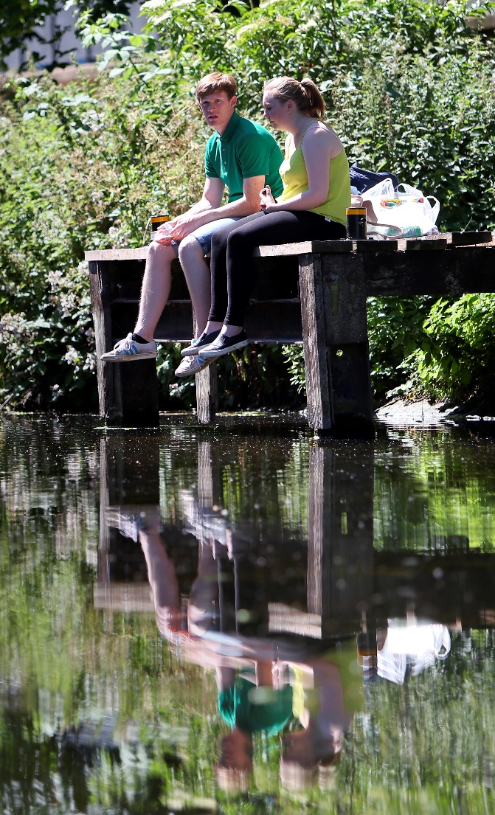




Planning for better water management
November 2019
Courtesy Jiri Rezac

Slide 2
Planning for better water management
What integrated water management is, why it is important and what it can deliver
Why planning for water matters and how integrated water management is delivered through planning
The factors critical for success
Responsibilities: who does what
The role of national and local planning policy
A case study to show how this all works together to achieve the outcomes
Notes:
This presentation sets out:
What integrated water management is, why it is important and what it can deliver
Why planning for water matters and how integrated water management is delivered through planning
The factors that are critical for IWM to succeed
Responsibilities in the water sector: who does what
The role of national and local planning policy
It concludes with a case study to show how this all works together to achieve the broad spectrum of good outcomes that IWM can deliver

Slide 3
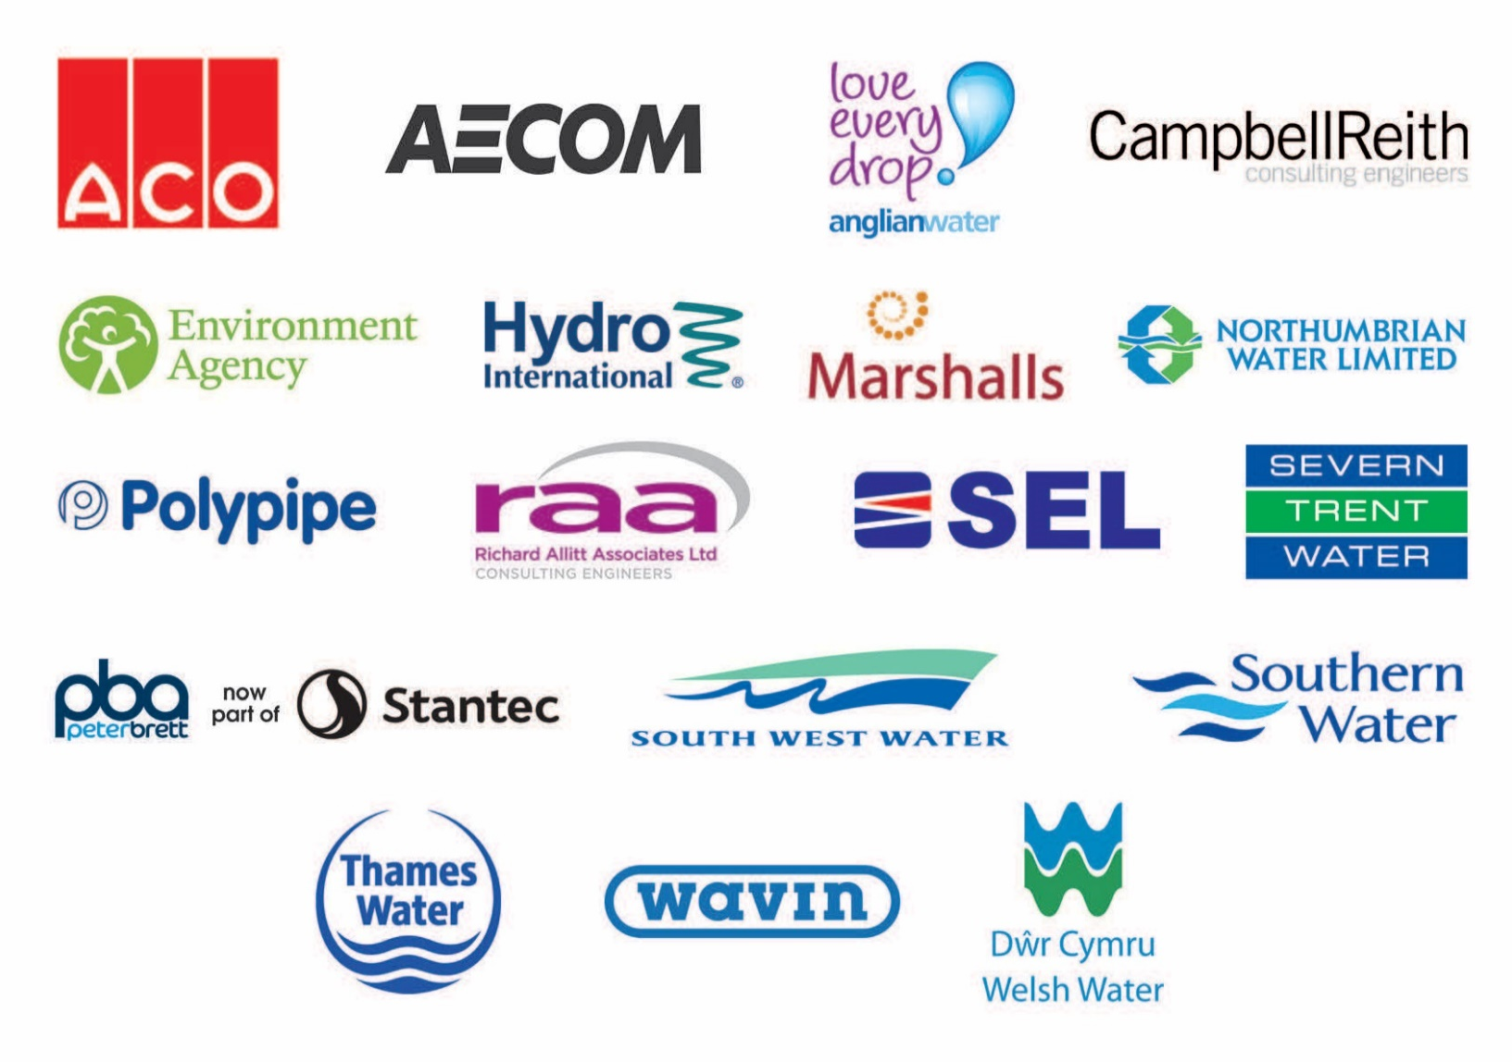
Thanks to our supporters
Funders:
Notes:
As with most CIRIA projects. This project was collaboratively funded by these organisations.
The outputs were guided by a Project Steering Group that included x organisations , that represented the funders, the target audiences, relevant institutions and stakeholders.
As indicated at the beginning of the presentation the outputs have also been endorsed by the Catchment Based Approach (CaBA), Chartered Institution of Water and Environmental Management (CIWEM), the Royal Town and Planning Institute (RTPI) and Town and Country Planning Association (TCPA)

Slide 4
What is integrated water management?
"A collaborative approach to managing land and water that delivers coordinated management of water storage, supply, demand, wastewater, flood risk, quality of water and the wider environment"
Notes:
Integrated Water Management (IWM) is a concept that brings together a range of interventions to make the most of opportunities to improve people’s lives whilst also avoiding and mitigating the risks from too little or too much water, and water pollution.
This is the definition we have adopted.

Slide 5
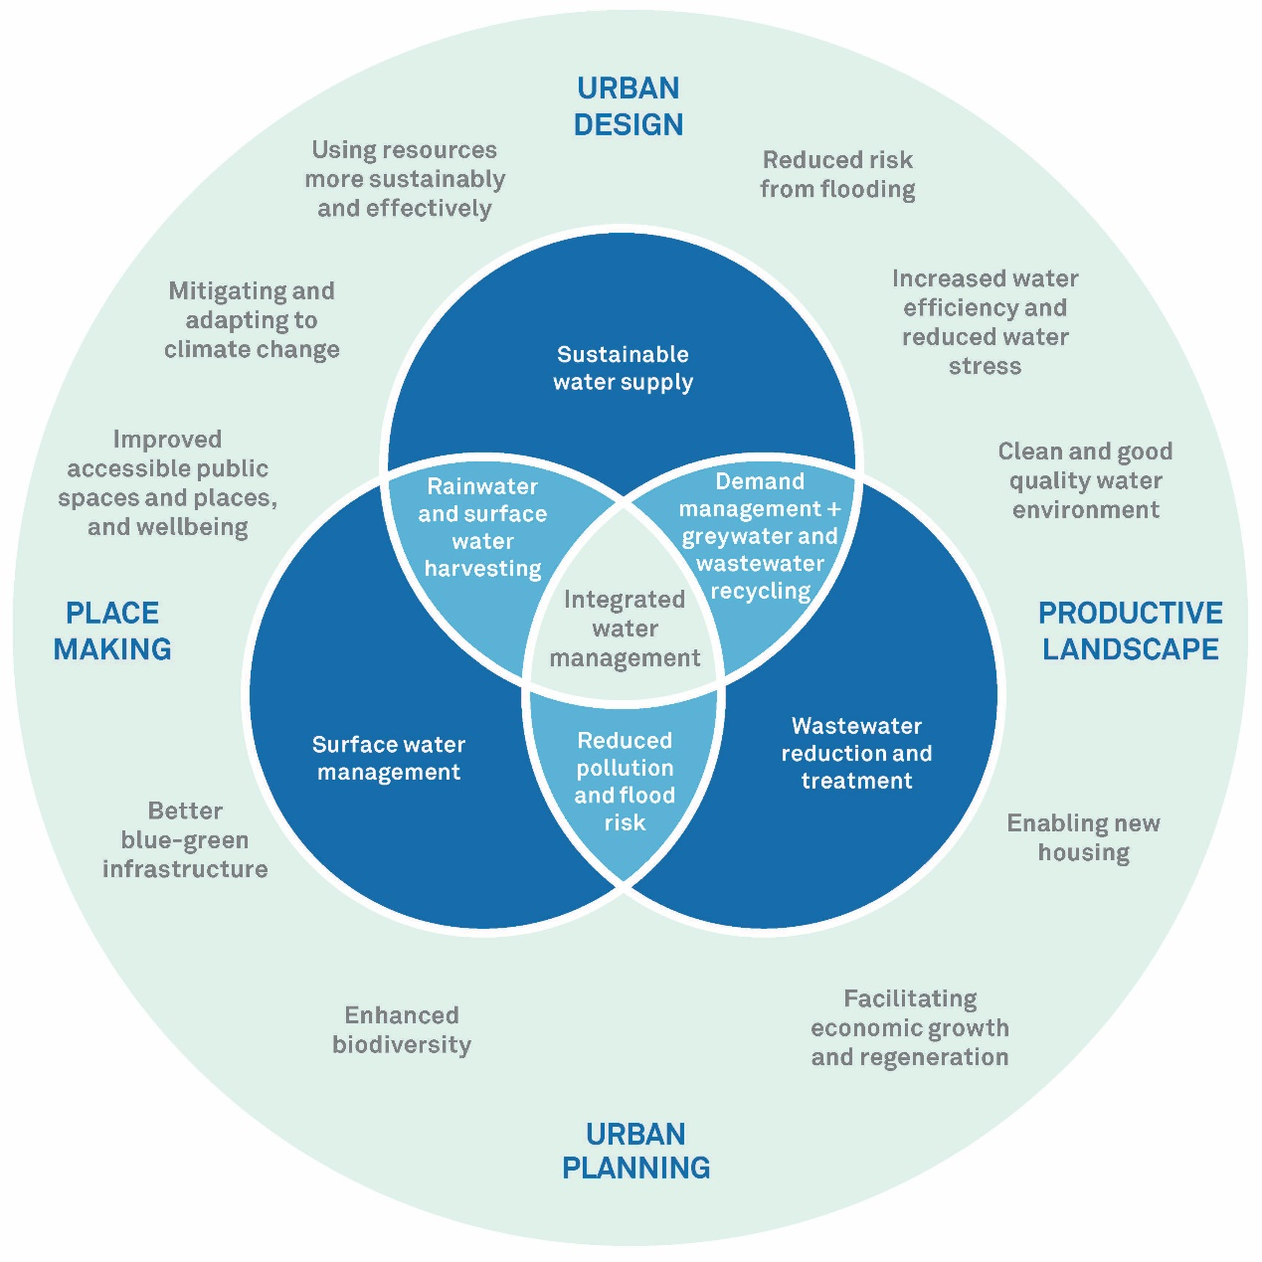
Why is integrated water management important?
Notes:
This diagram shows how IWM is driven by urban planning, facilitated through urban design, is a key part of place making, and improves landscape, to create truly sustainable development.
It shows the good outcomes that can be delivered through IWM.
By bringing together water supply, surface water and flood risk management, and wastewater disposal, IWM realises benefits for each sector in an integrated and more effective way.

Slide 6
What can integrated water management deliver?
Reduced risk from flooding
Increased water efficiency and reduced water stress
Clean and good quality water environment
Enabling new housing
Facilitating economic growth and regeneration
Enhanced biodiversity
Better blue-green infrastructure
Improved public spaces and places, and wellbeing
Mitigating and adapting to climate change
Using resources more sustainably and efficiently
Notes:
1. Reduce risk of flooding from a range of sources at a range of scales, from landscape scale natural flood management reducing the risk of river flooding to SuDS reducing and attenuating runoff to reduce the risk of local flooding.
2. Increased water efficiency and reduced water stress: Approaches to reduce potable water use including rainwater harvesting and use, greywater and wastewater recycling/reuse can reduce demand on the public water supply. If this is linked to water efficiency measures in buildings, the savings can be significant.
3. Clean and good quality water environment: Reduce or remove pollution from surface water, and provide a more natural and biodiverse water environment.
4. Enabling new housing: Providing water management and efficiency solutions to challenges such as flood risk; availability of water, lack of drainage capacity and poor urban environment.
5. Facilitating economic growth and regeneration: Improving urban environments and enabling sustainable redevelopment.
6. Enhanced biodiversity: IWM interventions can provide a more natural environment, introducing a range of habitats and species from wetlands to wildflower meadow at a range of scales, often in otherwise biodiversity-poor urban areas.
7. Better blue/green infrastructure: Providing functional and connected greenspace which deliver multiple benefits, connecting urban places for water, wildlife and people.
8. Improved accessible public spaces and places, and wellbeing: Providing good quality open space which, as well as manging water, is accessible, creates more liveable places and promotes health and wellbeing.
9. Mitigating and adapting to climate change: Providing urban greenspace at a range of scales make urban areas more resilient by reducing the urban heat island effect, reducing energy consumption, making better use of water, and enabling our towns and cities to better cope with more extreme weather events.
10. Using resources more sustainably and effectively: Cost savings and efficiencies, particularly through partnership working delivering multiple benefits, makes schemes affordable, and more can be done for less.

Slide 7
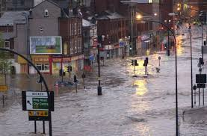
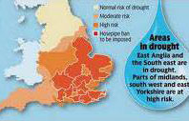
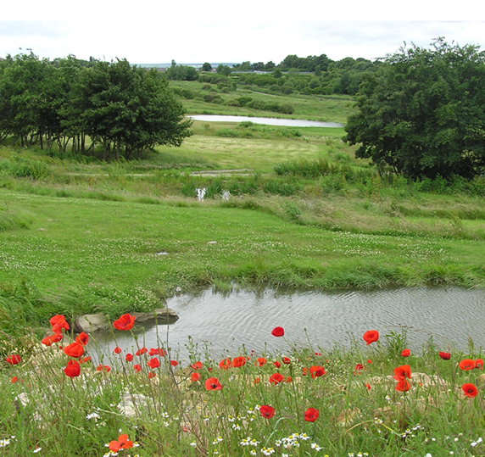
Why planning for water matters
Extended periods of rainfall already increasing
3m homes at risk of surface water flooding
UK water deficit of 22% by 2050
Only 10% of floodplains remain functional
Planning for water provides opportunities to design our towns and cities to be:
Greener
Healthier
More biodiverse
Less liable to flood
Resilient to climate change
Notes:
Extended periods of extreme rainfall are already seven times more likely than in pre-industrial times.
More than 5.2 million people in the UK live and work in 2.7 million properties that are at risk of flooding from rivers or the sea, 3 million are also at risk of surface water flooding, and 200,000 are at risk of groundwater flooding.
Only 10% of floodplains continue to provide their natural flood attenuation function. 42% of floodplains in England and Wales are separated from their rivers, largely by engineering. Part of this problem arises from granting of planning permission for housebuilding – residential development of floodplains has grown by 1.2% since 2011, 0.5% faster than other areas.
Water management is a vital aspect of good town planning. Planning for water provides opportunities to design our towns and cities to be greener, healthier, more attractive, more biodiverse and more resilient to climate change. Development can have significant impacts on water use and water network capacity affecting water resources, wastewater disposal and flood risk.

Slide 8
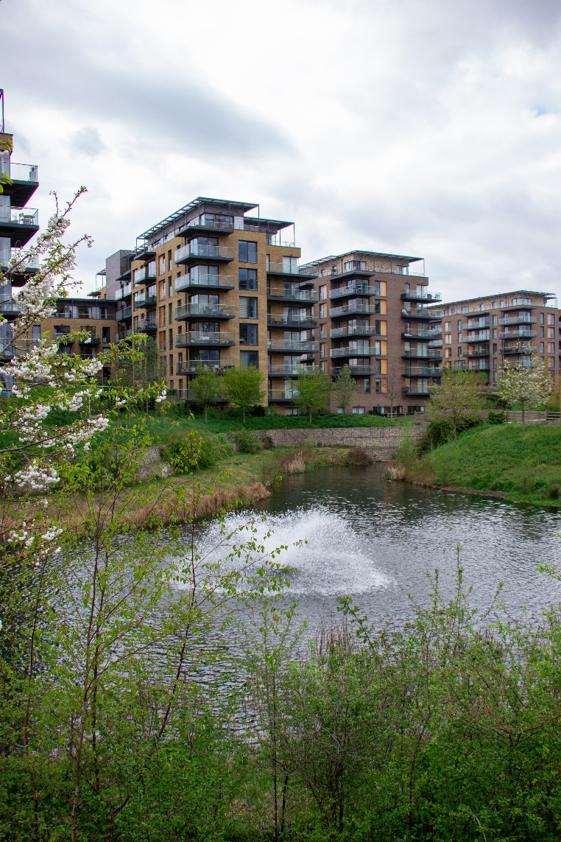
How integrated water management is delivered through planning
Blue-green infrastructure
SuDS
Urban design and place-making
Rainwater harvesting and water re-use
A more pleasant and healthy environment
Notes:
Planning can create Blue/green infrastructure, the network of greenspace and water that permeates and connects the urban fabric to provide the elements of IWM and deliver the multiple benefits that it provides.
Planning can require and facilitate Sustainable drainage systems to manage surface water and collect rainwater for reuse.
If planning incorporates IWM interventions as part of Urban design and place-making it will provide good quality open space which, as well as manging water, is accessible and creates more liveable places. This in turn attracts business and promotes economic growth.
Planning can create opportunities for Rainwater harvesting and re-use to reduce demand for mains water.
Incorporating IWM into the urban fabric creates A more pleasant and healthy environment - The IWM measures provide recreational space and an improved urban environment, promoting wellbeing and improving biodiversity.

Slide 9
Critical Success Factors
Notes:
The project has identified the factors which are critical to the successful implementation of IWM. These are shown on this slide:
A. Understanding IWM:
Knowing which IWM interventions are appropriate
Identifying IWM possibilities at an early stage
Showing that IWM is effective and efficient
Breaking down institutional barriers and changing mindsets
B. Supportive local policy:
Clear and understandable local plan policies
Clear, supportive plans and strategies from LLFA and water company
C. Early engagement:
With the water company, developers, LLFA and other areas of local government
With the local community
With the catchment partnership and other stakeholders
D. Partnerships:
Good links with (and between) LPAs, LLFAs and water companies
Catchment partnerships
An engaged and supportive local community
Understanding partners’ interests and drivers
E. Good management:
A strong champion
Early and clear identification of long term management arrangements
Coordination of budgets and funding
Enforcement of conditions

Slide 10
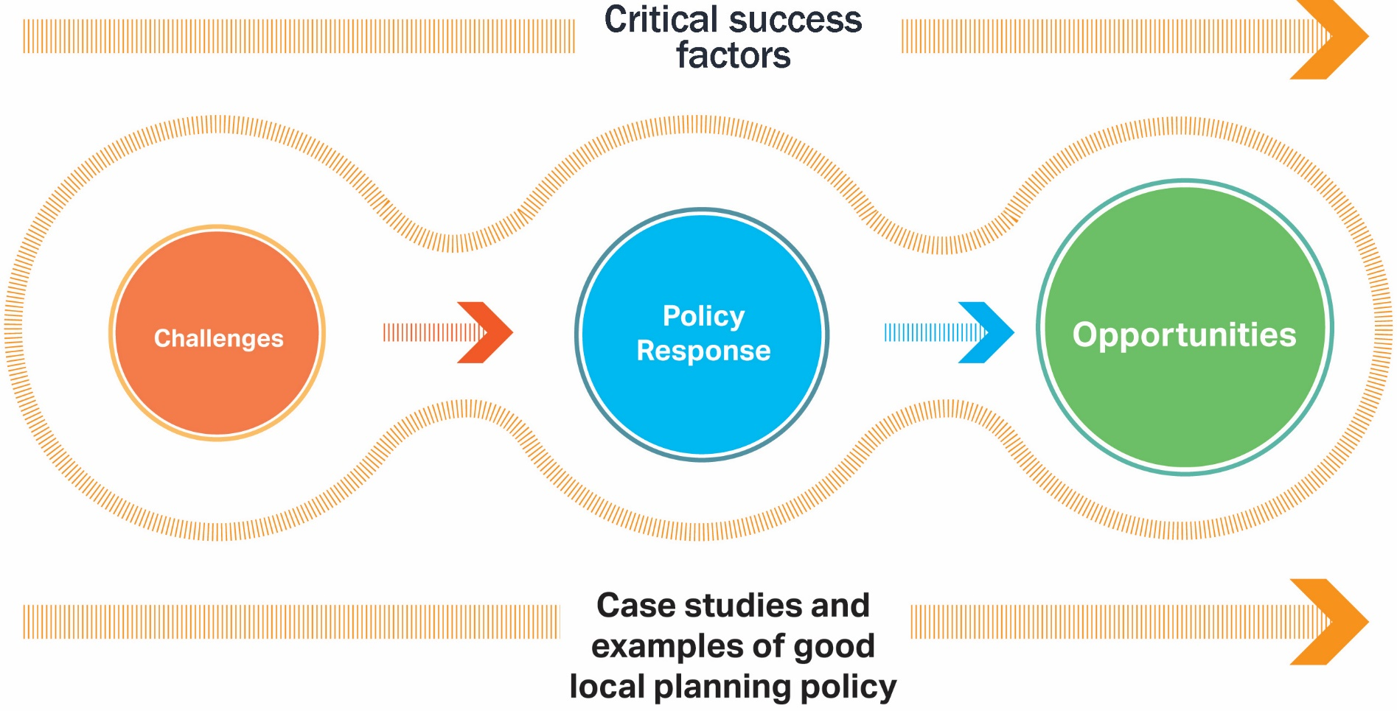
The Golden Thread
Outcomes
Notes:
The principle of the Golden Thread is very simple: identify the water-related opportunities and challenges for the community (e.g. environmental quality, water supply/quality; flood risk); identify the appropriate IWM response; put in place policies to enable IWM; and facilitate the partnerships to achieve the outcomes.
Case studies and examples of good local planning policy show how policies and Critical Success Factors come together to help respond to the opportunities and challenges to deliver IWM outcomes.

Slide 11
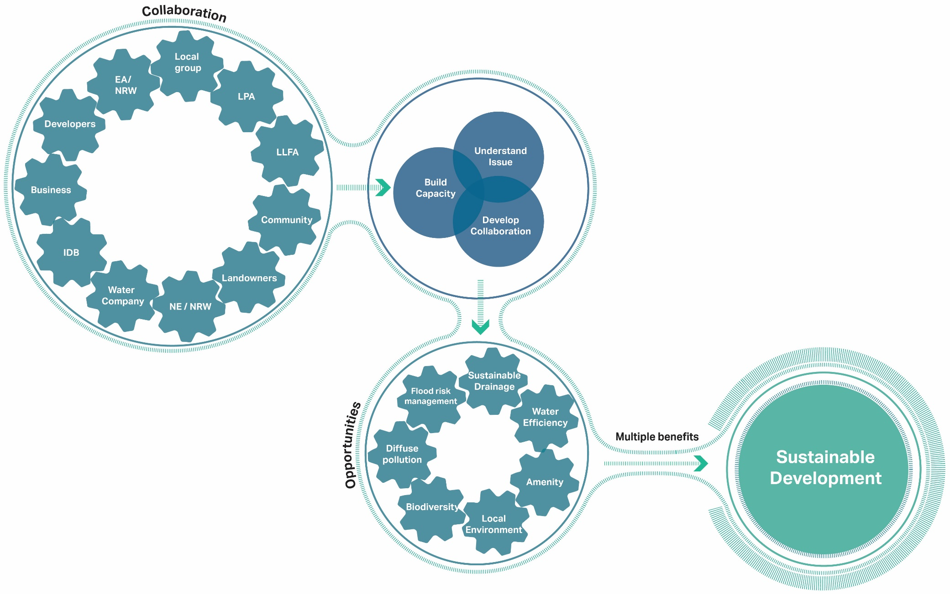
Partnerships, process and outcomes
Notes:
This diagram shows how, by working together, the different stakeholders in a catchment can appreciate each other’s drivers and objectives to build a mutual understanding of the issues affecting their area.
This shared understanding:
facilitates collaboration to identify shared objectives and opportunities;
builds capacity to deliver multiple benefits;
and results in sustainable development.

Slide 12
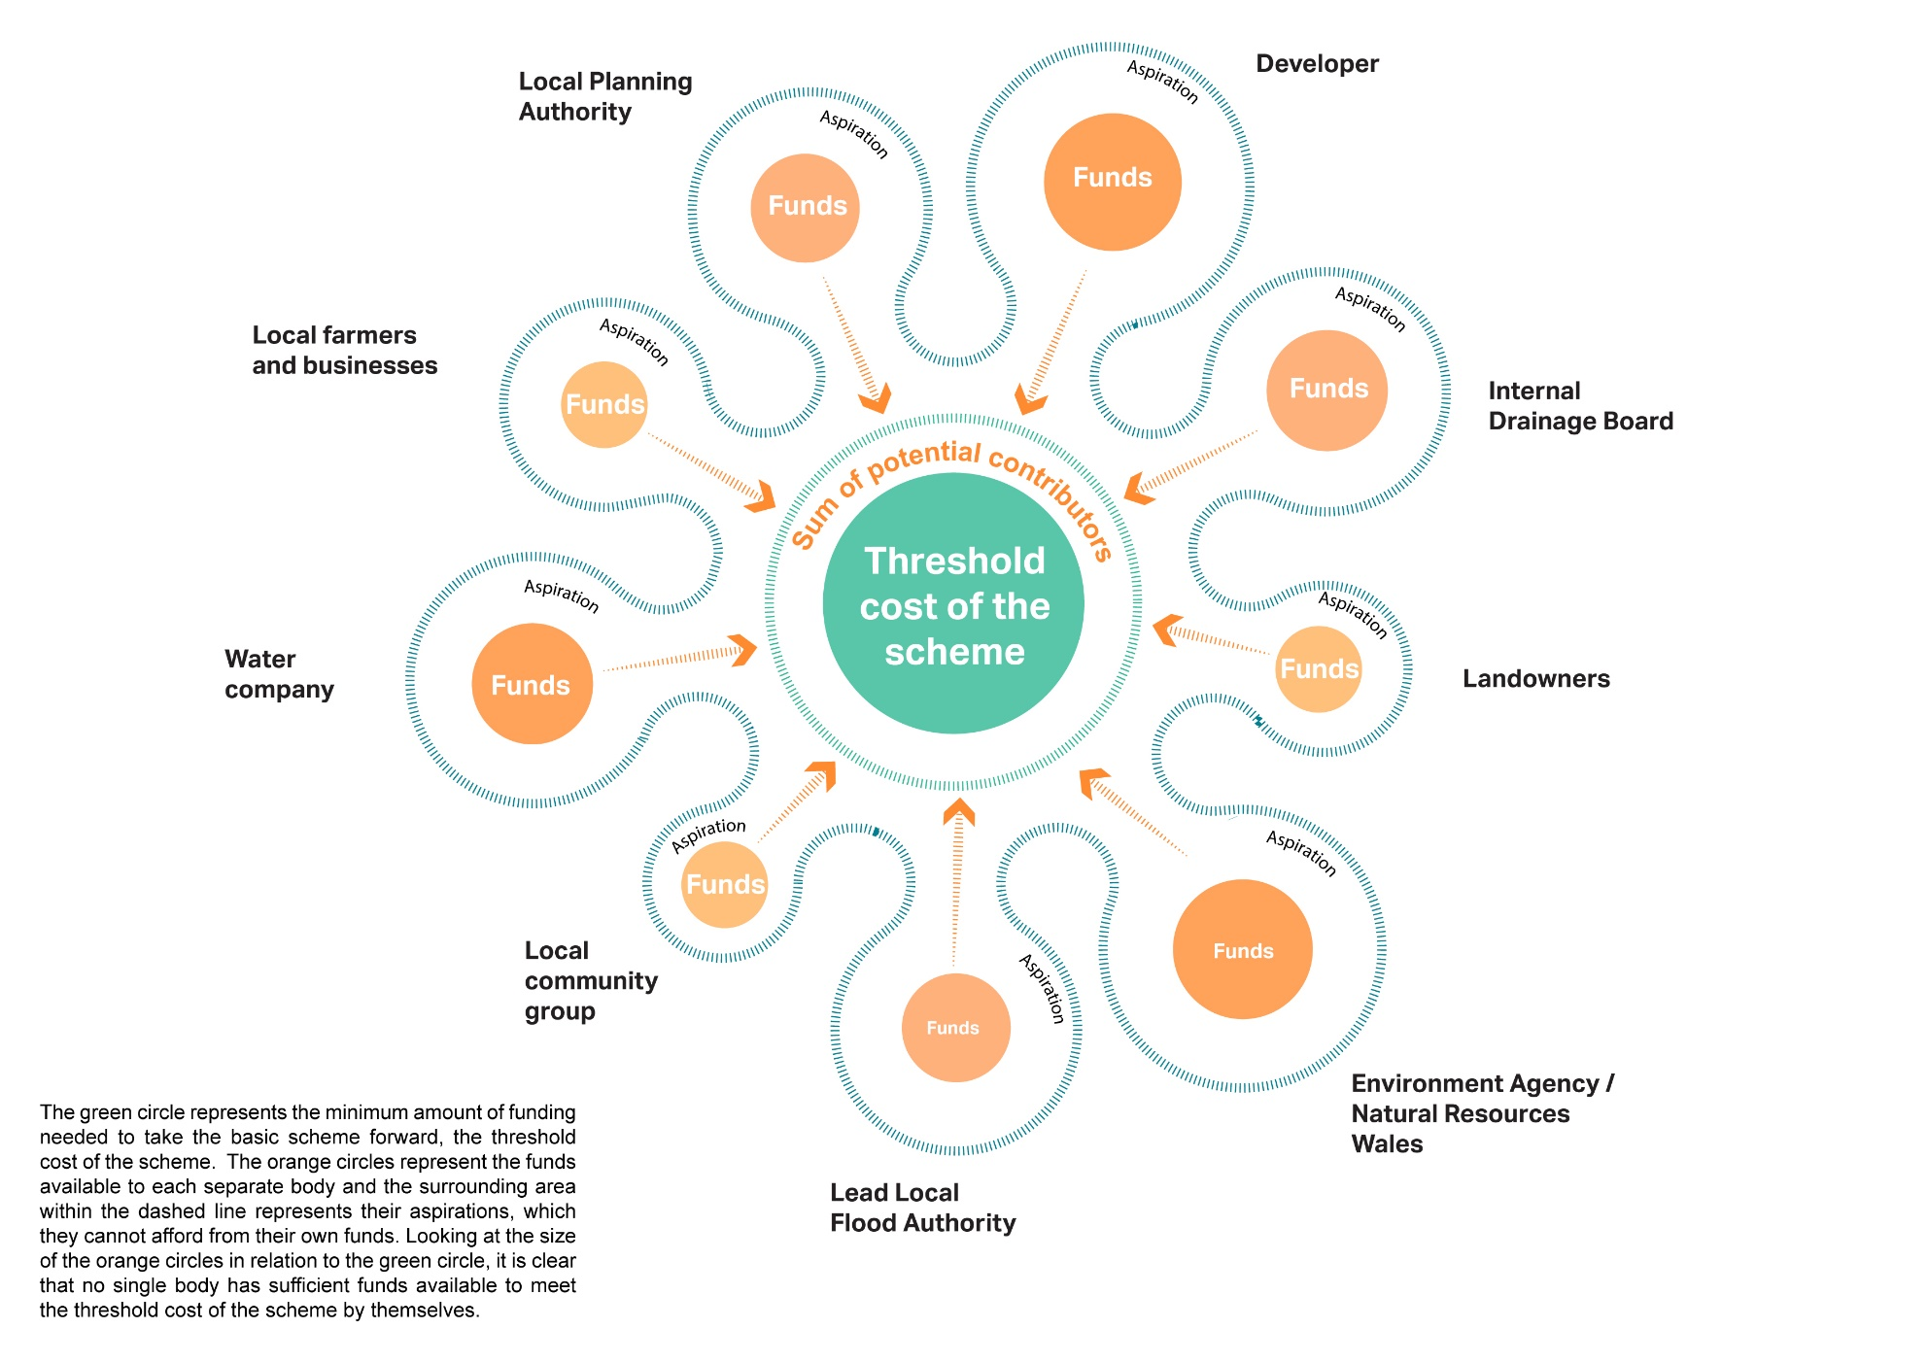
Partnerships: getting more for less
Notes:
The driver for making successful and effective partnerships is delivering multiple benefits through IWM interventions. Working in partnerships and pooling resources enables delivery of projects that are not affordable for individual partners on their own. Additionally, the sum of the pooled resources can be greater than the threshold cost of the scheme, allowing more to be achieved for the money, or for savings to be made by the partners. Either way, this is getting more for less.
In this diagram, the green circle represents the minimum amount of funding needed to take the basic scheme forward, the threshold cost of the scheme. The orange circles represent the funds available to each separate body and the surrounding area within the dashed line represents their aspirations, which they cannot afford from their own funds. Looking at the size of the orange circles in relation to the green circle, it is clear that no single body has sufficient funds available to meet the threshold cost of the scheme by themselves. However if the different bodies pool resources, they can not only meet the threshold cost, but have sufficient funds available to achieve wider aspirations.

Slide 13
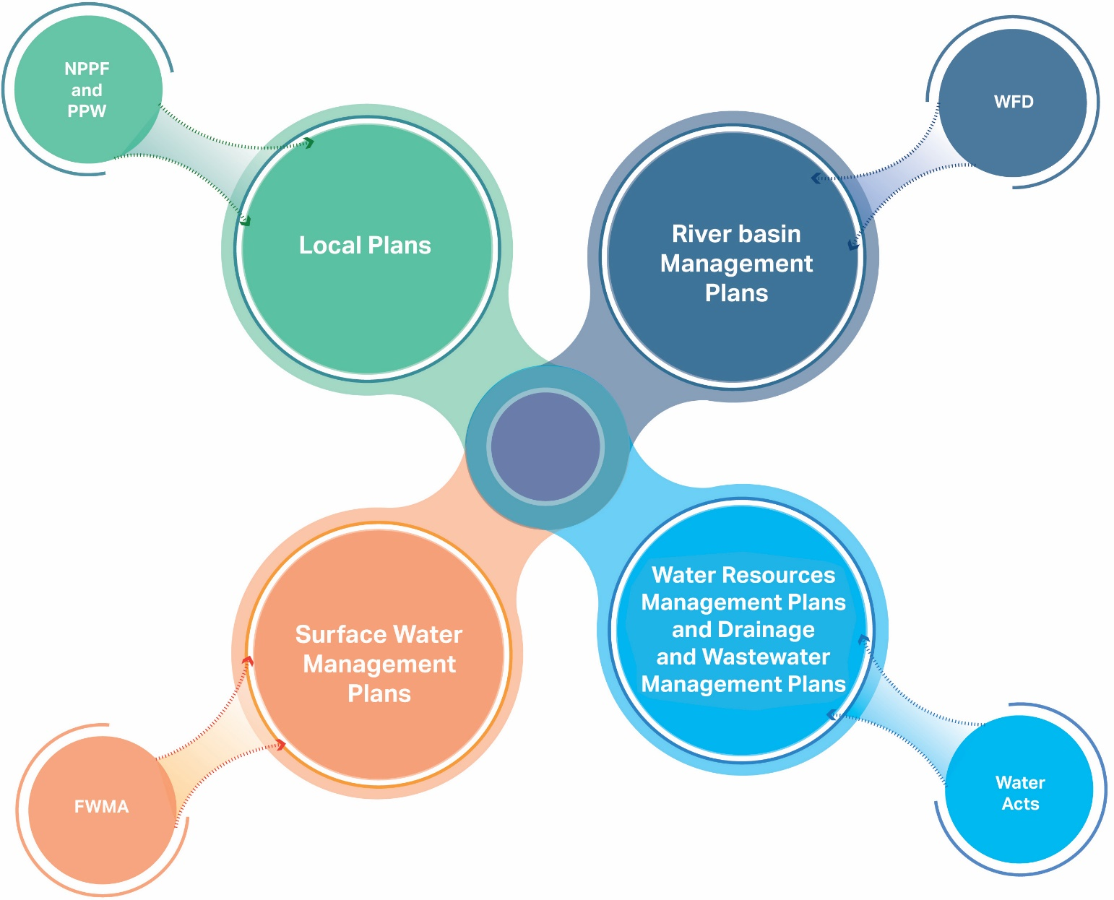
Responsibilities
Notes:
Planning policy for England is set out in the National Planning Policy Framework (NPPF) and Planning Practice Guidance, and for Wales is set out in Planning Policy Wales and Technical Advice Notes. This national policy is applied through local plans, made by local planning authorities (LPA) (district and unitary councils) and associated neighbourhood plans, and through assessment of planning applications.
The Flood and Water Management Act (2010) introduced duties for local surface water management which are coordinated by Lead Local Flood Authorities (LLFAs) (county and unitary councils). LLFAs establish the surface water management strategy for a given location.
The Water Framework Directive sets out the requirements for River Basin Management Plans, which are produced by the Environment Agency and Natural Resources Wales. River Basin Management Plans identify the pressures that the water environment faces and what this means for the current state of the water environment in the river basin district, and what needs to be done about it.
Water legislation gives water companies a statutory duty to prepare and maintain Water Resource Management Plans, which look ahead 25 years and describe how each water company aims to secure a sustainable supply of water. It places a resilience duty on water companies, which includes the requirement to protect the natural environment, now and in the future. There are also initiatives within the water industry to look more strategically and produce Drainage and Wastewater Management Plans (DWMPs) to improve wastewater and surface water management.

Slide 14
Role of national and local policies
Using an analysis of national policy and guidance and good practice, the project identifies:
  key characteristics of local policies delivering IWM
  case studies of good local policy
Volunteers planting, River Wandle (courtesy South East Rivers Trust)
Notes:
The report provides practical advice to help put in place the policies needed for better IWM.
Using an analysis of national policy and guidance and good practice, the project identifies:
key characteristics of local policies delivering IWM
case studies of good local policy
Key characteristics of good local policies are:
Evidence based: we provide a list of documents that
Vision: IWM policies should help deliver a clear vision for sustainable development, or a theme such as ecosystems services or climate change adaptation.
Strategic: Local plans should include a strategic policy that integrates managing flood risk, water quality, water efficiency and blue / green networks and set the framework for any non-strategic local plan or neighbourhood plan policies.
Avoid duplication: Don’t reproduce NPPF policy but translate it into locally-specific policy.
Clear and positive: Use strong language that emphasises the requirements for new development to deliver positive benefits, preferably identified as targets (e.g. what constitutes ‘reduced water demand’ or ‘better water quality’).
Evidence-based: Clearly justify policies by linking to and referencing Strategic Flood Risk Assessments, Local Flood Risk Management Strategies, River Basin Management Plans, Water Resource Management Plans, Catchment Management Plans, water companies’ Drainage and Wastewater Management Plans and Water Resource Management Plans, Green Infrastructure strategies, viability assessments and other relevant evidence.
Co-operative: Develop policies with strategic partners and neighbouring LPAs. Include IWM issues in Statements of Common Ground to help pass the Soundness test.
Deliverable: Include IWM in Infrastructure Delivery Plans and longer term masterplans including identifying long-term management arrangements and partners.

Slide 15
Key characteristics of good local policies
Practical guidance for policy-makers based on
national planning policy and guidance
good practice guidance (e.g. Green Infrastructure Partnership)
Part A, section 4
Part D National Policy Review
Key characteristics of good local policies are:
  Evidence based
  Visionary
  Strategic
  Avoid duplication
  Clear and positive
  Cooperative
  Deliverable
  Part E Characteristics of good local policies
Notes:
We know how hard-pressed local planning authorities are and while searching for and reviewing Local Plans, we decided to identify the key characteristics of good local policy to help deliver better water management. Policy makers can use these to help them draft their own policies. Most of the local plan examples have been found ‘sound’ by Planning Inspectors.
We used guidance from national policy and guidance of England and Wales and other good practice guidance such as that produced by the Green Infrastructure Partnership. We identified the key characteristics in Part A, section 4, and in Part E, we provide examples of each characteristic from the case study local plans.
Also, in Part D, we provide guidance to the key policy hooks in English policy (25 Year Environment Plan, NPPF and PPG) and Planning Policy Wales and Technical Advice Notes.

Slide 16
Technical Requirements or ‘Asks’
Provide examples (with commentary) of policies that contain clear technical asks for
  Sustainable drainage
  Water efficiency in homes and other buildings
  Water quality
  Biodiversity
  Part A, section 4
Notes:
At the request of the Project Steering Group, we provided examples of what we regarded as good examples of clear ‘technical asks’ in local plan policies.
We reproduce these case studies with some commentary on why we consider they are good practice.
We couldn’t find clear technical asks for all outcomes, but we did for sustainable drainage, water efficiency, water quality and biodiversity (including ecosystem services)

Slide 17
Case studies of local plan policies
15 post-NPPF local plans
Most adopted, all well advanced
Urban, suburban and rural authorities
Regional, unitary, district and national park
Some emerging plans as well
Part C, Examples of good local policies
Ecosystems Services (courtesy South Downs National Park Authority)
Notes:
Part C of the guidance contains the 15 case studies of local plans which we believe are good practice in promtioing better water management through planning.
They emerged through our initial survey, from the PSG and from our own research.
We aimed to get a spread across England and Wales (although we didn’t find any in Wales) and have a range of urban, suburban and rural plans
Different levels of local government
Later on in the process we identified some emerging policies that we thought demonstrated good practice and we included these with links as well.
The Local Plans are also summarised in Part A, section 5.

Slide 18
Local Plan case studies
Each case study includes
  List of policies
  Summary
  Challenges / Opportunities
  CSFs / Outcomes
  Further Information links
8 of 15 demonstrate ‘golden thread’ link to projects
  Part C, Examples of good local policies
Notes:
Part C of the guidance contains the case study local policies.
Each are in the same template so they are easily accessible for readers.
They list the relevant plan and policy or policies
Summarise the issues the policies are addressing
Outline particular local challenges or opportunities
Identify and explain the Critical Success Factors to getting the policy in the plan and the intended better water management Outcomes
Contain links for further information.
We were able to identify 8 local plans where the policy had influenced one of the physical projects on the ground. In some cases, a project had influenced the development of a project e.g. Croydon. – reverse golden thread.

Slide 19
Physical case studies
12 case studies, each includes
  A description of what was done
  The CSFs involved and outcomes it delivers
  How it relates to planning policy
  Who did it
  Further Information links
11 demonstrate ‘golden thread’ link to planning policy
  Part B, Physical case studies
Notes:
Part B of the guidance contains the physical case studies, examples of what can be achieved on the ground if the principles in this guidance are followed.
Each is set out in the same format, with illustrations, so they are easily accessible for readers.
They set out:
What was done;
The outcomes that were achieved, and how the CSFs contributed;
Hoe the development relates to planning policy;
The organisations that were involved, and;
References and links to further information.
In 9 of the 12 case studies planning policy supporting IWM had influenced the development – the golden thread. In two cases, the project had influenced the development of IWM-supporting planning policy e.g. Croydon and Sheffield - a reverse golden thread. The one case study with no link to IWM supporting planning policy shows what can be achieved through constructive partnership with the LLFA/LPA

Slide 20
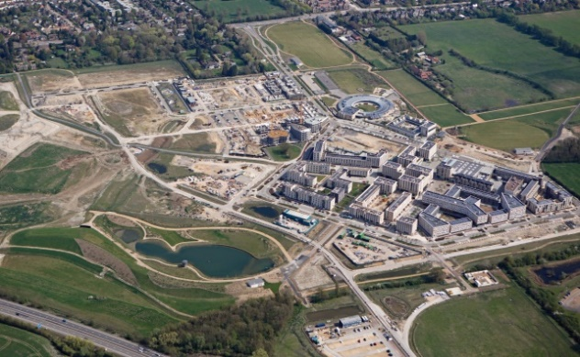
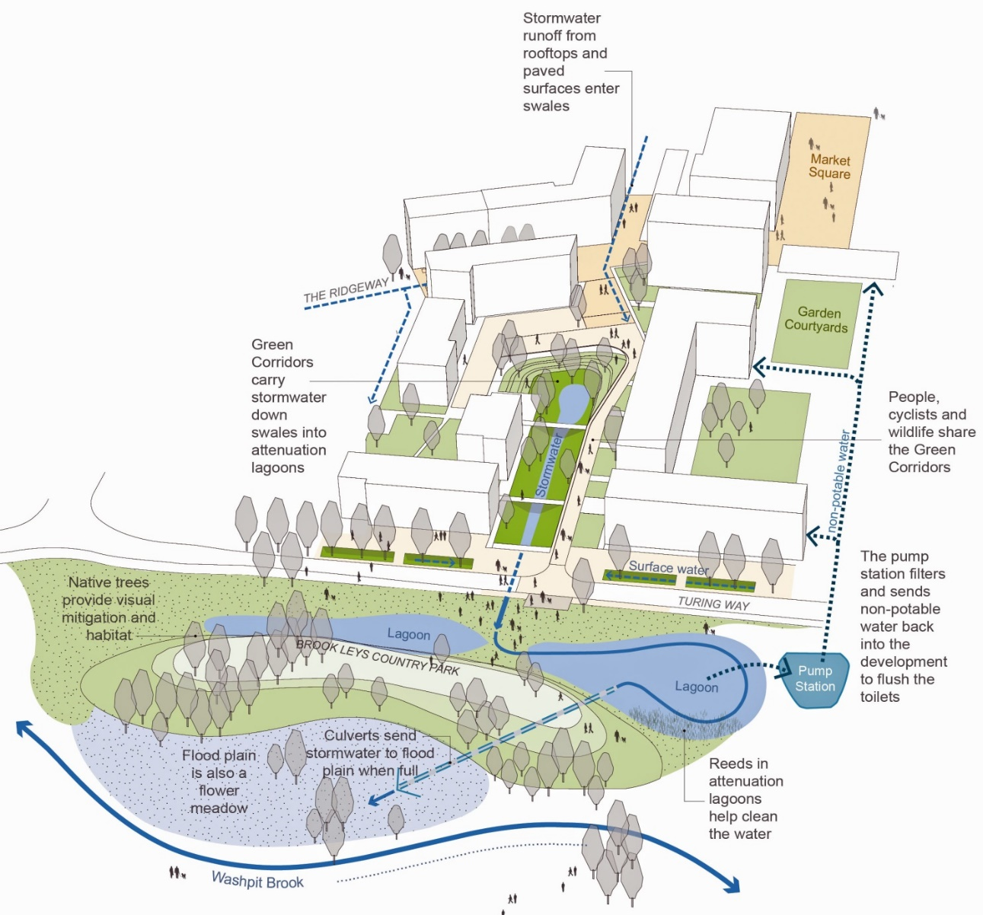
North West Cambridge
3,000 homes and 100,000m² of other uses
IWM driven by local plan policy
Site wide IWM system
Swales, blue and brown roofs and green corridors manage water through the site into man-made lagoons
Treated rainwater pumped back into the homes
Will be largest rainwater harvesting system in the country
Flow and volume discharged will not exceed greenfield runoff rates
Notes:
This case study illustrates the Golden Thread in operation and how applying the CSFs leads to good outcomes and multiple benefits.
Cambridge is located within an area of water stress (East Anglia has the lowest rainfall in the country and is described officially as semi-arid) and is also at high risk of surface water flooding. The local communities downstream regularly suffered flooding from two different brooks so there was no capacity within existing watercourses to accommodate additional surface water from new development. Cambridge planning policy requires sustainable drainage and sets stringent standards for water use.
The North West Cambridge project is a 150 hectare development with a comprehensive integrated water management system reducing off-site flows to below greenfield runoff rates, and the largest water recycling system in the country, capturing up to 45% of rainwater to reduce potable water demand.
In particular:
It will deliver 3,000 homes and 100,000m² of other uses
The IWM is driven by local plan policy
It incorporates a site wide IWM system
Swales, blue and brown roofs and green corridors manage water through the site into man-made lagoons
Treated rainwater is pumped back into the homes
It will be largest rainwater harvesting system in the country
Flow and volume discharged will not exceed greenfield runoff rates

Slide 21
North West Cambridge - outcomes
Demonstrates all the Critical Success Factors:
Will capture 25-45% of rainwater for recycling.
The water recycling scheme will cut water consumption to 80 litres ppd (compared to Cambridge average of 150 litres ppd).
The rainwater harvesting system will reduce mains water consumption across the site by over 45%
Will enable a discount on customer bills by charging different tariffs for potable and non-potable sources.
Reduced risk of downstream flooding.
Cleansed water reduces the risk of contaminating sensitive water courses.
Understanding IWM
Enabling local policy
Early engagement
Partnerships
Good management
Provides all the IWM outcomes:
Reduced risk from flooding
Increased water efficiency & reduced water stress
Clean & good quality water environment
Enabling new housing
Facilitating economic growth & regeneration
Enhanced biodiversity
Better blue-green infrastructure
Improved public spaces & places, & wellbeing
Mitigating & adapting to climate change
Using resources more sustainably & efficiently
Notes:
North West Cambridge demonstrates the application of all the Critical Success factors for IWM:
Understanding IWM
Supportive local policy
Early engagement
Partnerships
Good management
It delivers the full range of IWM outcomes:
Reduced risk from flooding
Increased water efficiency and reduced water stress
Clean and good quality water environment
Enabling new housing
Facilitating economic growth and regeneration
Enhanced biodiversity
Better blue/green infrastructure
Improved public spaces and places, and wellbeing
Mitigating and adapting to climate change
Using resources more sustainably and efficiently
In particular:
It will capture 25-45% of rainwater for recycling.
The water recycling scheme will cut water consumption to 80 litres per person per day (compared to Cambridge average of 150 litres ppd).
The rainwater harvesting system will reduce mains water consumption across the site by over 45%, a daily saving of approximately 595,000 litres – the equivalent of 8,500 baths of water
It will enable a discount on customer bills by charging different tariffs for potable and non-potable sources.
It’s consequence will be less water in local watercourses and reduced risk of downstream flooding.
The cleansed water that is discharged from the development reduces the risk of contaminating sensitive water courses.

Slide 22
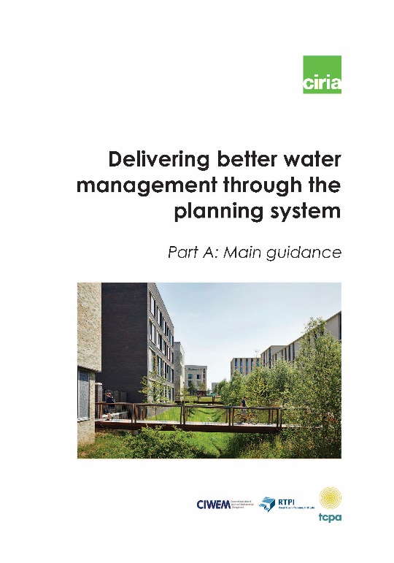
Making IWM happen
Partnerships are crucial
Community engagement is essential
Local Plans are key
Legislation has a role, but
Changing mind-sets is more important
You can’t make them do it, but you can make them want to do it
Notes:
To sum up:
To make IWM happen:
Partnerships are crucial
Community engagement is essential
Local Plans are key
Legislation has a role, but
Changing mind-sets is more important
The key message is:
You can’t make them do it, but you can make them want to do it

