Slide 1
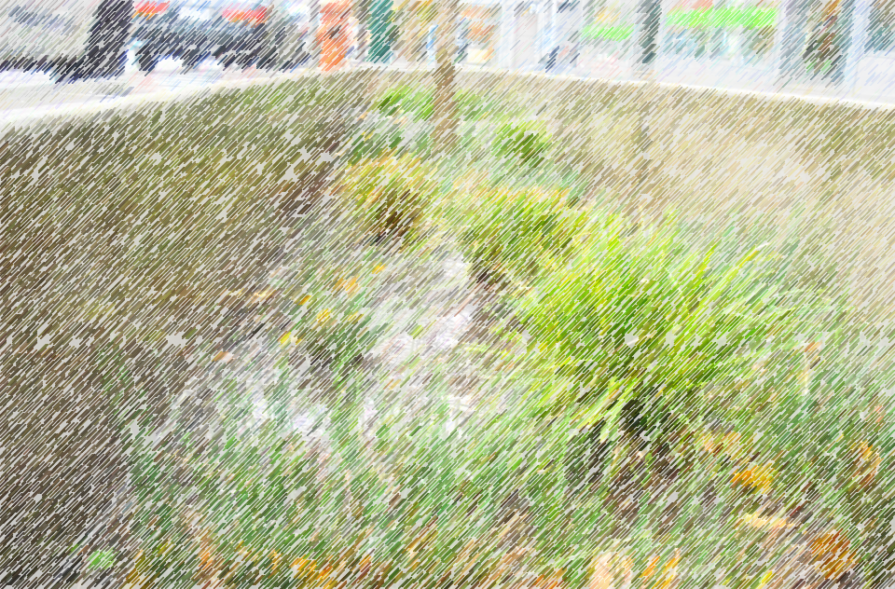


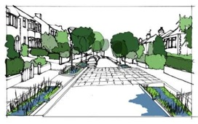


Retrofitting to manage surface water
Retrofitting to manage surface water
Notes:
Presentation provides an overview of the opportunities for retrofitting to manage surface water. It’s based on CIRIA publication C713 Retrofitting to manage surface water.
As the framework that stakeholders operate in changes, we have the opportunity to retrofit surface water management measures in a joined up and holistic way.
The guidance and this presentation sets out the key opportunities we have and issues we face, that will provide the driving force for a different approach to retrofitting surface water management measures.
Use of presentation and images
Presentation
Please make use of the presentation and feel free to adapt as required. Please also acknowledge its source as CIRIA C713 presentation.
Images
Images that have not been attributed to organisations or individuals ie (Jo Bloggs) can be used. Again please acknowledge its source as CIRIA C713 presentation.

Slide 2
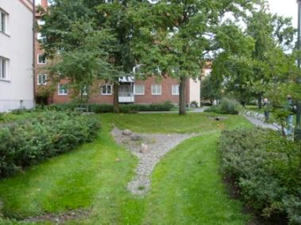
Retrofitting to manage surface water
A great opportunity
Why retrofit?
What we can retrofit
The benefits of retrofitting - differently
Guidance overview
Augustenborg, Malmo
Notes:
So what we’re covering
Overview of the presentation
Outline of the opportunities that can support the implementation of retrofit measures
Background to why we should be doing it
Summary of what measures we can retrofit
Outline of the benefits from retrofitting non-conventional measures
Overview of the key aspects of the guidance

Slide 3
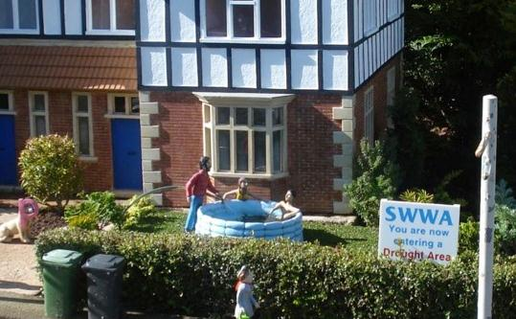
Current drivers (opportunity)
Notes:
3
Some of the drivers
There are many drivers (now and in the future) that create the opportunities to retrofit.
Drought – (even model villages realise it!)
Joining up the water cycle and making better use of rainfall will be critical in the future (explored in Water Sensitive Urban Design).
This will help reduce the risk of water stress if we can infiltrate more water to the ground and re-use water through rainwater harvesting where at all possible.

Slide 4
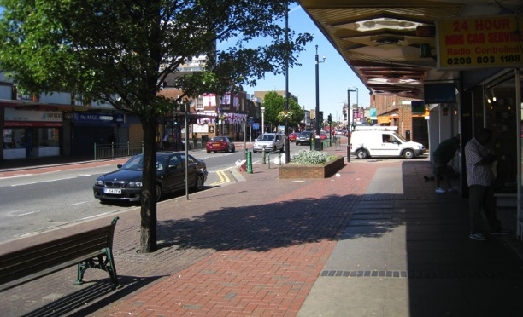
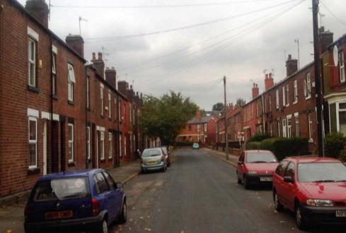
Current drivers (opportunity)
Notes:
4
Improving quality of life
Neighbourhoods and streets will continue to be rejuvenated and enhanced. Will they create the multiple benefits though?
These are typically in existing run-down areas.
Important to identify this great opportunity to introduce measures that manage surface water whilst improving the urban realm. To do this, strong partnerships between stakeholders will be vital.

Slide 5
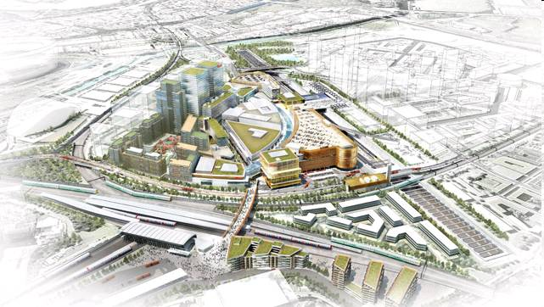
Current drivers (opportunity)
Notes:
Regeneration
Wider urban regeneration across large areas can often improve public open space and the surrounding buildings. This provides a fantastic opportunity to manage surface water also.
Where there is major change to buildings and public space, water can be managed holistically through the use of rain water harvesting and source control to slow down the rainwater.
Consider also using the surface water to create features that form part of the urban realm.

Slide 6
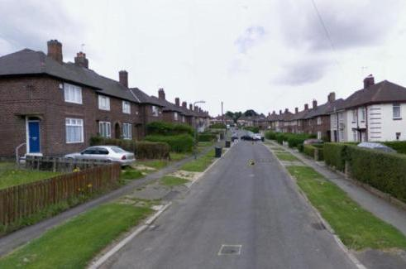
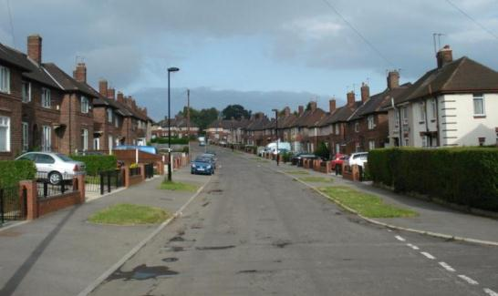
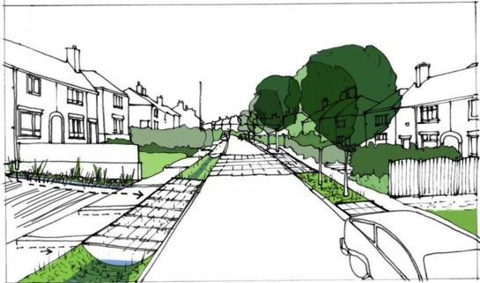
Key opportunities
Working together at a variety of scales to deliver multiple benefits
Notes:
Opportunities
Successful retrofitting requires good partnership working between a range of stakeholders. When stakeholders understand what each others needs are within an area, and their planned expenditure, then there is the opportunity to align goals.
The examples on the top demonstrate firstly what can happen, when improvements are made, but surface water is not considered in the design approach.
The artist impression demonstrates what could have been retrofitted, to provide the enhancements whilst also managing water. This includes managing water on both the private and public realm. Measures are positioned appropriately depending upon the variety of multi-purpose uses required as well as which direction they face, such as tree planting on the south side.

Slide 7
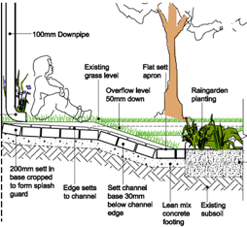
Every space is an opportunity
Within the day-to-day urban design and planning process
  Enhancing and greening available space and changing surface water management
  Requires partnerships and planning strategically
  There may not be a clear individual business case for each scheme
(Robert Bray Associates)
Rain garden, Ashby Grove, Islington
Notes:
Spatial planning
When retrofitting it is critical to think differently from now on.
It is about identifying the opportunities, protecting them, and where possible green them. This typically can only be achieved when there is a clear multi stakeholder strategy to maximise the opportunities and gain greatest bang for buck. Potentially combining green infrastructure, surface water management and other aspects like highways.
Having a strategy amongst all partners will define how we will manage surface water in the future.
A strategic plan across areas, that can be implemented in stages, as drivers (and funding) becomes available, will result in an holistic solution in the long term.

Slide 8
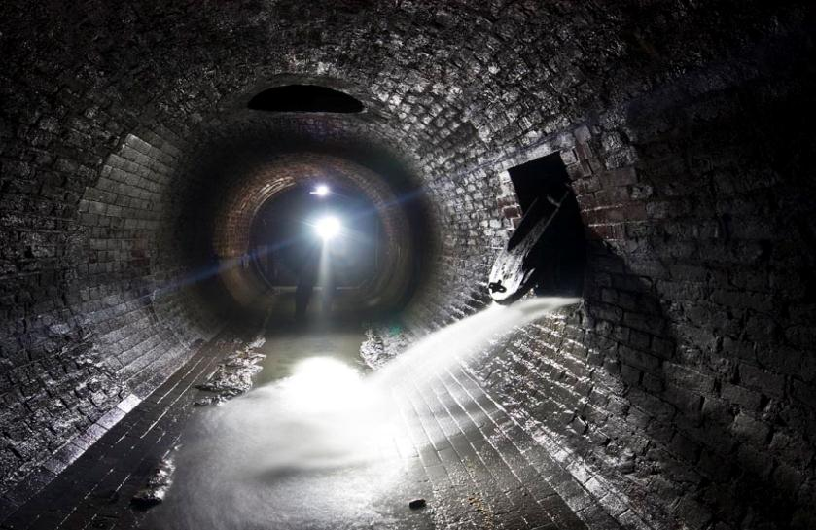
Traditional approaches to managing our surface water
Ofwat believe that external drivers cannot be affordably addressed using traditional underground systems
www.silentuk.com
Notes:
8
New ways of thinking
These are an example of the sewers designed and delivered by Bazalgette in the 19th Century.
However, increased urbanisation, beyond any sort of rate he imagined, has meant that these sewers, which have a finite capacity, are now becoming overloaded.
This is not just as a result of growth (through new development) but also due to urban creep which is more adhoc and difficult to control.
This means we will see increases in Combined Sewer Overflow discharges and surface water flooding.
Therefore our traditional approaches to managing surface water can no longer remain and we need to see an alternative (grey-green infrastructure) mix and match approach.
This grey-green infrastructure approach is being exploited in places like Seattle, Portland, Philadelphia and New York City. Where traditional grey infrastructure is being improved together with the installation of green infrastructure.

Slide 9
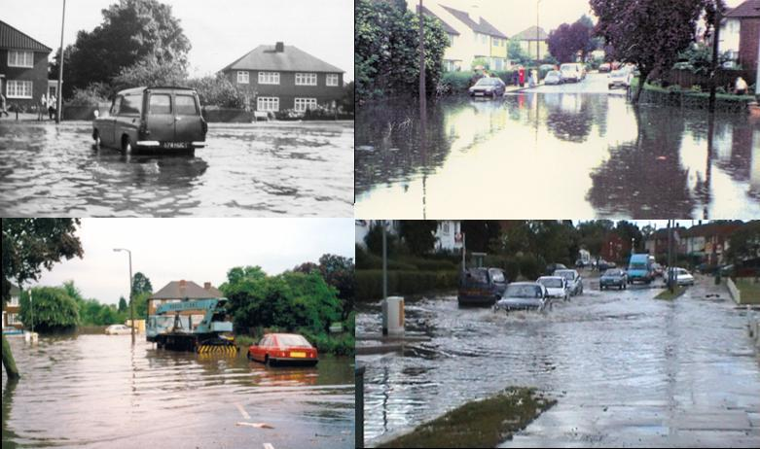
Current drivers (challenges)
1963
1993
1988
2007
Notes:
9
Urban flooding
The lack of capacity within the drainage network results in problems such as this.
This is flooding in North Brent, London in 2007 and on previous occurrences before, despite interventions.
This creates a clear driver for improvement but also highlights in this case, the extreme complexity of the problem and the need to fully understand all the issues that cause the flooding.

Slide 10
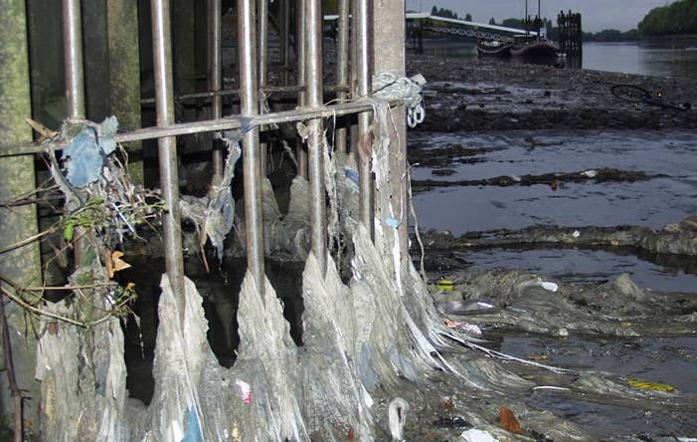
Current drivers (challenges)
Notes:
10
Diffuse pollution – Combined Sewer Overflows
The same can be said for Combined Sewer Overflow (CSO) discharges, which we can identify that need improving.
Raw sewage, mixed with excess surface water, enters our rivers through these CSOs, as seen here in the Thames.
There are a variety of approaches to deal with this challenge, some providing more benefits than others.

Slide 11
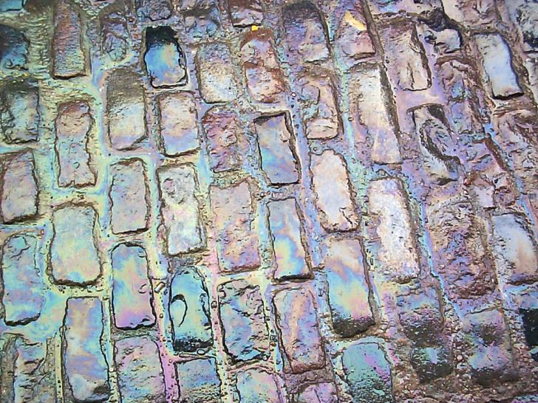
Current drivers (challenges)
Notes:
11
Diffuse pollution – surface water runoff
Problems also occur when oils and heavy metals are washed from the surface with diffuse pollution, that can enter watercourses via surface water drainage and combined sewer overflow discharges.
This is especially the case after prolonged dry periods.
Targets to meet the Water Framework Directive are fast approaching and this could be an imminent problem that we need to resolve.

Slide 12
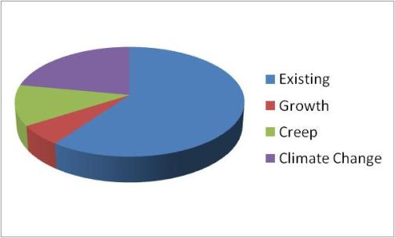
Key challenges
Economic uncertainty
More for less
European Directives
Growth and creep
Climate Change
+ 40% flow to 2080
Development alone will not be enough
Notes:
Challenges
Whilst we have current drivers which can be seen as opportunities, there are further challenges (or opportunities) lurking ahead.
The current and potentially short to medium term economic problems and uncertainty is forcing stakeholders to drive more for less. However, funding overall, could represent a significant challenge going forward.
We have European Directives we will need to comply with such as the Water Framework Directive (looking at the quality of water bodies).
New development (although we hope we can control better) and urban creep will place increased burdens on our aging infrastructure.
UKCP09 projections for climate change indicate that our climate will change, and place further pressures on the infrastructure..
Therefore, we cannot address the challenges we face simply through good surface water management in new developments.

Slide 13
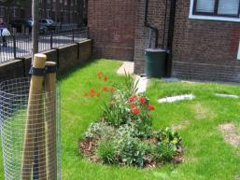
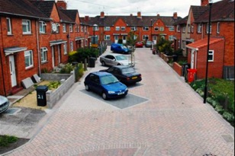
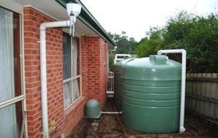
Engaging with householders and others
Need special engagement for the public
  responsibility for their own surface water
  embrace retrofit measures
Financial and other incentives are needed
Images
1. Ashby Grove, Islington
2. Dings, Bristol (Sustrains)
3. Melbourne (Darren Bos)
Notes:
Working with communities and individuals
If we are to make a success of managing surface water and responding to the opportunities and challenges, we will have to retrofit at the property level and in the public domain. This may reshape our urban areas for good.
However, one of the biggest challenges is to work with property owners/dwellers to accept greater responsibility
This requires good engagement, that understands their needs and what is important to them before understanding what they may wish to support and play a part. Along with this, incentivisation is required – financial; harvesting…. Greening etc..
First example, is a small rain garden in a low rise residential estate in Islington, here there’s an information and interpretation board presenting the approach and benefits.
Second example, in the Dings development in Bristol SUSTRANS and the Council had 2 years of engagement with the community in this areas before measures were retrofitted as part of a Homezone initiative (that introduced shared spaces). .
Third example, in the catchment of Little Stringybark Creek in Victoria (Australia) there has been an auction to ‘sell’ disconnection and the take-up rate is now around 38% of the 748 properties.

Slide 14
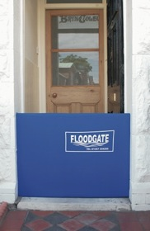
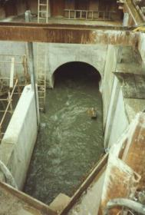
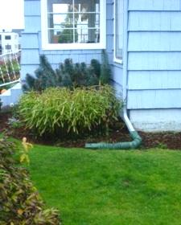
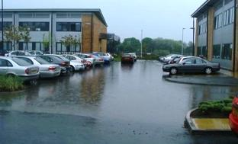
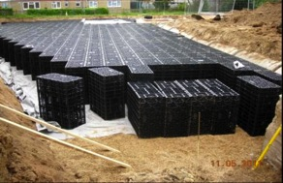
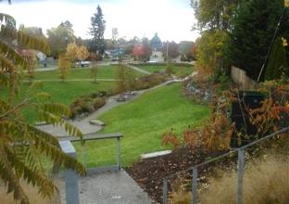
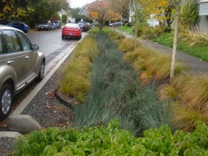
What we can retrofit - mix and match measures
Images courtesy of
(Floodgate, Jacobs Engineering,
Wayne Rushmere)
Notes:
What can be done
Pipe work alone is not the only option and therefore what is required is a mix and match approach to measures. Firstly:
Existing buildings will be fitted with green roofs and rainwater harvesting systems. Downspouts will be disconnected and flows slowly discharged.
Roads will have rain gardens or bio swales in their verges, collecting and storing runoff, removing pollutants and calming traffic.
Some roads, paths and spaces between buildings will be reshaped to carry surface water, and during extreme events act as ‘blue’ flood pathways when the capacity of drainage is exceeded.
Open areas such as parkland and car parks will be designed and designated to act as temporary flood storage.
At the same time they will provide green infrastructure benefits such as creating places for recreation and reducing urban heat islands.
Surface water management will be an integral component of urban design, providing a host of benefits such as enhancing amenity, increasing biodiversity and enhancing land value.
Local flood protection measures will be installed to make buildings more resistant to flooding.

Slide 15
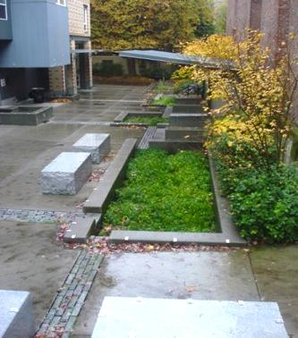
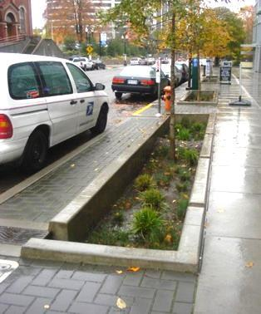
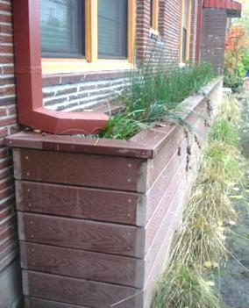
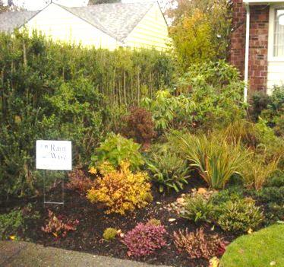
What we can retrofit - in urban areas
Images of retrofitting from Portland, Oregon
Notes:
Four examples here from the U.S.
Variety of rain gardens and street planters in slightly different urban contexts.
Top left is in the centre of a city, and roof and hardstanding flows are conveyed to a series of bio retention areas which stores water and infiltrates.
Top right is a street planter (newly built) with flow entry points from the footpath and the highway.
Bottom right is a rain garden that takes surface water from the disconnected downspout
Bottom left shows a long planter next to a residential property that is very deep and long taking flows from the roof

Slide 16
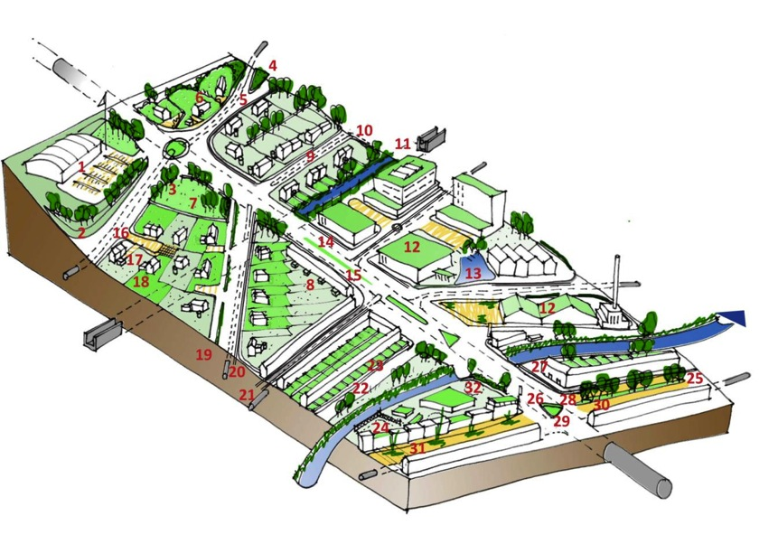
The benefits of retrofitting
(using SuDS)
Limit flows entering drainage systems
Manage flows above ground
Surface water used as a resource
Increase extent and viability of green infrastructure
Surface water used as an amenity
Maximise capacity of the drainage system
Improve water quality
Improve resilience
Notes:
(Some of) the benefits
The benefits of retrofitting surface water management measures, and specifically for some benefits green infrastructure/SuDS are shown on the slide
Generating as many benefits as possible will help tilt the balance in terms of providing wider support for retrofit surface water management projects where non conventional approaches are adopted.
Understand your drivers and opportunities and identify what other benefits the work will bring. Cost them using the available approaches, it is likely that costs and benefits will accrue to different stakeholders over different times and areas.

Slide 17
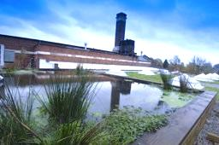
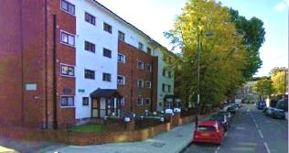
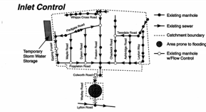
The benefits of retrofitting
Can…
  Mimic natural drainage processes
  Improve water quality
  Reduce flood risk
  Manage the impact of future changes
  Enhance urban areas
  Enhance biodiversity
  Pollution and climate
  Create more for less
Images
1. Manchester (Paul Harris Photography)
2. Ashby Grove, Islington
3. Dings, Bristol (Sustrains)
Notes:
The benefits
It is important to differentiate between conventional (piped) and SuDS/green infrastructure schemes
The examples include:
Manchester green roof top
Islington rain garden retrofit as a precautionary buffer against climate change
A long-standing hydrobrake scheme in London (Wadley Road, Waltham Forest) – that limits the rate of inflow into the sewers. It makes use of conventional system and has its’ place in managing surface water.

Slide 18
The guidance
Support practitioners to retrofit surface water management measures
Notes:
About the guidance
The guidance is underpinned by extensive consultation and research to identify best practice and examples globally
Many parts were tested in practical application
It uses flow charts and case studies to demonstrate points
It is aimed at wide range of professions and stakeholders to help achieve retrofitting for a range of drivers.
It is split into four parts:
The first outlines the opportunities and benefits of retrofitting, aimed at decision makers
The second contains the main guidance
The third contains case studies and tables
The fourth contains references, glossary and abbreviations

Slide 19
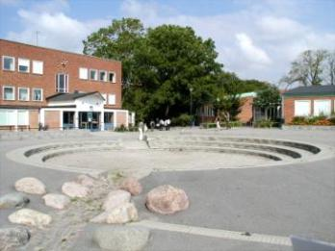
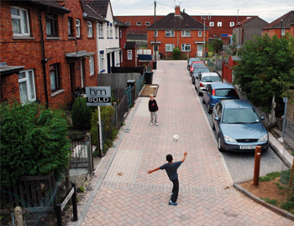
The guidance - Two fundamental approaches
Strategic retrofitting
Opportunistic retrofitting
Opportunistic approaches should fit into a wider more strategic SWM approach providing greater benefit and be ‘joined up’.
1. Malmo, Sweden (Dick Fenner) 2. Dings, Bristol (Sustrans)
Notes:
Approaches to retrofitting
The guide is underpinned by two fundamental approaches:
Strategic retrofitting that is addressing specific issues, opportunities and drivers, such as flood risk
Opportunistic retrofitting, that nibbles away, retrofitting when there is an opportuntiy
However, it is important that the approaches tie in with a more strategic plan that needs to be jointly developed between the key stakeholders that will help to deliver multiple benefits and hopefully identify multiple sources of funding.

Slide 20
Framework
Notes:
Framework for retrofitting
The guidance uses the framework above which has six phases and is under pinned by urban design principles. Urban design is one of the more important aspects of the guide advocating bringing together different disciplines to consider how we better manage surface water and reshape or enhance some of our urban areas (where appropriate).
These are typical delivery steps, but focus on the retrofitting aspects and key issues to address.
Note that this process does not stop – SWM is not something to be done and walked away from in the future, but will be a continuous cycle where more retrofitting will be required and maintenance and monitoring will be for the long term (to differing degrees).

Slide 21
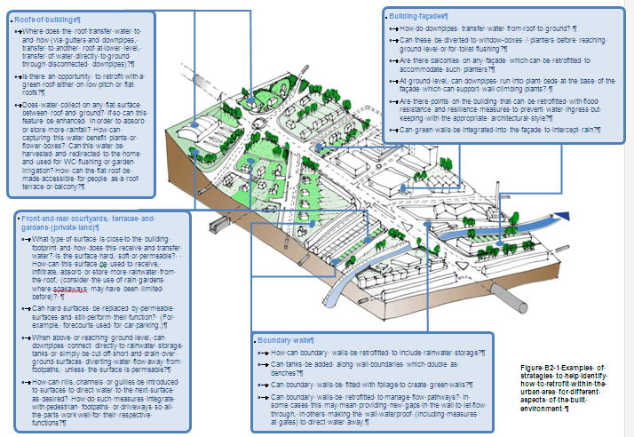
Urban design
Seven principles of urban design central to the guidance and retrofitting
Notes:
The role of urban design
The Guidance recognises that urban design must sit at the heart of urban drainage for measures to form part of the urban realm
It is under pinned by seven key principles, with examples and drawings to help explain concepts and spark ideas and thinking.
It is important that practitioners think as much about what it could look like or the shape it takes as much as practically working hydraulically

Slide 22
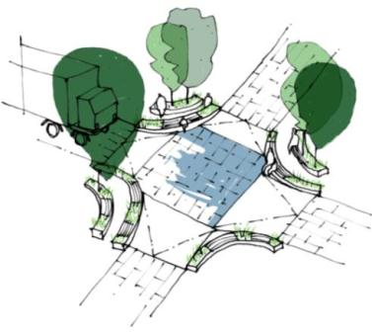
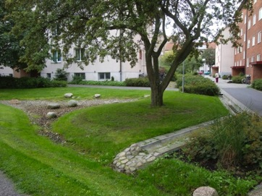
Principles of urban design
What kind of context? What scale of retrofit?
Design for people first
No space is useless
Create diversity at the place
Augustenborg, Malmo
Notes:
The principles of urban design
Context - This relates to the place where the retrofit is to be made. Any place is affected by what is around it, whilst the place itself affects its surroundings. Conservation area to regeneration. Scale - catchment, neighbourhood, property. Who will benefit and how from the retrofit?
Design with people in mind – identifying measures that can best support their needs. People need to be able to move around safely and freely. Consider micro-climates and how planting can create positive and negative impacts
All spaces should have a purpose, those that are not clear can fall into disrepair – maximise it, make it multi-purpose. Give it a function and use the edges to define it.
Create a variety of spaces by using differences in scale, surface and texture. Remember, it is important to study an existing context’s Different places suit different measures and different designs. Consider when to introduce hard and soft features and how to mix them. Create diverse and inclusive places for people, Create key areas for biodiversity (and maintain over time)

Slide 23
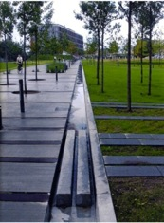
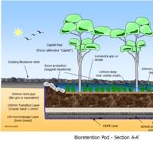
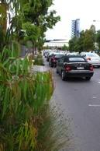
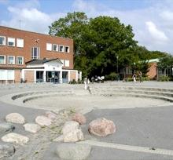
Principles of urban design
Improve connections and cohesion between places
Connect and integrate resource flows
Good places are never finished! Design to accommodate change
Images
(Bjorbekk and Lindheim
Bioretention plan (Tony Weber)
Portland, Oregon
Malmo (Dick Fenner)
Notes:
The principles of urban design (cont)
Improve both ecological and pedestrian connectivity and cohesion . Connections will already exist. Determine how they function and whether they function as well as they could. Then ask how all connections can be improved and made more attractive.
Connect other key resources; water (blue infrastructure), vegetation (green infrastructure) and utility (red infrastructure; power, heat, cooling and material resources). Green and blue spaces can interconnect with each other in a network in order to provide opportunities for ecosystems to grow and thrive. At the same time, these provide much better areas for recreation and public use. Utility services which include heat, power, drainage and cabling need easy access for maintenance and upgrades. Avoid future disturbance to streets and neighbourhoods by planning how these utility networks are integrated with all urban design and SWM strategies.
Design places with the ability to adapt to change. Acknowledge the varying durability and / or permanence of different elements of a design. We need to adapt to changes in demographics, urbanisations and climate. Ensure the space is given for other resource flows to minimise future impact

Slide 24
Preparation
Partnership working critical to success
Linking disciplines
Linking professions
Not necessarily one leader
(Dwr Cymru)
Notes:
Preparation
This outlines key steps required for successful retrofitting at the start of the project. This is applicable for one off, opportunistic schemes or large scale schemes which will help ensure wider opportunities are not missed.
Clear reasons for the need, even if it is opportunistic retrofitting
Outlines partnership working for short and long term. This must be signed up and agreed at the highest level (securing a champion(s)).
Highlights the importance of multi-disciplinary teams
Recognises that the leadership may be by those not undertaking the work, but by the most appropriate partner

Slide 25
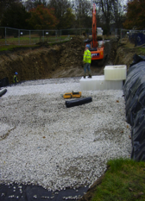
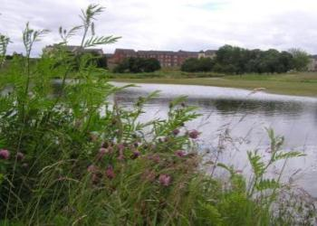
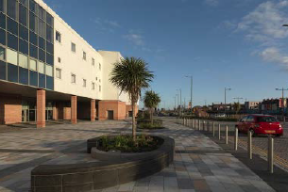
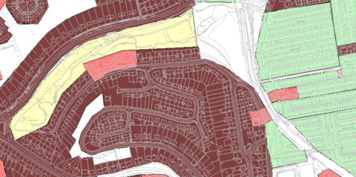
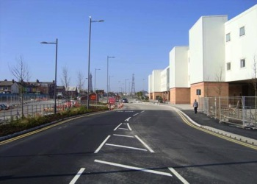
Feasibility
Establishing the need
Establishing opportunities
Identify retrofit strategies
Think longer term as well as for the immediate needs
Fit to the planning process
Images
1-4 Yorkshire (City of Bradford Metropolitan District Council)
5. The Manor, Sheffield (R. Nowell)
6. Thematic mapping
7/8 Blackpool (Gillespies LLP)
Notes:
Feasibility
Outlines the key issues related to the feasibility stage.
It recognises the importance of ‘truly’ understanding the need i.e. what is the problem to be addressed (particularly for strategic retrofitting) as this is often not well enough understood at times.
Establish the opportunities
Target, which may be achieved quickly or provides an easy opportunity to manage surface water (e.g. disconnection of a large area from a drainage system or large open green space).
Common, areas where similar types of measures may be retrofitted and approaches targeted
Future, where there is opportunity to align programmes of work and potential funding
Match up the needs with the opportunities to then assess the potential impacts and where you may first look to retrofit and when. This can help to undertake targeted assessments for strategic retrofitting.
Based on the understanding the needs and opportunities, retrofit strategies can be developed. Recognise the wider benefits that are possible using the strategies.
Remember the retrofit may be over a long period of time to achieve the required final outcomes.
The examples are:
Top is Bradford which demonstrates understanding where the source of the problem is, the pathways of the surface water and the receptors. This also showed the importance of understanding the problem, and a forgotten watercourse was found that ran underneath the houses
Bottom shows target (green space), common (land use assessment) and Future opportunities (Blackpool retrofit with vegetation to improve water quality and harvesting by improving the streetscape).

Slide 26
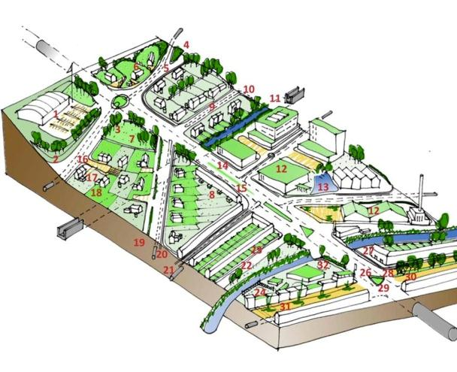
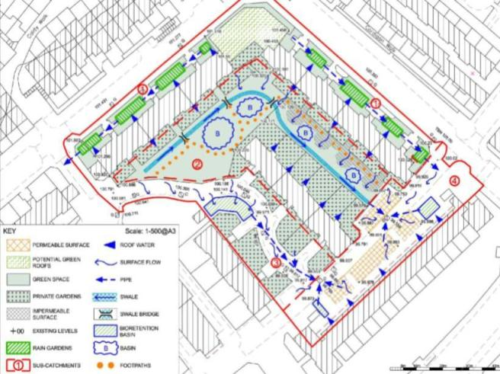

Develop options
Develop and assess options, sizing the measures and understanding performance
Images
1. Opportunities
2. Scheme plan (Robert Bray Associates)
3. Lamb Drove Monitoring (Royal Haskoning)
Notes:
Developing options
The next stage once we have strategies to solve the problem or make use of an opportunity is to develop options.
Need to recognise there are a large number of measures that can be selected. It will be appropriate to mix grey and green measures, through a mixture of hard and soft landscapes. Remember to consider early the context of the urban area.
Identify measures (tables at the rear to support the identification and selection of measures and the benefits they bring)
Model the performance of the options where appropriate. For example, opportunistic retrofitting may not require computer modelling. For more strategic retrofitting, modelling the hydraulic performance will be important. Some packages are emerging for modelling water quality and these may be used.
It is important to note that we still have a lot of work to do in order to understand performance of the measures with high confidence for water quality, although the existing science indicates that there will be a reduction in a wide range of pollutants. For example, monitoring at Lamb Drove, in Cambourne (new development) has provided some confidence.

Slide 27


Appraisal
Different appraisal approaches
Consider a wide range of benefits that can be evaluated and help support scheme value
Notes:
Appraisal
The appraisal approaches go far beyond simple capital, operational and Whole Life Costs
A far wider assessment of the benefits is vital that may help tilt the balance of taking a grey/green approach compared with more conventional approaches.
Considering the wider benefits that the work will bring should be undertaken as early as possible to ensure the right appraisal approach is selected.
This stage also includes the consideration of incentives and multiple funding sources, which the formation of a strong partnerships across an area will help bring.
A growing number of calculators to assess the wider benefits (eg social and environmental) from these types of measures are becoming available – this will be a fast developing arena, therefore look for developments and new work coming out.

Slide 28




Implementation
Practical implementation identifies key aspects to address
Images
1. Lamb Drove, Cambridgeshire 2. Retrofit park, Seattle
3. Toronto (L Sharp) 4. Ashby Gardens, Islington
Notes:
Implementation
This chapter outlines key issues to address and consider once the options have been selected. This includes working in the public and private realm.
It identifies a wide range of detailed design guidance that is available
Includes issues such as ownership and adoption (which should be discussed as early as possible), health and safety, permissions, detailed design, construction, operation and maintenance.

Slide 29


Performance monitoring
Identifies what and why we should monitor, when and how
Sharing knowledge
Images
1. Benefits of SuDS Mgt Train (Neil Mclean)
2. Lamb Drove Monitoring (Royal Haskoning)
Notes:
Monitoring
Final chapter outlines why it is important to consider monitoring either to confirm the performance and when to undertake maintenance activities
Lamb Drove provides a good example for us of the monitoring that can be achieved. Further information is also on CIRIA’s SuDS website.
Statutory and other requirements are highlighted for the practitioner to consider and how this should form part of an asset management approach.

Slide 30

Case studies and examples
Estimating the multi-value benefits
Halewood primary school
Green Infrastructure North West on-line calculator
Net present value £80,000 over 25 years:
  Recreation and leisure: £75,000
  Land and property value increases: £22,000
  Climate change mitigation: £1,000; carbon sequestered through the new tree planting
Initial SuDS design (Mersey Forest)
Notes:
A case study – school retrofit
The guidance contains examples throughout and a large number of case studies in Part C. This includes highlighting where there are multi value benefits for example
Green Infrastructure North West tool for multi-value evaluation was used at Halewood Primary school.
Another good examples in England includes Mayes Brook Park, which used an ecosystem services approach.
International examples includes the application of the Centre for Neighborhood Technology’s tool that has demonstrated that using Green Infrastructure in Philadelphia for surface water (instead of a sewer tunnel for half the city) brings $3bn added value benefits

Slide 31


Making most of the opportunities
No space is useless
Partnership working
Mix and match measures
Link disciplines
Multi functional and multi value land use
Multiple benefits in a time of austerity
Notes:
How to go forward
Be open to opportunities at every chance
In a time of economic constraint we have important opportunities for multi-functional/multi-value land use and societal benefits.
We can do more with less

Slide 32
Retrofitting to manage surface water
Free to download
www.ciria.org
Retrofitting to manage surface water

