Slide 1
Introduction to sustainable drainage
Notes:
Use of presentation and images
Presentation
Please make use of the presentation and feel free to adapt as required. Please also acknowledge its source as CIRIA general SuDS presentation.
Images
Please only use images that are attributed to CIRIA and please acknowledge there source as CIRIA general SuDS presentation.

Slide 2
Outline of presentation
Challenges of existing drainage
Drivers for SuDS
SuDS philosophy and principles
Benefits of SuDS
Examples of SuDS
Challenges of SuDS
Summary

Slide 3
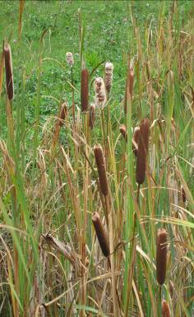
Challenges of existing drainage
Flooding
  Too much runoff from developments into watercourses
  Runoff drains too quickly into watercourses
Environmental
  Runoff is polluted
  Does not enhance biodiversity or green space
Notes:
We are facing a number of challenges regarding our existing traditional drainage.
Flooding
The traditional approach to drainage in the UK was driven by the need to remove drainage from our cities as quickly as possibly (primarily related to concerns about sanitation). However, development reduces the permeability of soil and increases surface water runoff and our drainage systems now do not have the capacity to cope with our drainage, and this is only set to get worse in the future with urbanisation, urban creep and climate change.
Sustainable Drainage Systems, (SuDS) provides an approach where the flow rates and volumes can be managed from developments and highways. SuDS slows water down (attenuation) before it enters the watercourse, provides areas for storage and can be used to allow water to soak (infiltrate) into the ground or evaporated from surface water and transpired from vegetation (known as evapotranspiration).
Environment
Many of our hard surfaces in the built environment collect pollution (from cars, litter, animal waste etc), this pollution can get washed into sewers and eventually watercourses causing diffuse pollution.
In some areas where there are combined sewers (that combine waster water and surface water) the sewer systems are designed to overflow into watercourses during extreme rainfall. These Combined Sewer Overflows can discharge a mixture of sewage and surface water into rivers, also causing pollution.
Some SuDS components provide water quality improvements by reducing sediment and contaminants from runoff either through settlement or biological breakdown of pollutants.
Traditional drainage approaches tend to be underground and do not provide benefits in amenity and biodiversity. Where as SuDS can contribute to the delivery of green infrastructure and create habitats that encourage biodiversity.

Slide 4
Natural catchment (greenfield)
evapotranspiration
surface flow
baseflow
interflow
Notes:
In natural catchments a large proportion of rainfall remains in the catchment or evaporates, or infiltrates with very little surface water runoff.
Surface runoff is less significant and natural water balance is preserved.
With SuDS urbanisation should not cause surface runoff increase.
This goal can be achieved by reducing the amount of paved surfacing and implementation of a broad range of SuDS components.
Variability of soil and other catchment characteristics will need to be taken into account for the selection of the appropriate SuDS method(s).
Best results are likely to be obtained by a combination of SuDS methods.

Slide 5

Developed catchment
evapotranspiration
surface flow
interflow
baseflow
Notes:
Urbanisation adversely impacts on the natural water cycle.
Development increases percentages of impervious surfaces, where infiltration is significantly reduced and there is increased surface water runoff.
As well as having an impact on the development, downstream areas should be protected against adverse effects of new developments.

Slide 6
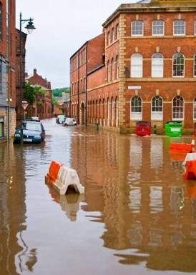
Drivers for SuDS
National and local planning policy
Flood and Water Management Act
Climate Change
Water Framework Directive
Building Regulations
Delivering better places and spaces
Flooding in Sheffield 2007
Environment Agency
Notes:
Planning policy statements
National planning guidance in countries promote and encourage SuDS. Some of this has filtered down into strong policy within Local Plans
All UK jurisdictions have policy that promotes flood risk and the use of SuDS.
A number of Local Plans include policy to support the delivery of SuDS
Flood and Water Management Act
The Flood and Water Management Act received royal asset in 2010.
It creates clearer responsibility with Lead Local Flood Authorities (upper tier local authorities) become the lead for delivering local flood risk management.
It introduced Schedule 3 of the Act which relates to SuDS and this has been implemented in Wales. At the moment in England SuDS is delivered through the planning system
Climate change
Predictions suggest greater variability of weather, with more extreme events.
It’s been suggested there will be warmer summers and wetter winters which is likely to lead to greater runoff.
Concerned about runoff from new development and impact on flooding.
We need to have developments that are more resilient to the challenges of climate change.
Water Framework Directive
A European Directive or framework for managing the water environment.
Quality and ecological objectives set for ground waters and surface water.
Building Regulations and the Code for Sustainable Homes
Building Regulations have a drainage hierarchy, with SuDS and infiltration higher then discharge to surface water sewer
Delivering better places and spaces
Multi-beneficial SuDS where surface water is managed on the surface can create better places and spaces. This is also linked to the delivery of blue-green infrastructure

Slide 7
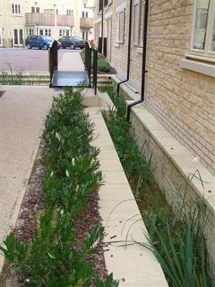
The SuDS philosophy
Mimic natural drainage from a site
Where possible, manage water on the surface
Manage runoff close to source
Provide multiple benefits
SuDS scheme at Stamford
Robert Bray Associates
Notes:
SuDS is a concept/philosophy – it’s not just one type of component.
As SuDS is a philosophy (wide variety of components) it can be used on any site, however you need to be aware of the constraints and opportunities afforded by a site.
SuDS should mimic the natural drainage, ie before any development.
Water should be managed on the surface, this enables visual inspection, and enables water to be integrated into the development, providing greater benefits, particularly amenity and biodiversity. It also enables biological breakdown of pollutants and easier maintenance.
Treating water as close to the source as possible, managing both the flood risk and water quality before it is passed downstream.
SuDS is not just about drainage, its primarily about managing water quantity, water quality as well as providing biodiversity and amenity. The balance will depend on the site, there will also be opportunities to deliver other benefits such as recreation, education and water resources etc.

Slide 8
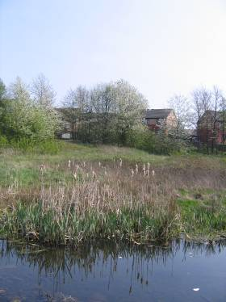
SuDS principles
The management train – SuDS components in series
Source control – runoff managed as close as possible to where it falls as rain
Sub-catchments – division into small areas with different drainage characteristics and land use
SuDS scheme in Sheffield
CIRIA
Notes:
SuDS philosophy – deliver water quality and quantity benefits together with improvements for amenity and biodiversity using three key principles/
The SuDS Management train - uses a sequence of SuDS components to help manage the flow and volumes of water. It also provides incremental improvements in water quality. It normally starts with source control, moving to site control and regional control. This can be explained in the Lamb Drove case study. Source control and approaches to prevent runoff and pollution should be considered before source control (this referred to as “prevention”.
Source control – manage water as close to its source as possible, Source control may be preferred in urbanised areas where space may be at a premium. Often source control components are within the curtilage of properties and maintained by the property owner or management (examples include green roofs, permeable paving etc).
Sub catchments – provides an opportunity to manage runoff in cost effective parcels, it also enables pollutants associated with different land uses to be managed more effectively.

Slide 9
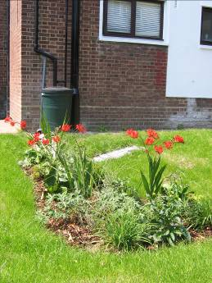
SuDS schemes
SuDS can include a variety of components.
The selection of SuDS components depends on site opportunities and constraints.
Provide management and treatment train.
Shallow systems are always better than deep systems (and usually cheaper)
Shallow systems are safer (construction and operation)
Retrofit SuDS in Islington
CIRIA
Notes:
9
SuDS uses both landscaped features and harder engineering. Landscaped or softer engineered features include more natural components such as ponds, wetlands and shallow ditched. Harder or engineered components may include rainwater harvesting, permeable paving, geocellular storage, proprietary products – these may be particularly used for constrained sites.
Each SuDS component is likely to be suited to different site opportunities and constraints. In most cases a combination of components is required to provide the best results.
Shallow systems, where water is managed on the surface are often cheaper, easier to maintain and help overcome the challenges of managing surface water on contaminated sites.

Slide 10
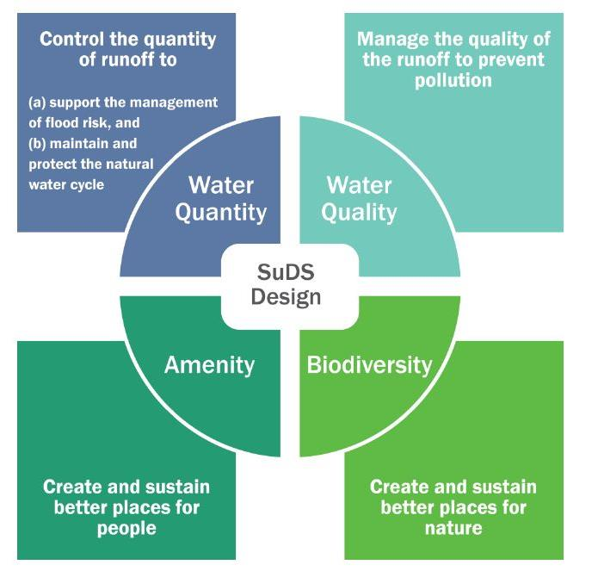
SuDS and multiple benefits
Reduced flood risk
Improved water quality
Increased biodiversity
Increased levels of green infrastructure
Better places to live
Engagement with local communities
Adaptation to climate change
Carbon management
Notes:
Typically SuDS has focused on delivering benefits in terms of water quantity (flood risk etc), water quality and amenity and biodiversity. However there are are range of other benefits that need to be considered.
By managing the flows and volumes from surface water runoff SuDS can help manage flood risk on the site and further downstream.
SuDS components can help manage water quality by reducing sediments and contaminants from runoff through a variety of physical and biological treatment processes.
SuDS provide opportunities to create attractive green (vegetated and landscaped) and blue (water) corridors' in developments connecting people and the environment to water and open spaces. SuDS will only fulfil their ecological and green infrastructure potential, if the design process considers ecology, flood risk and water quality management together.
SuDS also provides attractive public open space and the development of social cohesion to improve the quality of life and create better communities.
SuDS also provide the opportunities to mitigate and adapt to climate change. Well design SuDS schemes should be able to accommodate extreme events better, vegetation and areas of water can also provide some thermal comfort (through evaporative cooling etc).
SuDS are inherently a more natural approach to drainage and should not require pumping or energy. In addition to this, SuDS should also reduce the amount of surface water entering the traditional drainage system reducing the requirement for pumping and in a combined sewer system downstream treatment.

Slide 11
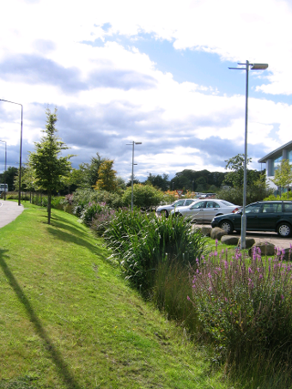
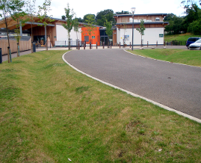
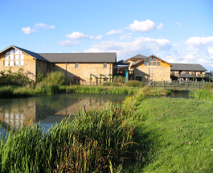
SuDS can be this…
Swale in a school, Exeter
Robert Bray Associates
Linear wetland, Scotland
CIRIA
J4 Services, M8, Scotland
Wetland pond, London
CIRIA
Notes:
11
SuDS can be both landscaped, soft as this slide or hard engineered – in the next slide.
Linear wetland
This linear wetland, is along a highway in Scotland. The wetland provides conveyance to a larger wetland downstream. During this process the water is conveyed and treated in the wetland. The potential for storage and vegetation provides and opportunity to breakdown pollutants.
Swales
A swale is a shallow vegetated channel, this one collects runoff from the highway and provides conveyance to other parts of the SuDS management train. SuDS are becoming increasingly common in schools (there a number of case studies on the CIRIA SuDS website). Careful management and education enables the SuDS scheme to be a used within the curriculum – and can be a valuable educational resource.
Wetland pond
This pond provides valuable amenity and ecology benefits and is integral to this nature reserve.
Other soft or landscapes components include raingardens, detention basins, retention ponds.

Slide 12
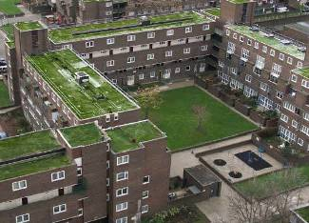
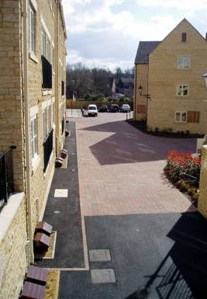
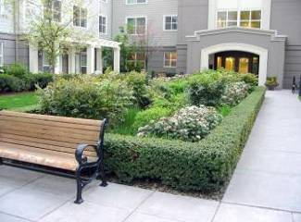
SuDS can be this…
Green roof, London
Lambeth Council
Permeable pavement, Stamford
Robert Bray Associates
Bioretention, Portland, Oregon
Environmental Protection group
Notes:
12
This slide shows some hard or “engineered” SuDS components. Other examples include; rainwater harvesting, geocellular storage, proprietary products, filter drains etc.
Permeable pavement
Permeable pavements (or surfaces such as gravel, porous asphalt) allow water to soak into the ground or a gravel-filled base. Permeable surfaces can attenuate the flow and provide treatment. It’s great for constrained sites as it provides a drainage and car parking function. This example at Stamford uses permeable paving and geocellular drainage.
Green roof
This primarily is as close to the source as you can get and primarily is a roof covered in vegetation or another medium. The effectiveness of a green or living roof will depend on the thickness of the substrate on the roof, it provides attenuation and other benefits such as biodiversity enhancement and thermal cooling. CIRIA has produced guidance on green roofs and further information is also available from Livingroofs.org.
Bioretention
Are depressions filled with engineering soil and vegetation. Water enters through a vegetated surface and trickled into a perforated pipe at the bottom before being transported downstream. It provides attenuation and water quality treatment.

Slide 13
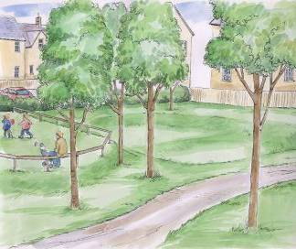
Delivering SuDS
SuDS at Lamb Drove, Cambourne, Cambridge
35 dwellings per hectare
Adaptation to climate change
  SuDS retrofitted to existing layout
  Attenuation to 1:100 year storm return period (plus 20% climate change)
  Resilience and resistance measures included
Thanks to Cambridgeshire County Council and Royal Haskoning!
Artist impression of Lamb Drove
Notes:
FLOWS is an Interreg Project with European partners to look at local flood risk management.
Lamb Drove in Cambourne 8 miles west of Cambridge which is a growth area and the main driver for the Interreg Project.
All the information for this example has been kindly provided by Cambridgeshire County Council and Royal Haskoning, more information is provided on the CIRIA website.
Cambridgeshire Country Council worked in partnership with a housing society to create a showcase development that includes SuDS and flood resilience measures.
Lamb drove is generally a medium density housing development.
It’s a retrofit site solution in that the layout was already agreed – this meant the design process was more complicated than it needed to be.
Objective of the design was to attenuate runoff, using open landscaped features up to a 1:100 year event (including allowance for climate change).
Currently being monitored with promising performance information (which is on the CIRIA website).

Slide 14
Source control/
conveyance
Swales
Source control/conveyance
Swale
Site control
Detention basins
Site control
Detention basins
Site control
Detention basins
Source control
Green roof
Prevention/
Source control
Water butts
Source control
Permeable surface
Source control
Permeable surface
Source control/ conveyance
Underdrained swale
Source control/ conveyance
Underdrained swale
Source control/ conveyance
Underdrained swales
Regional control
Retention pond
Notes:
The site uses source control and the SuDS management train.
Full attenuation of the 1 in 100 year storm is provided through the use multi use of open space (which is more cost effective).
The storage required the use of Public Open Space, which includes basins in play areas.
Overland flow routes were provided for runoff in excess of the design volume, sacrificial storage was provided for storms in excess of 1 in 100 year event.
Quality, quantity and amenity were considered equally although particular attention was required to consider flood risk management.
Engagement with the residents also took place to ensure that they understood how the site functioned.
The SuDS Mgt Train
Prevention – Water Butts provide prevention, lots of grassed areas as well.
Drainage from impermeable areas leads into permeable pavement – source control.
There is a token gesture of green roofs – however, depending on construction can provide 30-50% (if not more) this is regarded as a source control measure.
Roof water is also collected into swales – which is a source control measure and the conveyed onwards to basins.
Swales convey the water to detention basins that act as site control and only get wet in a 1 in 100 year event.
The swale network then conveys water to a retention pond which acts a regional control at the bottom of the site.

Slide 15
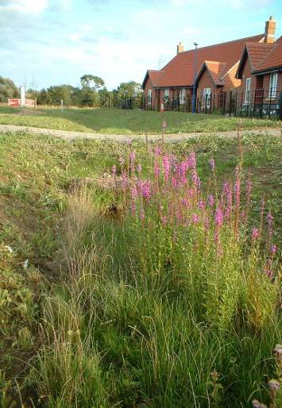
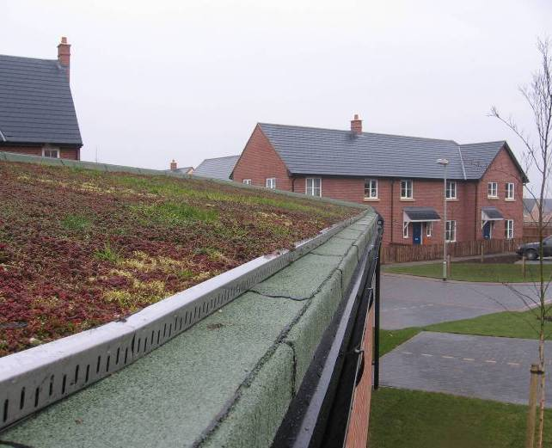
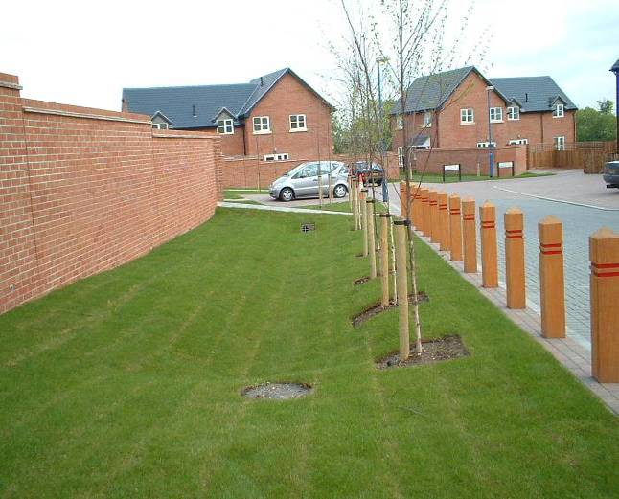
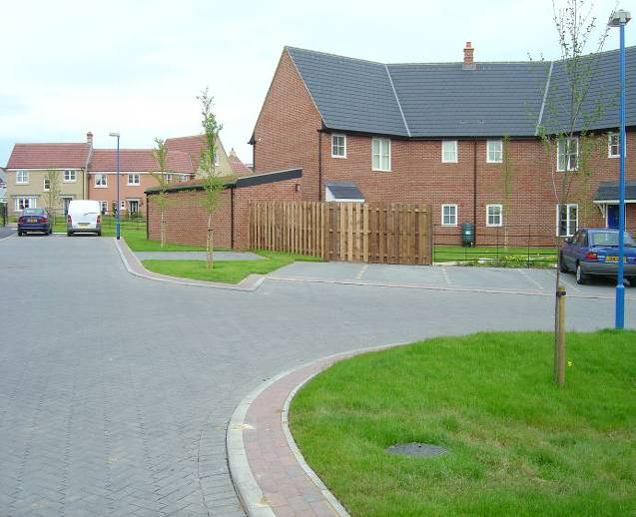
Source control
Cambourne
Permeable paving
Swale - Greenway
Green roof
Swale – internal swale
Notes:
Images are from early stages of the development of the site.
Permeable/pervious pavement
The permeable pavement is a load-bearing construction surfaced with materials that allow surface water to enter the underlying construction. Small gaps between the block paving.
Runoff is stored and conveyed through the sub-base construction.
Provides attenuation, infiltration as well as some water treatment.
Green roof
Normally a multi layered system that covers a roof with vegetation over a drainage layer.
This can reduce the volume of runoff and attenuate peak flows from the roof.
Can reduce the size of other SuDS components – normally looks good too!
Swales
Shallow channels designed to collect, convey and treat water.
Development has two types of swales, normal and underdrained swales – provide greater drainage – often dry.
Swale on the green way (perimeter of the site) also provides opportunities for enhanced biodiversity.

Slide 16
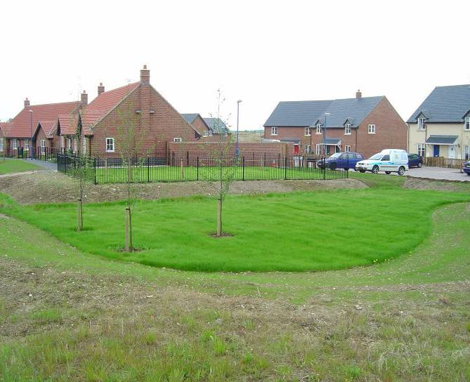
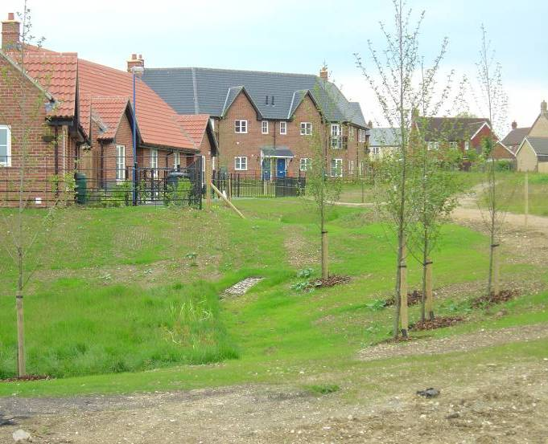
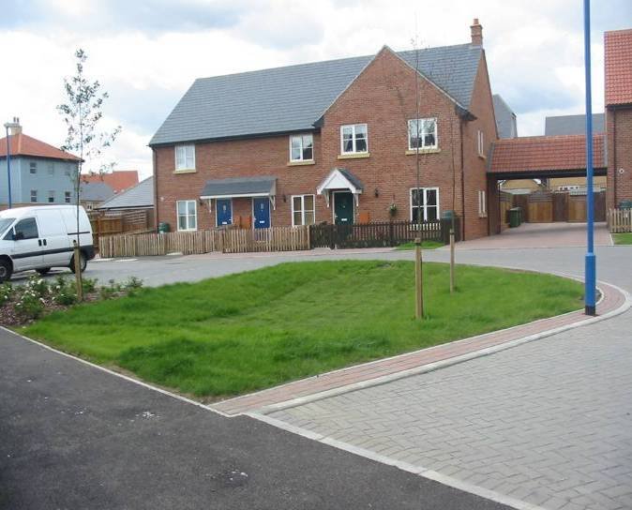
Site control
Cambourne
Detention basin – near entrance
Detention basin – near play area
Detention basin – near golf course (NE)
Notes:
Detention basins
Depressions designed to detain runoff for a period of time (primarily during extreme events).
The compete system and SuDS management train enables the development to meet flood risk management considerations and water quality criteria.

Slide 17
Construction and operation
Construction
Programme management
Silt management
Attention to detail essential
Inspection of works
Operation
Assess any H&S risks
Maintenance - landscape tasks
Simple checklist of tasks
Multiple adoption:
  Cambridge Housing Society – site care
  Wildlife trust – off-site care
  County council – permeable paving
Notes:
This slide covers aspects that required consideration during construction and operation
Construction
As well as good design, good delivery will also need good construction and maintenance.
Drainage is often the first thing to be put on site, with a SuDS scheme it needs to be checked last – so the construction programme may need to be amended.
SuDS are different (rather than more difficult to construct) biggest impact is silt management –programme management can reduce the problem. Good house keeping (like no storage of loose fines on permeable paving) needs to be encouraged.
Delivery on the Lamb Drove site could have been improved if contractors more closely followed the recommended construction programme and had a good attention to detail, in some places the levels were wrong and they used incorrect materials. Common challenges are around getting the levels and planting correct.
Operation
A simple health and safety risk assessment (as suggested by the SuDS Manual) should be undertaken. In this case the Royal Society for the Prevention of Accidents (ROSPA) undertook a health and safety review – gave it a clean bill of health.
SuDS at Lamb drove are primarily landscape maintenance, ie litter picking and mowing the lawn.
Maintenance needs to be simple and the maintenance plan should include a simple check list of maintenance tasks.
This was a long time before the Flood and Water Management. Securing adoption was a challenge, they had a multiple adoption arrangement:
Cambridge Housing Society – general landscaping and site care. Grass cutting litter picking and inlet/outlet
Wildlife trust – offsite features (landscaping) amenity objectives
County council – adopt permeable pavements (biannual suction sweeping)

Slide 18
Lessons learnt from Lamb Drove
SuDS philosophy is suitable for any development.
Early planning discussions are essential.
  Setting/agreeing the design criteria
  Consider/agree adoption mechanisms
SuDS design is interdisciplinary.
Well designed SuDS can be cheaper than traditional drainage.
Keep it simple.
Notes:
With good and innovative design the SuDS approach and philosophy can be used on any site.
Early planning discussions are essential, resolve design criteria (eg permitted flows) and consider adoption mechanisms. SuDS can’t be a last minute consideration.
SuDS design is interdisciplinary (landscape architects, engineers, ecologists etc). Good communication and simplicity is essential. SuDS features should be simple, visible etc
Consider communication with all stakeholders, outline:
How SuDS differ to traditional drainage (ie local, “safe” ponding)
Objectives/principles of SuDS
Need to obtain commitment – reduce chance of inappropriate improvisation and changes
The site has been well monitored and performance in terms of flood risk management, water quality and general amenity are very positive.
There was a £11k cost saving on construction (10% saving) – analysis of operation costs have yet to be undertaken.
There has also be kudos, Cambridgeshire Country Council got a commendation at the RTPI planning awards.
Delivers strategic objectives – inline with the vision set out in PPS25!

Slide 19
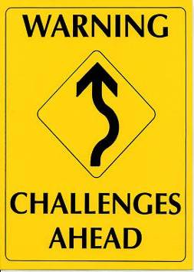
Possible challenges
Adoption and ownership – who does what?
What about existing problems
  Urban creep
  Retrofitting surface water management
Linkages with spatial planning (surface water management plans)
Delivering multiple benefits
Notes:
Adoption and ownership - Maintenance tasks are becoming increasingly better understood, the main challenge relates to who should undertake the maintenance and how this can be facilitated. This should be resolved with the commencement of Schedule 3 of the Flood and Water Management Act, anticipated sometime in 2012.
Existing problems – New build is difficult enough, but what to do with existing infrastructure problems. CIRIA is currently looking into developing guidance on this – which requires more partnerships and greater innovation.
Linkages with spatial planning – SuDS has linkages with spatial planning, urban design and surface water management plans. All of these can be used to help deliver SuDS principles. Many local authorities have SuDS policies in their core strategy and some are now developing their own SuDS guidance. Cambridge City has produced guidance as has the London Borough of Islington.
Delivery of multiple benefits – this will require stakeholder engagement and good interdisciplinary design – but it can be achieved and is synergistic with delivery of green infrastructure.

Slide 20
Summary
Many different components available to develop SuDS for a site.
SuDS are a flexible drainage concept that can be used on any site.
Specific constraints may preclude the use of some but not all components.
Notes:
20
A more sustainable approach to drainage can be embraced on any site.
SuDS can deliver multiple benefits and will help us manage regulatory and environmental challenges.
SuDS delivery will require good communication and engagement and partnerships.
SuDS can be delivered, there are variety of information sources available.

Slide 21
Sources of information
CIRIA:
    www.susdrain.org
EA:
    https://www.gov.uk/government/organisations/environment-agency
Natural Resources Wales:
    https://naturalresources.wales/?lang=en
SEPA:
    www.sepa.org.uk
Notes:
CIRIA has produced a variety of outputs to provide guidance and improve confidence in the delivery of SuDS and this is placed on susdrain. The website provides general information, case studies and outlines the guidance and training that is available.

