Slide 1
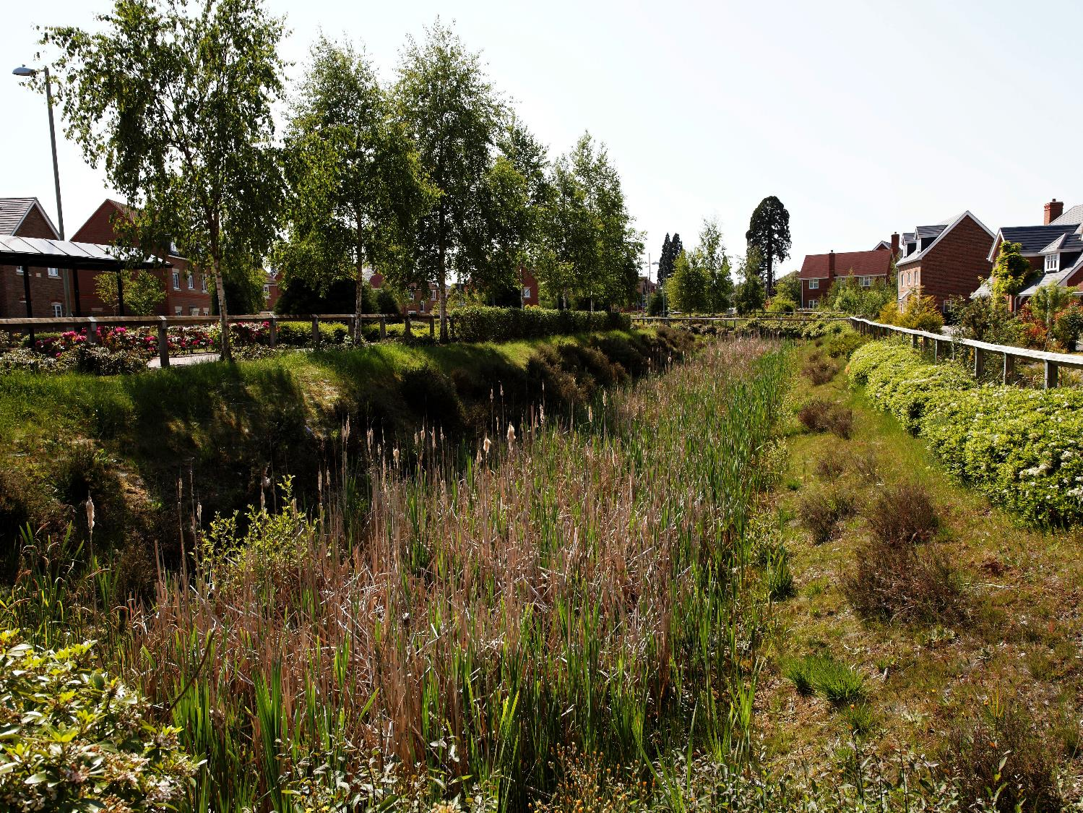



Using CIRIA’s B£ST:
Benefits Estimation Tool - Valuing the benefits of blue-green infrastructure
February 2019
Elvetham Heath, Hampshire
Notes:
This presentation provides an overview of
why we should evaluate the wider benefits of blue-green infrastructure, (including natural flood management and SuDS, referred to from hereon as BGI) as a water management approach and
the development and application of a tool developed by CIRIA: W047a B£ST: Benefits Estimation Tool - Valuing the Benefits of blue-green infrastructure.

Slide 2
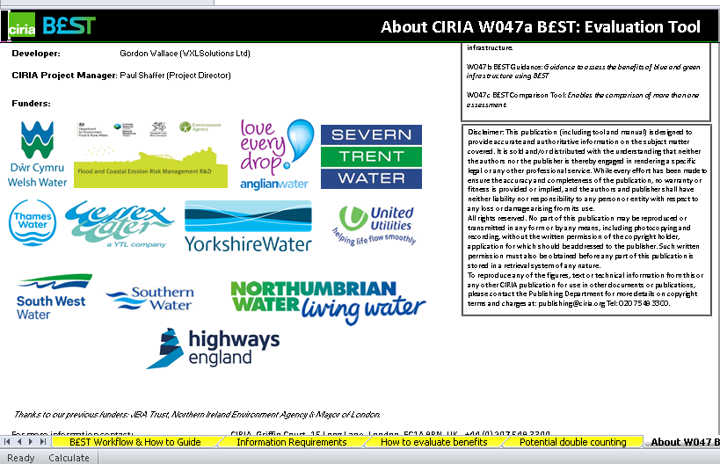
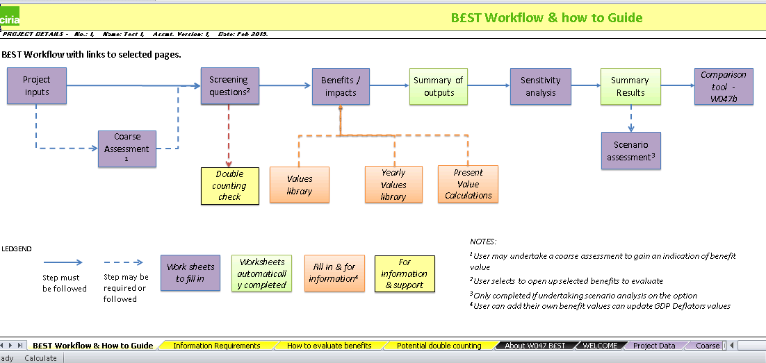
Benefits Estimation Tool
Supports:
  evaluation of benefits of BGI
  Collaborative decision making
  Business case development
Structured approach
Robust evidence base
Online guidance
Options comparison
Notes:
CIRIA has developed a tool and guidance, W047 B£ST to support practitioners to estimate the benefits that BGI can create.
Evaluating the type and magnitude of these benefits can otherwise be difficult, often requiring specialist economic inputs.
B£ST provides a structured approach to evaluating a wide range of benefits often based upon the system performance overall.
It follows a simple structure, commencing with a screening and qualitative assessment to identify the benefits to evaluate further.
Where feasible, it provides support to help quantify and monetise the benefit.
Automatically generates results.
A dedicated tool compares the results of different options under consideration.
Supports collaborative decision making and business case development.
The aim is to enable delivery of BGI using a robust evidence base and a consistent approach to assess its benefits to a wide variety of stakeholders.

Slide 3


Assessing benefits – why should we?
Elvetham Heath, Hampshire

Slide 4
Should we value benefits?
It is difficult to:
  Identify & link benefits to quantifiable outcomes
  Value quantified benefits (reliance on transfers)
  Aggregate (benefits, populations, time)
Uncertainty
Takes time and resources
Moral concerns
If we don’t, they are zero
Notes:
It’s difficult to evaluate benefits
To identify and link benefits, e.g. will BGI tangibly improve water quality? If so, by how much (e.g. change in good ecological status class) and over what length?
To value benefits - Pretty much all values in literature on benefits of BGI use ‘benefit transfer’ method. This raises questions about accuracy and reliability
To aggregate benefits – we need to avoid double counting across categories, identify beneficiaries, identify when benefits start/end and discount those occurring in the future
This leads to lots of uncertainty as there can be big differences or ranges in values in the literature. There are also some major gaps, e.g. contribution of BGI to jobs and investment
It takes time and resources to do valuation properly, hence the need for this work to provide assistance.
There are moral concerns about whether human-based valuation is valid (doesn’t cover intrinsic value).

Slide 5
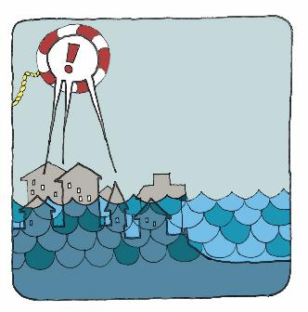

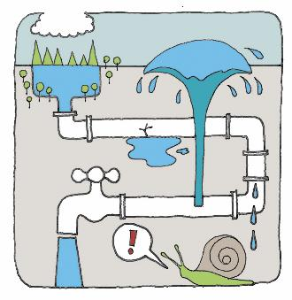
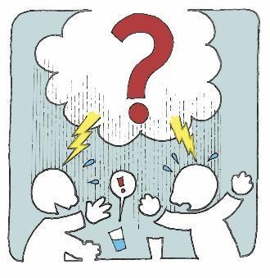
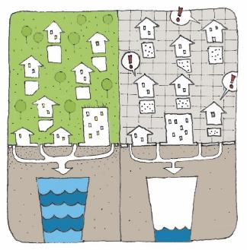

We have challenges now and in the future
Flooding – people and property
Water quality of urban watercourses
Connecting with water (on the surface)
Legislation and planning
Support growth – population & economy
Liveability – quality of life
Notes:
There are many important reasons why we need to manage surface water and create multiple benefits.
Here are 6 examples of the challenges / benefits that may be created and how BGI can contribute to meeting these challenges now or in the future

Slide 6
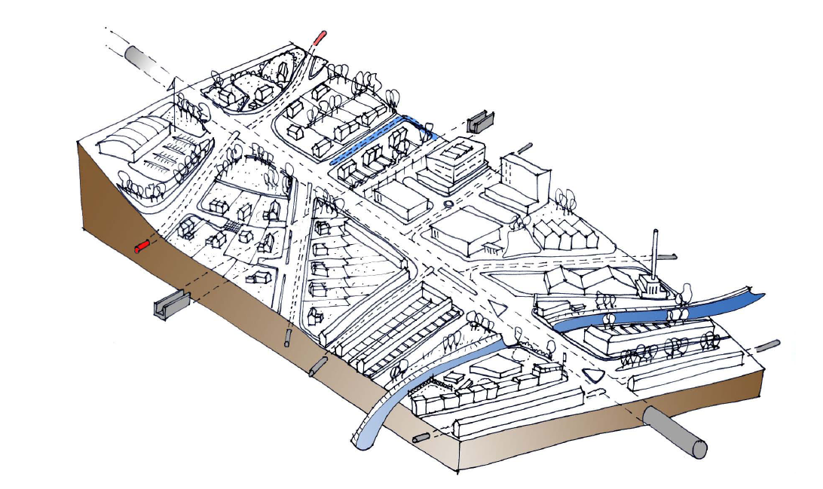
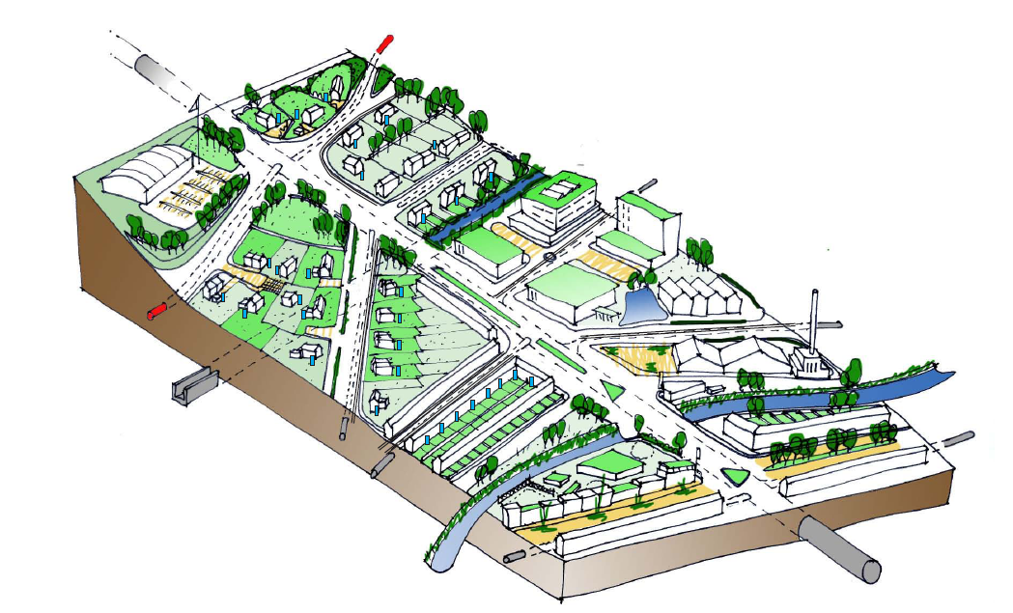
What is possible? How do we account for the benefits and should we?
Increase property value
Limit flows entering system
Enhance biodiversity
Improve thermal comfort
Provide education
Help manage air quality
Provide amenity and recreation
Enhance quality of urban space
Improve health and wellbeing
Maximise network capacity
Use as a resource
Improve water quality
Notes:
Local Authorities have the responsibility to balance up a number of competing demands. Taking an integrated BGI approach both from a retrofit and a new development perspective can help support these competing demands.
So if we take our existing urban areas or where we are developing – what is possible?
We can go beyond just visual enhancements and improvements (which we can spend money on without even thinking about the surface water), but contribute to achieving all these other benefits, depending upon the choices we make in our water management design integrated with its surroundings.
This won’t happen overnight, but we do need to start somewhere.

Slide 7
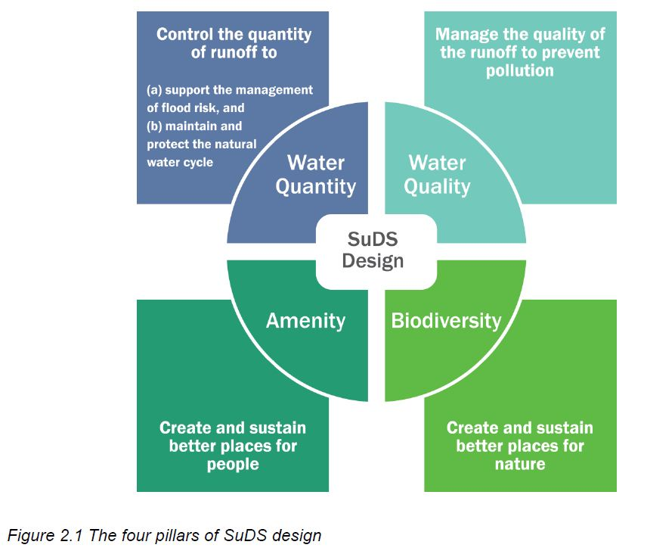
How do we change?
Sustainable Drainage Systems manage impacts from development on the quantity and quality of runoff, provide amenity and biodiversity as well as other potential benefits
The four pillars of SuDS
Notes:
So how might we achieve this change?
BGI provides the benefits expected from a conventional approach as well as many others. This is possible because BGI invariably enhances the area being developed and contributes to economic development and environmental quality.
SuDS (which include a range of hard and soft measures, green, grey and blue infrastructure) for both new development and retrofit can help us to meet the challenge.
SuDS have long been recognised to give us more than just water quantity control (benefit) but improve water quality, enhance amenity and biodiversity.
The (updated 2015) SuDS Manual can help with the design of these systems.

Slide 8
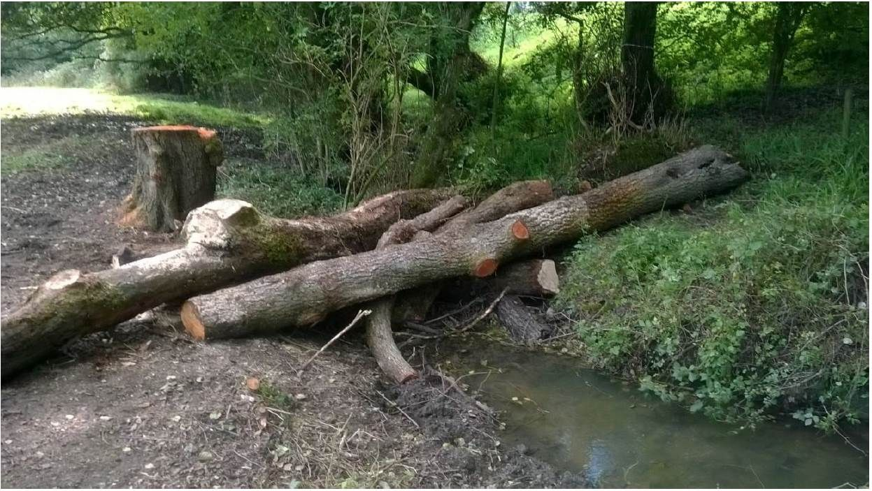
How do we change?
Natural Flood Management (NFM)
working with natural processes, features and characteristics to manage the sources and pathways of flood water
to protect, restore and emulate natural functions
‘Leaky dam’
Deliberately placed but
mimicking natural process of trees
falling across watercourses
Notes:
Many SuDS are the same as, or equivalent to, the measures used for NFM - in seeking to work with natural processes to protect and restore the natural functions of catchments.
NFM sets out to utilise, and where necessary enhance, naturally occurring land and other features in order to reduce the runoff from land surfaces, encourage interception and plant uptake, store or temporarily slow down flows and restore natural functionality to watercourses and ecological systems.

Slide 9
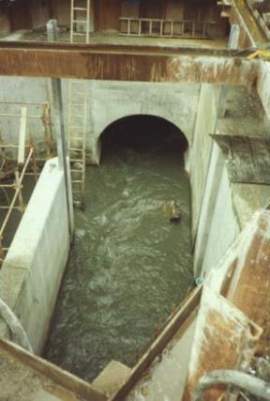
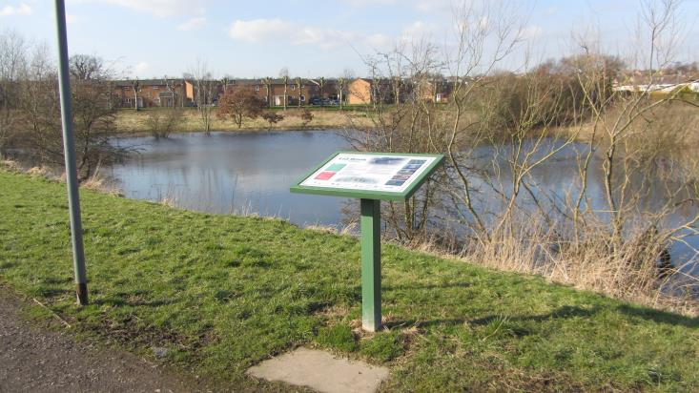
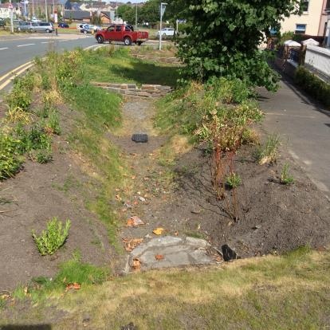
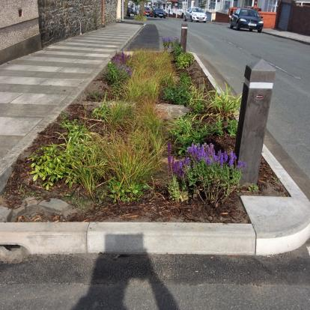
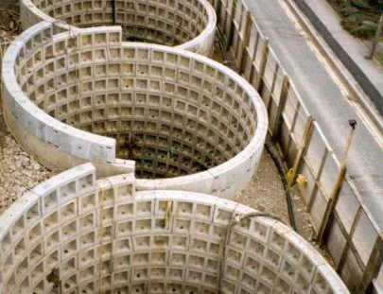
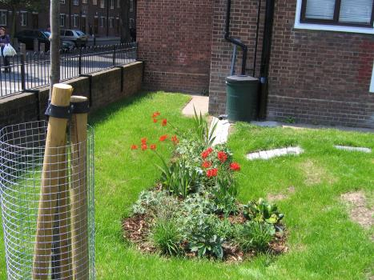
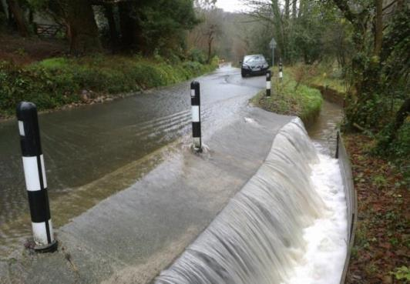
Surface water management approaches to cope with different size storms in different ways can create a range of benefits
Notes:
Its important to highlight here, this is not about the green brigade charging to fit green infrastructure, NFM or vegetative SuDS on a whim. This is about getting the balance to address the various quantity and quality challenges we face to come up with effective BGI.
Ultimately, its about getting the right combination, moving away from grey infrastructure only – to a more balanced equation.

Slide 10

Evaluating the benefits unlocks the potential for…
Fairer comparisons
Better decision making
Meeting funding requirements
Enabling conversations
Delivering BGI
Notes:
So how can evaluating benefits help? It:
Enables comparisons between different options by valuing the wider benefits
Supports making decisions by providing more information
Can help to meet other potential funders requirements
This in turn critically will help enable conversations between partners and stakeholders
Ultimately we believe it will help to deliver BGI

Slide 11
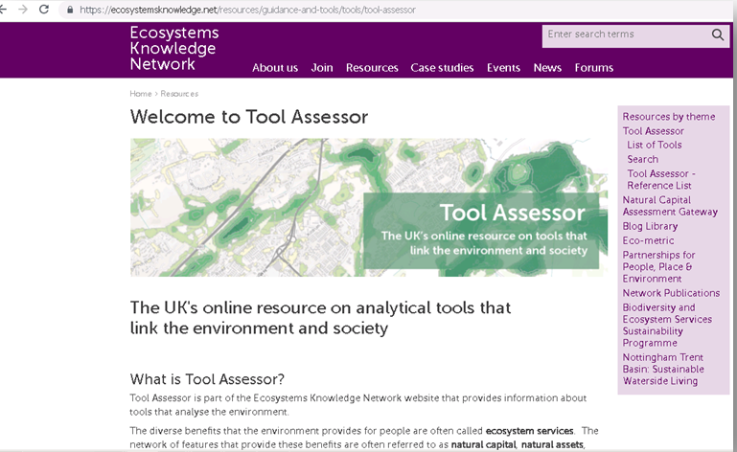
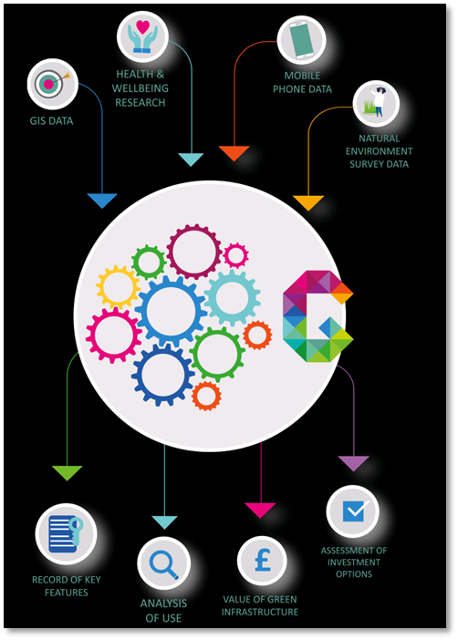
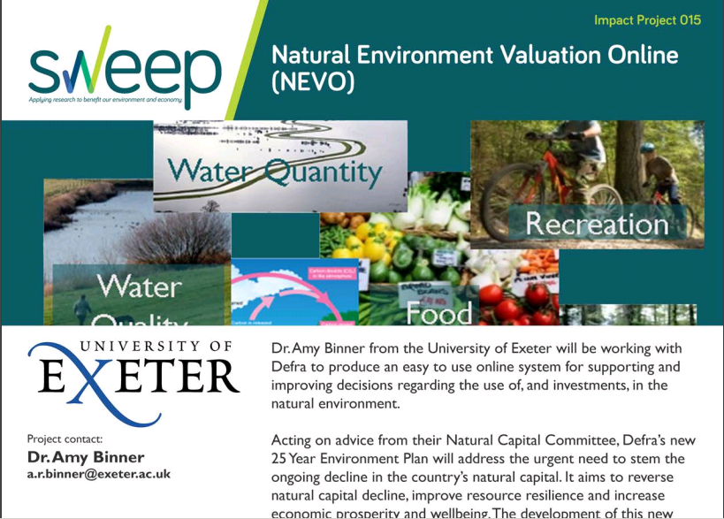
There are other tools…
Tool Assessor helps identify appropriate ones from the range
Greenkeeper - big data for GI
NEVO - spatial for land use plans
Notes:
The Ecosystems Knowledge Network has on online ‘Tool Assessor’ which is a starting point for people needing to identify tools for practical application; informing design, planning and management decisions relating to land, freshwater and coasts.
Two of these of particular relevance to B£ST are Greenkeeper and NEVO
Greenkeeper uses Big Data from a range of sources to understand how people use and value urban green infrastructure.
The NEVO tool is a map-based decision support tool to inform decisions that affect the natural environment of England and Wales. It makes use of state-of-the-art environmental and economic models developed by the University of Exeter in a user-friendly interface. The tool assesses the value of ecosystem services relating to agriculture, recreation, forestry, carbon emissions, biodiversity and water quantity/quality.
Neither focus specifically on Blue-Green Infrastructure

Slide 12
Overall aim of B£ST
The overall aim of B£ST is to collate and present evidence and to share an approach to assess and value the multiple benefits of blue-green infrastructure and Natural Flood Management
Notes:
B£ST aims to help enable delivery of BGI using a robust evidence base and a consistent approach to assess its benefits to a wide variety of stakeholders.
Specific objectives include to:
Improve and raise awareness of evidence on the benefits and business case for BGI, particularly retrofit projects.
Support collaboration using a valuation framework that facilitates partnerships and making the business case for partnership funded schemes.

Slide 13












Thanks to our funders
With thanks also to our previous funders: JBA Trust,
Northern Ireland Environment Agency
Mayor of London
Notes:
As always, thanks to:
The project steering group,
Industry testers,
and those who have provided Case Studies.
Without their help, this project would not have been completed.

Slide 14

Introducing B£ST (W047)
Elvetham Heath, Hampshire
Notes:
The next few slides introduces the approach taken to develop B£ST, reasoning and some key components of the tool.

Slide 15
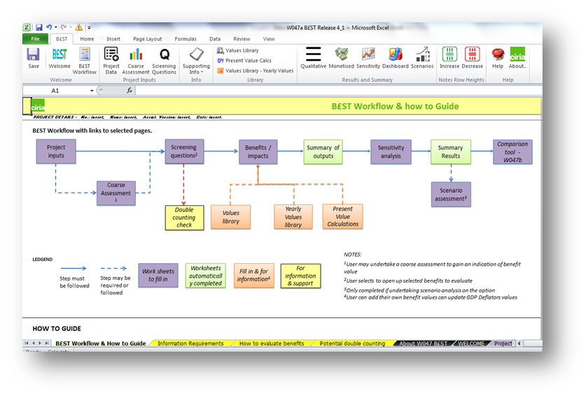
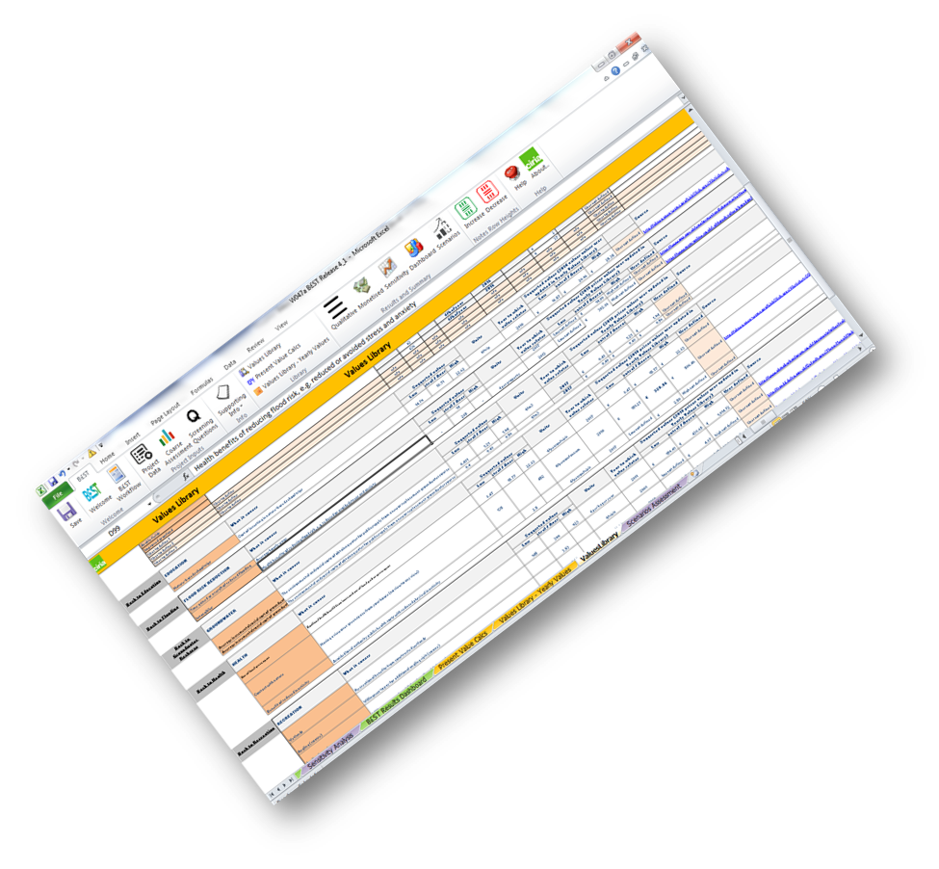
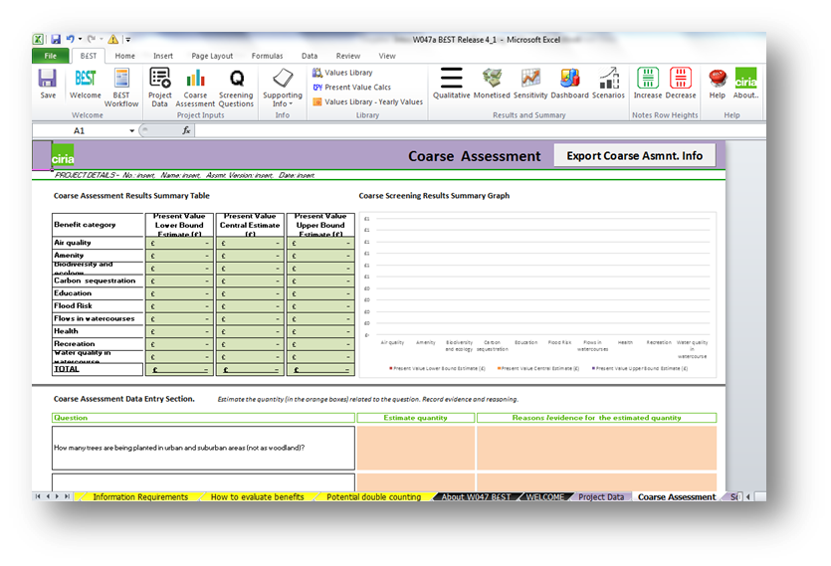


B£ST: Benefits EStimationTool
Collates evidence (values)
Structured assessment approach
Considers confidence
Supports practitioners to qualify and quantify (monetise) benefits
Compares options
Provides for detailed audit trail
Notes:
B£ST devised by Stantec, (Dr Bruce Horton, Prof Chris Digman and Jordan McMullan), Prof Richard Ashley of EcoFutures (and various universities) along with support from a wide number of colleagues covering various disciplines.
B£ST aims to support practitioners to evaluate the multiple benefits of blue-green and wherever possible, determine the estimated monetary benefit. Developed by practitioners across a number of disciplines (such as drainage, landscape architecture, ecology, economics).
Collation of evidence (values) –over 500 values considered from 100s of papers, led by an environmental economist to look at quantities and monetised values and how they had been assessed, where and when. Followed an impact pathway approach.
Structured assessment approach - logically walks the user through an assessment, which can be quite a challenge when not knowing where to start. Its important to note that B£ST is built in excel 2010 and 2013 due to the available functionality.
Considers confidence –confidence values are applied to avoid falling into the trap of over-estimating what the benefits are.
Support practitioners to qualify and quantify (monetise) benefits – the tools provides structure for the user to think about the impacts that will take place (it is not a black box), and asks the user to qualify and then quantify benefits.
Compare drainage options – where more than one option is being considered, the tool can be used more than once, and the results copied into the comparison tool to enable simple comparisons and graphs to be automatically generated.
Provision of detailed audit trail – the tool holds all the information entered and encourages the user to record reasons for decisions, e.g. sources of supporting evidence / potential sources of disagreement

Slide 16
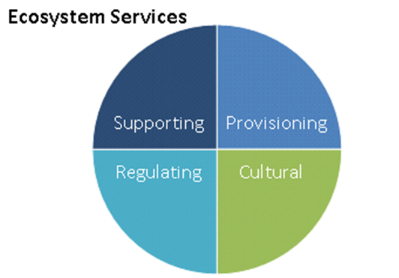
Wide range of benefits
Benefit category | Monetised
Amenity | ✓
Asset performance | ✓
Biodiversity and ecology | ✓
Building temperature | ✓
Carbon reduction and sequestration | ✓
Crime | ✗
Economic growth | ✗
Education | ✓
Enabling development | ✓
Flooding | ✓
Health | ✓
Noise | ✓
Recreation | ✓
Tourism | ✗
Traffic calming | ✓
Water quality | ✓
Water quantity | ✓
Environmental
Supporting
Provisioning
Cultural
Notes:
These are the benefits currently included in the tool and which ones can be monetised with confidence (indicated by a tick).
Others can be qualified – or if the user has some local information from surveys (or there has been information published not yet incorporated into the tool), it can still be monetised. Beyond this also, there are user defined benefits to account for categories not included here.
The benefits are then summarised in a series of graphs and linked to Ecosystem Services (ESS) categories.

Slide 17
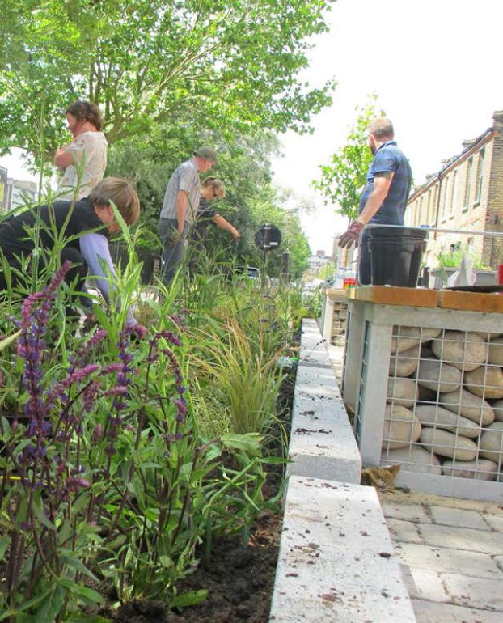
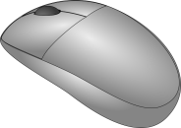
B£ST has three components
Tools
W047a
Benefits Estimation Tool
Support
Wo47b
Guidance
W047c
Comparison
Tool
Notes:
There are 3 parts to B£ST:
W047a B£ST – Benefits Estimation Tool – Valuing the benefits of blue-green infrastructure (referred to in the guidance as ‘the tool’ or B£ST). A structured spreadsheet tool that estimates a wide range of benefits linked with BGI based upon the values and decisions made by the user;
W047b B£ST Guidance – Guidance to assess the benefits of blue and green infrastructure using B£ST. Provides background to the tool, data, and how to complete an assessment. The tool has direct links to appropriate sections of the guidance.
W047c B£ST - Comparison Tool – A summary spreadsheet that creates graphs and compares options where more than one option is ‘run’ through the Estimation tool.

Slide 18
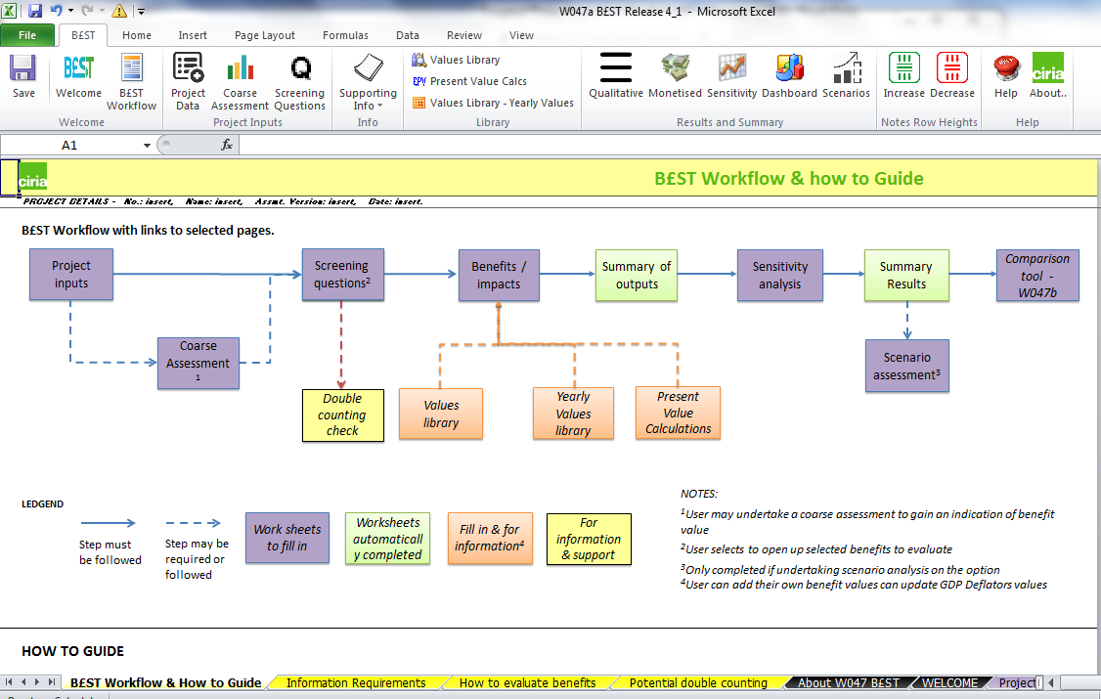
Using B£ST – workflow
Notes:
The next slides go through the key steps for completing an evaluation, following the workflow guide.
The first step is to record project details.
If at this stage it is uncertain whether a detailed assessment of benefits is appropriate, a coarse assessment can be carried out (or by-passed if a full evaluation is needed).

Slide 19
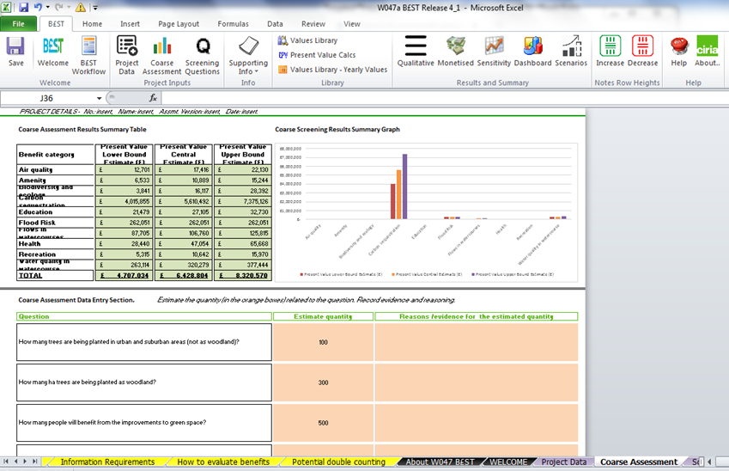
Using B£ST – Coarse assessment
Notes:
The coarse assessment allows a high-level assessment of ten of the most significant benefits associated with BGI to be undertaken quickly and with very limited input information.
As such, it can only provide a very broad indication of the range of potential benefits from any given BGI scheme and should not replace a full assessment.
It is based on a number of key questions, responses to which are linked to quantified variables and monetary estimates that are combined to produce an overall value in each of the ten benefit categories.
Appropriate confidence scores and a discount rate are applied to a default assessment period of 40 years to produce a total benefit estimate.
A simple results dashboard is included in this part of tool and comments can be recorded, e.g. about what decisions have been made and why.

Slide 20
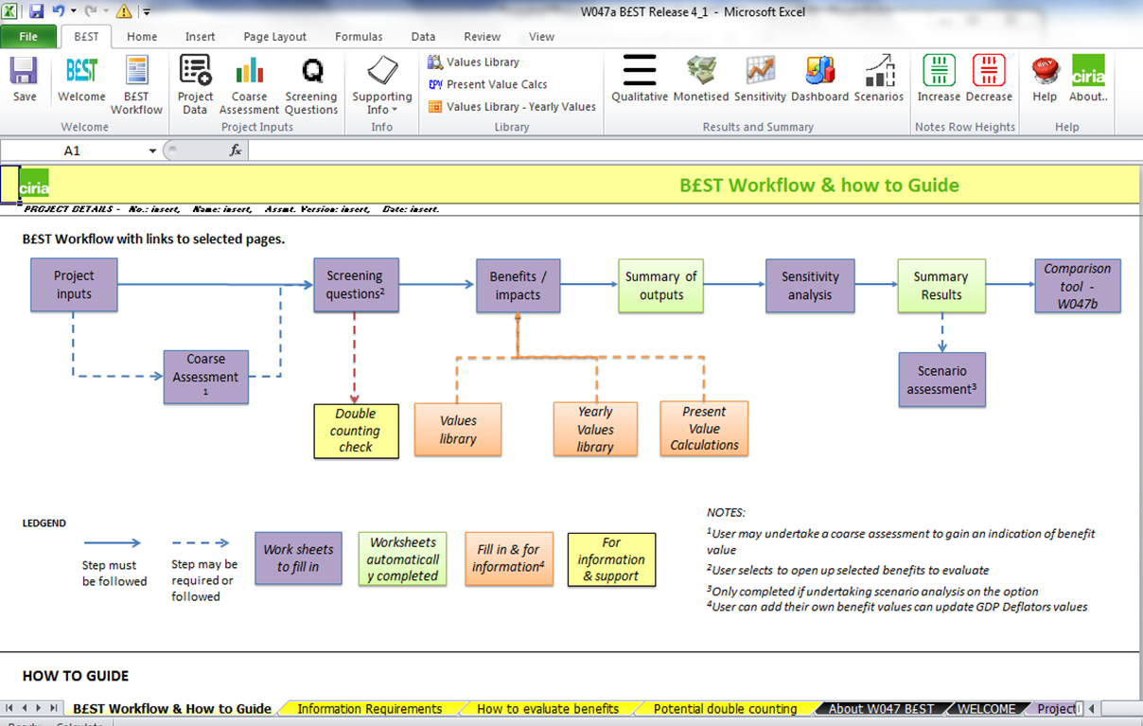
Using B£ST – workflow
Notes:
Following a decision to proceed with an assessment of benefits, the next step is to complete the screening.

Slide 21
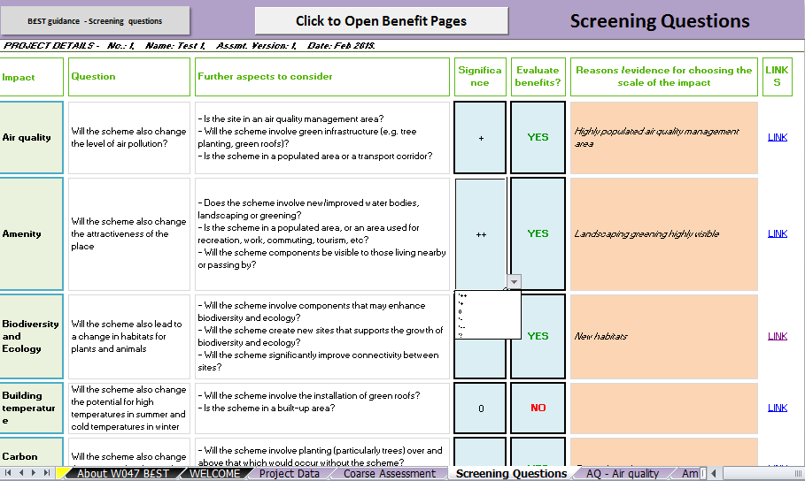
Using B£ST – Screening questions
Notes:
The aim of screening is to help the user think what benefits to evaluate, and their potential impact, with space to record reasons. Some will be obvious, others need a little more thought.
For each of the benefit categories covered by the tool, the user must decide whether there are likely to be significant benefits (or dis-benefits) arising from the scheme, so if the answer is YES, the scale of impact should be chosen from the drop-down choices:
significant positive ++
minor positive +
not significant 0
minor negative -
significant negative --
or unknown ?
Text added here in support of the decision is automatically transferred to the ‘qualitative’ section of the relevant benefit sheet.
Screening determines which benefits are evaluated. If YES is selected, the relevant benefit tab will open following a click on ‘Click to Open Benefit Pages’. Therefore it is a crucial part of the evaluation tool.
(The benefit tabs can also be accessed by following the LINK).

Slide 22

Using B£ST – workflow
Notes:
The next optional step is a double counting check, which is an opportunity to reconsider the benefit categories chosen.

Slide 23
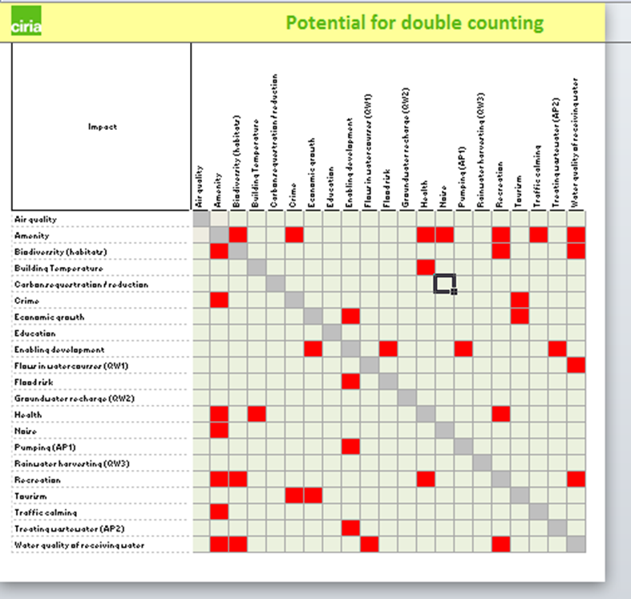
Using B£ST – avoiding double counting
Notes:
There are two potential sources of double counting in an economic assessment:
overlap between benefit categories; and
using benefits transfer values that include more than just the specific benefit being valued.
Although this cannot identify all potential sources of double counting, use this as a guide to indicate where there is a risk of double counting of benefits.
Where it highlights a risk of double counting across different impact categories consult the relevant parts of the guidance and take special care to check that this risk is avoided or minimised.
It may still be the case that impacts do indeed exist in more than one of the categories highlighted in red and therefore should be assessed.
For this reason, we have not blocked the assessment of multiple benefit categories in the tool.

Slide 24
Using B£ST– workflow
Notes:
The next step is to evaluate the benefits that were selected to have an impact within the screening questions.
For example, 5 benefits were selected at this stage, those 5 tabs would become available when the ‘Click to open benefits’ button was selected.
A few examples of the benefit sheets follow.

Slide 25
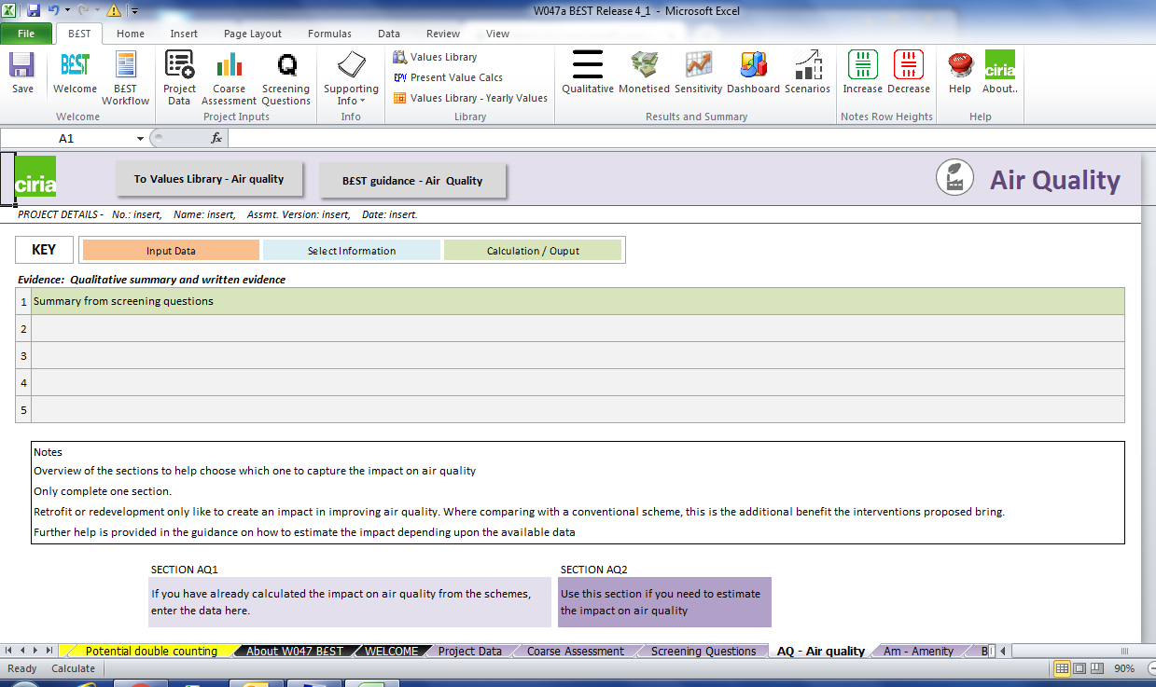
Using B£ST– example benefit sheet
Notes:
Each benefit sheet has a similar look and feel to it.
If an independent assessment has been undertaken, the values and calculation can be used within the tool.
If not, the tool provides one or more approaches to enable evaluation of the potential benefits.
The appropriate section of the guidance can be accessed by clicking on the link.

Slide 26
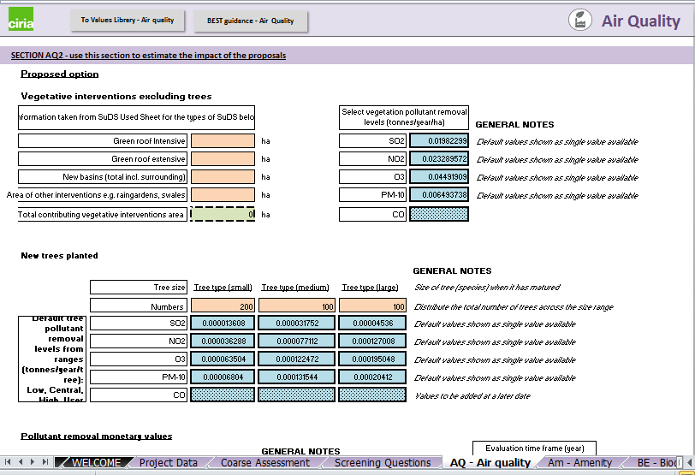
Using B£ST– example benefit sheet: air quality
Notes:
Colour coding/formatting is used to indicate the boxes to fill in:
Green (dotted): information automatically comes in from other cells entered (such as the present value calculations before and after applying confidence)
Orange: user enters values (some are limited by the ranges such as the years for the start and finish of the evaluation period)
Blue (bold outline): these contain information for the user to select, such as values identified from literature that may be appropriate to use or the confidence values to apply (25%, 50%, 75%, 100%).

Slide 27
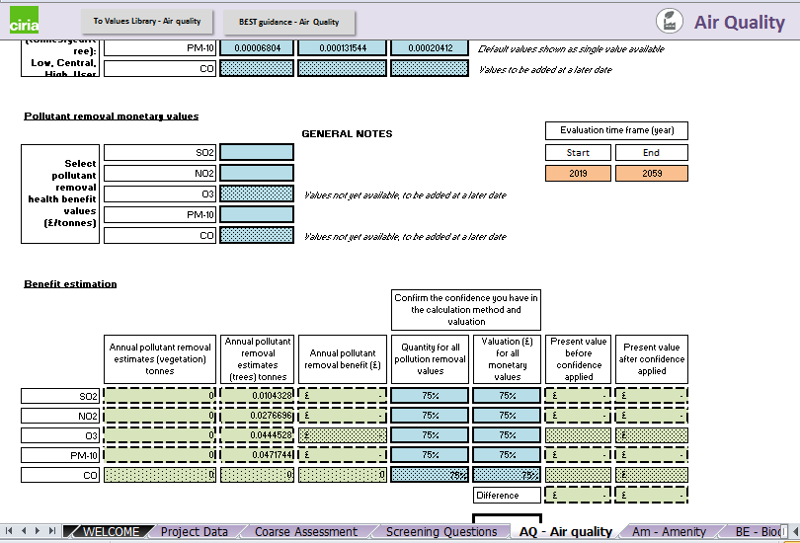
Using B£ST– example benefit sheet: air quality

Slide 28
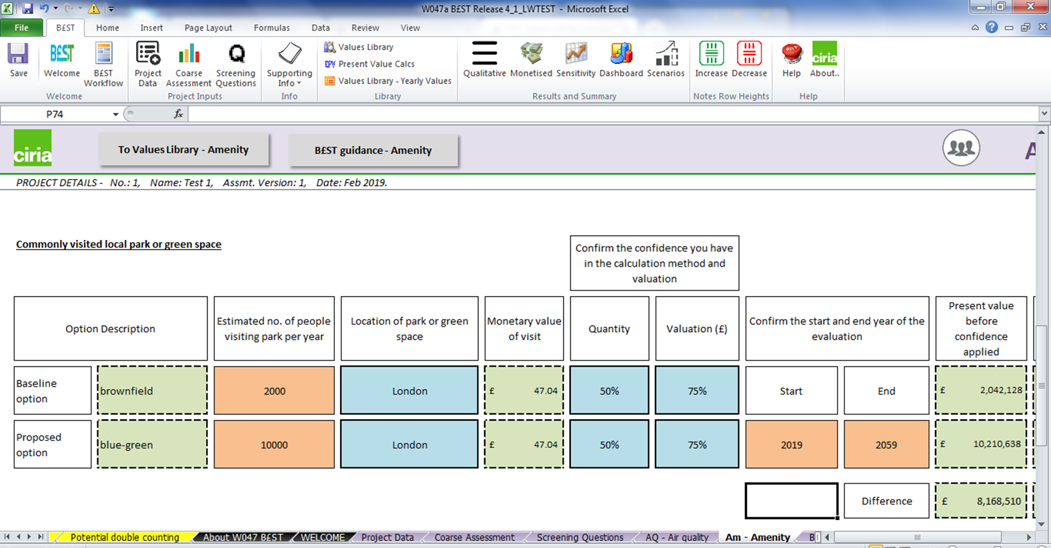
Using B£ST– example assessment: amenity

Slide 29
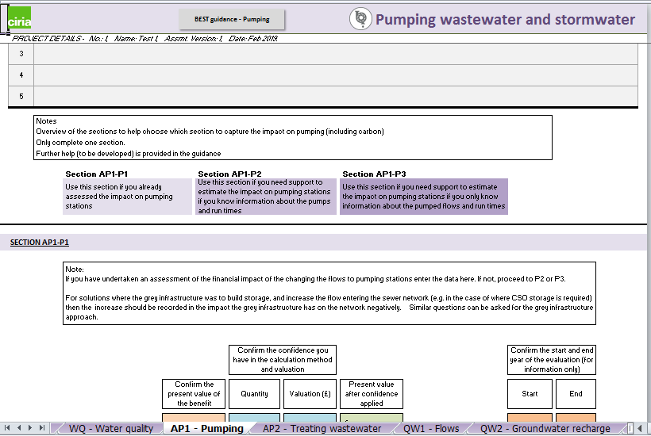
Using B£ST– example benefit sheet: asset performance

Slide 30
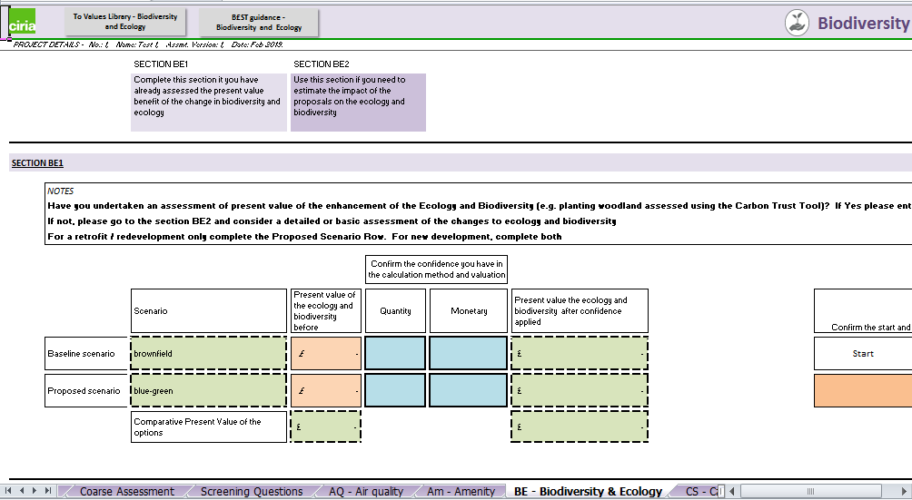
Using B£ST– example benefit sheet: biodiversity & ecology

Slide 31
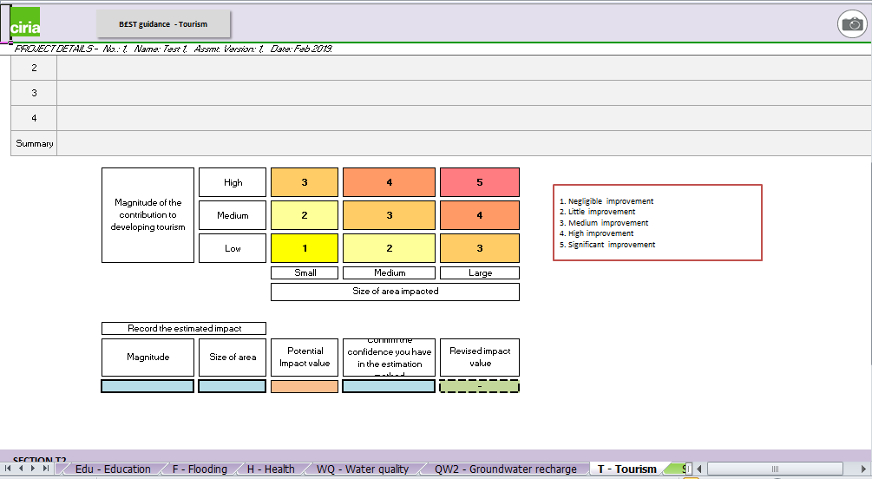
Using B£ST– example benefit sheet: tourism

Slide 32
Using B£ST– workflow

Slide 33
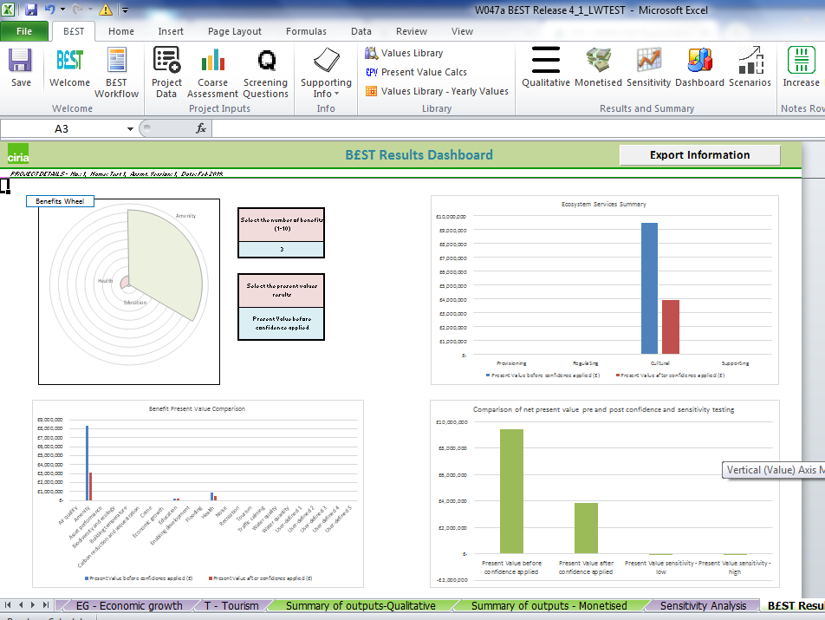
Using B£ST– results dashboard
Notes:
The tool automatically summarises and presents the results of the assessment based on an assumed 2018 base year (this can be adjusted by the user). Several graphs, tables and other information are automatically generated. These are offered to help the user and can be copied directly into presentations and reports.
Results are collated under:
Summary of outputs – Monetised: this brings together all the key information for all benefits (whether evaluated or not) including the present value of the benefits (pre and post confidence), confidence values and the start/end year of the evaluation for each benefit. This includes a colour coding that indicates which benefits are greater than 10% of the overall monetised values;
Summary of outputs – Qualitative: this tabulates the non-monetised impacts that have been subjectively scored; and
B£ST Results Dashboard: this provides automatically generated graphs and tables, which summarise the key outputs of an assessment, and can be manipulated to suit users’ needs. This is through bespoke menus or through graph functionality within excel.

Slide 34
Using B£ST– workflow
Notes:
Sensitivity analysis enables the user to alter the confidence scores and time range to determine their influence on the results.

Slide 35
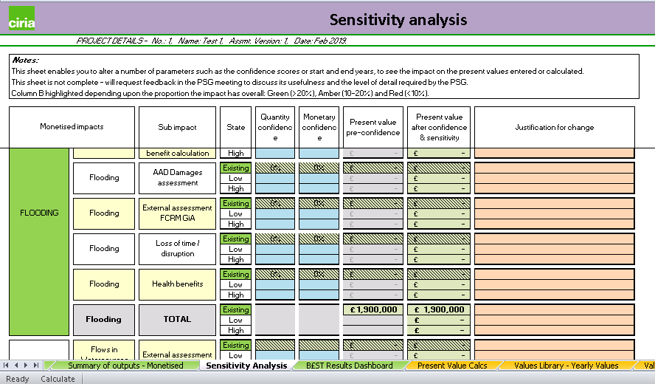
Using B£ST– sensitivity analysis
Notes:
This sheet enables you to alter a number of parameters such as the confidence scores or start and end years, to see the impact on the present values entered or calculated.

Slide 36
Using B£ST– workflow
Notes:
Scenario assessment supports thinking about different possible futures.

Slide 37
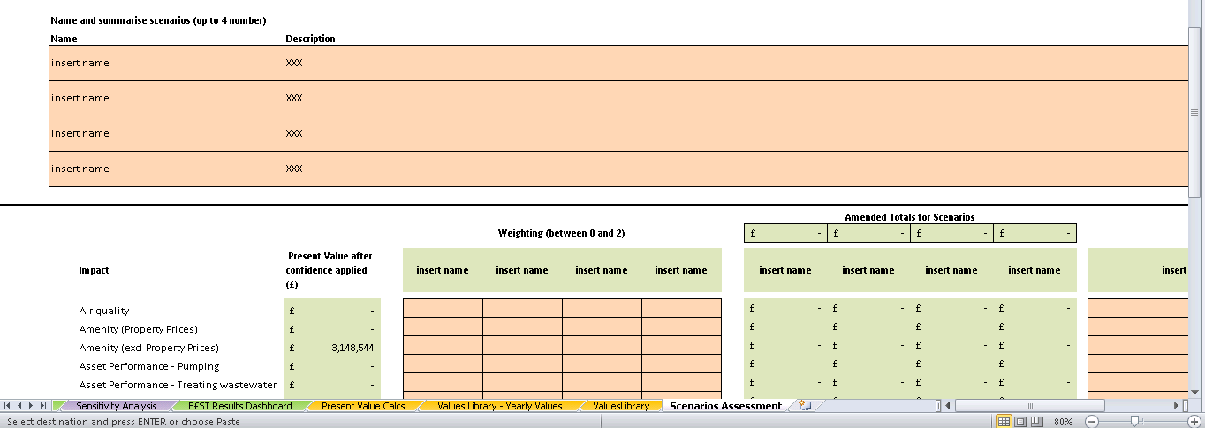
Using B£ST– scenario assessment
Notes:
A BGI scheme may be a one-off or part of a process that sees stages of implementation over time.
Scenario assessment enables consideration of how the system will respond under possible future changes in conditions (e.g. climate) or in what society expects the system to provide (e.g. arising from economic or behavioural changes).
The guidance aligns with Environment Agency standard practice for FCERM schemes and is set out step-by-step to provide a template for including longer-term considerations for BGI designers, planners and those advising policy and decision makers.
This approach can help support the engagement of stakeholders and communities if these stakeholders can identify that potential future benefits are important to them.

Slide 38
Using B£ST– workflow

Slide 39
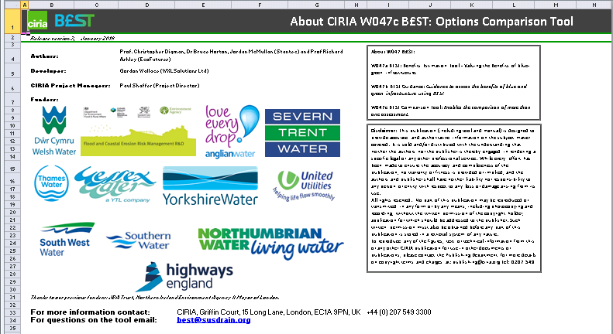
Using B£ST– Comparison Tool W047b
Notes:
The Option Comparison Tool enables data from more than one ‘simulation’ of B£ST to be copied and compared with the overall net present cost, benefit and value.

Slide 40
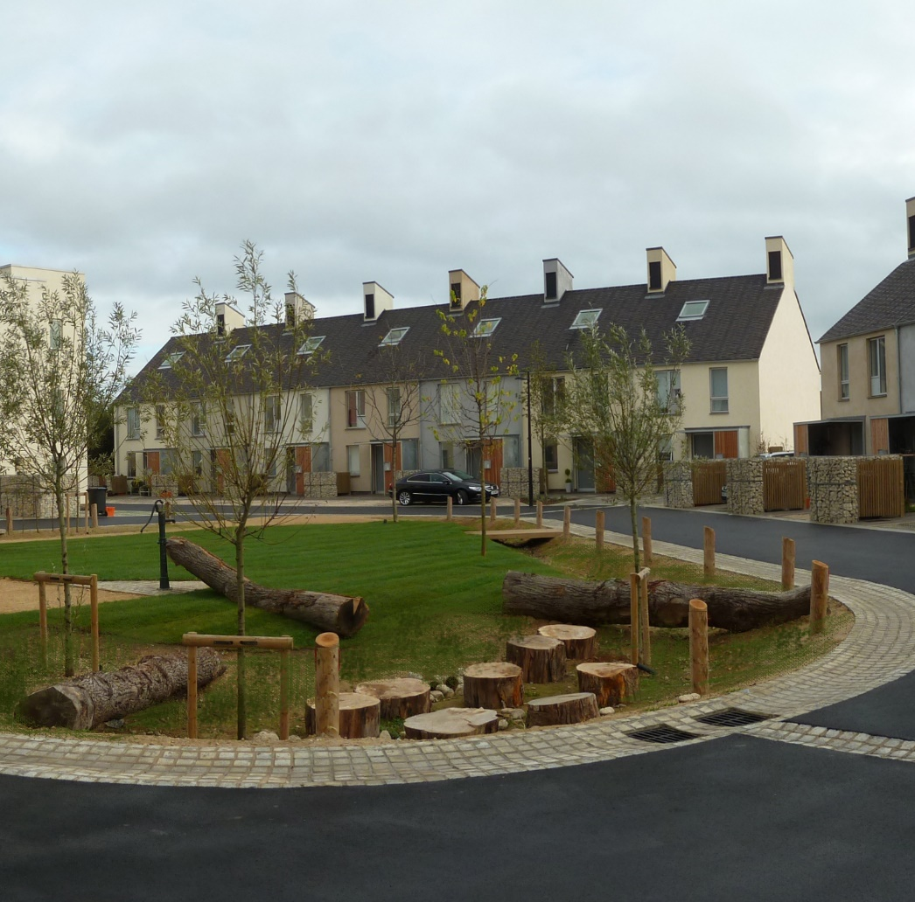
Thank you
Want to know more?
http://www.susdrain.org/resources/best.html
best@susdrain.org
Studio Engleback, Curtins Consulting & Kevin McCloud
Notes:
If you want to know more, please visit susdrain or email us

