Slide 1

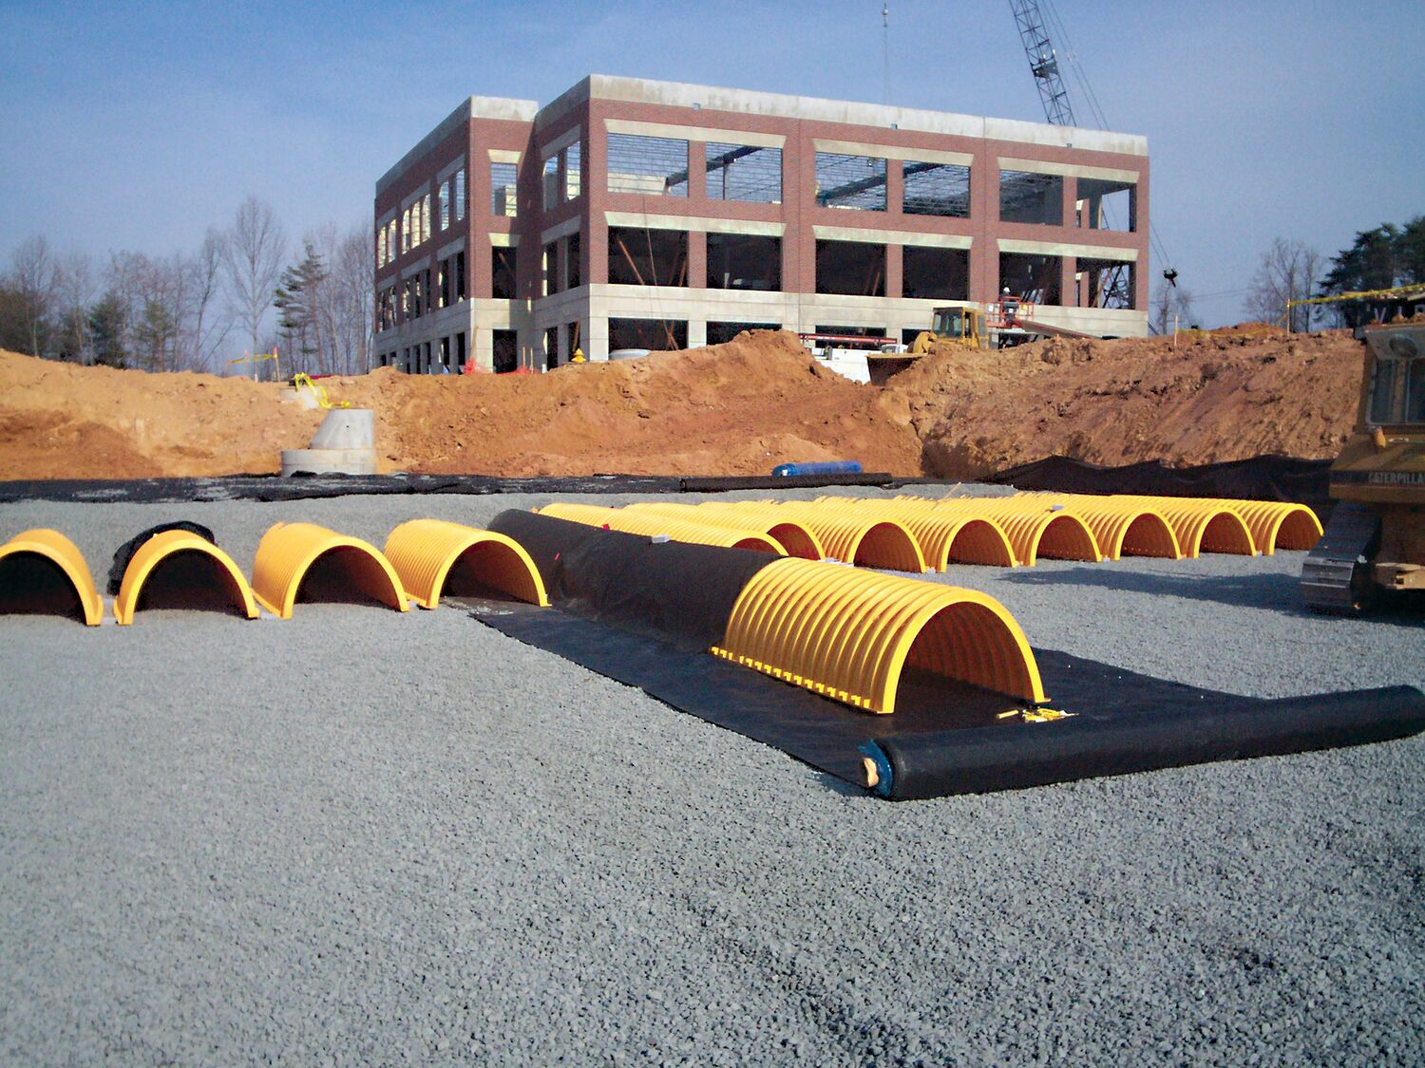
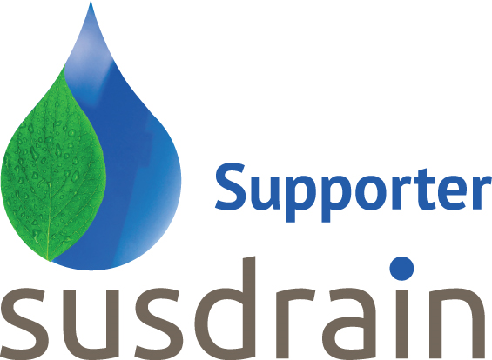

Standards, Certifications and Approvals for proprietary below ground SuDS attenuation assets
do they really do what it says on the tin?
Stuart Crisp
UK Manager
Advanced Drainage Systems

Slide 2
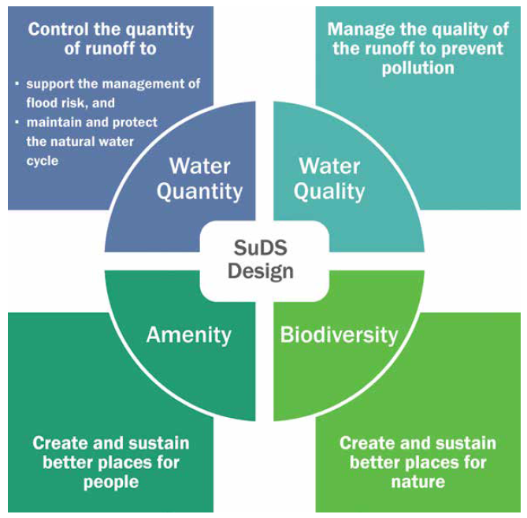
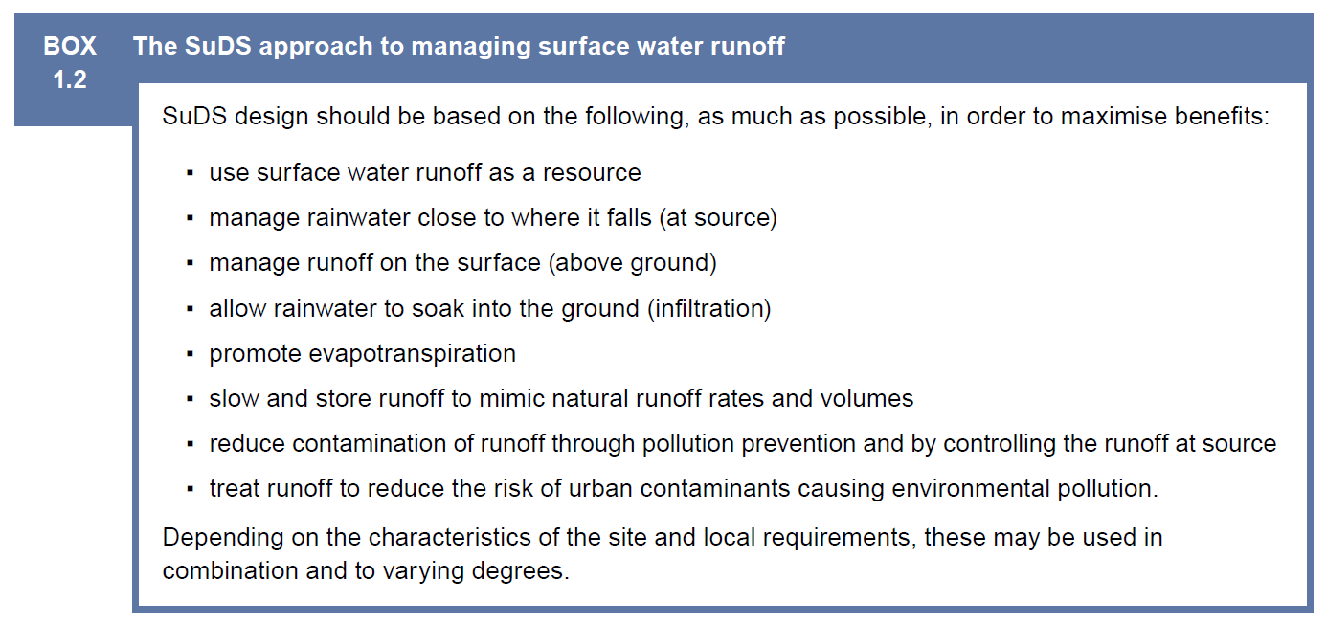
SuDS Philosophy: Mimic natural hydrological processes
Notes:
“Mimicking Nature” is the fundamental basis upon which SuDS is built.
Runoff dealt with as close as possible to where rainfall lands, i.e. on the surface.

Slide 3
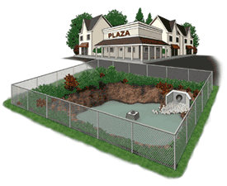
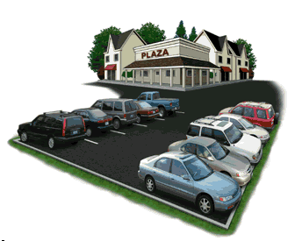
Why Go Underground…
Ponds:
Can take up developable space
Safety hazard?
Seasonal smell & insect nuisance?
Capable under high pollutant loading?
Maintenance costs?
Below-ground attenuation:
Can unlock more developable space
Can be used to augment surface storage
May reduce insurance liability
Quantifiable performance
Notes:
It is usually the cost of land that motivates a developer or engineer to design a subsurface system.
Ponds may fall out of favour for other reasons such as:
can be quite ugly as debris, shopping carts and slope erosion deteriorate the pond
cars have driven into ponds and children have drowned in ponds. They can be a safety hazard and can drive insurance costs up
aquatic insects including mosquitos can become an issue

Slide 4
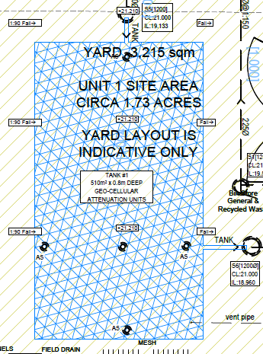
Planning, design, installation and adoption/operation of below-ground SuDS attenuation assets requires due diligence to ensure they are fit for purpose.
Below ground attenuation devices for sustainable drainage systems (SuDS), are often considered a commodity.
The tendency can be to fit the lowest cost option, given the volume of water required by the engineer’s design.
How can the ultimate asset owner be sure it will function as intended 10, 20, 50+ years down the line?
The long-term performance, maintenance and repair costs need to be assessed in order to agree the commuted sum that a developer pays when handing over the asset to the adopting body
Notes:
Historically, drainage has focused on hydraulic and structural performance.
This is where education and expertise exists in abundance.
Nevertheless, Compliances with Standards, Certifications and Approvals is not always defined or enforced.
Water Quality & aspects of pollution mitigation is understood less well across the supply chain.
We now need joined-up designs considering water quantity and water quality.
This requires an understanding of the nuances and inter-relationships between these areas.

Slide 5

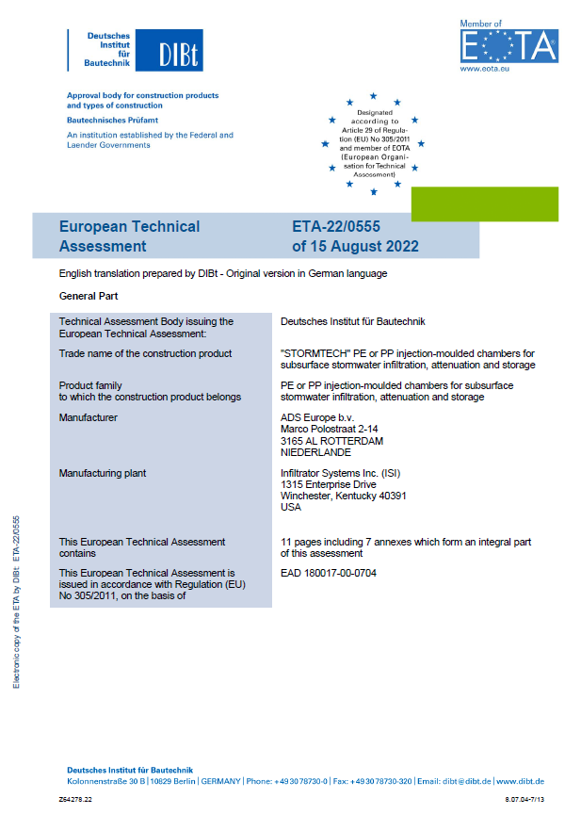
Due diligence required to check product compliance with all the necessary standards, certifications and approvals.
CE Mark
CE marking indicates that a construction product is in conformity with its declared performance and that it has been assessed according to a harmonised European standard or a European Technical Assessment has been issued for it.

Slide 6
Standards & Certifications
Products must conform to the relevant standards in terms of
(i) functional performance – governed mainly by evaluation, management and testing of the product’s material properties, manufacturing processes, geometry & dimensional tolerances.
(ii) structural design process.
British Standards (BS) are the most well known in the UK. In some cases, a harmonised standard, accepted by multiple nations, could apply, designated BS EN or BS ISO.
There cannot be more than one standard covering the same scope in any territory.

Slide 7
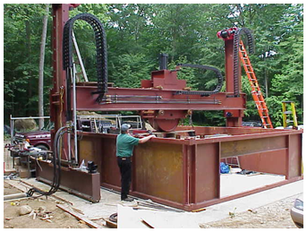
Structural performance
Structural design should be based on the Eurocode methodology.
Eurocode 1, EN 1991-2, sets out load cases, such as the weight of material above a SuDS attenuation asset and dynamic traffic including braking forces and fatigue due to cyclic loading.
Different sizes and designs of crates, pipes or arches can take greater or lesser loadings, depending on their geometry and material properties and the nuances of the installation design.
Table of Standards Relevant to Structural Design
EN 1990 | Basis of structural design
EN 1991-2 | Eurocode 1 - Actions on structures; Part 2 – Traffic loads on bridges and other civil engineering works
EN 1997-1 | Eurocode 7 - Geotechnical design

Slide 8
Structural performance
Guidance for the minimum and maximum cover for a product and the short- and long-term loading must be followed precisely.
A product is structurally adequate under Eurocodes if installed under the same conditions as the manufacturer’s design checks.
Eurocode 7, EN1997-1, is the methodology for geotechnical design requirements.
The level of supervision required during construction should be stated by the designer and the conditions that need to be checked.
Table of Standards Relevant to Structural Design
EN 1990 | Basis of structural design
EN 1991-2 | Eurocode 1 - Actions on structures; Part 2 – Traffic loads on bridges and other civil engineering works
EN 1997-1 | Eurocode 7 - Geotechnical design

Slide 9
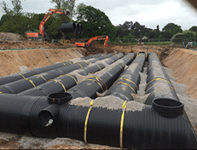
Product specifications: pipes
Pipes should be designed to BS 9295 to ensure their structural performance.
When pipes are laid in parallel, as is often the case for below-ground SuDS attenuation applications, a different approach to structural design is usually required compared with pipes laid as a single run.
For concrete pipes, BS EN 1916 and BS 5911-1 provide the details for product specifications.
Product specifications for plastic pipes should meet BS EN 1401-1 for solid wall pipes and BS EN 13476 for structured wall pipes made of HDPE, PP or PVC-U.
Table of Standards Relevant to large diameter pipes
BS 9295:2020 | Guide to the structural design of buried pipes
Table of Standards Relevant to Concrete large diameter pipes
BS EN 1916: 2002 | Concrete pipes and fittings, unreinforced, steel fibre and reinforced
BS5911-1 | Concrete pipes and ancillary concrete products (recently updated to align with Eurocodes)
Table of Standards Relevant to Plastic Pipes
BS EN 1401-1 | Plastics piping systems for non-pressure underground drainage and sewerage. Unplasticized poly(vinylchloride) (PVC-U): Specifications for pipes, fittings and the system
EN 13476 | Plastics piping systems for non-pressure underground drainage and sewerage – Structured-wall piping systems of unplasticised polyvinyl chloride (PVC-U), polypropylene (PP) and polyethylene (PE)
EN 14758. | Plastics piping systems for non-pressure underground drainage and sewerage - Polypropylene with mineral modifiers (PP-MD)

Slide 10
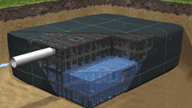
Product specifications: crates
Needs to account for creep; creep is the tendency to deform permanently over time under a constant stress.
Structural assessments must consider
  short-term loading e.g. traffic
  long-term loading, e.g. weight of material over the tank and lateral earth loads.
Use BS EN 17150, 17151 and 17152-1, with material tests, to determine characteristic long-term and short-term strengths & specifications.
Table of Standards Relevant to Crates
CIRIA C737 | Structural and geotechnical design of modular geocellular drainage systems
BS EN 17150 | Plastics piping systems for non-pressure underground conveyance and storage of non-potable water. Test method for determination of short-term compression strength of boxes.
BS EN 17151 | Plastics piping systems for non-pressure underground conveyance and storage of non-potable water - Test method for determination of long-term compression strength of boxes
BS EN17152-1 | Plastics piping systems for non-pressure underground conveyance and storage of non-potable water - Boxes used for infiltration, attenuation and storage systems Part 1: Specifications for storm water boxes made of PP and PVC-U

Slide 11
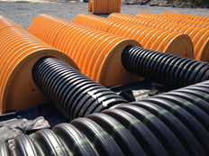
Product specifications: arches
The elliptical profile can ‘shed’ load into the stone. The embedment forms structural arches, adding to the strength of the system. The arch-shaped chambers can be used at shallower cover and deeper invert depths than many alternative systems.
Short-term and long-term loading should be considered, including the effect of creep.
ISO4982 looks at materials, product geometry, testing, system design, factory control procedures, production, installation methods.
Table of Standards Relevant to Arches
ISO4982 | Plastics piping systems for non-pressure underground conveyance and storage of non-potable water — Arch-shaped, corrugated wall chambers made of PE or PP used for retention, detention, storage and transportation of storm water systems — Product specifications and performance criteria
ASTM F2418 | Standard Specification for Polypropylene Corrugated Wall Stormwater Collection Chambers
AASHTO LRFD | Bridge Design Specifications Section 12.2
ASTM F2787 | Standard practice for structural design of Thermoplastic Corrugated Wall Stormwater Collection Chambers

Slide 12
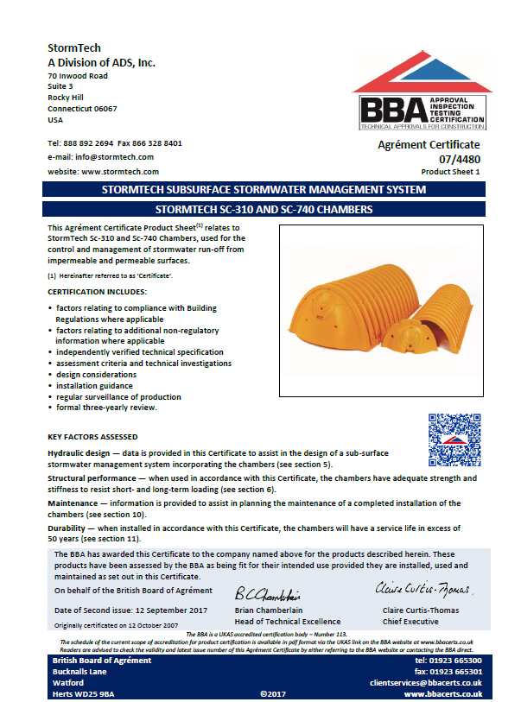



For innovative solutions, where a product standard does not exist, manufacturers must take a different approach.
Some pick clauses from different standards to demonstrate fitness for purpose. This is not a reliable approach.
Responsible manufacturers put products through an evaluation by a recognised certification body such as
  British Board of Agrément (BBA)
  Water Research Centre (WRc)
  British Standards Institution (BSI)
This process effectively assesses the key elements that a standard would cover, and checks that the product meets the claims of the manufacturer.

Slide 13
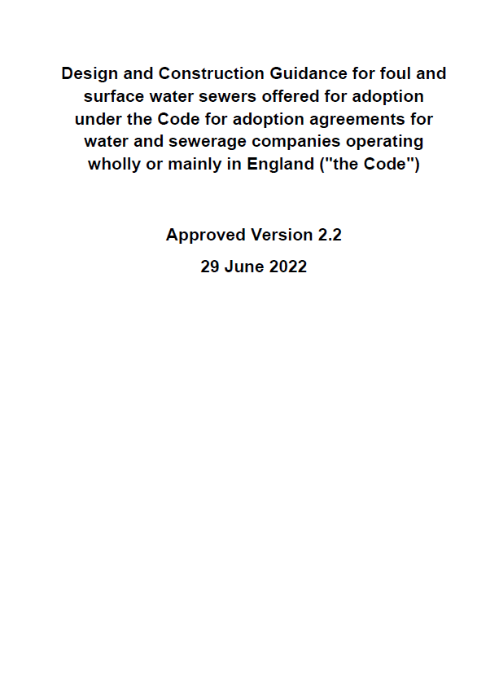
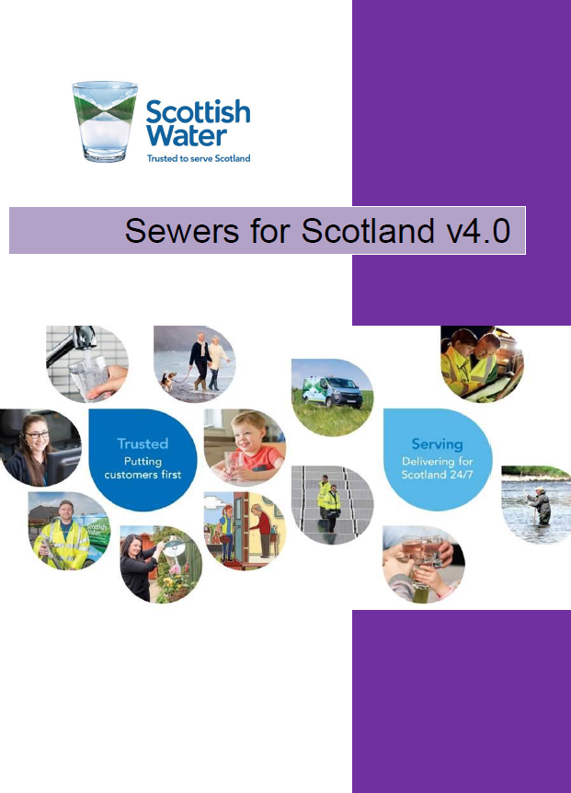
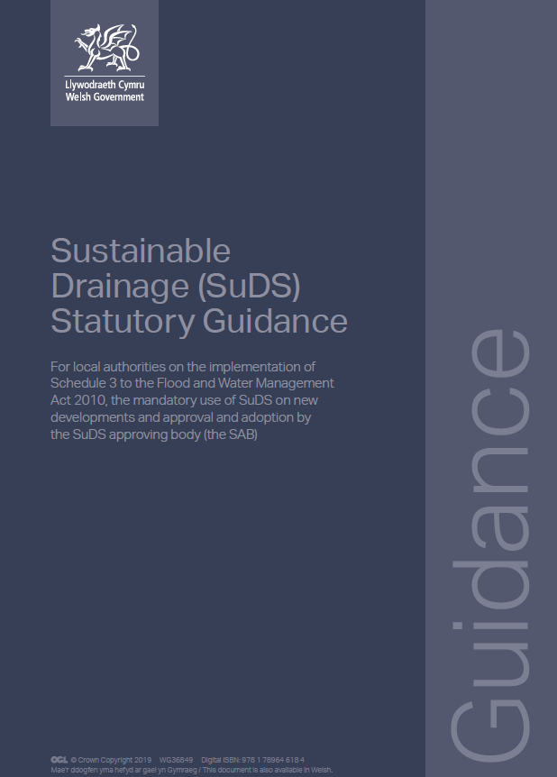
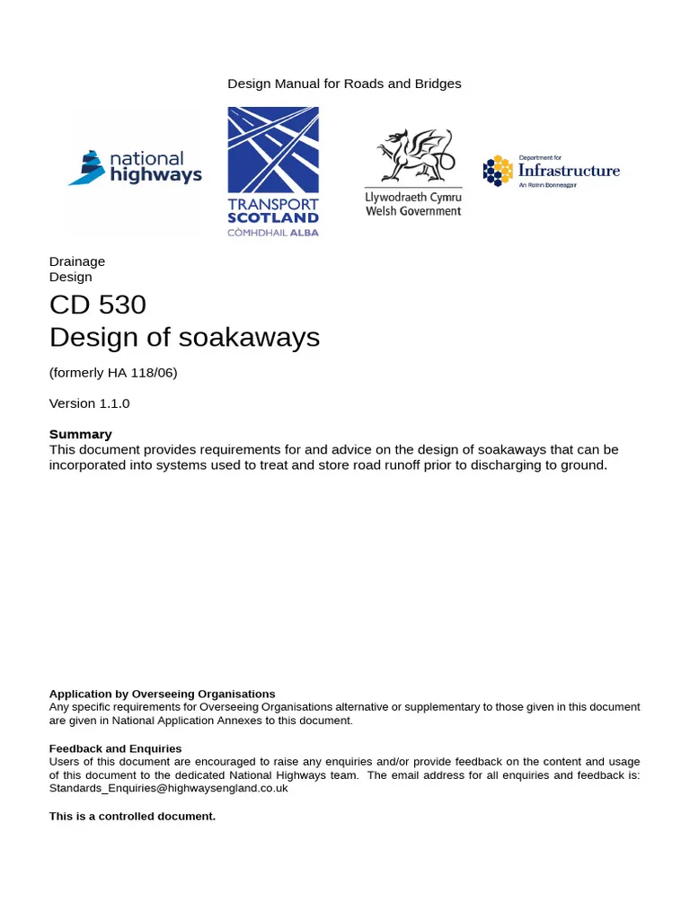
Approvals – adopting asset owners
England. Water companies require developers to follow OFWAT’s Design and Construction Guidance (DCG). LLFA must also approve drainage designs.
Scotland. SuDS must meet the requirements of Sewers for Scotland 4th edition. SEPA must be satisfied that the treatment train protects water quality.
Wales. SAB approval based on Welsh Government’s Statutory Guidance for SuDS.
Independent adoption bodies e.g. Icosa Water, IWNL may take on SuDS assets.
Highways. DMRB most relevant. Products not recognised within National Highways’ standards can be used through the departure from Standards process.

Slide 14
In conclusion
The compliances touched on in this presentation are just part of the due diligence process for SuDS.
Below ground attenuation devices can be rendered unfit for purpose, even when perceived to meet the relevant Standards, Certifications and Approvals.
This may be due to misunderstanding the interrelationship with other parts of the SuDS system, such as swapping-out one product for another and neglecting impact on water quality, installation process or ease and effectiveness of maintenance.
SuDS should be designed, installed and maintained so that they function over the lifetime of a development.

Slide 15

Thank you!

