Slide 1
The best of both worlds:
SuDS and rainwater reuse in business, residential properties and at a community level

Slide 2
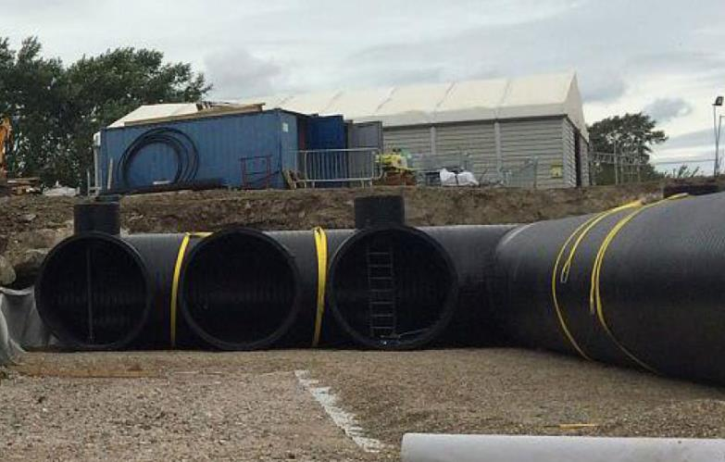
Introduction
Why do we need SuDS and reuse to coexist?
How can we make “the best of both worlds?”
A few examples of how things can be better!

Slide 3
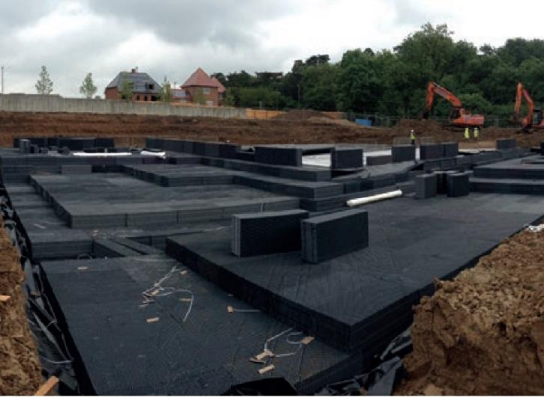
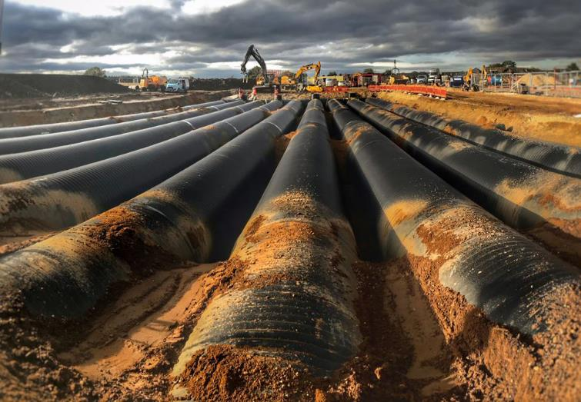
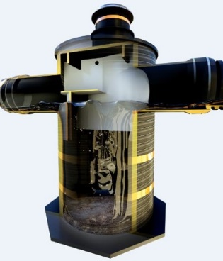
SDS have been doing SuDS for >24 years
Attenuation, separation, filtration and storage

Slide 4
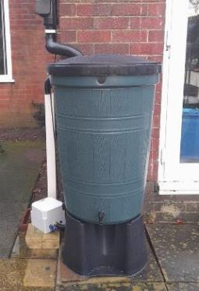
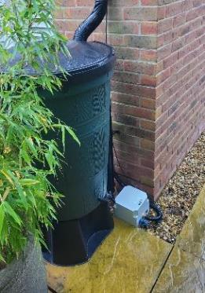
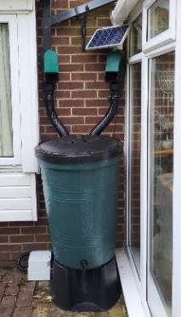
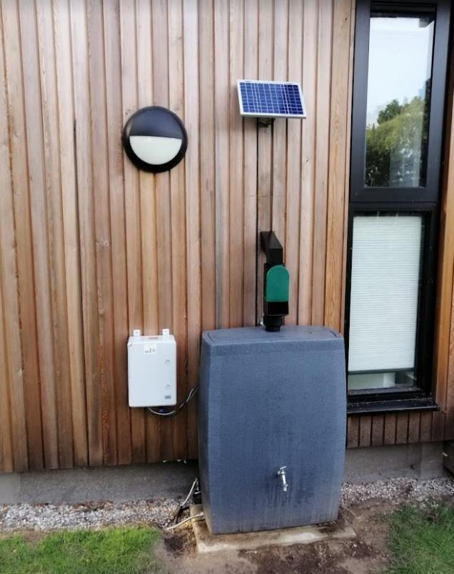
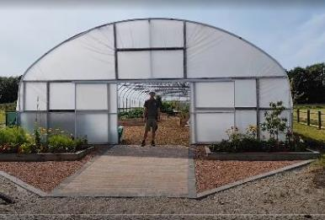
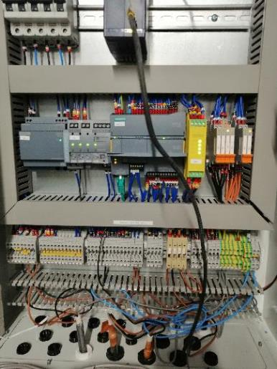
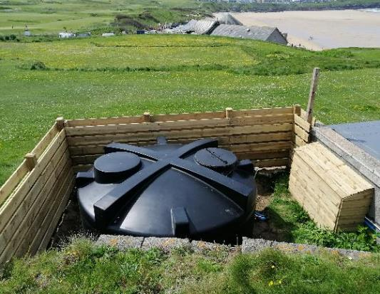
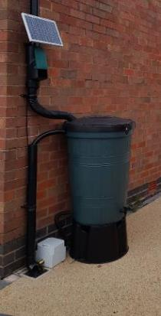
Technology enables smart reuse systems
Why do we want to do this?

Slide 5
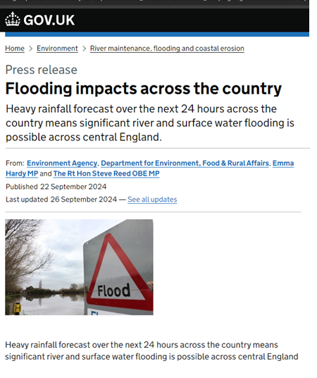
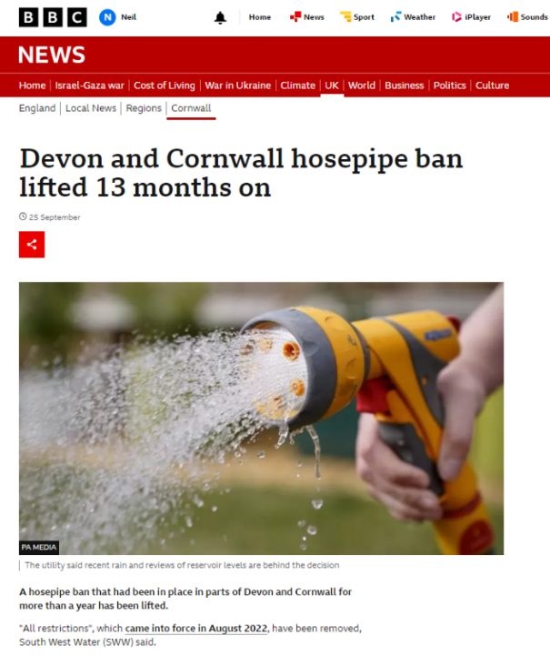
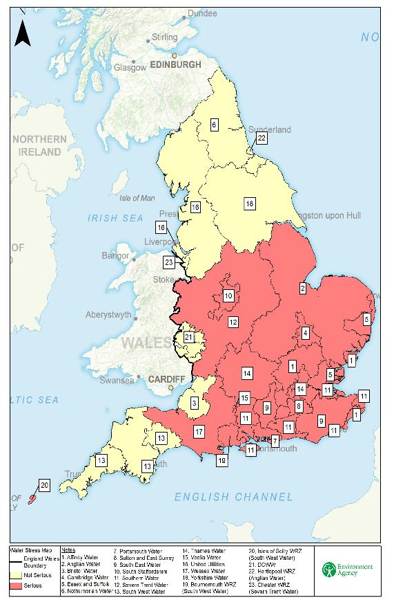
Traditional SuDS is just one side of the coin
SuDS “manages control removal of rainwater”
But, we have a scarcity problem too… are we missing something?

Slide 6
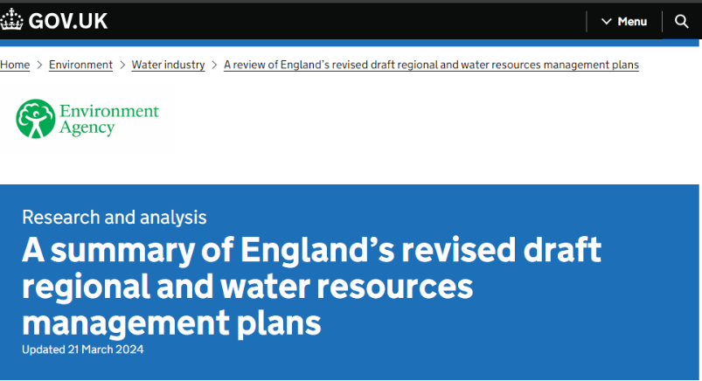
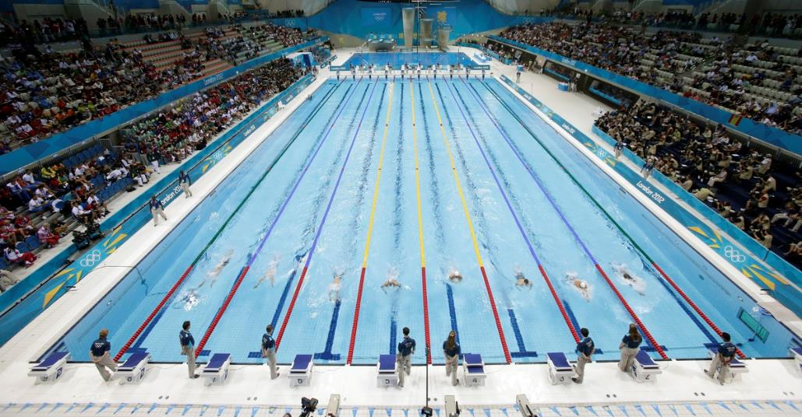
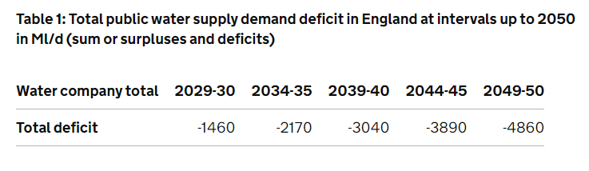
How big is this scarcity problem?
2,000 Olympic swimming pools per day…
Traditional SuDS can’t really help this problem – but smart SuDS can!

Slide 7
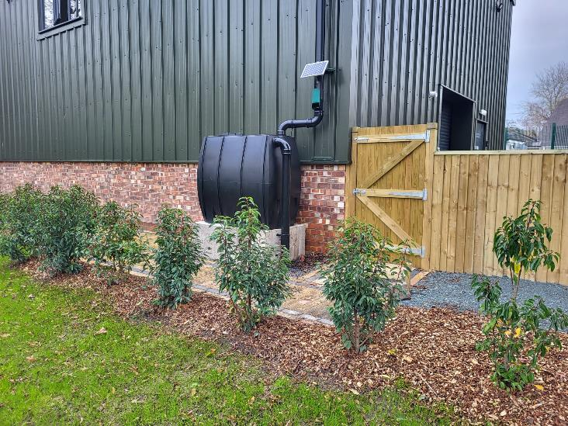
How does Smart SuDS help?
Uses attenuation as storage when attenuation isn’t needed.
This can happen at any scale:
  Household, residential properties
  Small industrial / commercial properties
  Large buildings / whole housing developments
Treating attenuation and storage as the same thing doubles the value of SuDS

Slide 8
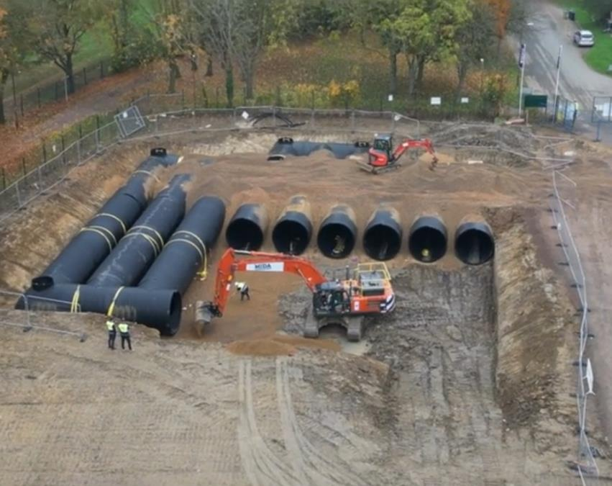
Attenuation and storage are interchangeable
Shift in mindset:
  Keep water for reuse.
  Release only as necessary.
The process:
  Identify some driving data (forecast)
  Create capacity prior to rainfall (release)
  Monitor performance (improve)
Changing the way we think about SuDS gives us enormous potential

Slide 9





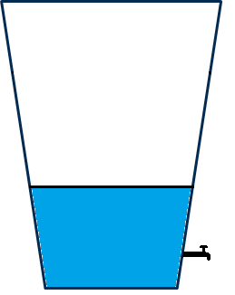




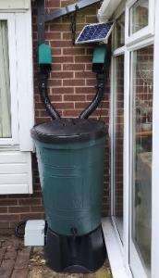
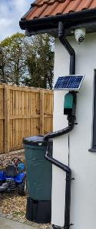
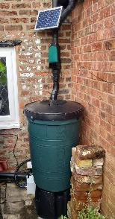
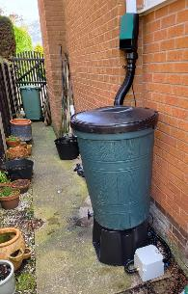
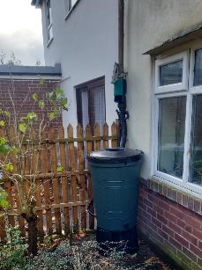
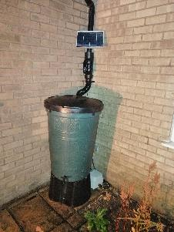
Residential example
4mm rainfall forecast
4mm rainfall forecast
Intellistorm® smart water butt
75%
Tank always has water for reuse + always capacity for rainfall = best of both worlds!

Slide 10
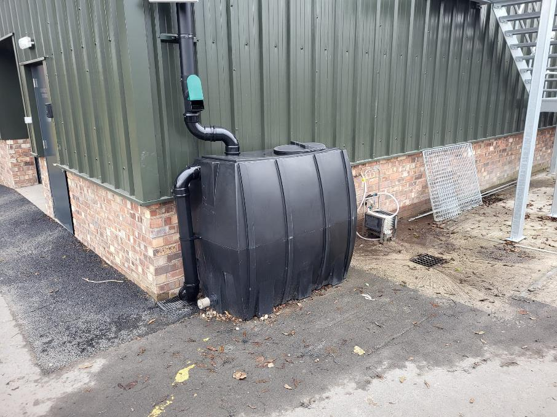
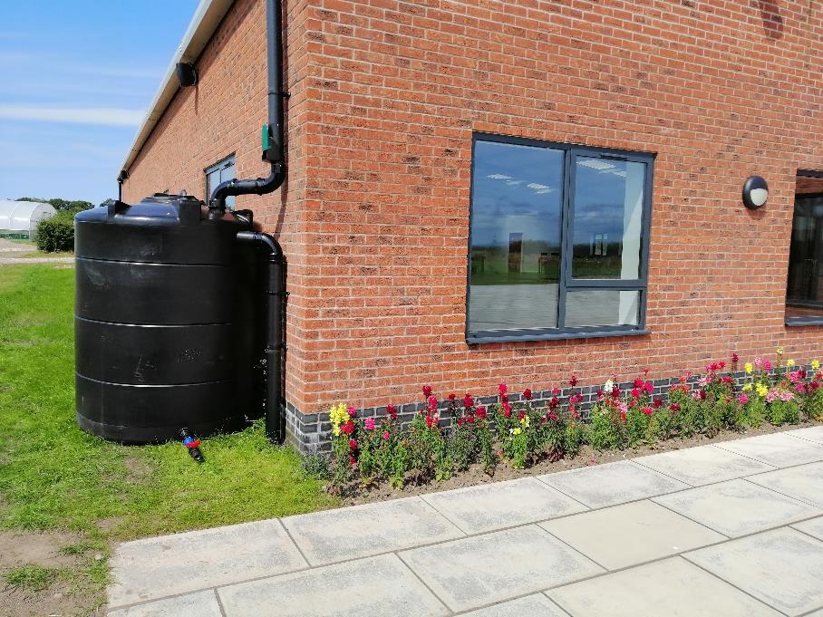
Industrial / Commercial example
1,000L tank for wash-down, 2,500L for irrigation

Slide 11
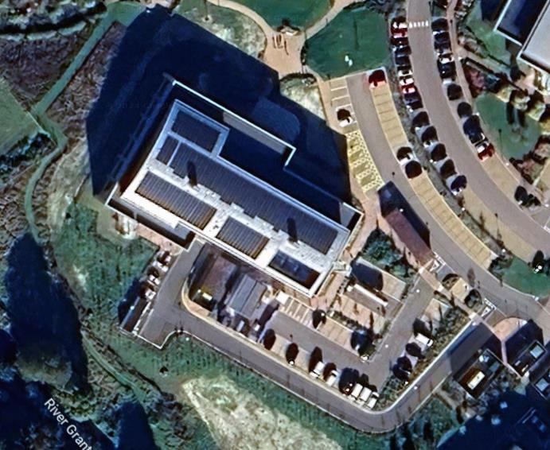
Larger scale commercial building example
Combination 150m³ tank
(50% storage & attenuation, 50% only attenuation)
2,000m² roof area
No mains water use for flushing since installation

Slide 12
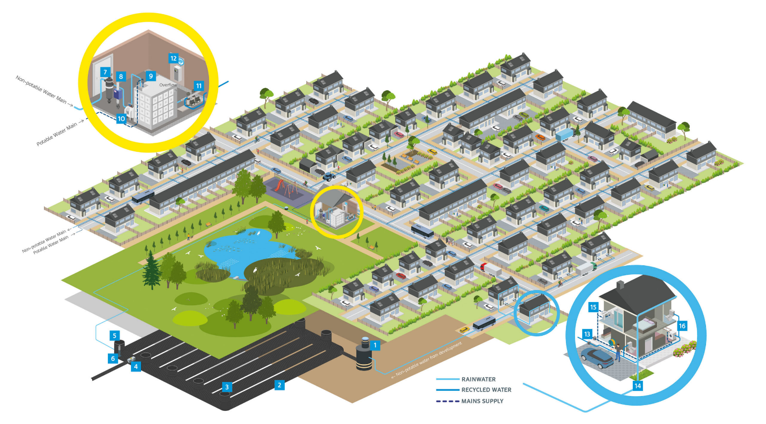
Residential development sites

Slide 13
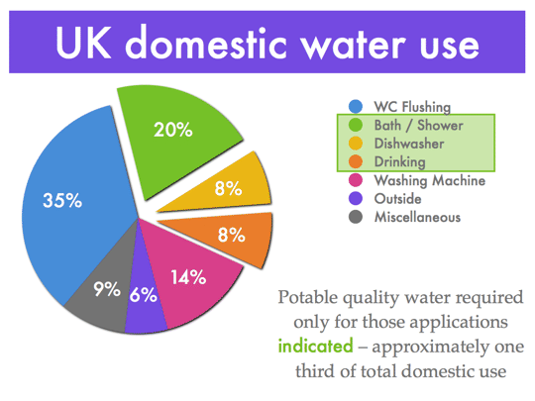
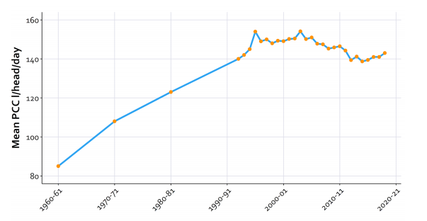
What level of impact can this have?
University of Nottingham, Global use of Water
Bristol Water, Predicting Water Usage
Scheme saves 93L/p/day (nearly 2/3 of potable water reduction)
More houses can be built as potable water per house lower is much lower

Slide 14
Why is this significant?
Reducing PCC will permit more house building
Smart systems which monitor use, reuse and attenuation will eventually become compulsory (how else will we meet the scarcity challenges?)
Consumers are aware of flooding and scarcity situations, and they know that water bills will rise – they will vote with their feet when it comes to buying new homes.

Slide 15
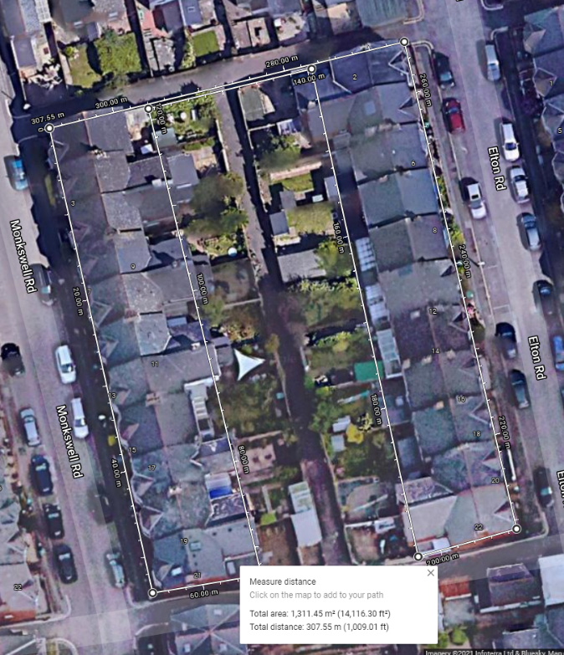
Conclusions
Smart systems like Intellistorm® make traditional SuDS into “super SuDS” plus give the additional benefits!
We should aim higher to tackle both the flood and scarcity challenges.
We still need “standard” SuDS – if maintained they can do a great job! (Jo…?)

Slide 16
Thank you for your attention!

