Slide 1
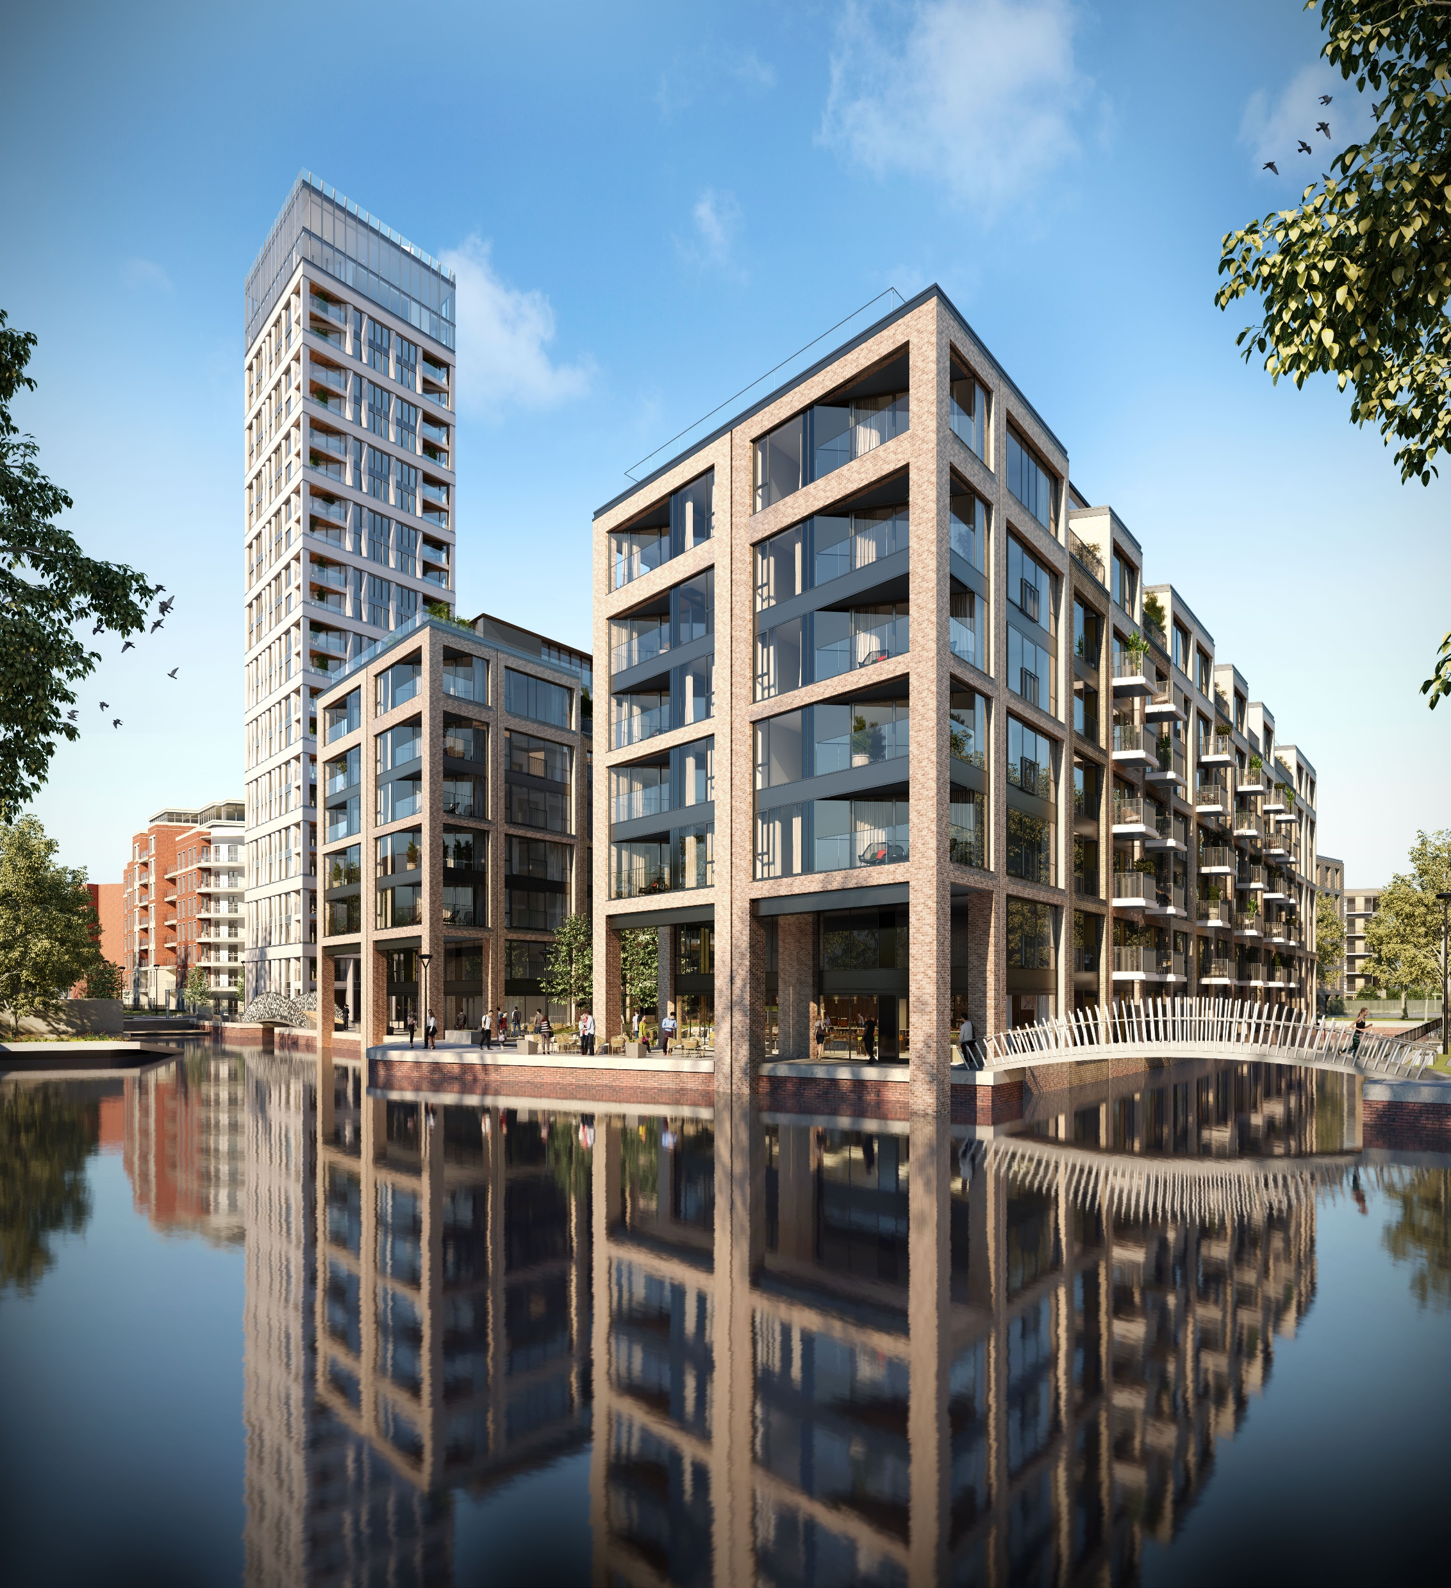



Case Study: New Housing Development (large)

Slide 2

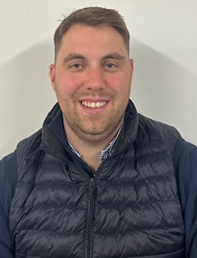

Katie Sampford
Senior Sustainability Manager
Elliot Wolfe
Senior Site Manager
Ana Pombo
Technical Co-ordinator

Slide 3
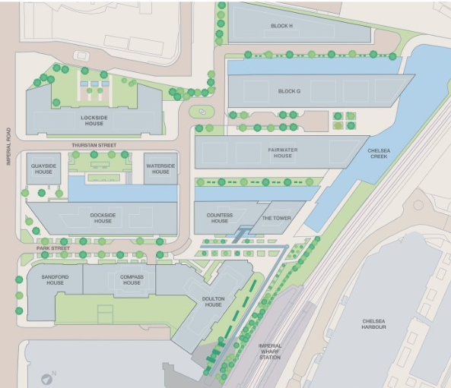
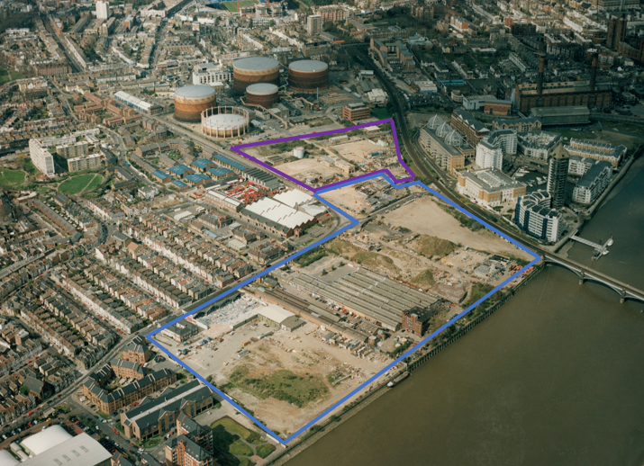
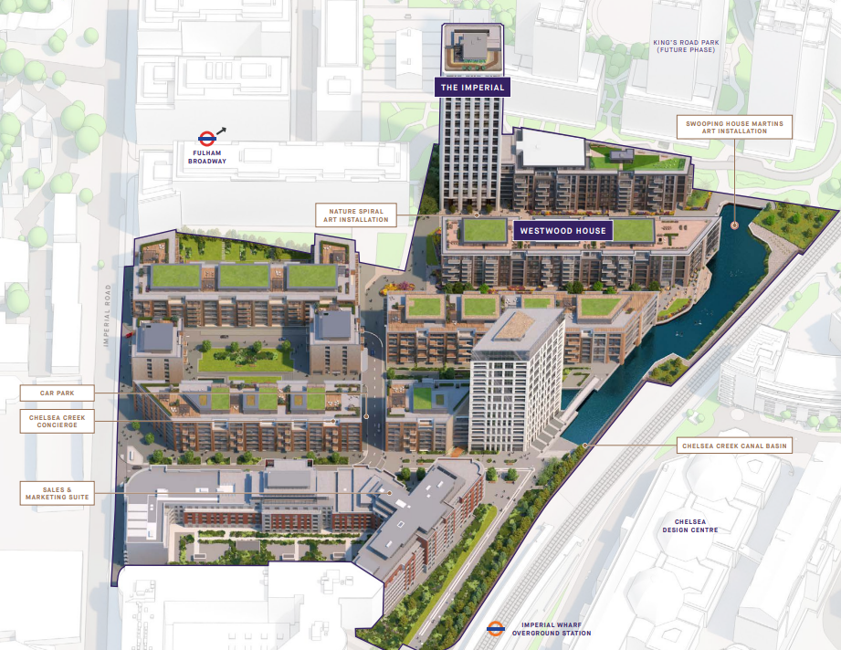
Former gas infrastructure site
Total site is 30 acres and 2,707 homes
Chelsea Creek is the final phase incorporating new canal network as SUDs

Slide 4
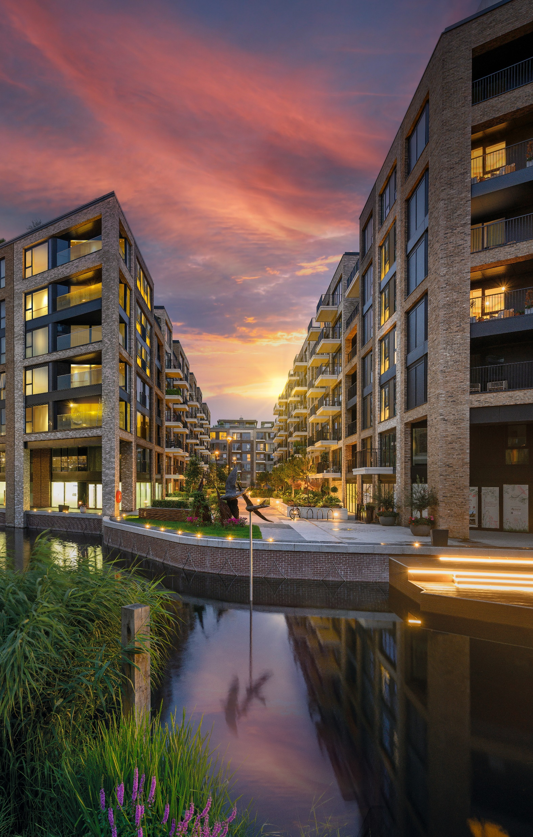
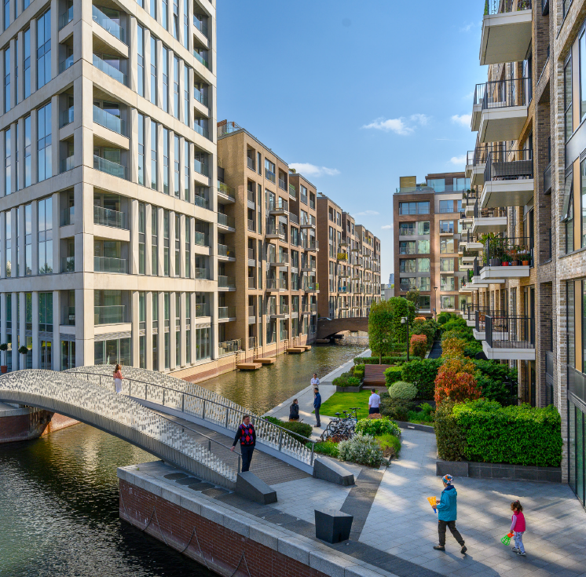
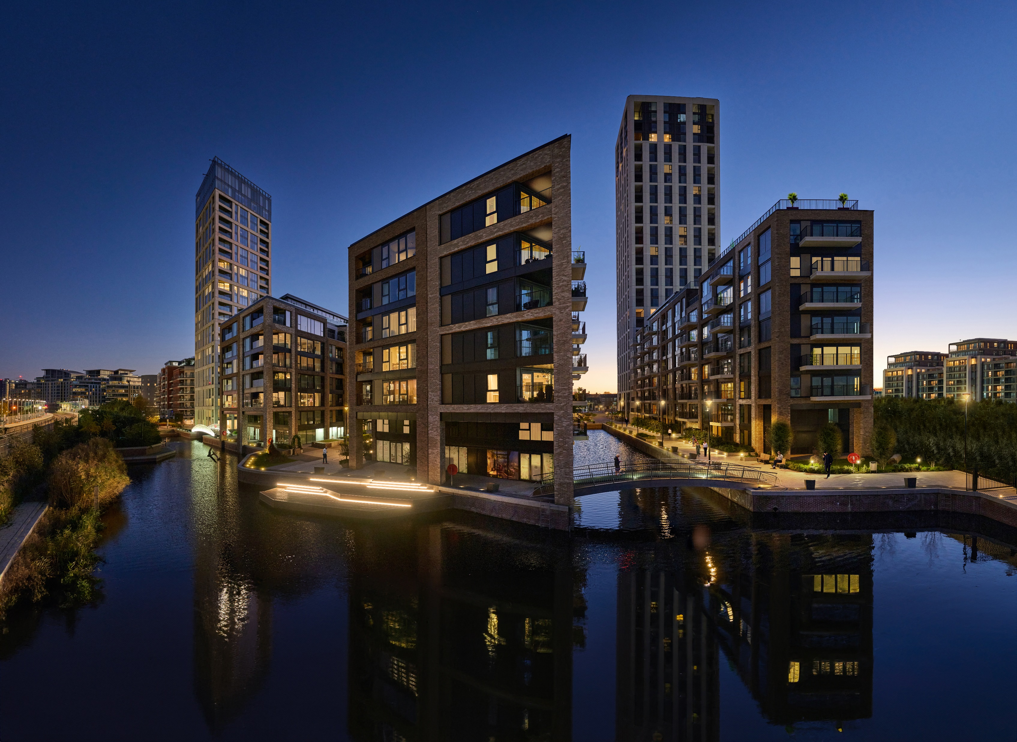
1,239 homes across 8 acres
Aimed to preserve local heritage and embrace European design
4.5 acres of open public space – including two new canals and marina; 450 new trees and 734m2 living roof
New Overground station

Slide 5
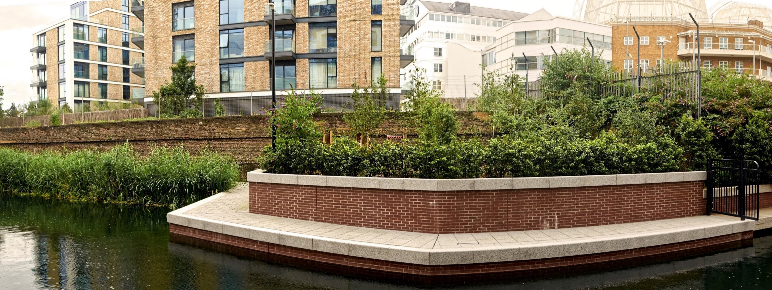
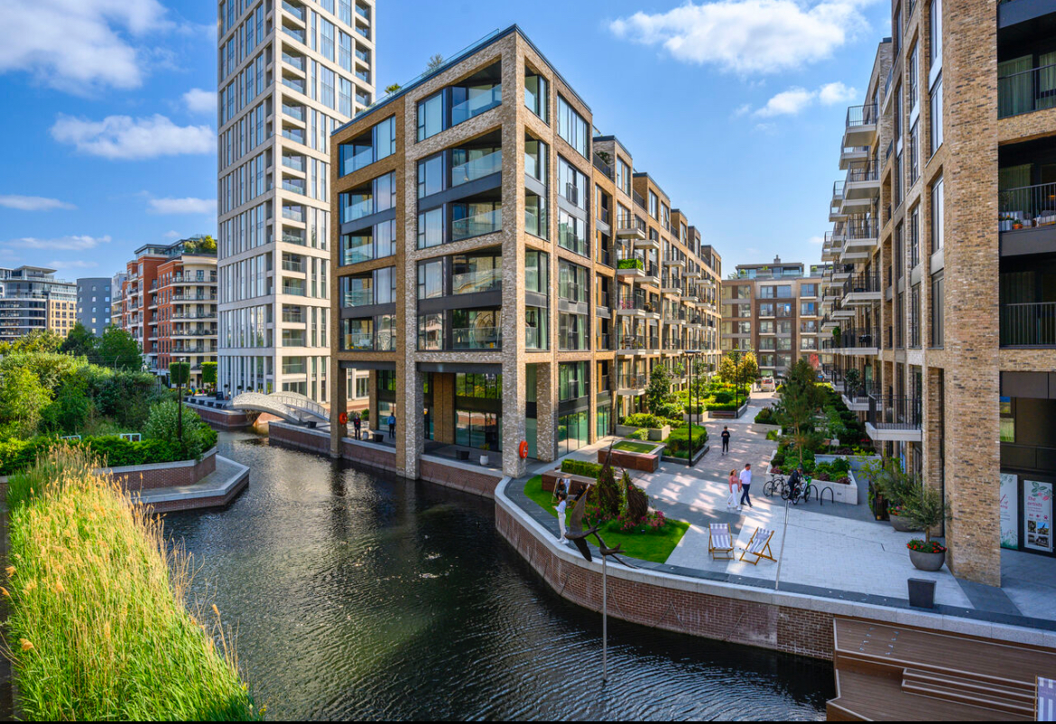
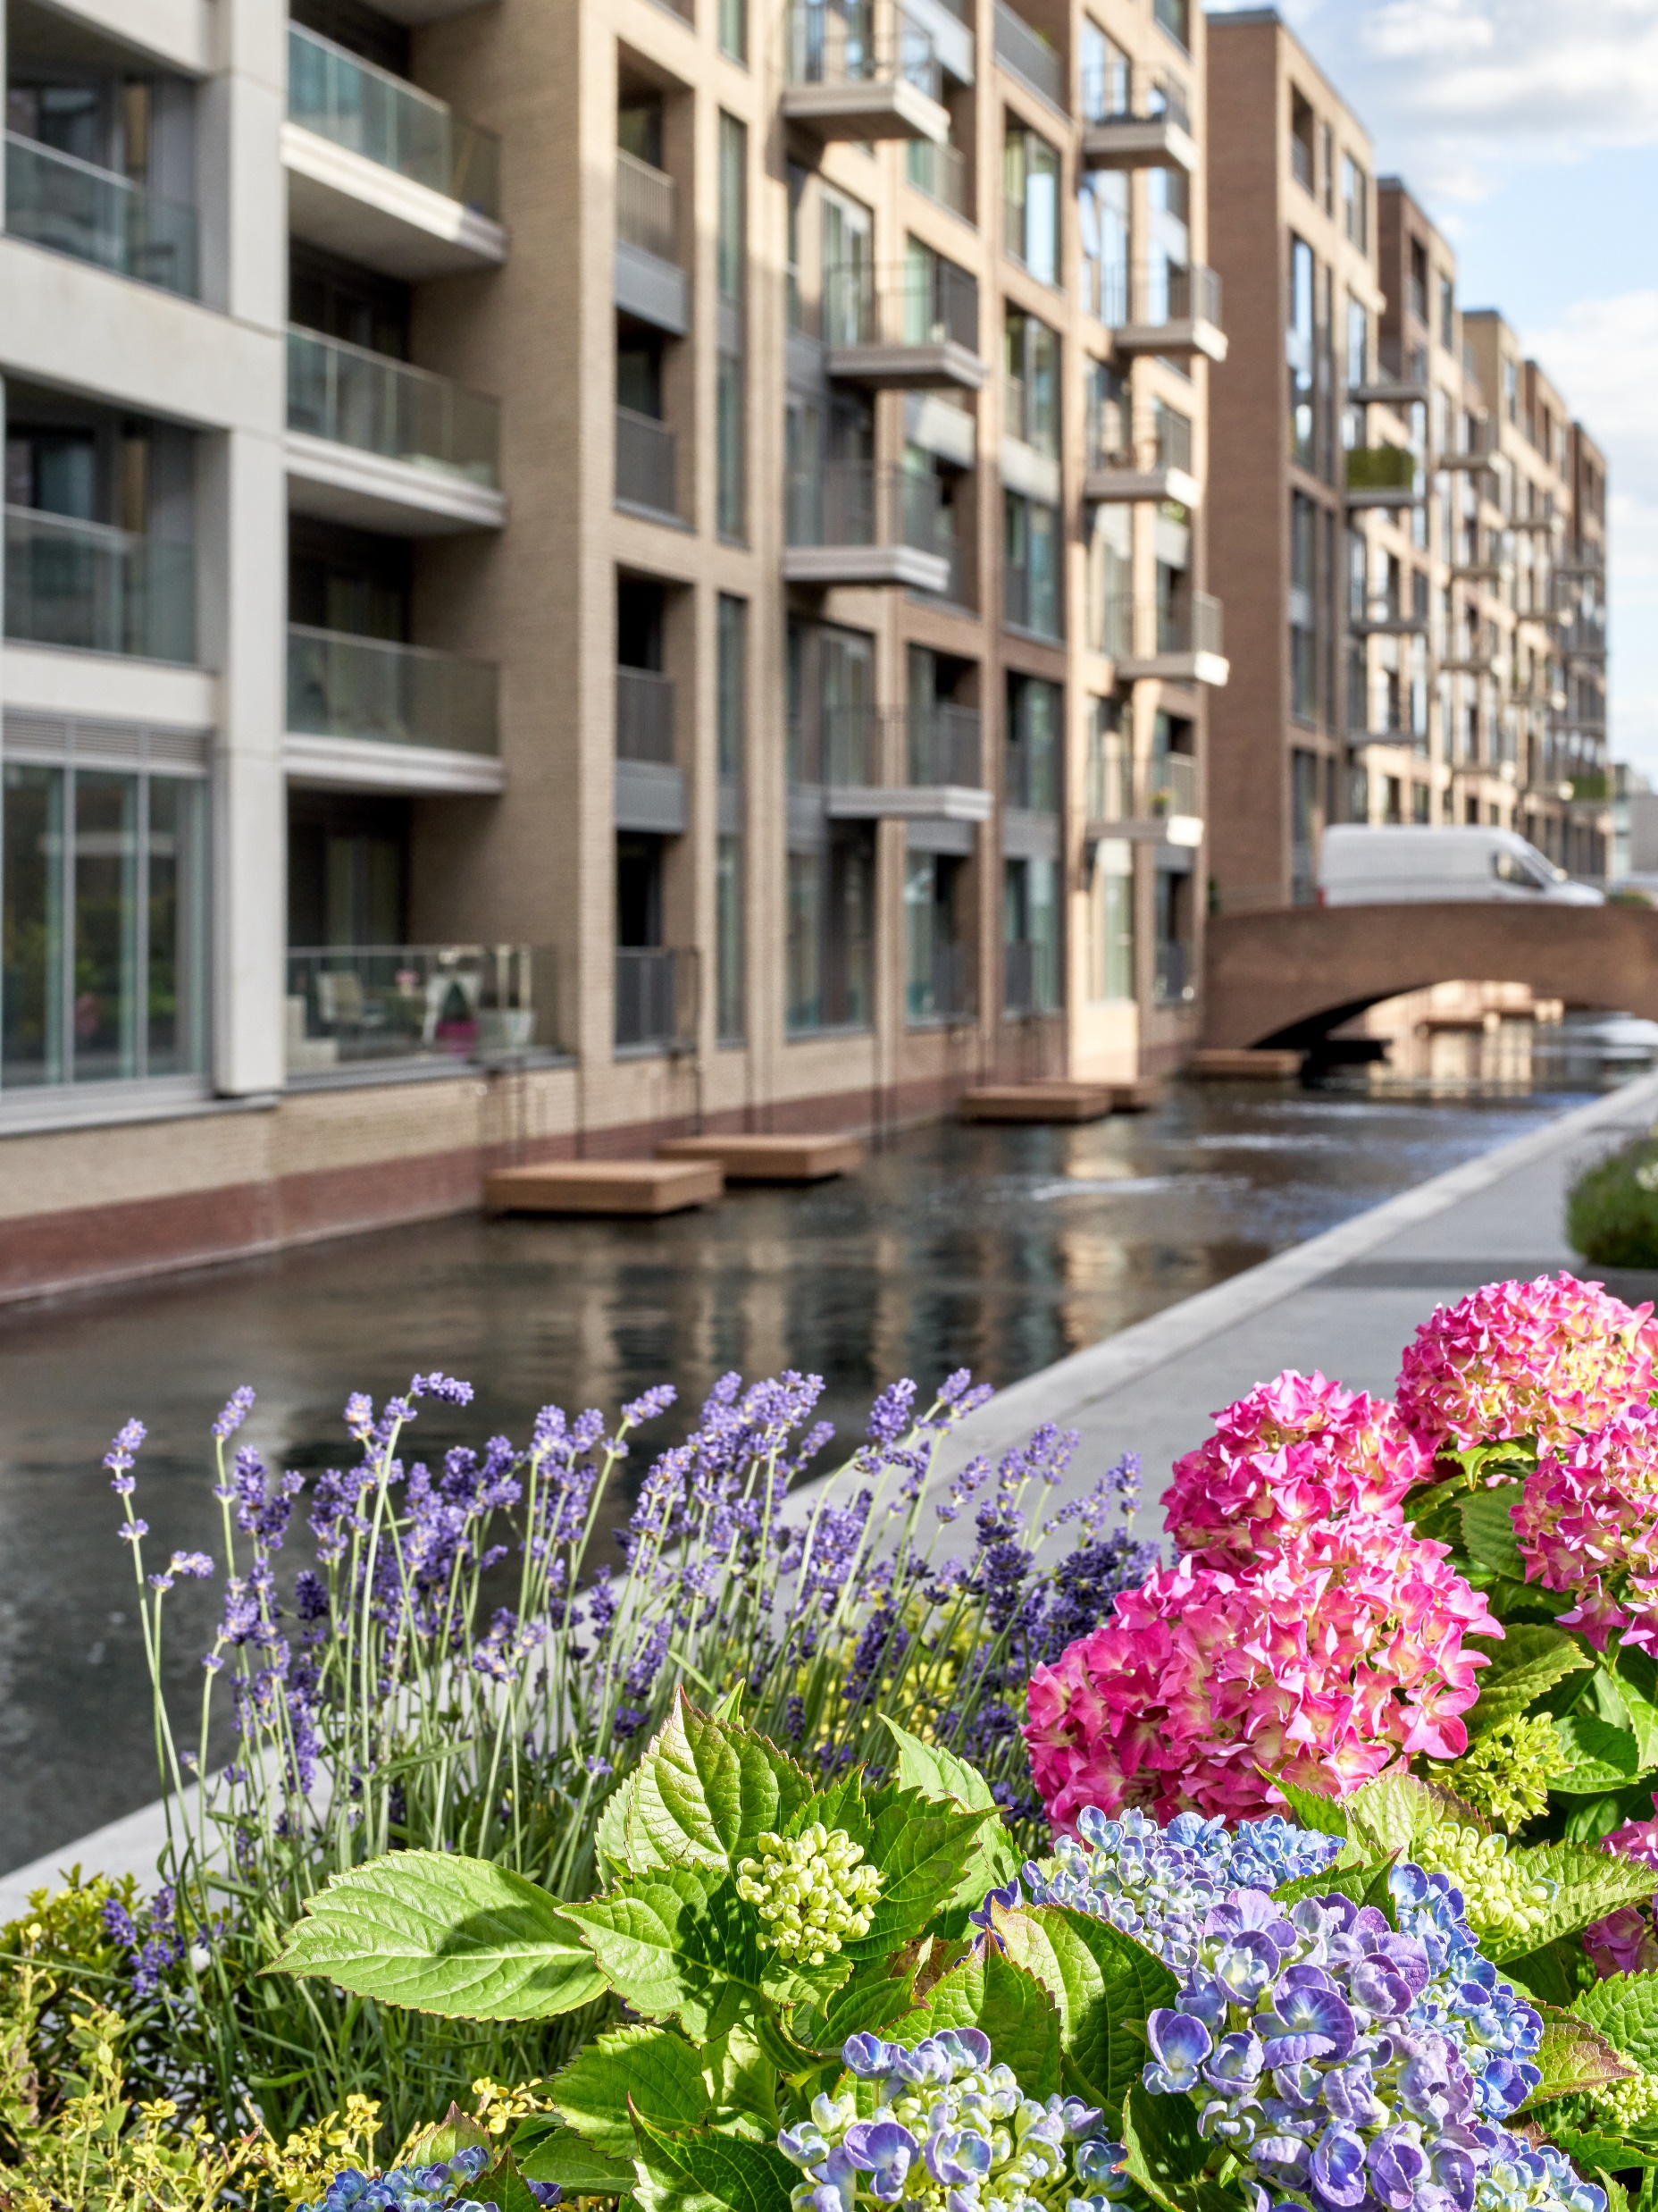
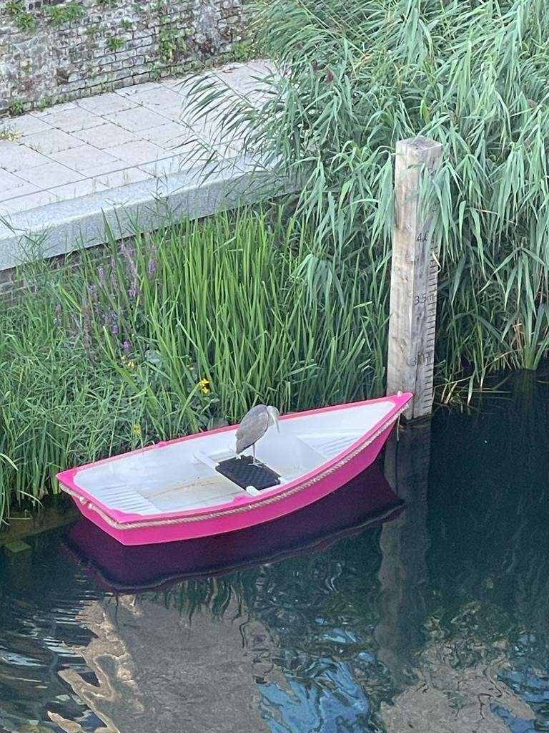
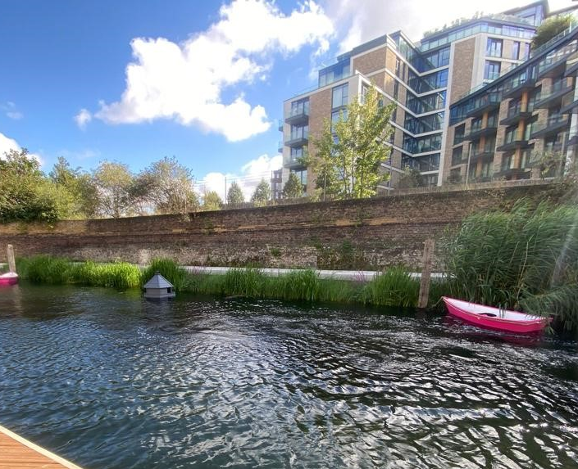
Regulates temperature
Improves local air quality
78m2 of riparian seed mix
3 Bee Farms & Duck Houses

Slide 6
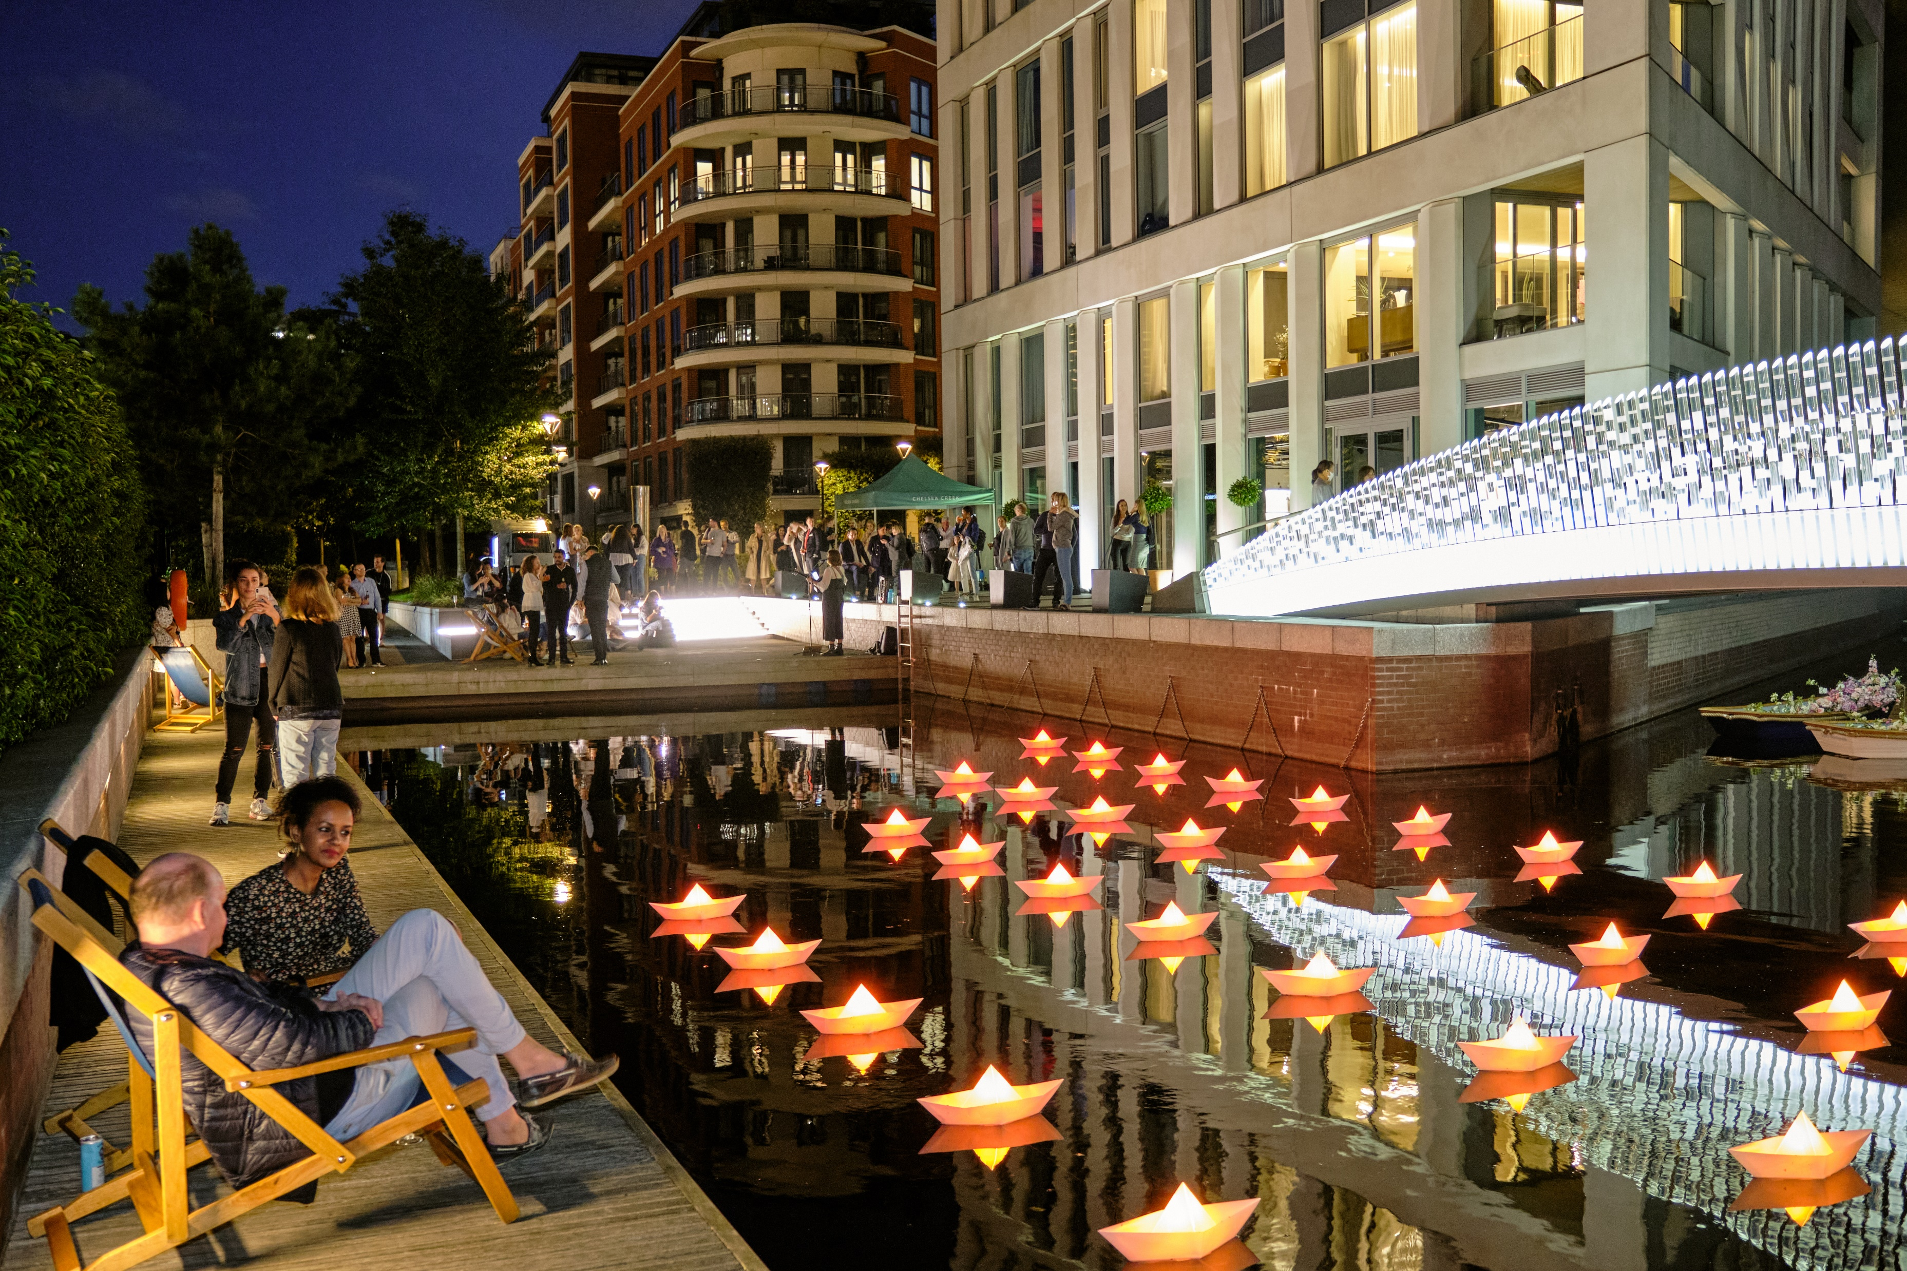
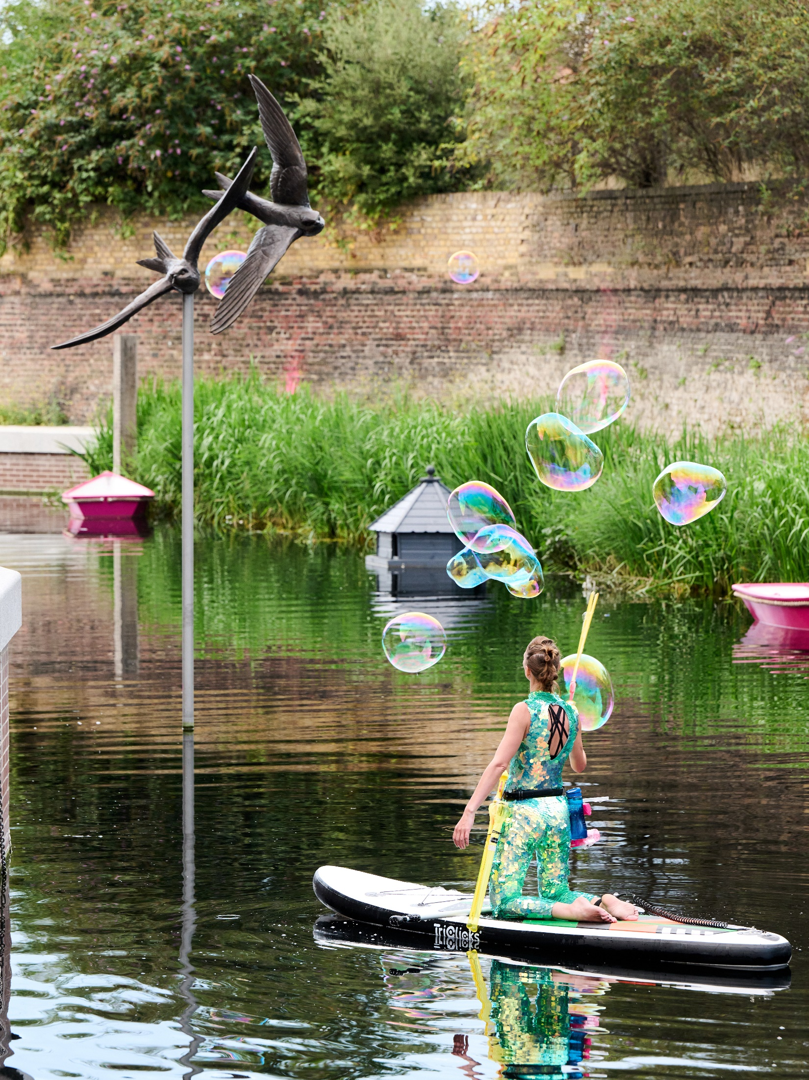
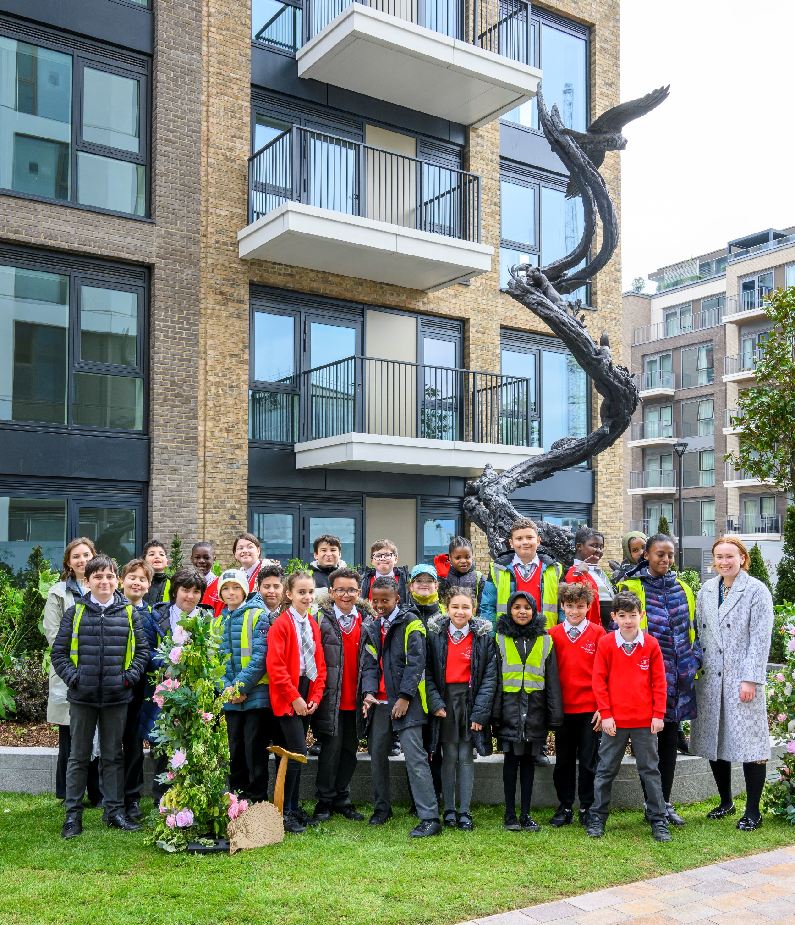
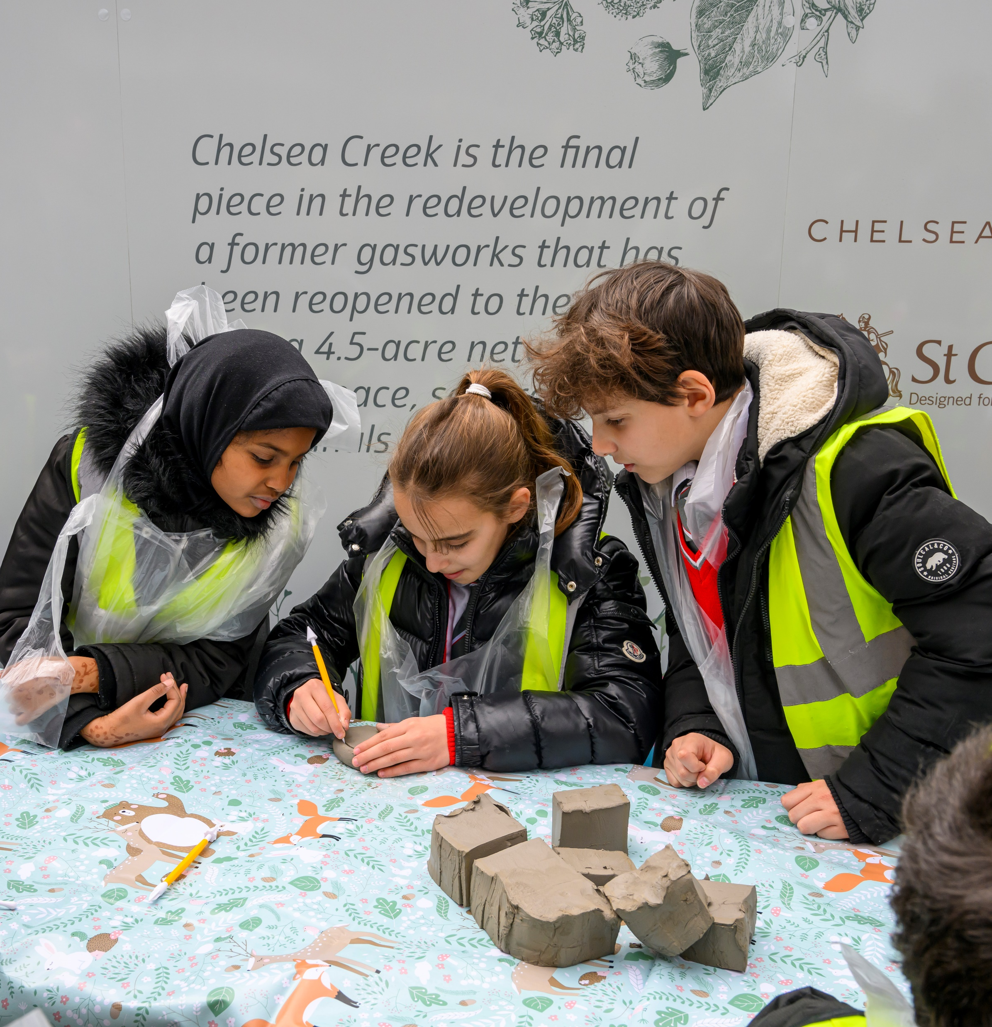
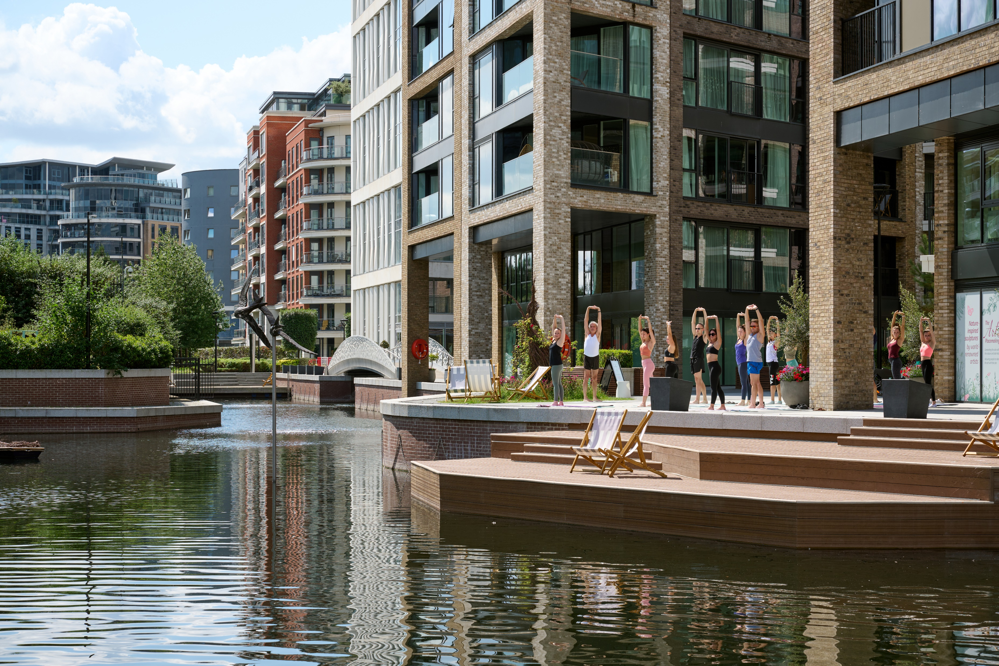
Access to blue/green amenities
Meanwhile use space
Swooping Martins public art sculpture

Slide 7
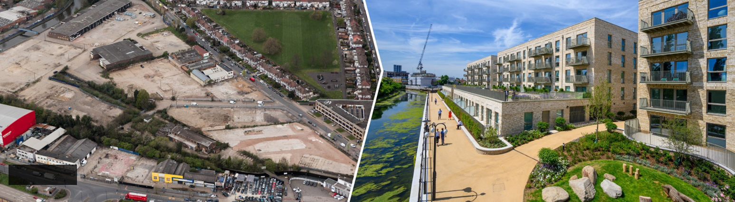

GRAND UNION
Before
Today
22-acre former Northfields Industrial Estate
3,350 homes including 1,170 affordable | 14 acres of open space |
5,000sqft Community Hub| 240% Biodiversity Net Gain | Nursery| 135,000sqft multistorey light industrial building ‘ V Park’

Slide 8
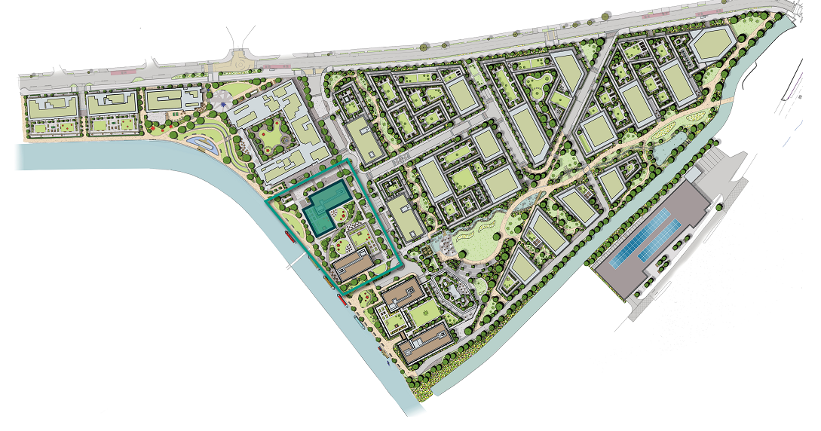
3
1 – Terraced Gardens
2 – Central Gardens
3 – Riverside Meadows
1
2

Slide 9
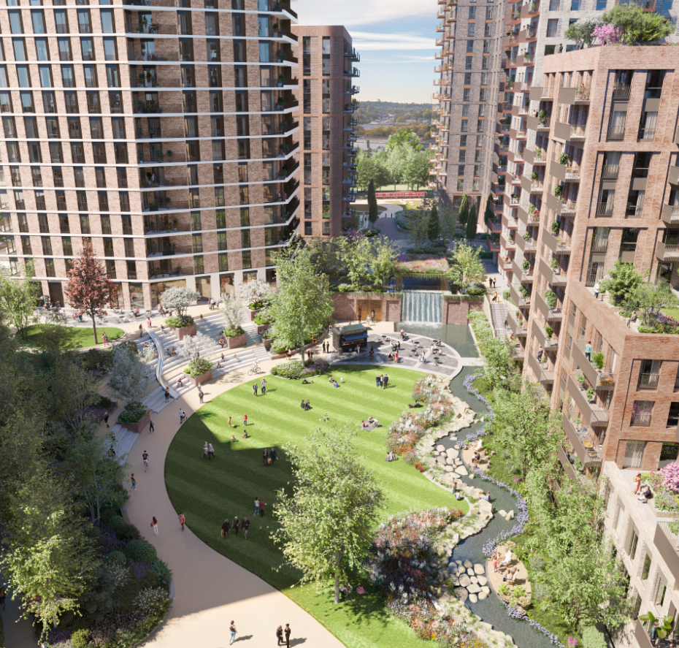
Terraced Gardens – outline design
Attenuation fed waterfall
Meandering water rill feature
Amphitheatre
Amenity space

Slide 10
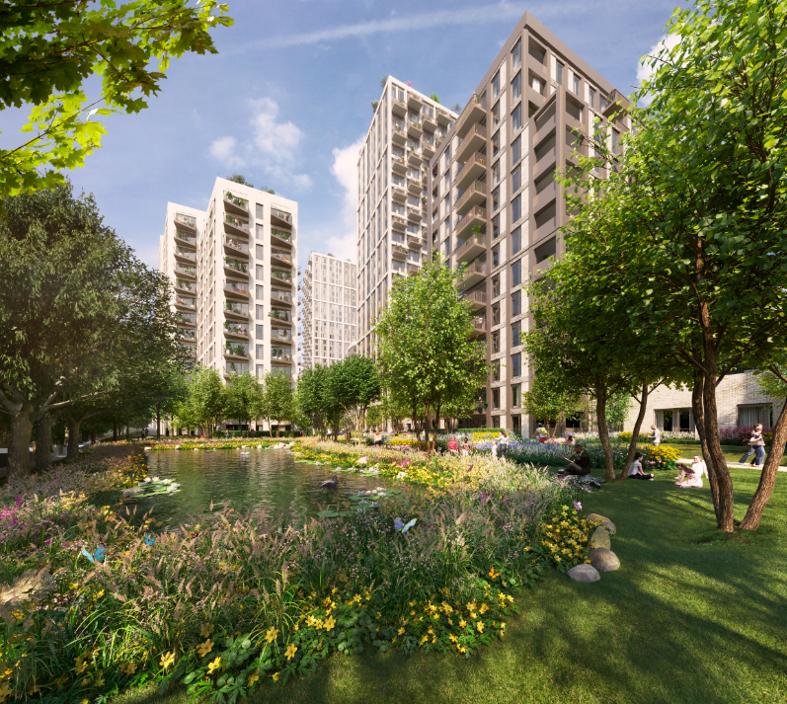
Central Gardens– outline design
Meandering water rill
Swale with marginal planting
SUDs has had to accommodate existing site constraints

Slide 11
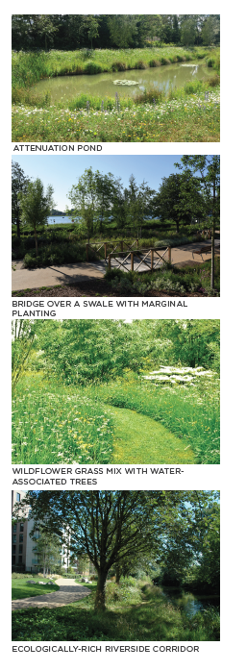
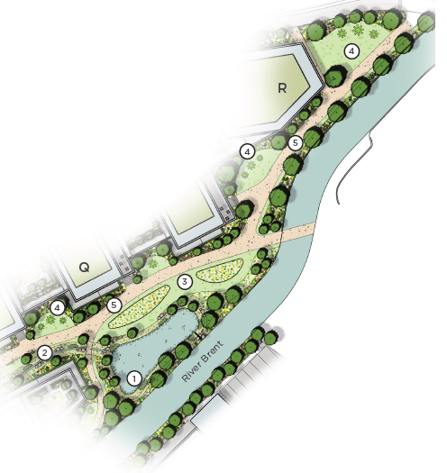
Riverside Meadows
Meandering swale and attenuation pond
Grading and planting of existing bank of River Brent

Slide 12
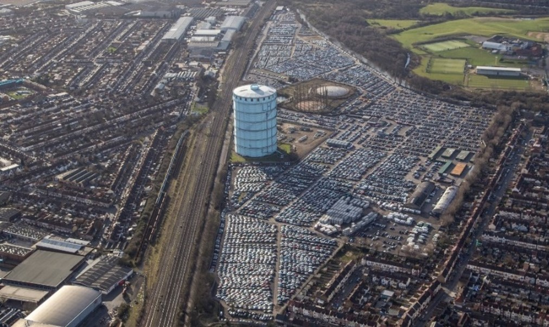
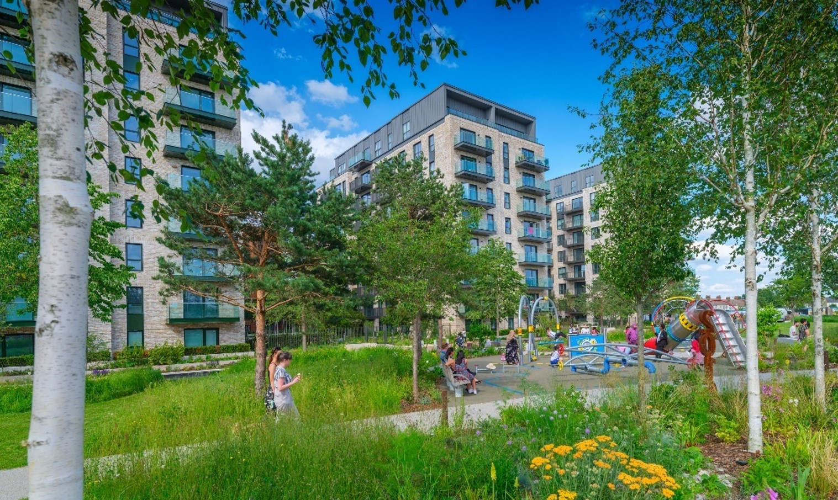

THE GREEN QUARTER, EALING
Before
Today
88-acre former gasworks
3,750 homes including 931 affordable | 42 acres of open space | 9-acre Wetland and Nature boardwalks|
Parkside Yards| 93.7% Biodiversity Net Gain | Primary school | Health centre

Slide 13
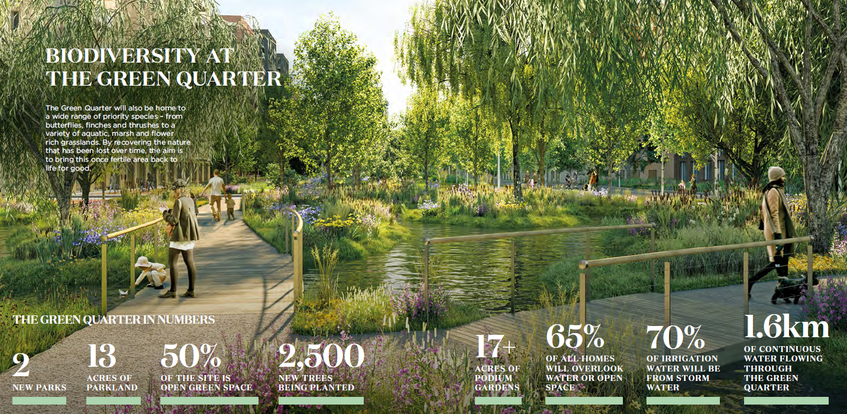
NATURE LED MASTERPLAN

