Slide 1
Being honest about the benefits of SuDS
Jo Bradley
Stormwater Shepherds UK

Slide 2
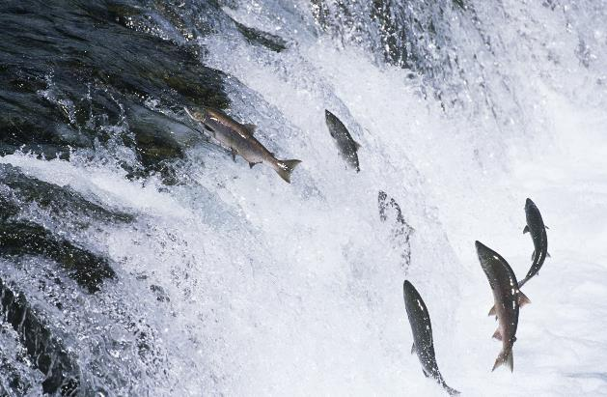
We are a Charity dedicated to the reduction of pollution from urban surfaces, including microplastics and plastic litter

Slide 3
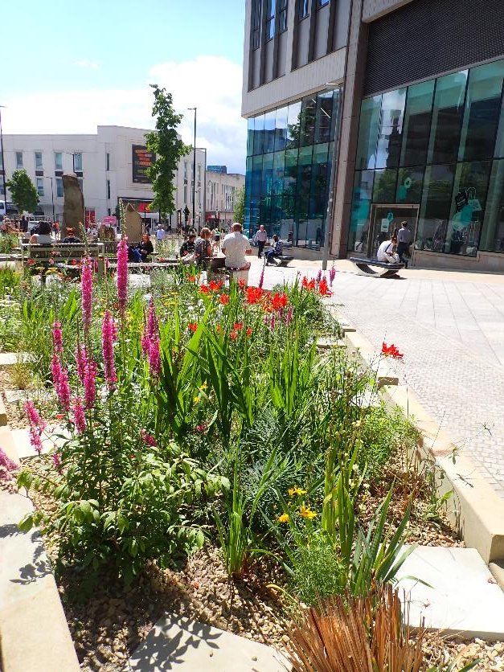
Keeping up appearances
If we want to encourage everyone to incorporate SuDS and to retrofit SuDS, we need to make sure that the schemes that we deliver, and the schemes that we have delivered in the past, look good and function well. But we also need to make sure that they are maintained in the long term so that they don’t fall into disrepair and become weed-filled scrubby corners that do nothing for anyone.

Slide 4
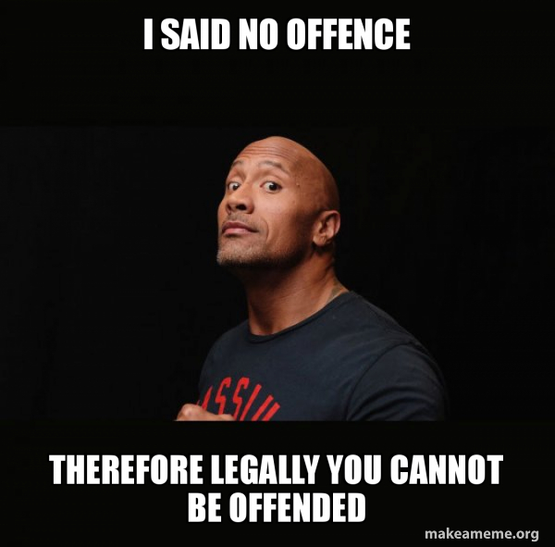
Please note:
I’ve done what I can to anonymise the SuDS examples in the following slides, when I am using them to illustrate potential problems.
Please don’t be offended if I have used one of your schemes.
I am only using them for illustrative purposes, so that we can learn from one another.

Slide 5
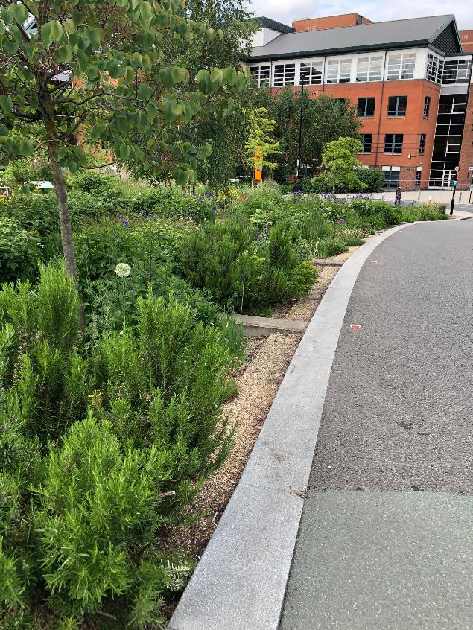
Good SuDS are magnificent
We all know this.
Good SuDS create beautiful places, they treat pollution, they reduce flood risk and they become habitats for wildlife.
We must maximise their use and incorporate them into new developments (with or without Schedule 3).
We must retrofit them at every turn.

Slide 6
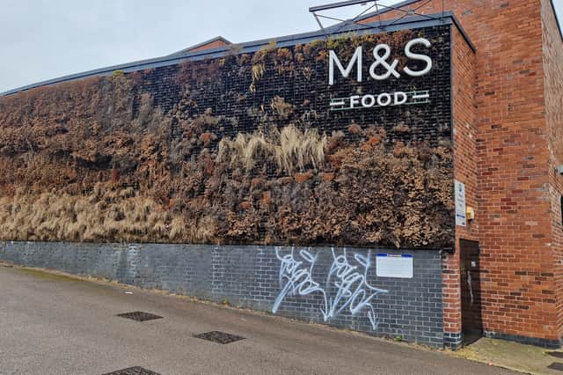
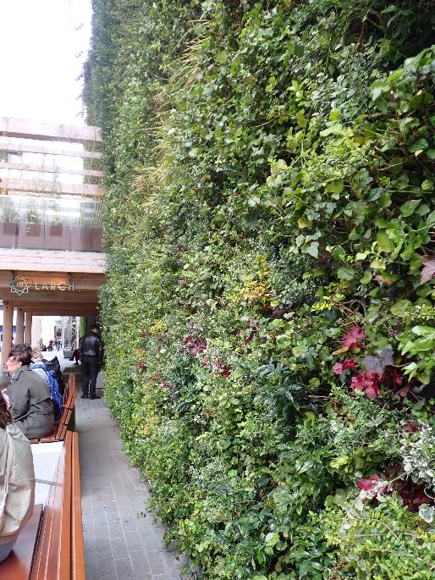
But what happens when they are not so good?
We must take care not to create fire hazards in urban areas, especially as the effects of climate change worsen. Green walls must have irrigation.

Slide 7
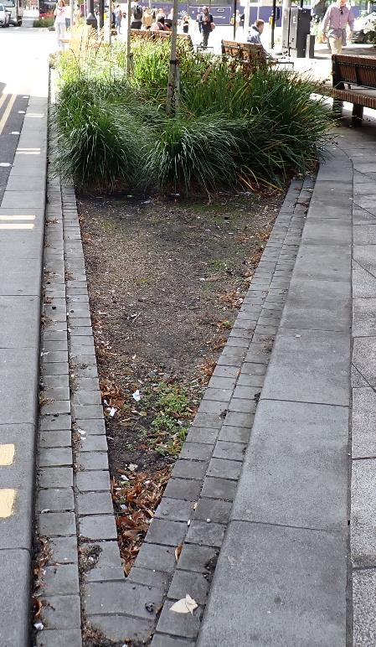
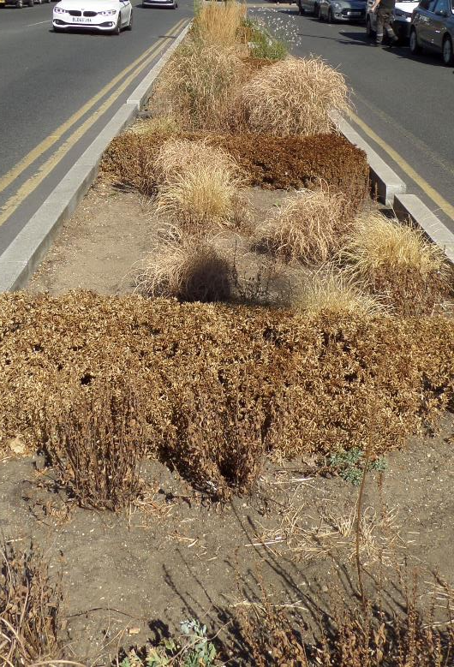
If we create habitats for wildlife, we must sustain them
If we’re creating a habitat for wildlife, we have a moral duty to keep them alive.
Why can’t devices like this include trickle irrigation from underground water storage?
Why can’t we replace failed planting?

Slide 8
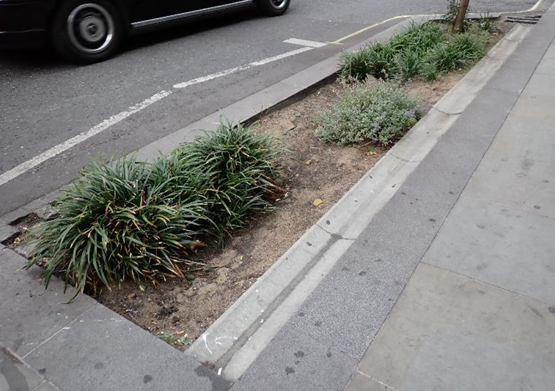
Is this beautiful?
If a device has no flowers, no moist soil, little shade and no water, what is it really delivering for wildlife?
What creature can live in a device like this?
If we’re really focussed on flood risk management, why not use stone filters, or permeable paving?

Slide 9
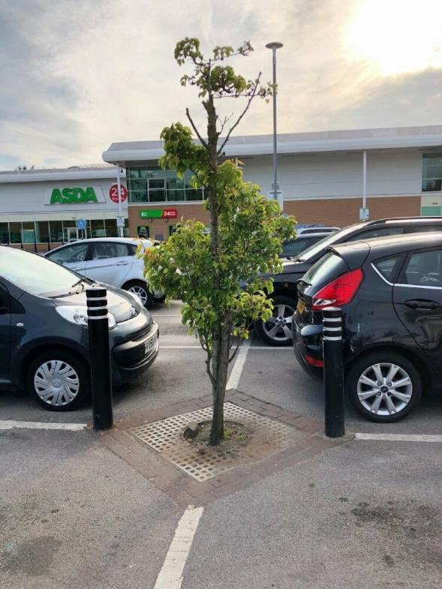
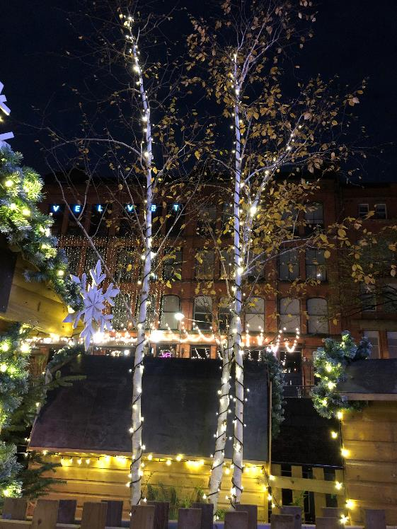
Think hard about trees
If they are illuminated, or isolated from other habitat, what can actually live in them? What do they contribute to local wildlife?

Slide 10
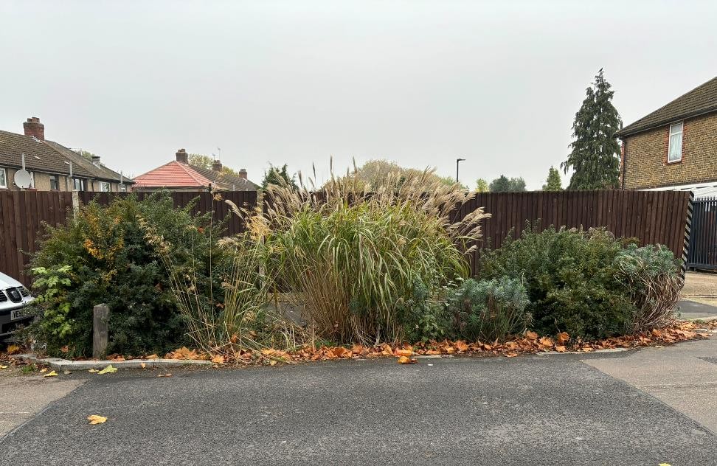
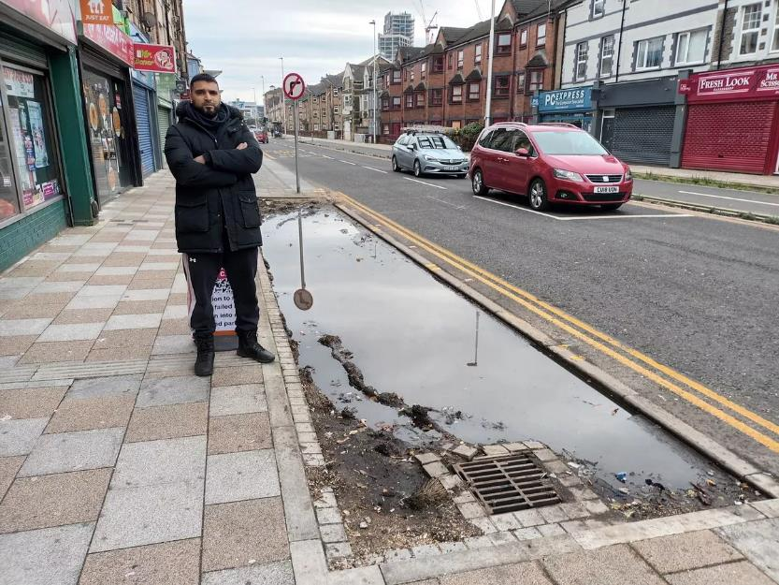
How do we get the locals to love them?
Notes:
Left: Deansway Enfield – the lady who lived across the road didn’t think the raingarden was in the right place and blamed it for someone hitting her car when they had to manoeuvre around it.
Right: Tudor Street, Cardiff. Story from https://www.walesonline.co.uk/news/wales-news/traders-say-fighting-survival-something-29765441

Slide 11
How do we get the local to love them?
Local Trader says "I can't survive. People can't come because they have nowhere to park."
Notes:
Left: Deansway Enfield – the lady who lived across the road didn’t think the raingarden was in the right place and blamed it for someone hitting her car when they had to manoeuvre around it.
Right: Tudor Street, Cardiff. Story from https://www.walesonline.co.uk/news/wales-news/traders-say-fighting-survival-something-29765441

Slide 12
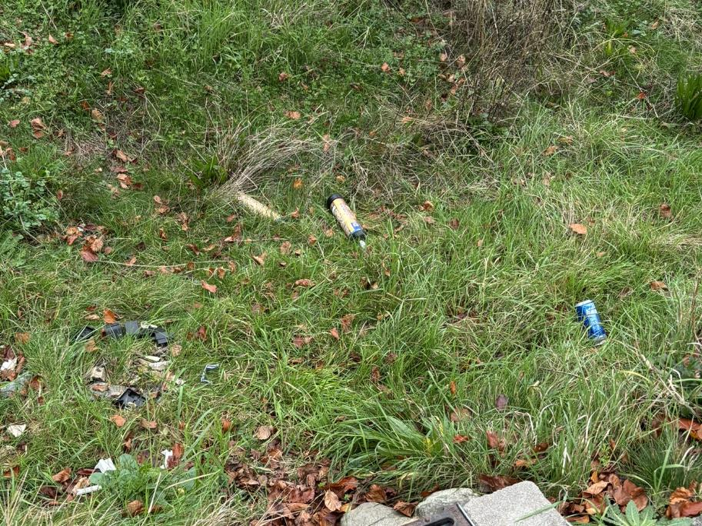
What happens if maintenance is not provided?
I would venture that all of the problems we see with existing SuDS are the result of inadequate maintenance.
If we can’t afford to maintain SuDS devices, should we rethink the design?
Even simple tasks like litter-picking seem impossible in some places

Slide 13
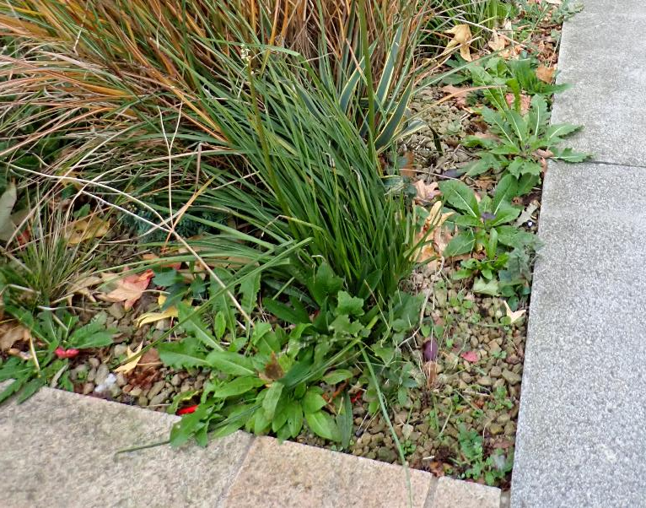
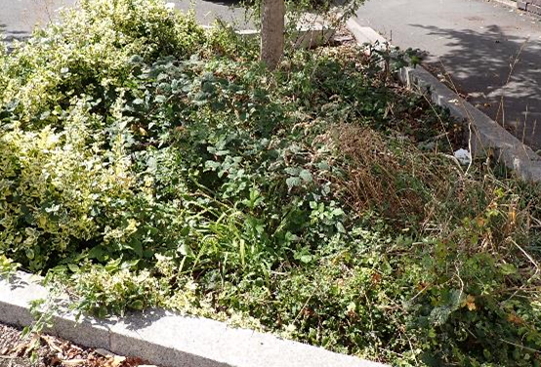
Lack of weeding can quickly become a problem
Bramble, bindweed, ragwort, thistles, nettles and dandelions have featured in SuDS devices I have seen in recent weeks.

Slide 14
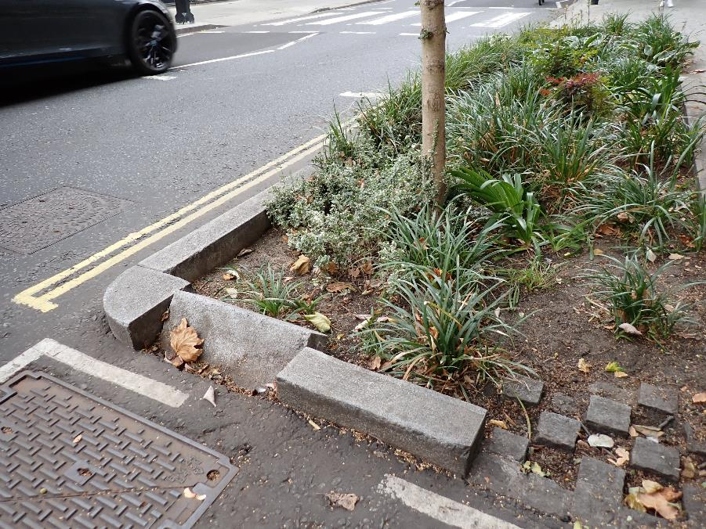
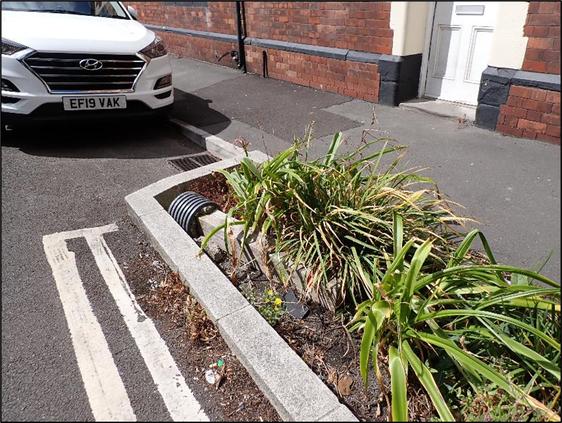
Structural damage can easily occur

Slide 15
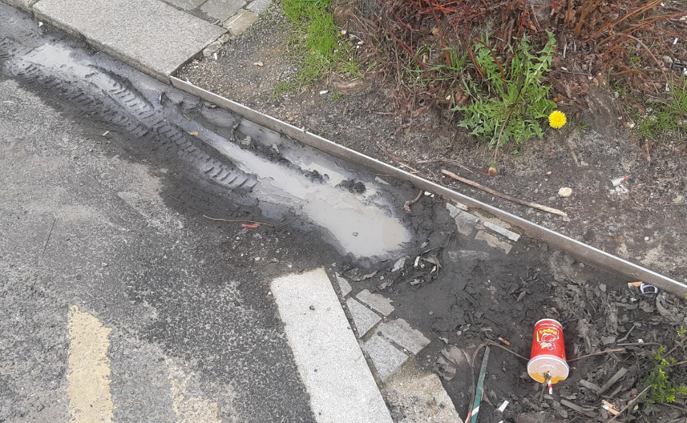
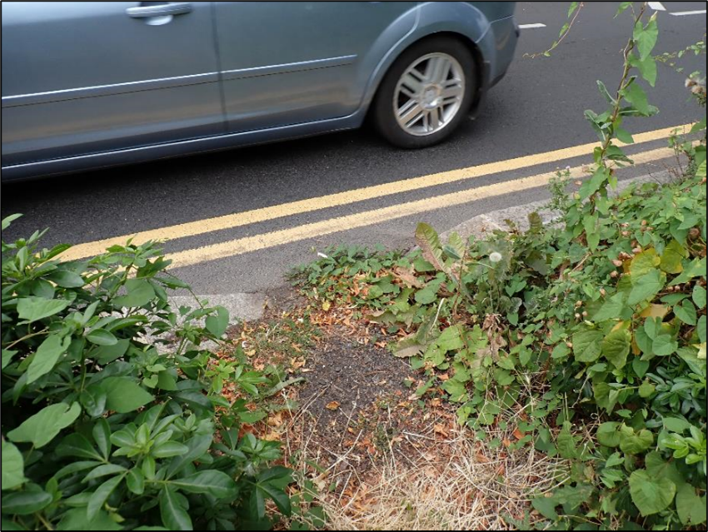
Blocked Inlets can become a problem

Slide 16
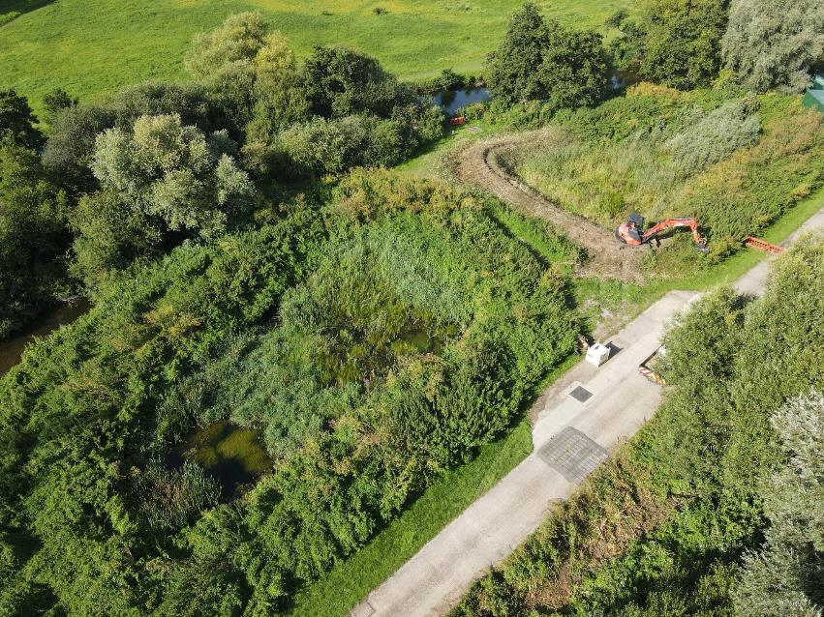
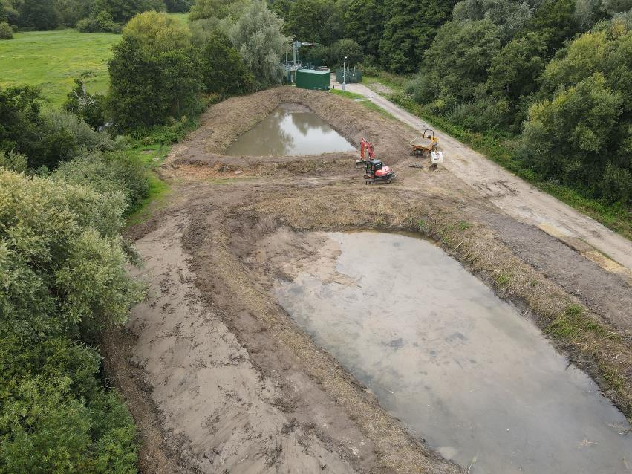
How does maintenance affect wildlife?
Photo credit: Stuart Banks off LinkedIn

Slide 17
Summary
We know how to design and build good SuDS, but we haven’t fixed the maintenance problem yet.
Lack of maintenance is letting us down; SuDS schemes are becoming scruffy and unattractive.
If we are not careful, ‘bad press’ will affect the appetite for SuDS in some areas and undermine two decades of hard-work.
We have to work out how to fund and deliver maintenance.
I was recently told that local authorities can’t commit to maintain a SuDS device ‘forever’ because their revenue budgets are renegotiated and reset every few years and the budget for SuDS maintenance can ‘disappear’ at any time.
How do we change that?

Slide 18
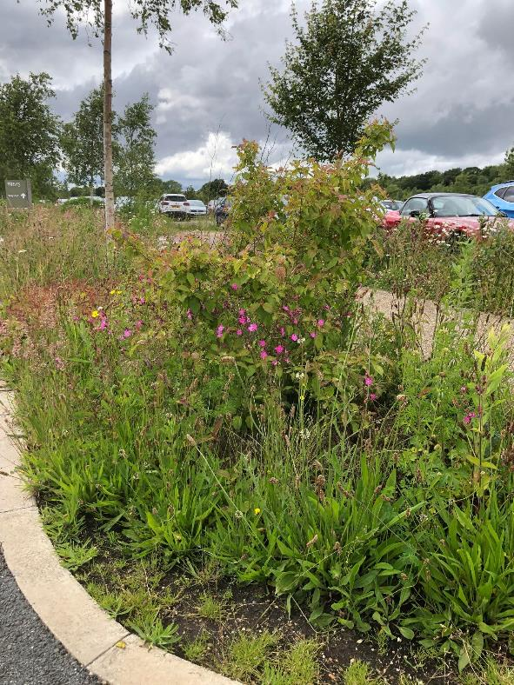
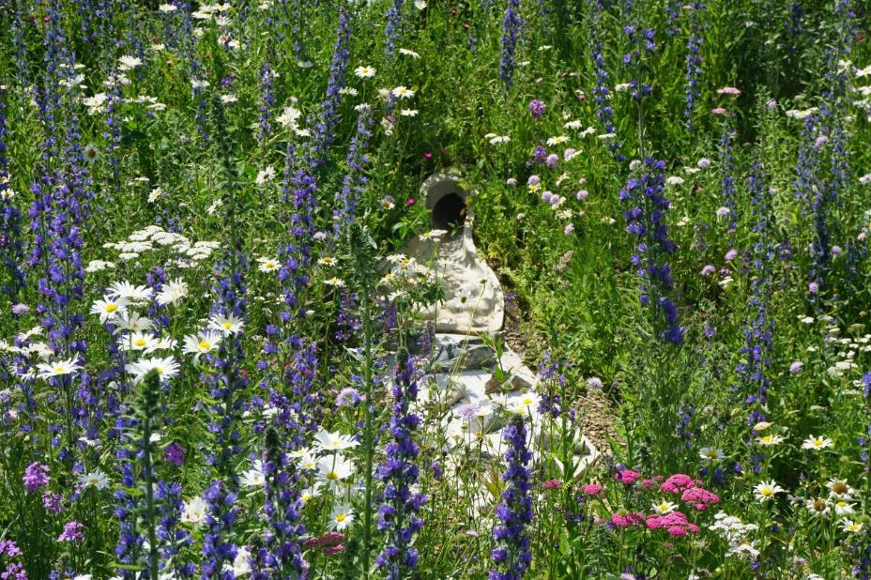
Let’s end on a positive!
Mansfield bioremediation zone – Photo: Dan Cornwell
RHS Bridgewater

Slide 19



Feel free to call me if you have any questions
Please follow me on Twitter @ stormwater_jo
And on LinkedIn
Visit our website, and maybe make a donation
stormwatershepherds.org.uk
jo.bradley@stormwatershepherds.org
Tel: 07799 380 523

