Slide 1





www.metisconsultants.co.uk

Slide 2
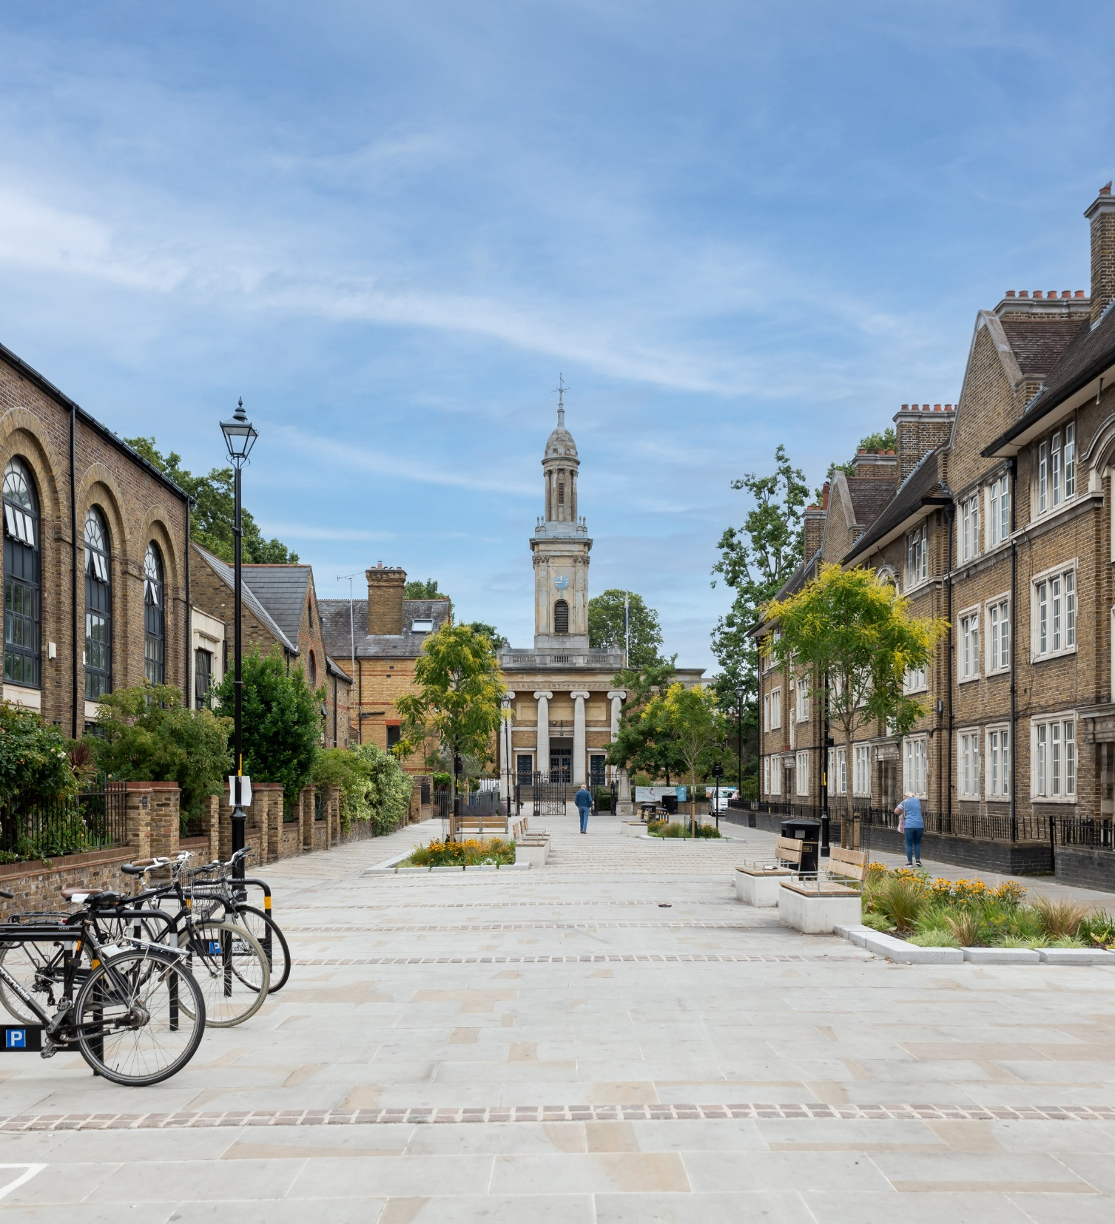
Urban Development and the Benefits of SuDS

Slide 3




Why SuDS in Southwark
Urban Development and Funding
Agenda
Identifying Suitable SuDS Sites
Case Studies

Slide 4
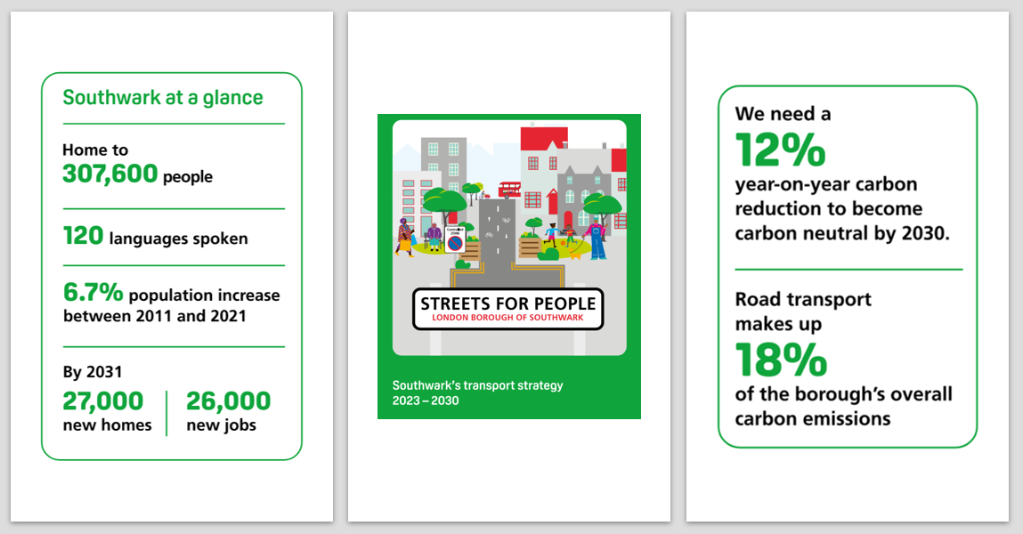
Why SuDS in Southwark

Slide 5

Urban Development and Funding

Slide 6
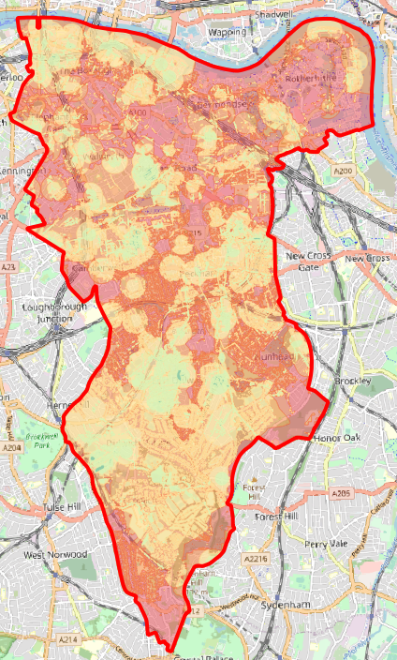
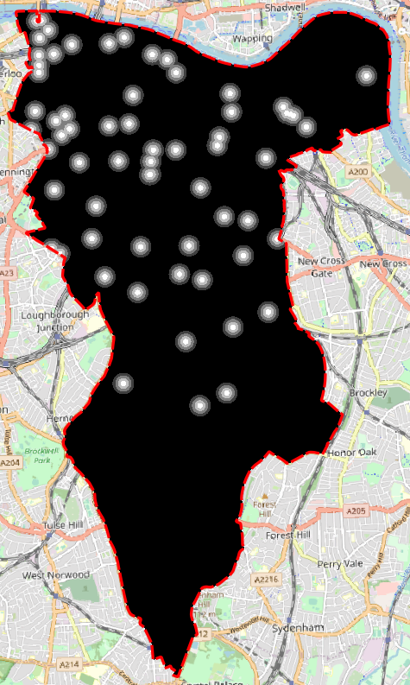
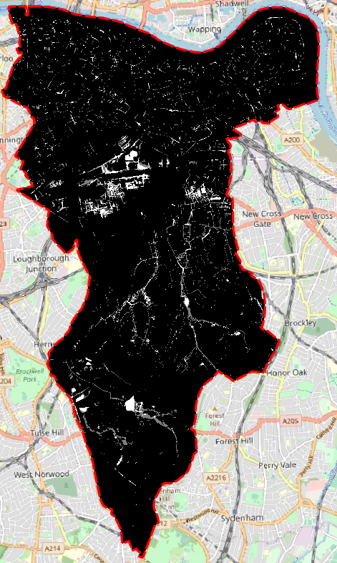
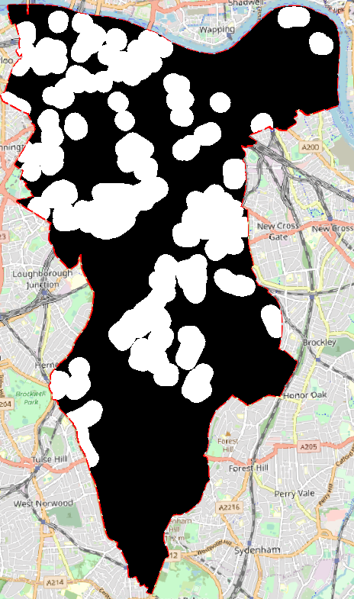
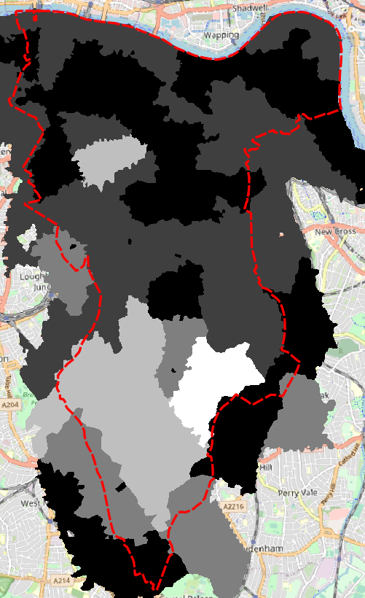
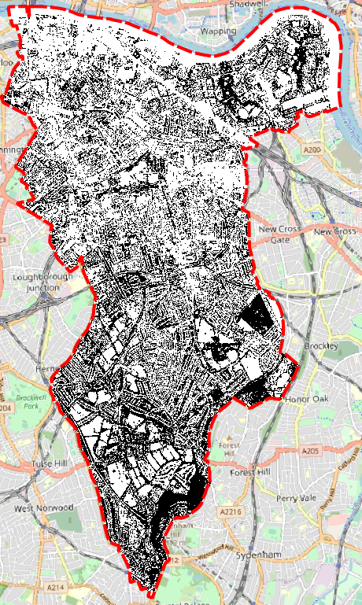
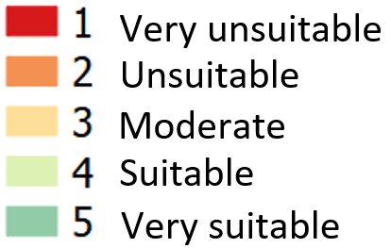
Identifying Suitable SuDS Sites
Opportunity Mapping
Risk of Flooding 1in100 (Depth)
Historic Flooding
Flooding Hotspots
Sewer Flooding
Tree canopy cover

Slide 7
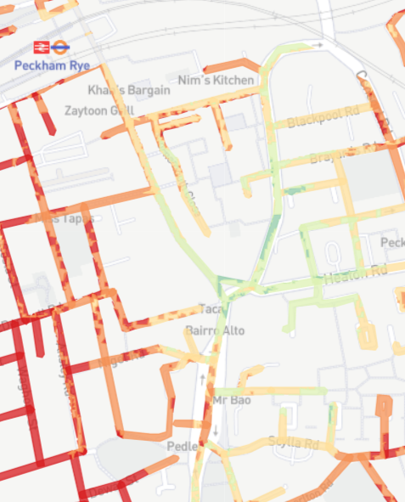
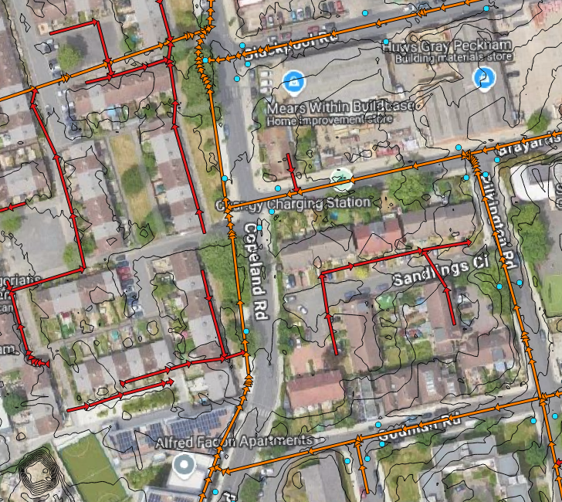
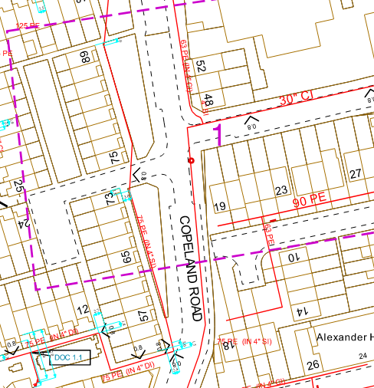
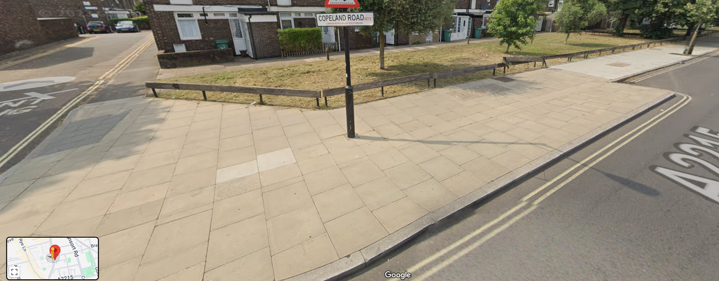
Identifying Suitable SuDS Sites
Opportunities and Constraints

Slide 8
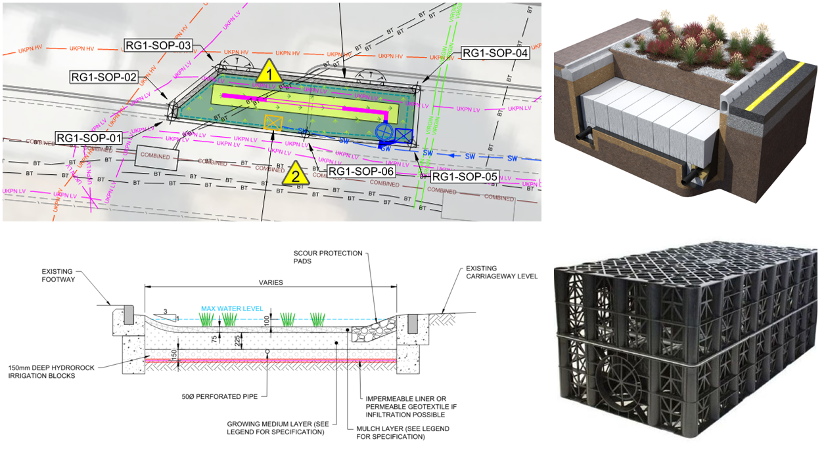
Copeland Road SuDS

Slide 9
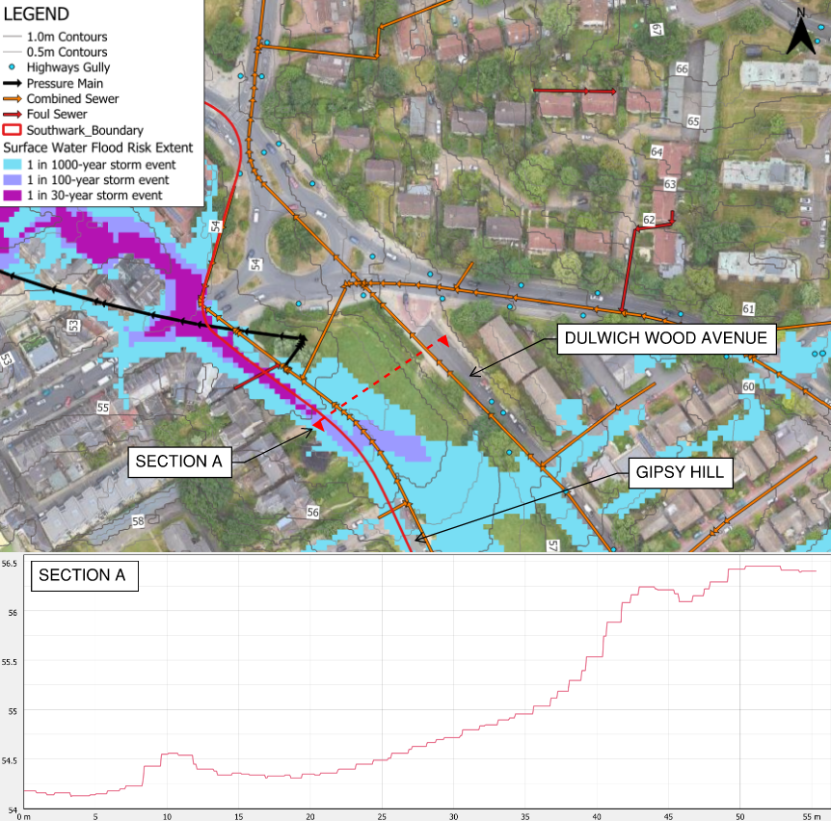
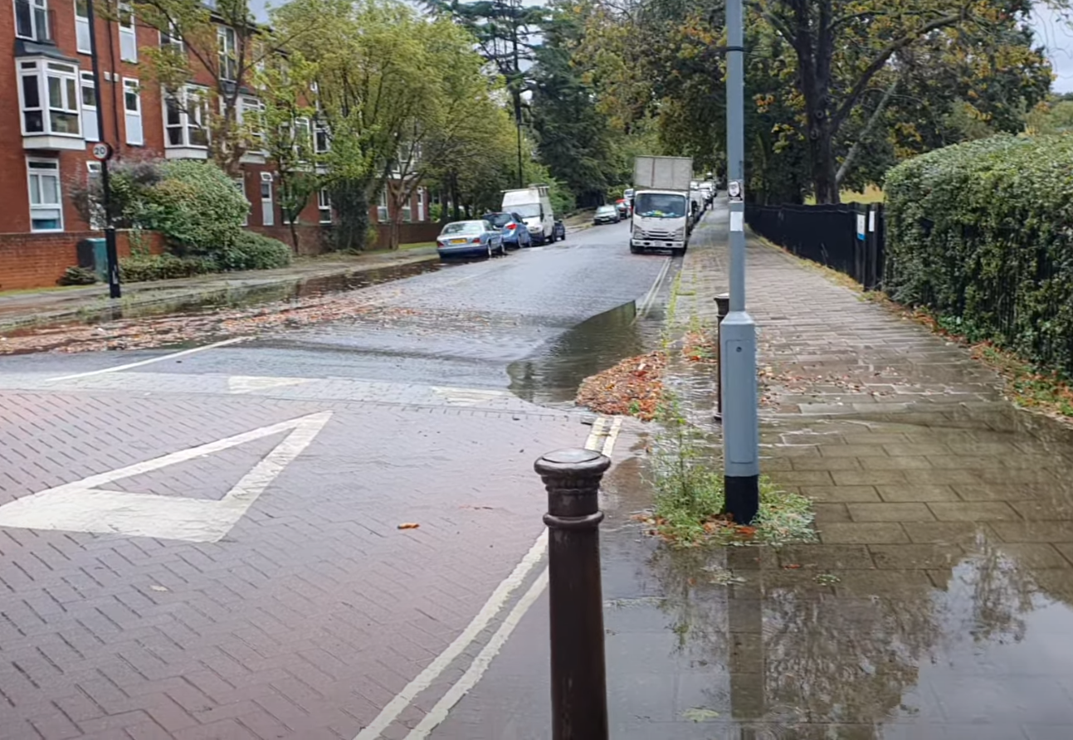
Gipsy Hill SuDS

Slide 10
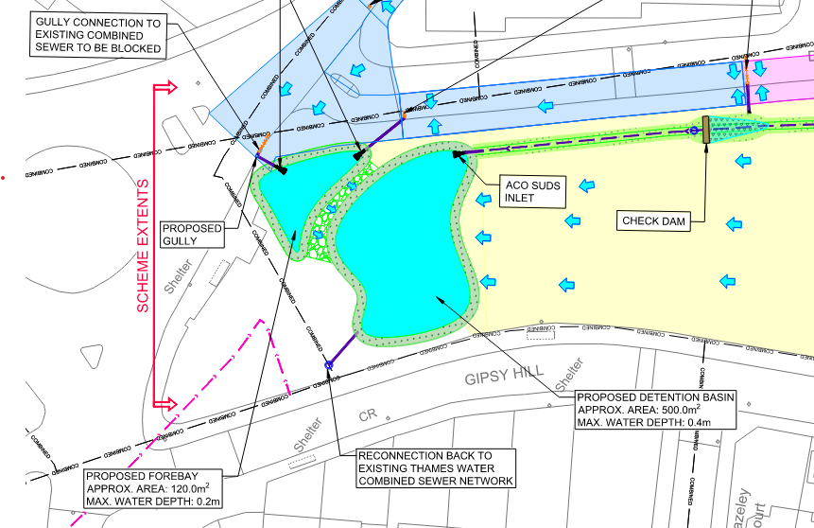
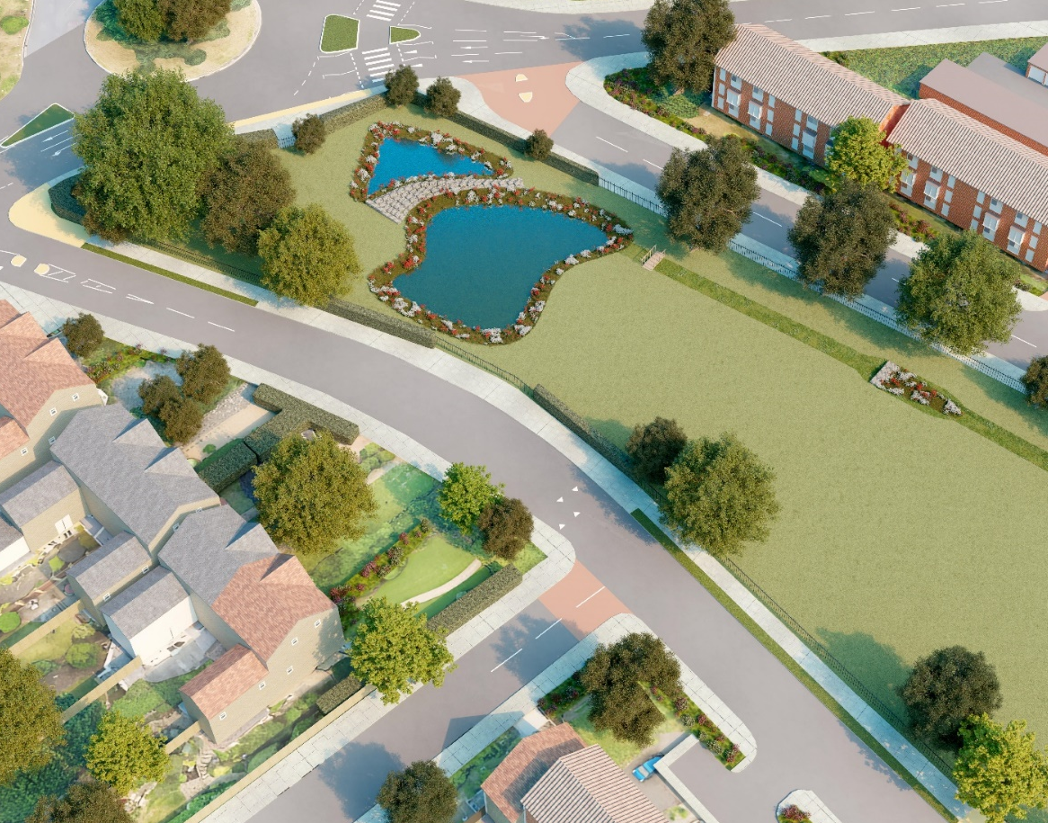
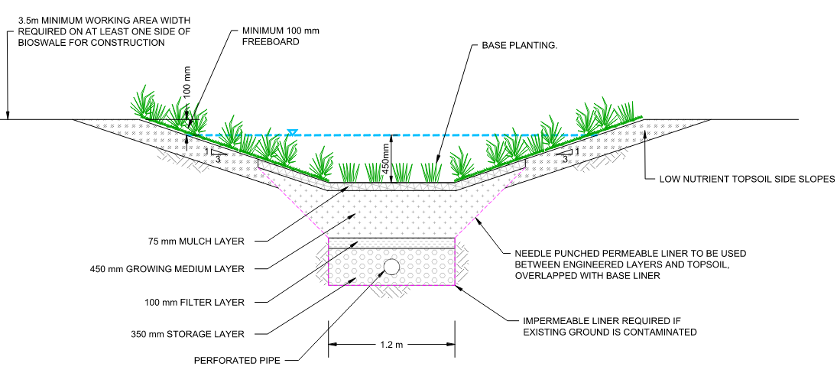
Gipsy Hill SuDS

Slide 11
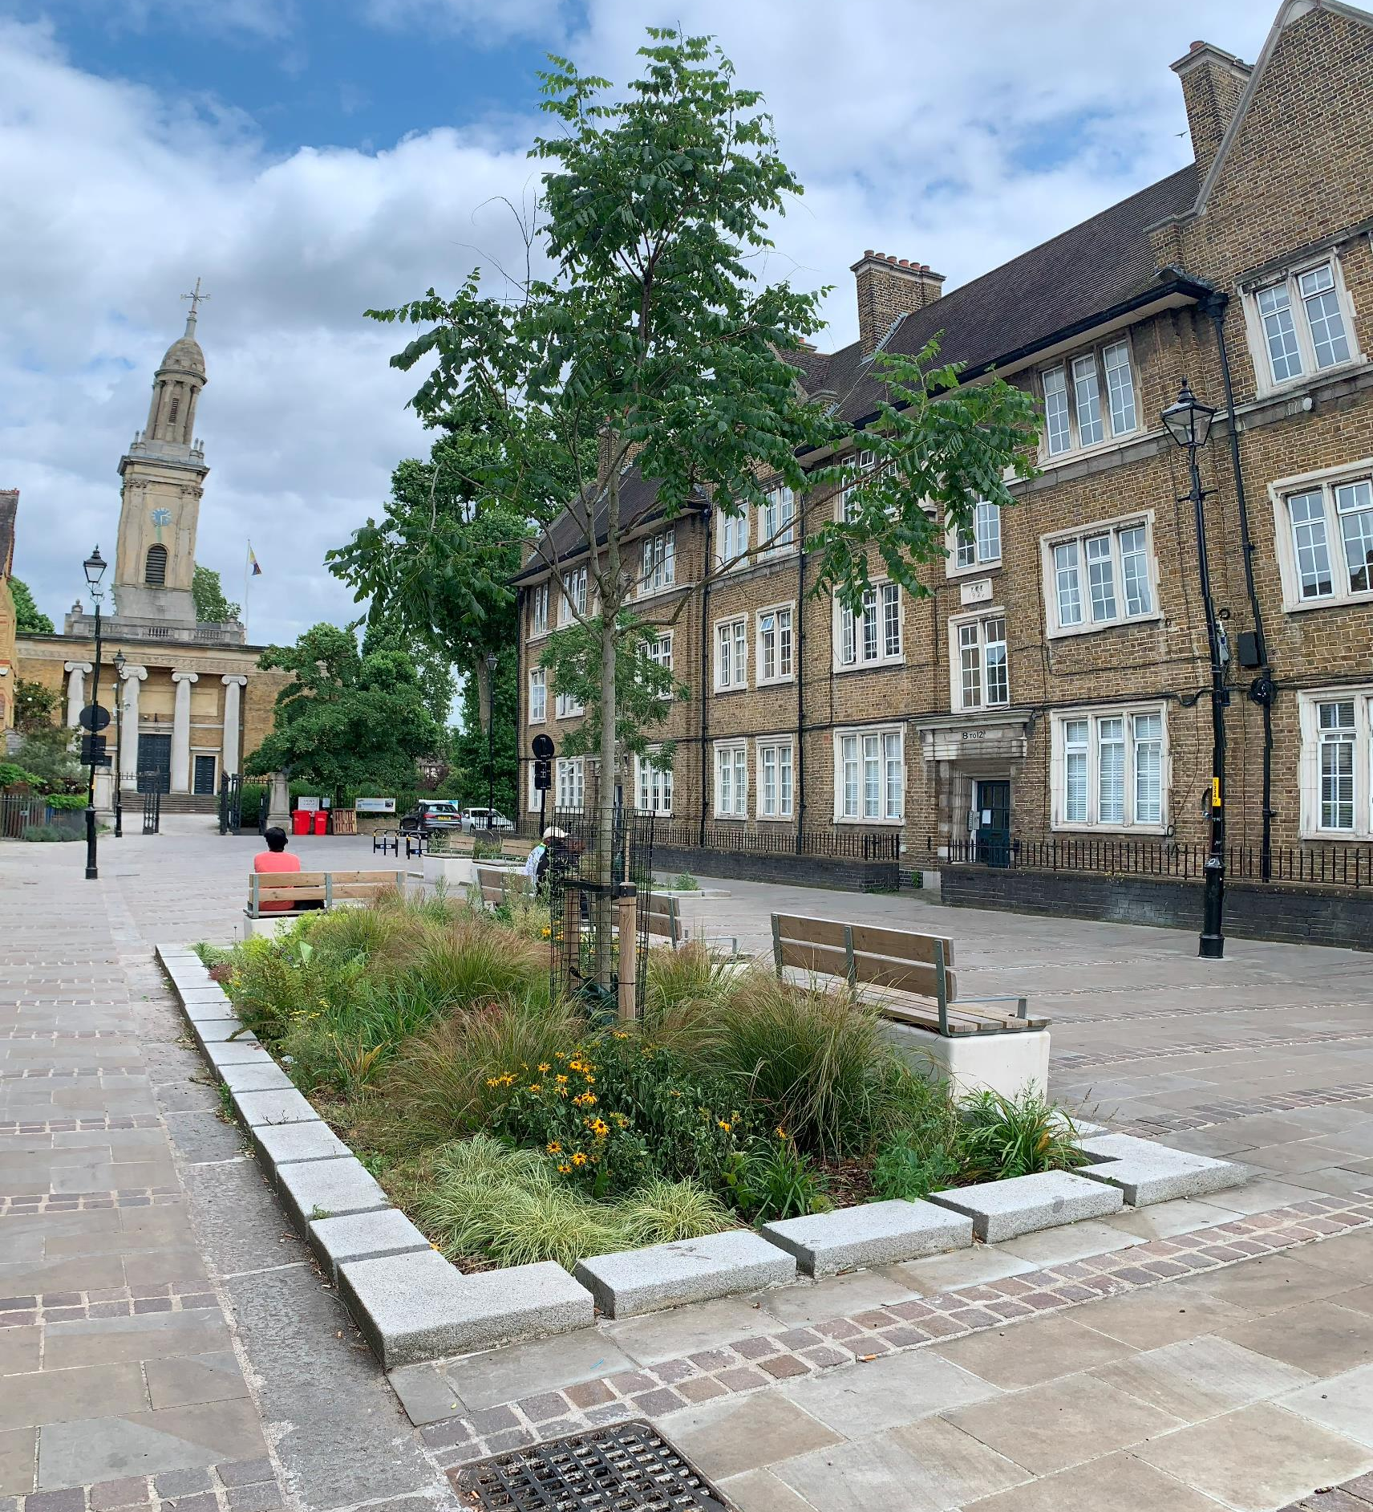
Thank you

