Slide 1
Surface water flooding in London
Holly Smith, Project Manager, Climate Adaptation Team
November 2024
Notes:
For those of you that don’t know what the GLA is, we work on behalf of the Mayor of London to deliver for Londoners.
I am going to go through what has been going on in London over the last year specifically around suds but also going to throw a few other things outside of suds

Slide 2
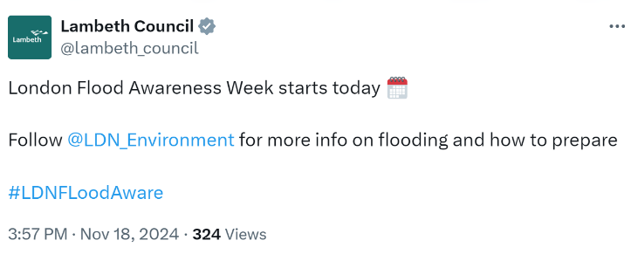
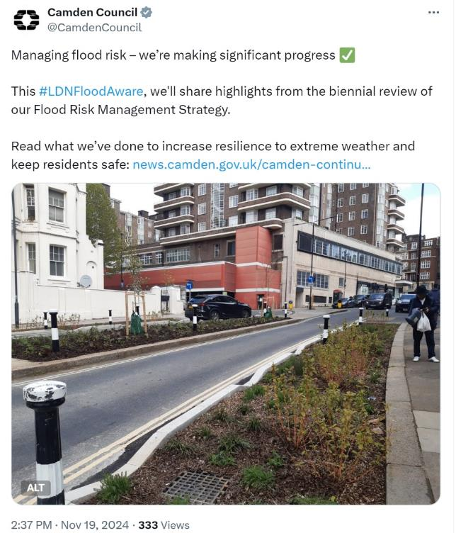
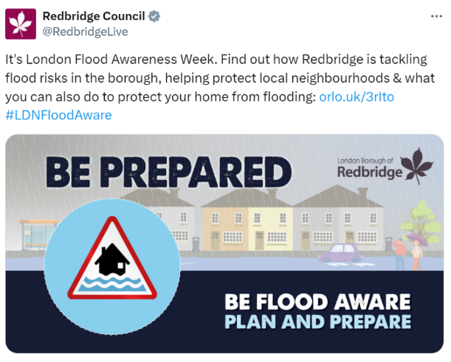
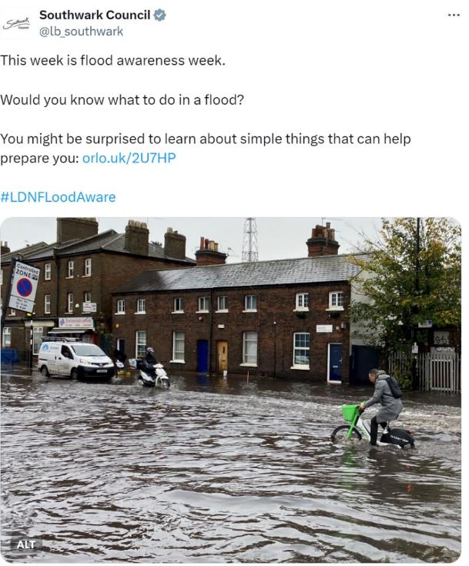
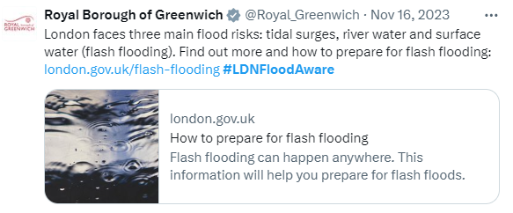
London Flood Awareness Week
18 – 24 November
Notes:
Its LFAW! Our 6th yearly campaign we run to make Londoners more aware of their flood risk, particularly the risk of surface water flooding (also known as flash flooding) and how they can be better prepared. We also want to highlight the great work happening around surface water flooding in London.
These are some posts from last year. According to analysis by the website “Brand Mentions” the campaign had the potential to reach 2.6 million people*. 75 postsd across 28 account.

Slide 3
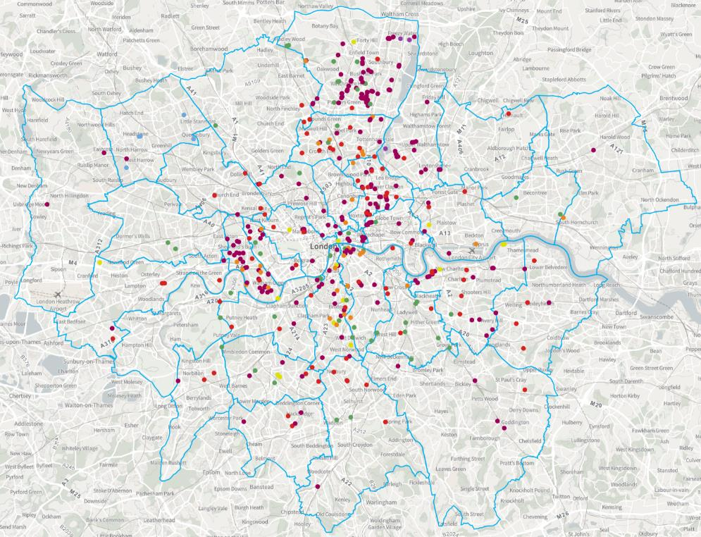
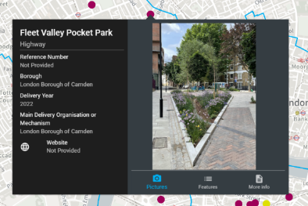
SuDS Retrofit Map – editable version
https://cityhall.maps.arcgis.com/apps/webappviewer/index.html?id=4d239b344fda4e6fb13c9a0efd7343c2
View and add locations of retrofit suds around London – please add your schemes!
Be sure to add photos and as much information on catchment/attenuation as possible.
The “public” map is here: https://apps.london.gov.uk/suds
Your scheme will show up on the public map once approved.
Notes:
So at the GLA we dont actually deiver that many suds schemes, its mainly delivered by the boroughs, land owners and others. Wanted to highlight this map to encourage all these SuDS installers int he room to add their schemes to the map. I report on this map and
https://apps.london.gov.uk/suds/– If your scheme isn’t on the map or the details are incorrect, please get in touch. LLFAs can now add their new SuDS schemes to this map. They must be complete on the ground , with photos ideally. It will then come to us to be approved and then they will go on the live public map. If you have a load of points to add, send us a shapefile and I can add them.
- The GLA have launched a retrofit SuDS Map of London. On this map, you can view locations of retrofit sustainable drainage systems (SuDS) around London. It show the good work done throughout London on SuDS in the public realm.

Slide 4


Climate Resilient Schools
95 schools
SuDS rain planters
72 schools with planters.
564 planters in total storage 157m3 of water
That’s 1962 bathtubs
First 3mm of a storm which is significant
Smarter Business Visits
28 schools have had SBVs (32 had already been visited).
558,892 litres of water saved per day.
1 Olympic swimming pool saved over a week!
Education and Monitoring
24 schools with planter loggers and/or weather stations.
Education resources produced in partnership with school teachers.
Climate Adaptation Plans (CAPs)
60 schools with CAPs
Overheating an issue in 78% of schools
Overarching summary document produced
Notes:
I just said we didn’t install SuDS much but we did have a big programme a couple of years ago. I wanted to show you some updated photos from the climate resilient schools programme that we finished back in early 2023. AS a reminder if you haven’t heard about this prgroamme...
Partnership between Mol, Department for education and Thames Water. £1.5 million programme. Contiuation of the schools guidance
Aim was to deliver a fully funded programme to help up to 100 primary and secondary schools across London become more resilient to heavy rainfall.
One part of the 4 part programme is the installation of sustainable drainage rain planters connected to drainpipes to make playgrounds greener and reduce surface water flood risk.
Thames Water are also carrying out water effeiecy audits, there smarter business visits to help save water in the schools.For example they could install water flow restrictors on taps, fix leaky urinals and install low flush toilets.
Climate adaptation education resources will be produced as well. As we are working with primary and secondary schools, these will be tailored to the different key stages. We hope to link this to the monitoring of the suds rain planters as well, using data in a smart and friendly way to engage students on climste change.
Finally we will create bespoke climate adapataion plans for the schools. Showing them how they could add in climate resilience and adaptation interventions in their schools, linking them to upgrades and maintenance schedules.

Slide 5
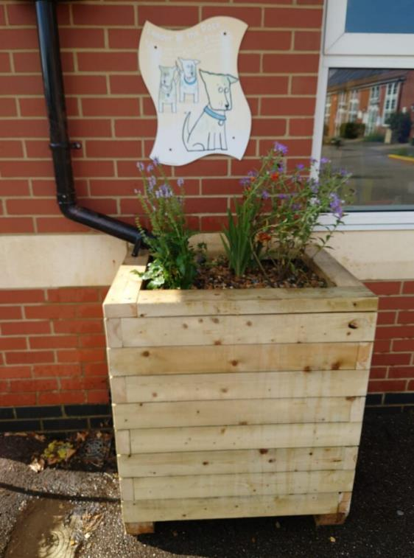
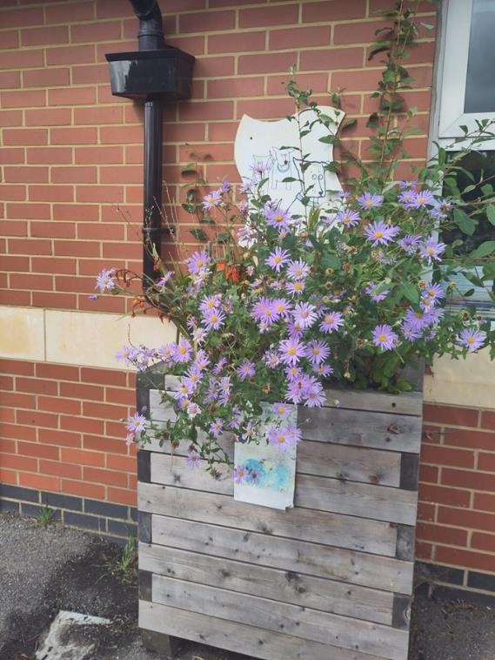

Climate resilient schools
Legacy
Image Credit Meristem Design
Image Credit Holly Smith
Notes:
SuDS rain planters
before 2022
after summer 2024

Slide 6
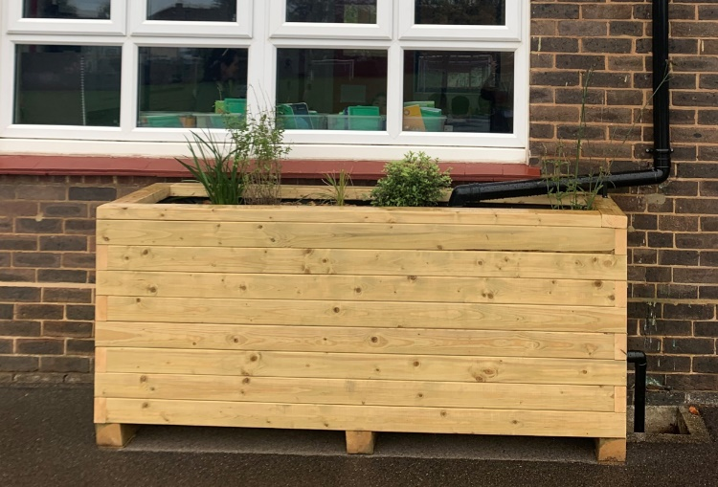
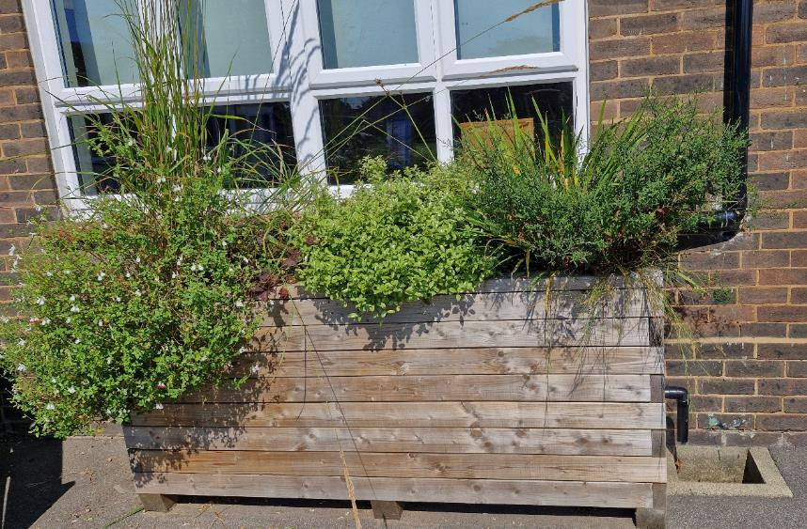
Climate resilient schools
Legacy
Image Credit Meristem Design
Image Credit AmbioTEK
Notes:
SuDS rain planters
before 2022
after summer 2024

Slide 7
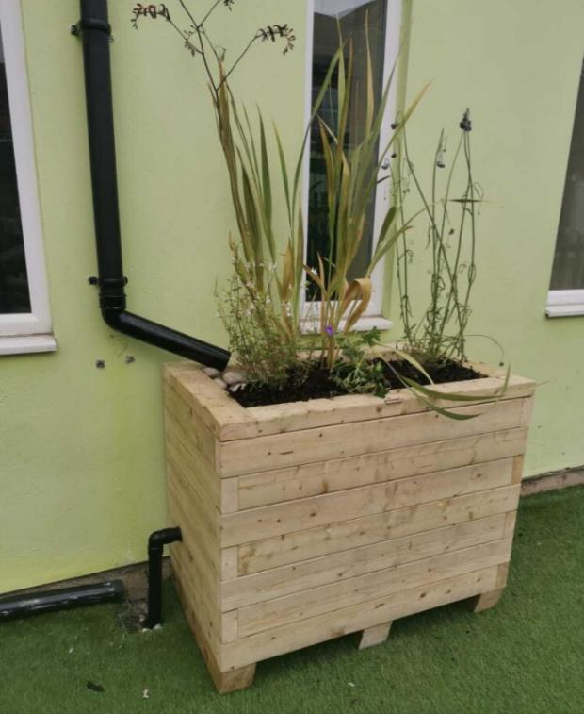
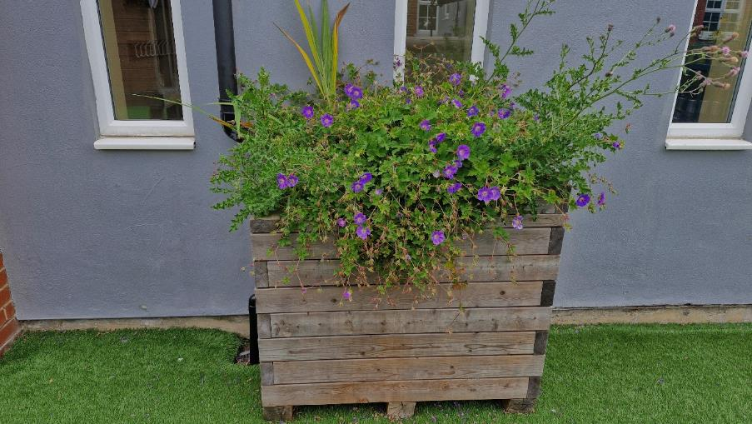
Climate resilient schools
Legacy
Image Credit AmbioTek
Image Credit Meristem Design
Notes:
SuDS rain planters
before 2022
after summer 2024

Slide 8
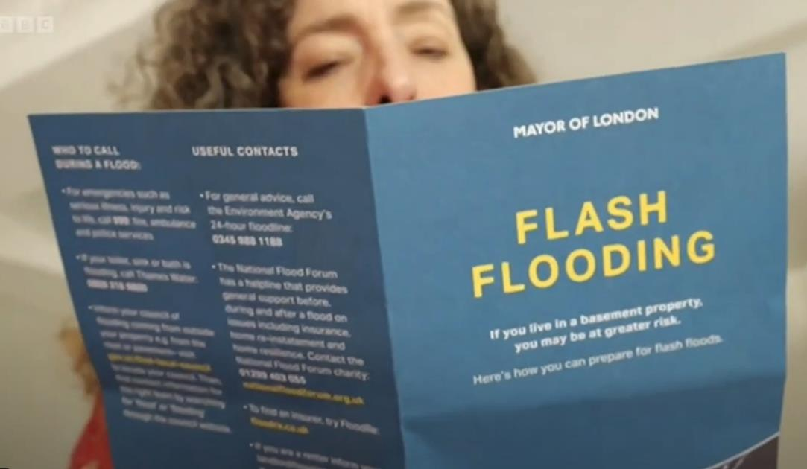
Basement data
56,000 leaflets were sent to basement properties across London during August.
help Londoners prepare for possible flash flooding and providing advice on what to do during and after such events.
An additional 6,000 requested leaflets were sent to community groups to distribute to their members and networks.
www.London.gov.uk/flash-flooding
Notes:
3rd year. Last year 49,000, we have identified 7000 more addresses with the ordnance survey new dataset.

Slide 9
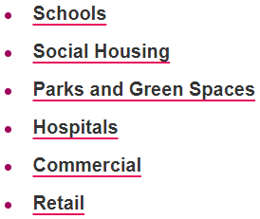
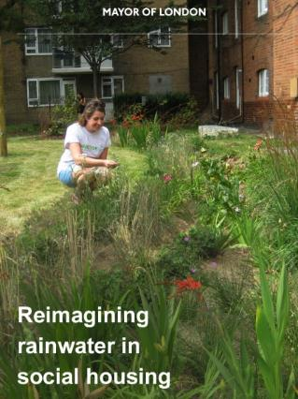
SuDS Sector Guidance - HIghways
Current project adding to our suite of SuDS guidance
Existing SuDS sector guidance:
Working with the infrastructure team to produce this new guidance for highways.
It is highly requested sector guidance. There is other guidance out there, but a lot is outdated or not relevant to London.
Due for publication soon.
It will include:
Myth busting around SuDS in the highways
Case studies of best practice
Funding approaches
Notes:
Due to be delivered soon!

Slide 10

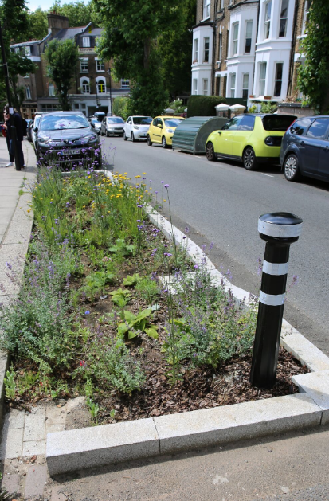
SuDS through streetworks
Parliament Hill, Camden collaborative streetworks.
'Developing a market-based approach to deliver SuDS through streetworks'
Background
In 2023, GLA led a collaborative project to develop a market operator model to scale-up delivery of SuDS through streetworks in London
This validated GLA / TW joint application to Ofwat's Innovation fund to take the market-based approach to a ready to implement stage: secured funding!
18-month project – October 2024 to April 2026
Project relevance
Objectives: 1) Creation of an implementable market framework, 2) industry awareness and commitment to implement market framework
Aligns with: London Surface Water Strategy interim report, London Climate Resilience Review (Recommendation 47), highways sector guidance and SuDS opportunity map etc.
Notes:
The GLA and TW has received funding from the Ofwat Innovation Fund to jointly deliver a project with Thames Water on SuDS. The project will develop a market-based mechanism to incentivise utility companies to install SuDS when reinstating their street works excavations instead of replacing the original surface. This innovative and cost-efficient approach aims to manage flood risks while simultaneously reducing road network disruption and bring along all the other benefits of SuDS that we are familiar with.
To date, the GLA’s Infrastructure Coordination Service has delivered 2 pilots whereby SuDS was installed alongside planned utility asset replacement works.
In both projects, Cadent Gas installed new gas mains, with the Boroughs of Enfield and Camden then reinstating the footway and highway with a SuDS feature.
These ICS pilots have shown that SuDS and utilities works can be delivered collaboratively – saving cost and disruption.
SuDS need to be delivered at scale and faster than BAU in order to address flood risk in London. Thames Water’s DWMP estimated that 17,500 raingardens need to be delivered annually, and ~165,000 major/standard streetworks routinely take place each year; there is an opportunity to unlock collaborative delivery systematically.
In 2023 the GLA’s Infrastructure Coordination Service secured funding through the Department for Science, Innovation and Technology’s Regulators Pioneers Fund (RPF) to develop a “market-based approach” to enabling delivery of SuDS through planned streetworks at scale.
The approach conceptualises the problem in terms of supply and demand. In essence, organisations seeking to deliver SuDS (Thames Water, LLFAs) would be able to pay work promoters already delivering streetworks (utilities, highways authorities etc.) to include SuDS as part of their planned schemes. This interaction would be governed and managed by an independent market operator.
This phase of work validated the potential for a market mechanism to scale up delivery of SuDS through street works and generated support across stakeholders for the approach. With stakeholder support, in 2024 the GLA and Thames Water submitted a joint application to Ofwat’s innovation fund to deliver the next stage of development, to take the market-based approach from concept to a ready-to-implement state.
This was successful and funding was awarded.
Timeline: October 2024 – April 2026
LCRR - Recommendation for the Mayor: Works with public and private sector organisations to introduce a marketbased system to enable the delivery of Sustainable Drainage Systems (SuDS) with funding through planned Street Works Programme.
LSWS - This initiative connects organisations that dig up London’s roads with organisations willing to pay for SuDS installation. It was recently awarded £1.3m by Ofwat, the Water industry’s economic regulator.

Slide 11



Concept Overview
Ambition: Create a delivery mechanism to enable retrofit of SuDS at scale through streetworks collaboration and in line with policy ambition.
Supply
Demand
26k major works
140k standard works
17.5k raingardens per year
People who are delivering streetworks
Utilities
LAs
TFL
People who want to deliver SuDS
LAs / HAs / LLFAs
Water companies
Developers (BNG)
Other? (Schedule 3)
Common datasets, design standards, governance and processes, market mechanisms, commercial agreements etc

Slide 12








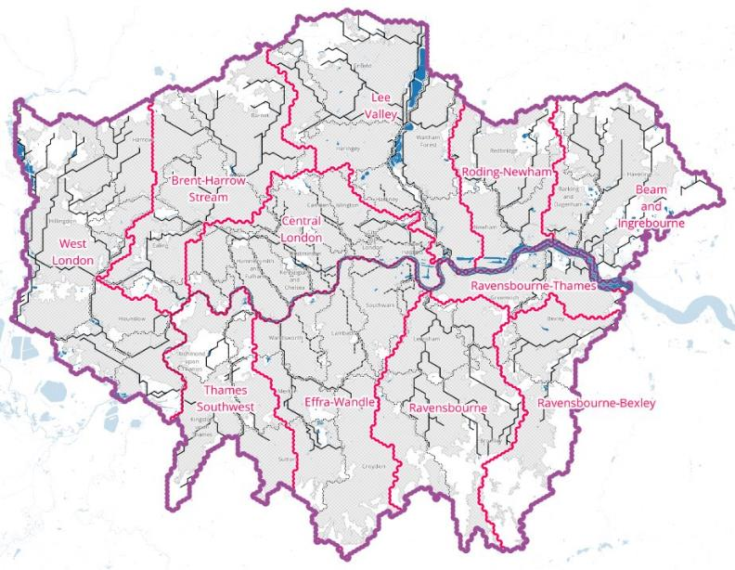
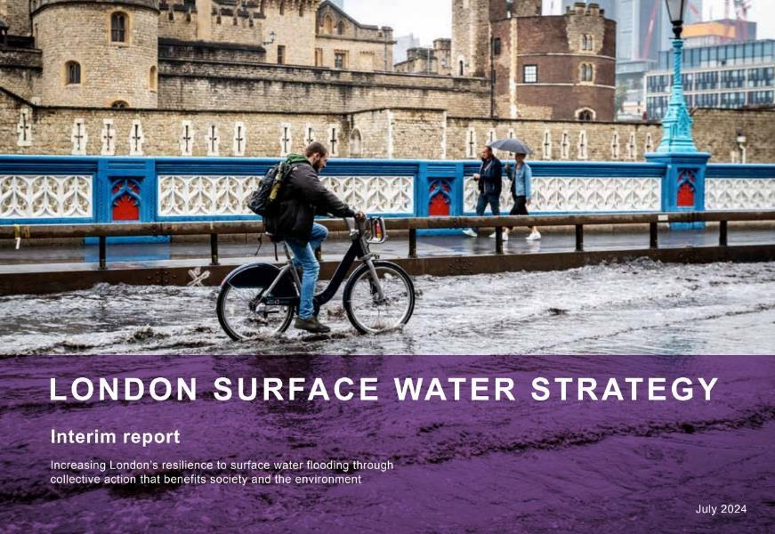
Surface water strategy
Strategy Vision: Increasing London’s resilience to surface water flooding through collective action that benefits society and the environment
Notes:
Interim report published in July with publication this winter. If you are a borough, you will hve had or will be having an session with the surface water strategy team by the end of November.
The main highlight is the development of these 11 new Surface Water Catchment Partnerships (SWCPs) with boroughs and other RMAs/partners. Looking ar surface water from a catchment perspective rather than borough by borough.

Slide 13

London climate resilience review
Published July 2024
50 Recommendations in total
25 directly to the Mayor of London
19 to UK Government
15 for local authorities
Many require co-delivery and have multiple owners
The Mayor of London and GLA will need to engage stakeholders (Anchors, wider public sector, businesses, communities, local authorities) to effectively advance London’s climate resilience.
Please go read it if you haven’t already!
Notes:
update on the LCRR

Slide 14
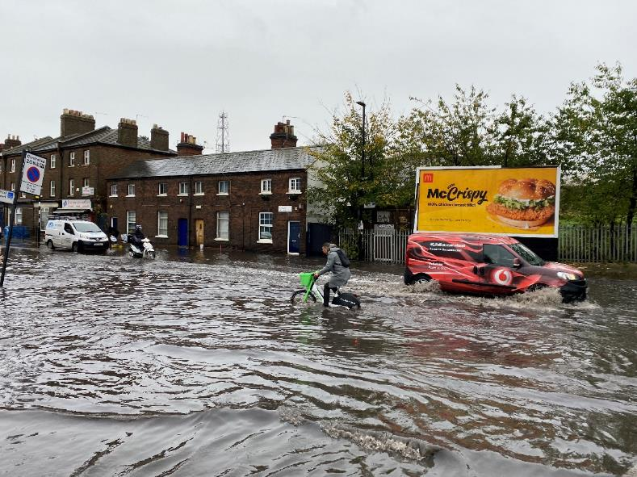
SuDS related recommendations
26. A step-change in Sustainable urban Drainage
27. A climate resilient built environment
32. Integrated Water Management Strategies
33. Strategic Surface Water Authority
34. Managing impermeable land
39/40. Blue and Green Infrastructure
47. Streetworks and Sustainable urban Drainage
Notes:
Plenty of x-cutting adaptation recs

Slide 15
Any questions?
Holly.Smith@london.gov.uk
Notes:
Just one last thing to flag is around water quality, CSOs have been mentioned several times already and river pollution is a big issue for the Mayor

