Slide 1
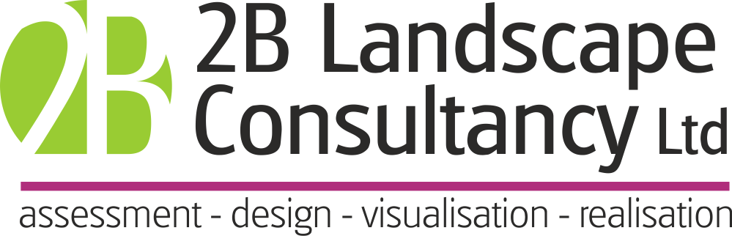

Early housing scheme – not yet completed
Bill Blackledge CMLI
Susdrain SuDS Theatre, Floodex
27/11/2024

Slide 2
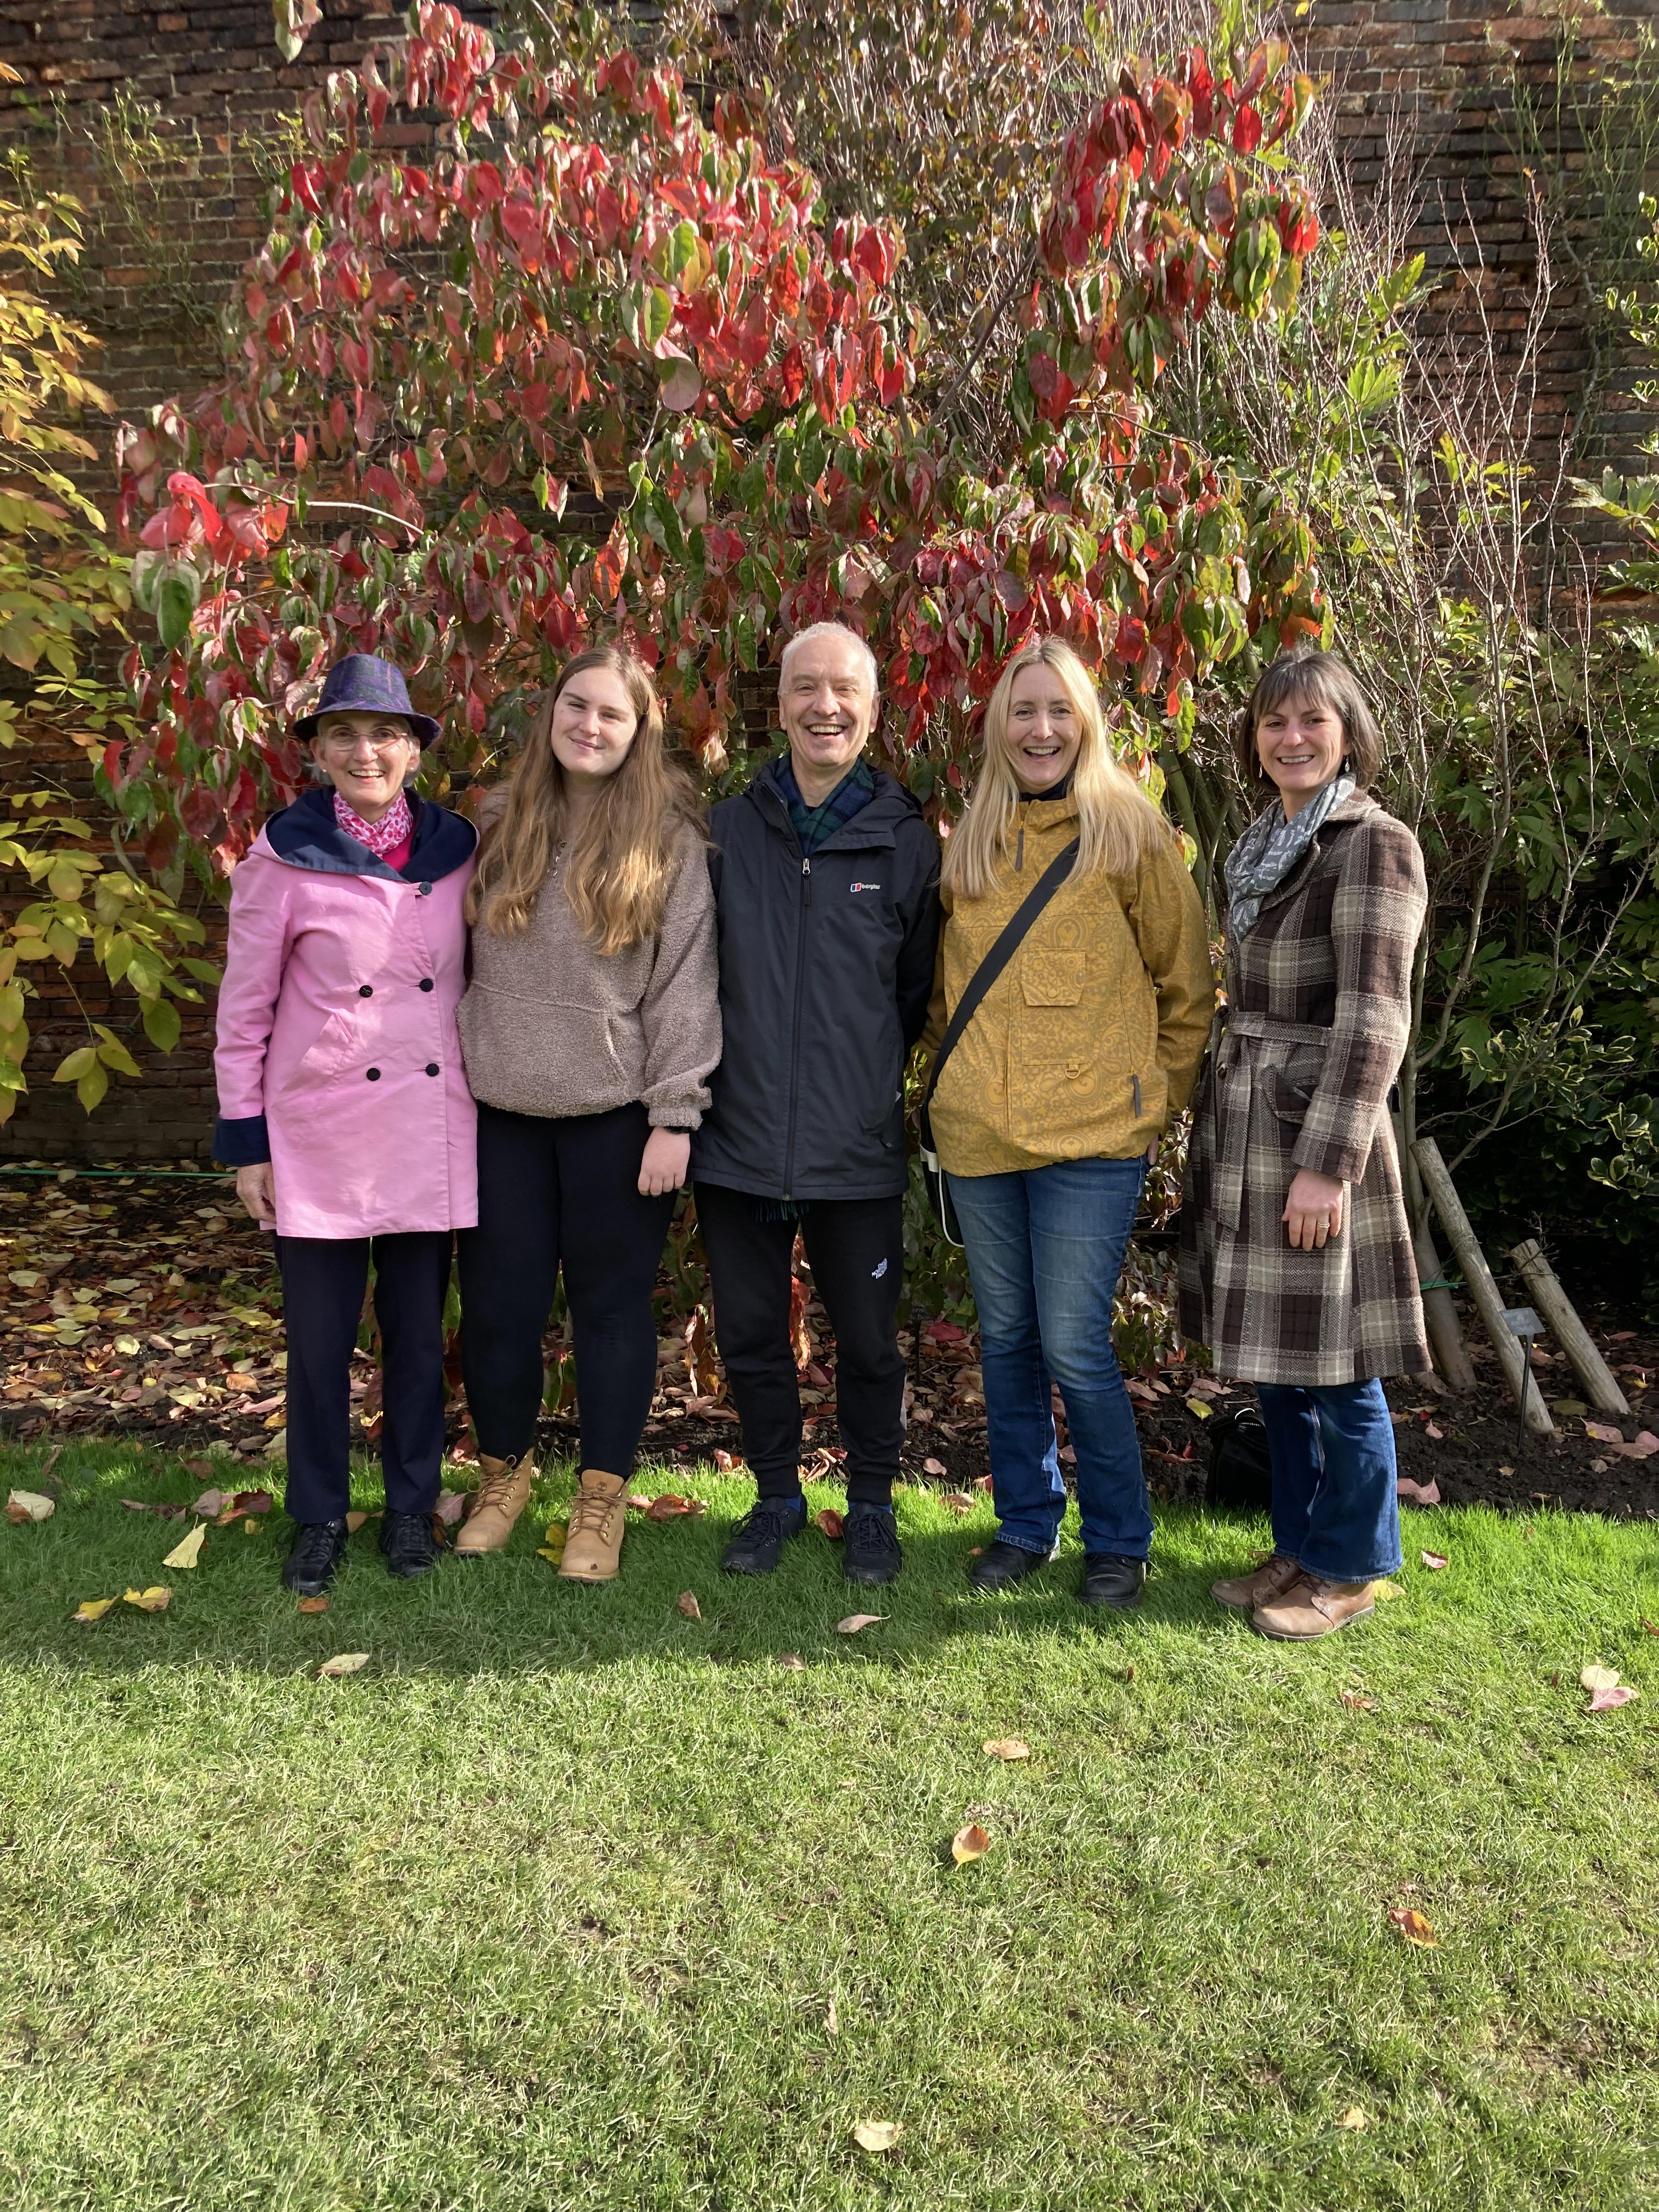
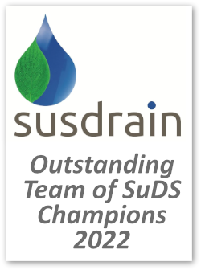
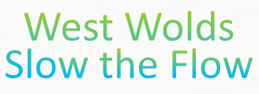

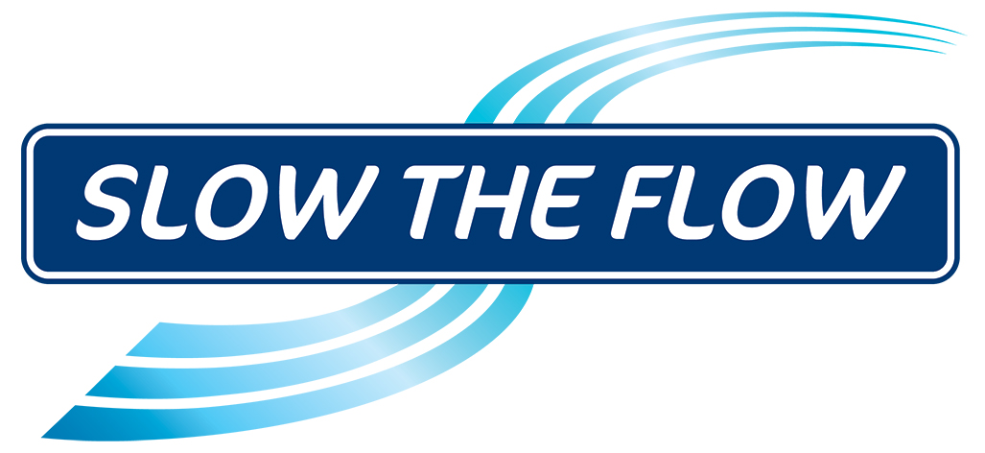
Bill Blackledge CMLI

Slide 3

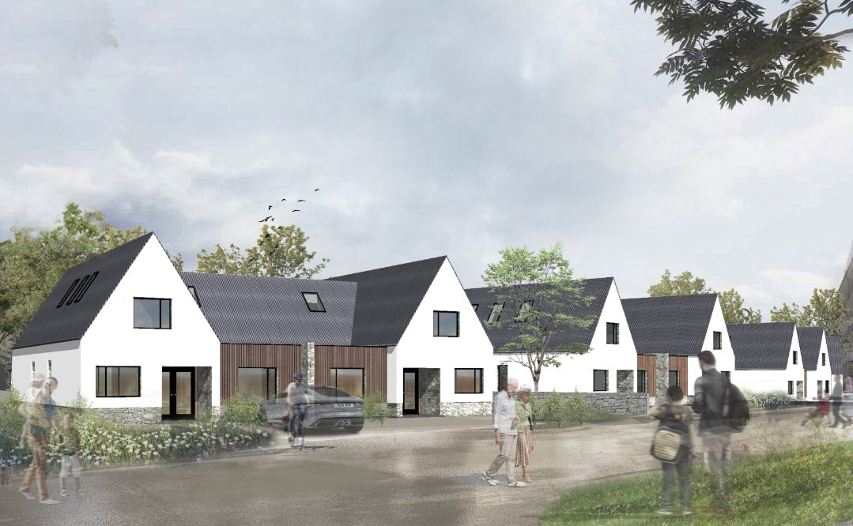
Wellbank Park Self-build Housing, Cumbria

Slide 4
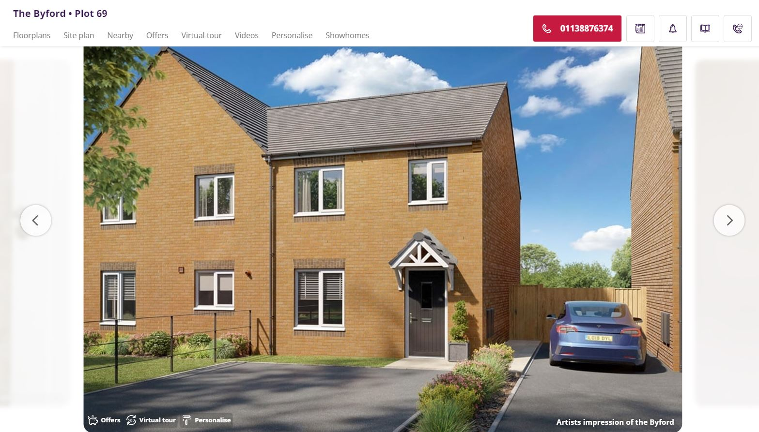

Slide 5
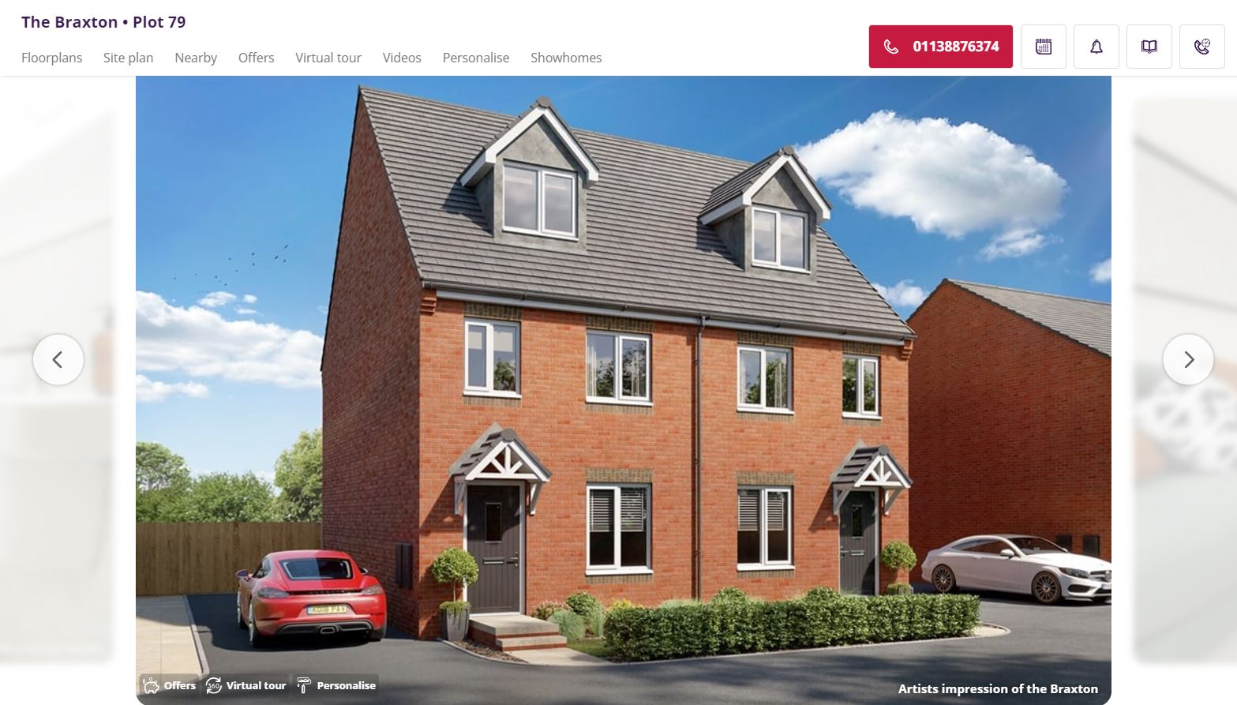

Slide 6
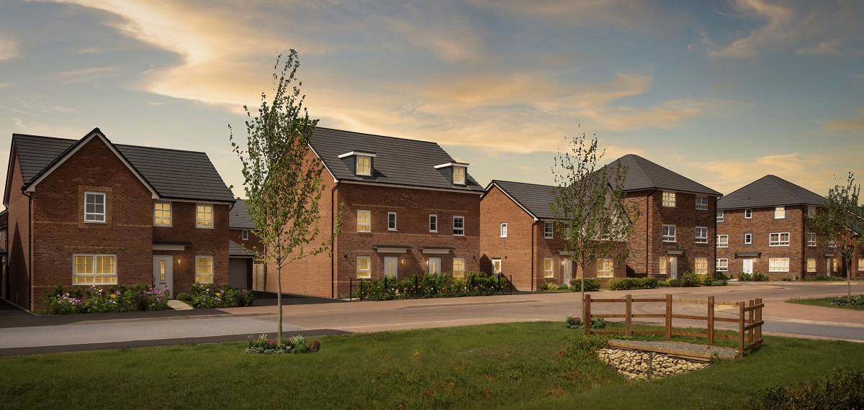

Slide 7
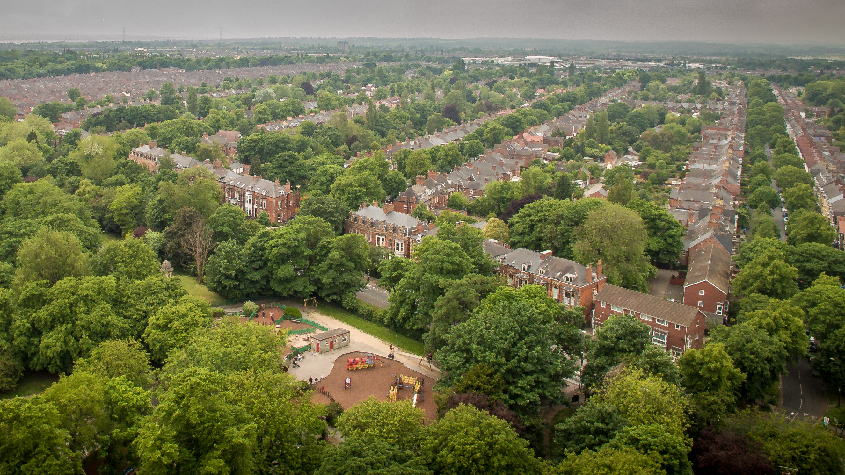

Slide 8
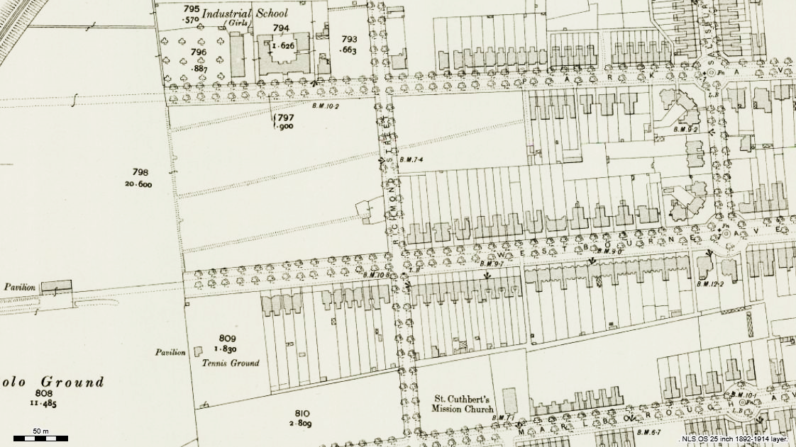

Slide 9
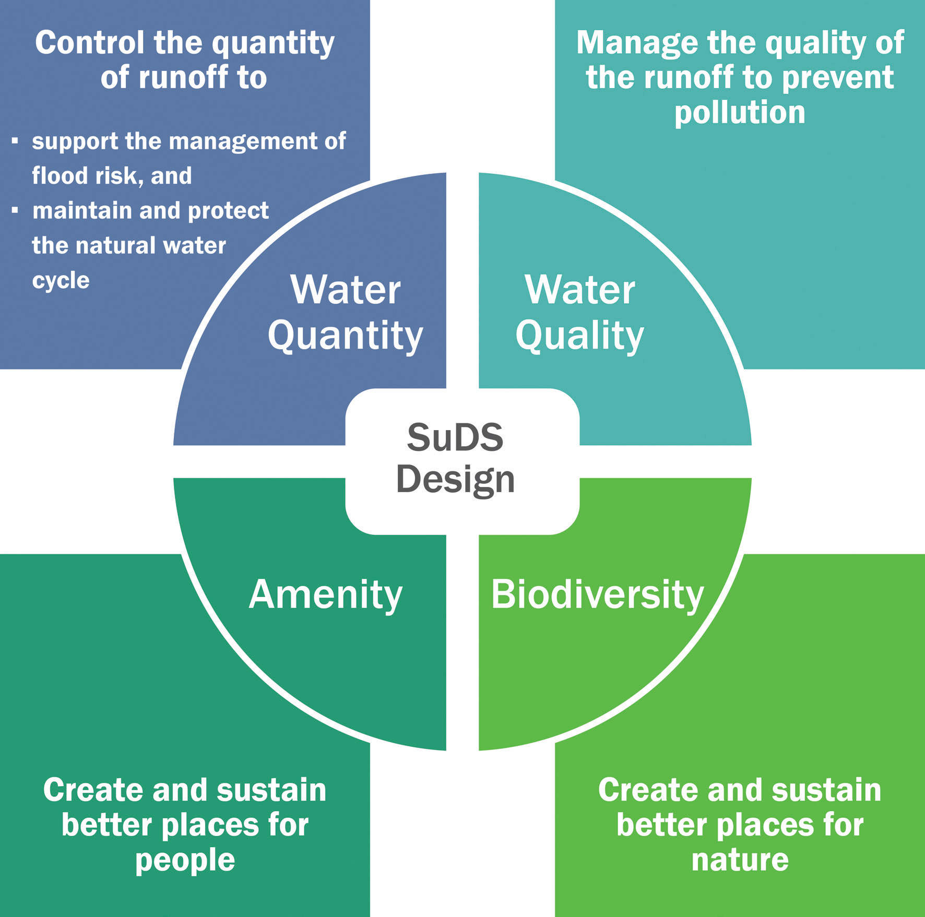
Landscape Design
Save money
Help sales
Satisfy regulation
Climate mitigation
Multifunctional
Better places
…Unlock development
Sustainable Drainage
Biodiversity (Net Gain)

Slide 10
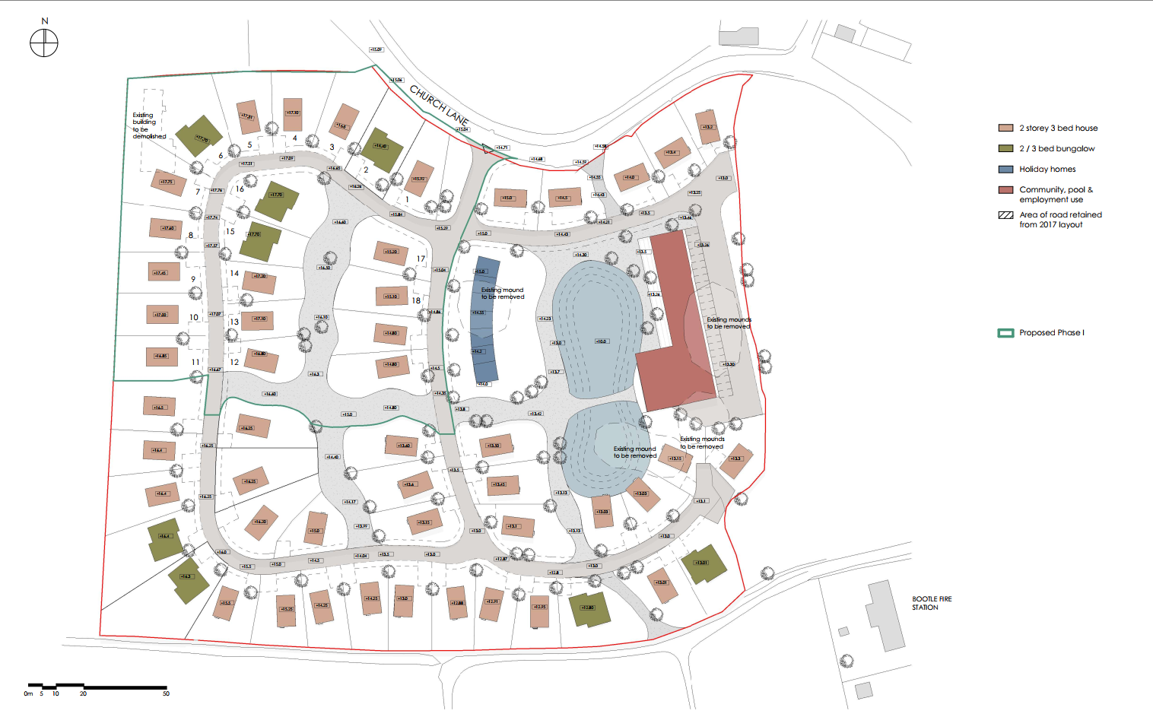
Project image here

Slide 11
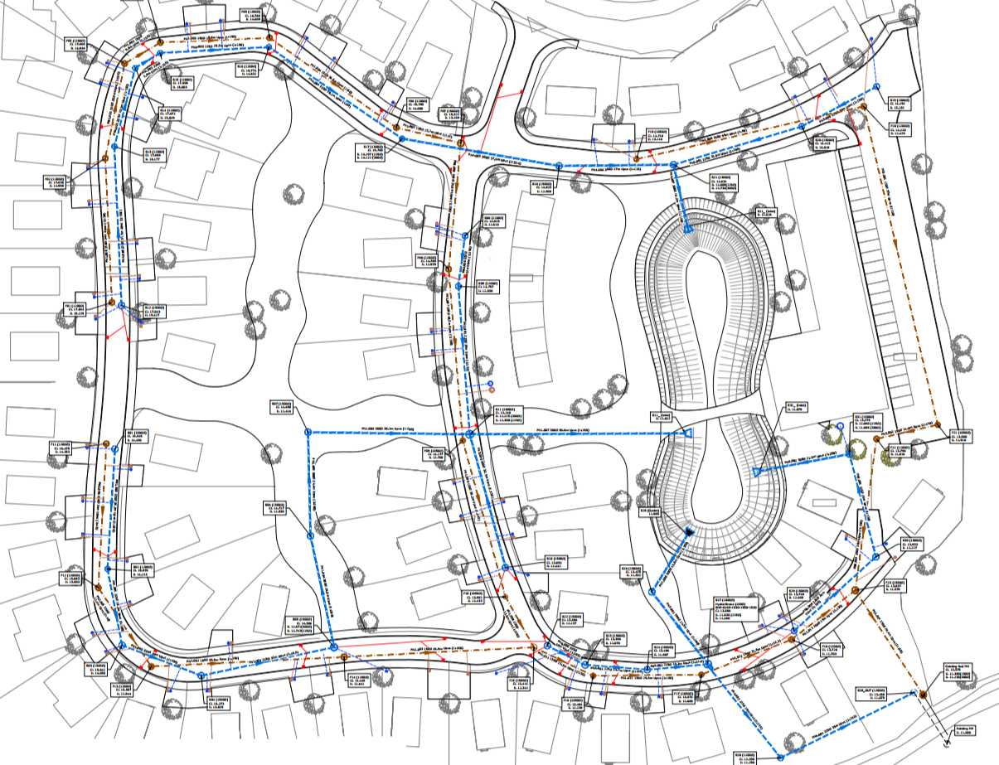

Slide 12
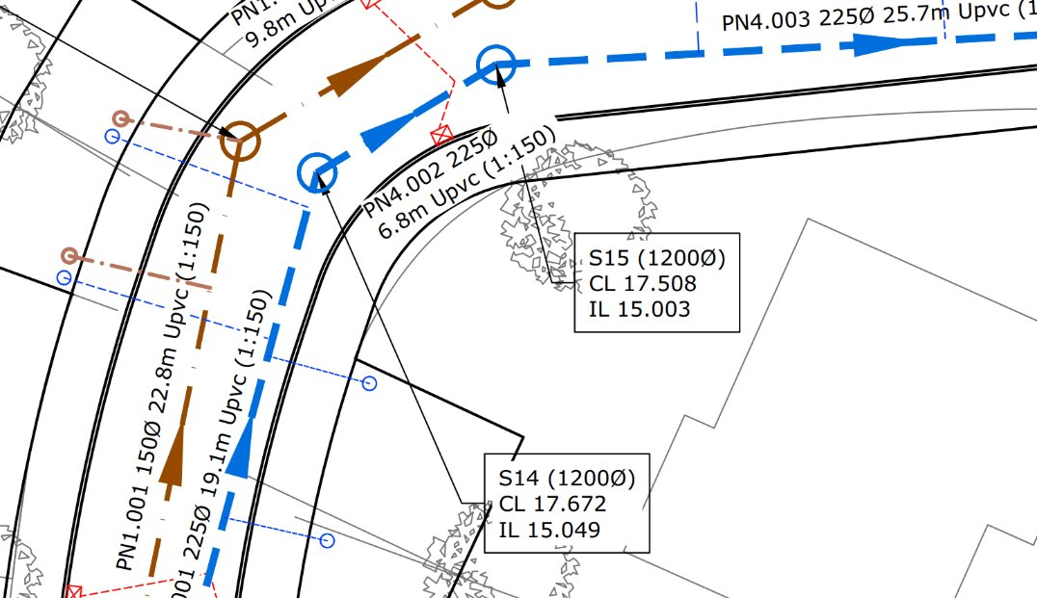

Slide 13
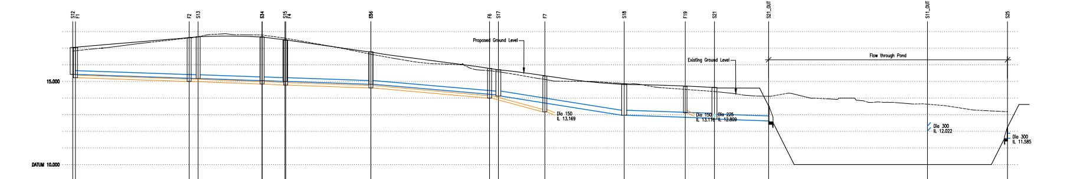
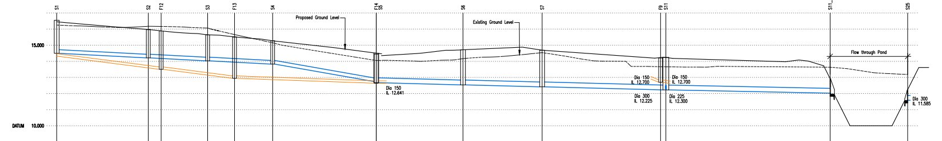

Slide 14
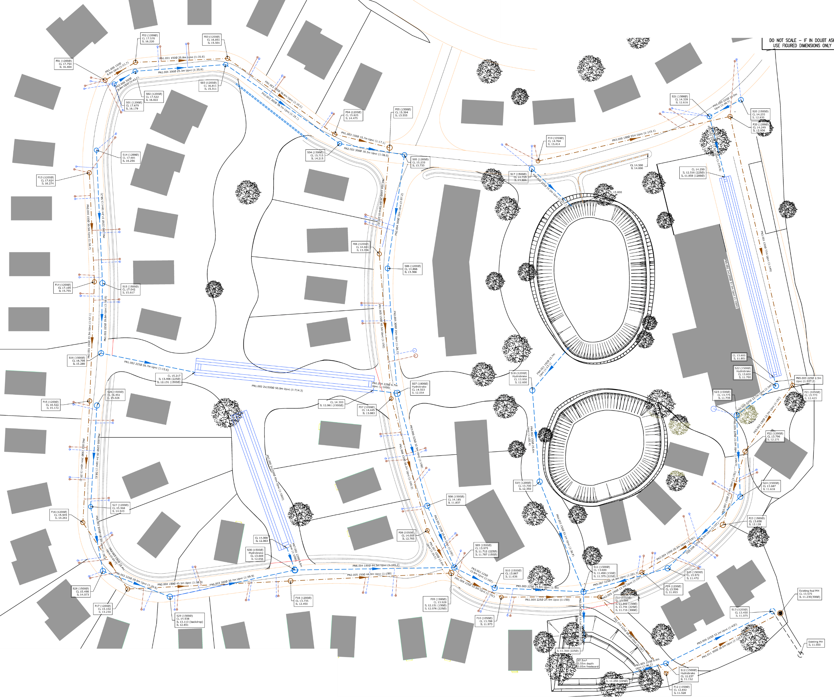
Swales for conveyance only – no attenuation
Cellular storage
No use of landscape apart from ponds – still deep
Limited by assumptions as to adoptability by Highways / UU (and no time/scope to enter into discussions with them)
Time to give up?

Slide 15
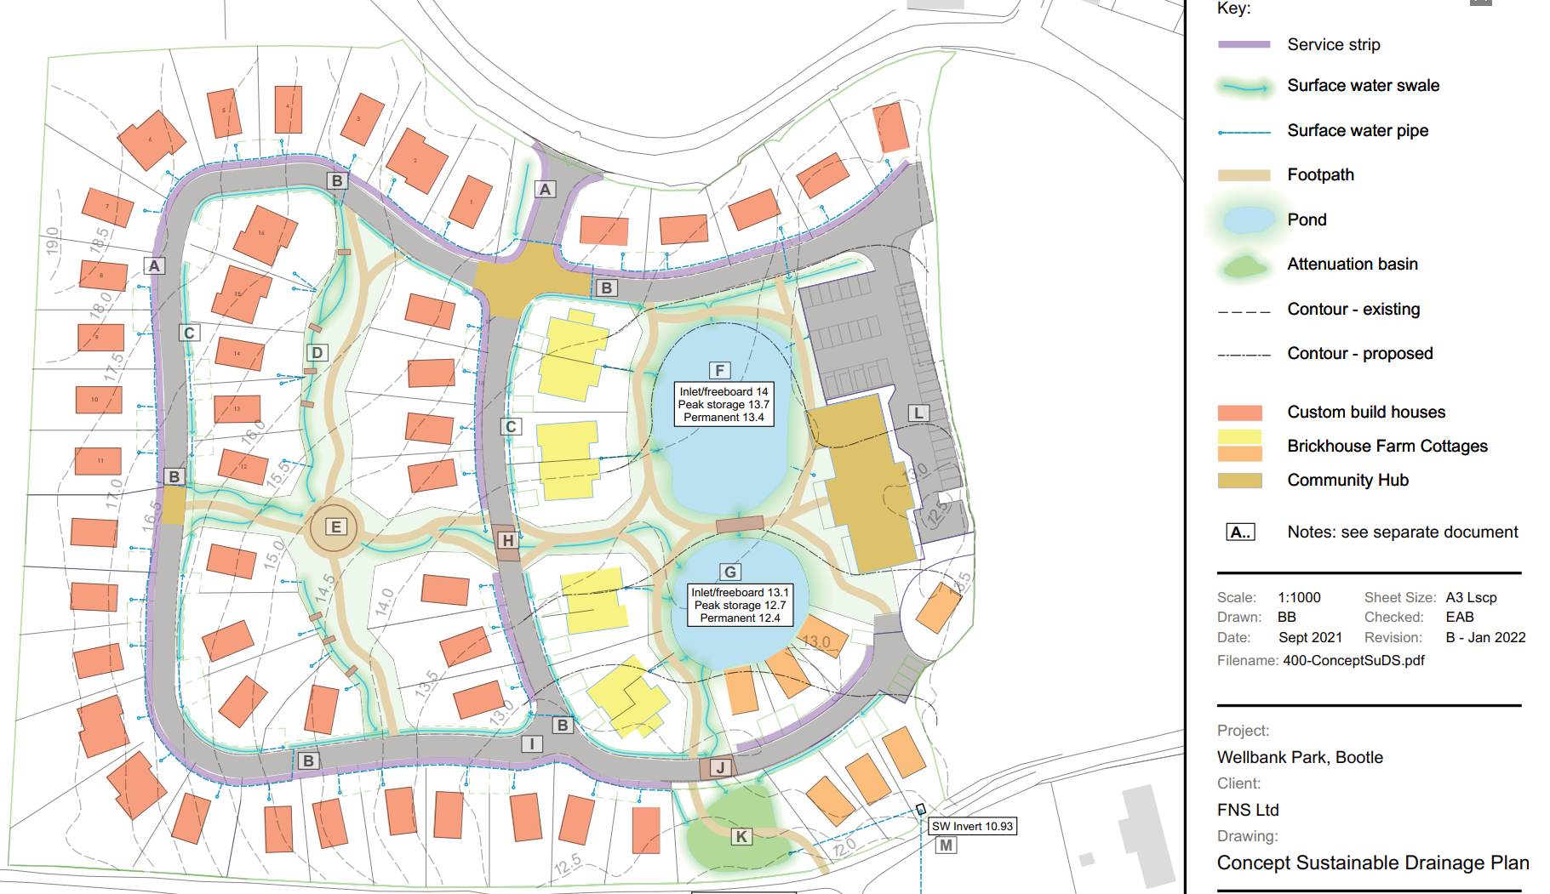
Shallow highway crossings allows connections between plots + highway swales
Swales with attenuation
Contours!
Permeable paving
Shallow-edge ponds with defined levels
Use of landscape

Slide 16
Key Principles:
Keeping water at, or as close to, the surface as possible, with shallow sides-slopes and depths for maximum safety
Minimising underground pipework and drainage
Distributed collection and attenuation of rainwater and use of swales for conveyance (source control and bio-filtration)
Multi-functional uses, e.g. surface water conveyance and attenuation, amenity, play, biodiversity – noting that source control and bio-filtration will result in cleaner water in swales and pond.
To satisfy, as far as possible, the 'four pillars of SuDS' (CIRIA SuDS Manual and potential revised National SuDS Standards): water quantity, water quality, amenity and biodiversity.
All attenuation/conveyance features (except ponds) are to be designed for controlled drain-down over 24-48 hours after a storm event, resulting in normally-dry swale/basin features. Legibility of SuDS function enhanced by choice of edge planting and use of local cobbles/rocks giving 'dry stream' effect.
Site subsoil is effectively impermeable, so no infiltration is assumed. All SuDS features drain by gravity, via control features, to lowest point of site and thence to outfall manhole.

Slide 17
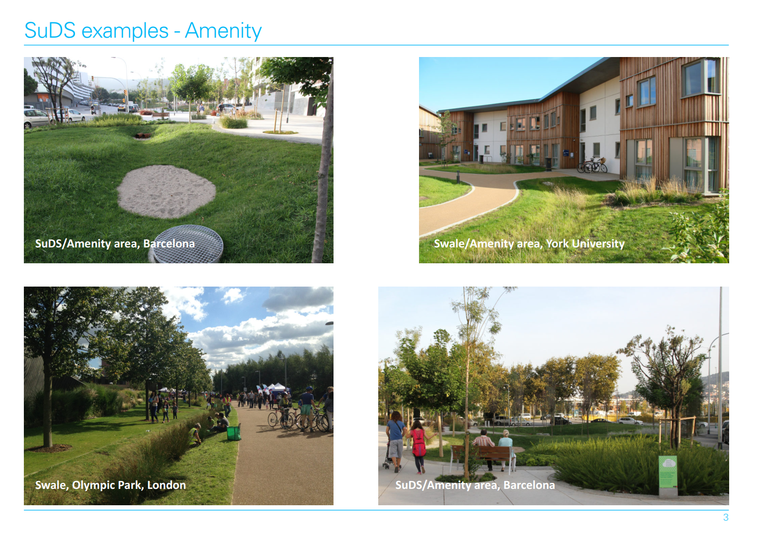
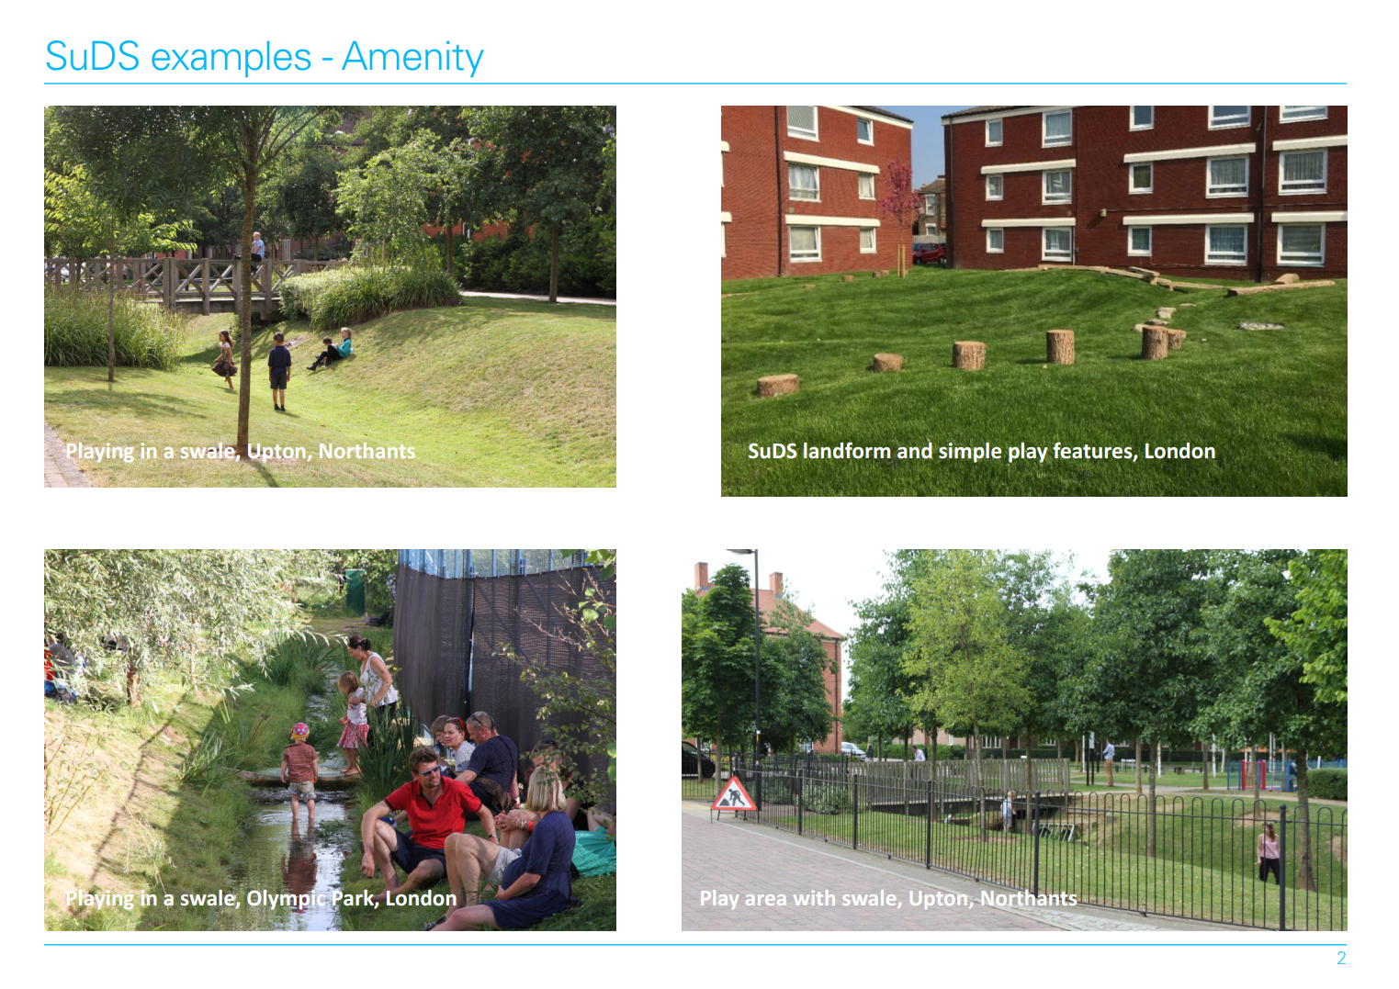
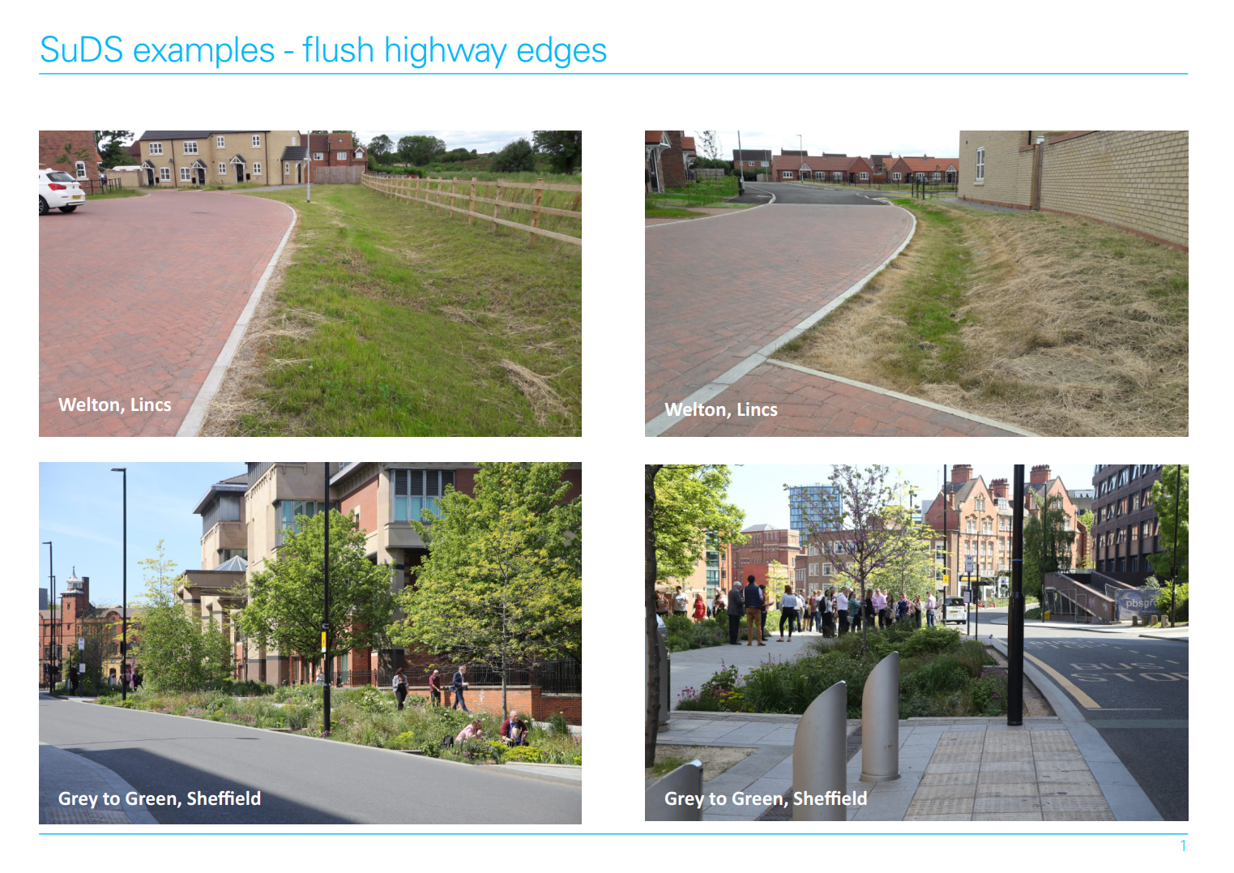
SuDS Examples

Slide 18
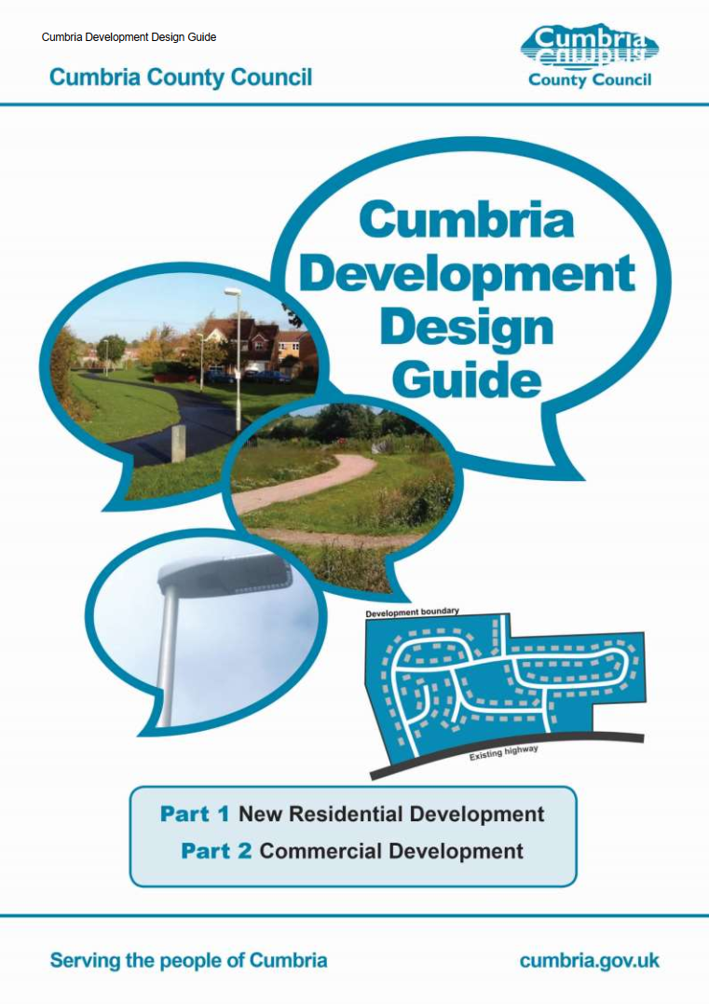
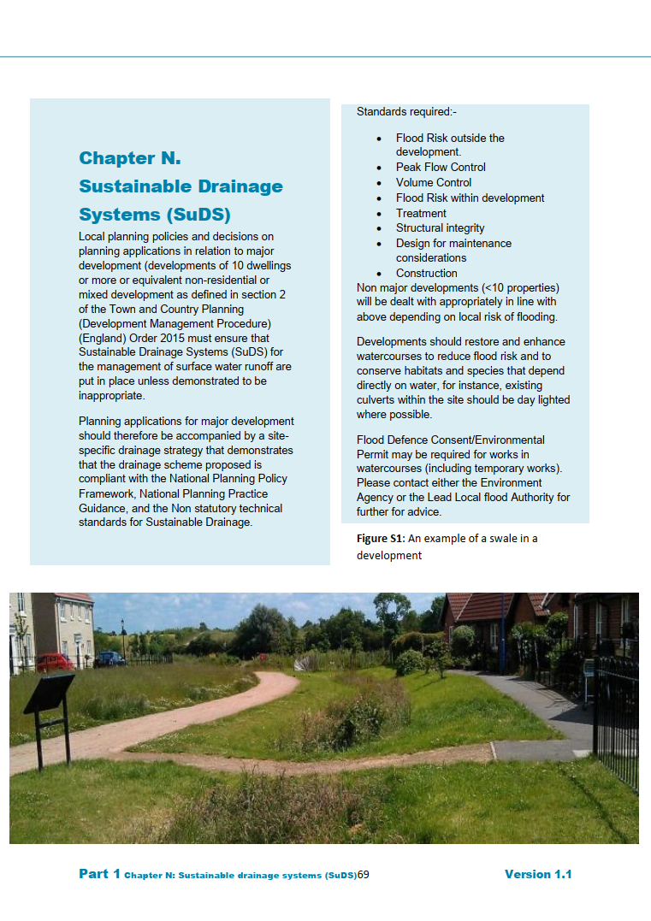
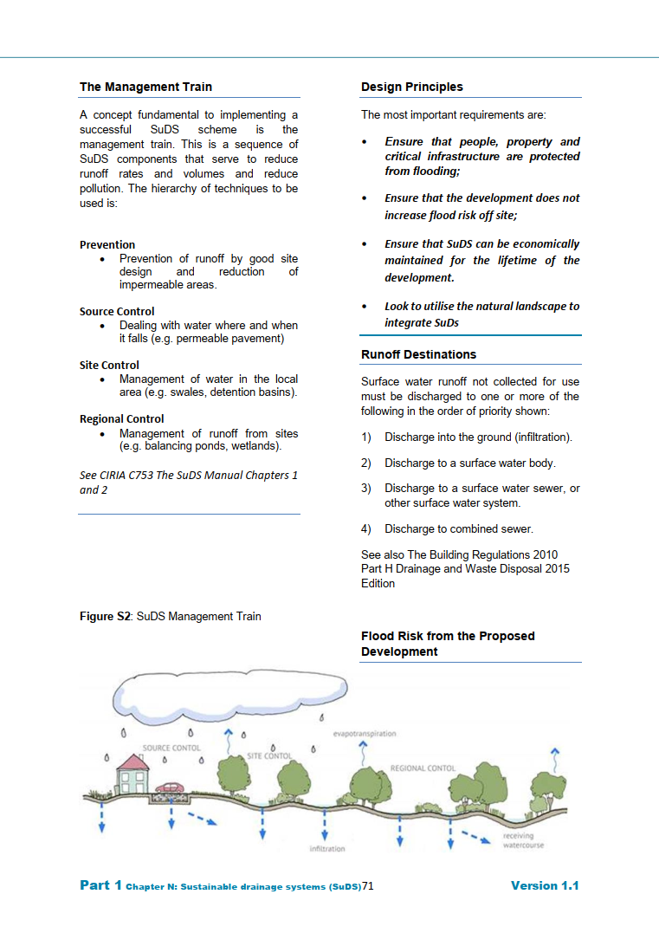
“Priority must be given to the use of sustainable drainage systems (SuDS).
Sustainable Drainage Systems (SuDS) mimic natural drainage patterns and provide water quantity (flooding), water quality (pollution), amenity and biodiversity benefits. The SuDS manual C753 (published by CIRIA) provides guidance on the planning, design, construction and maintenance of SuDS.”

Slide 19
Two major changes:
Client decided to create management company (worked with community features such as the Community Hub) – so no adoption issues…
New engineer appointed

Slide 20
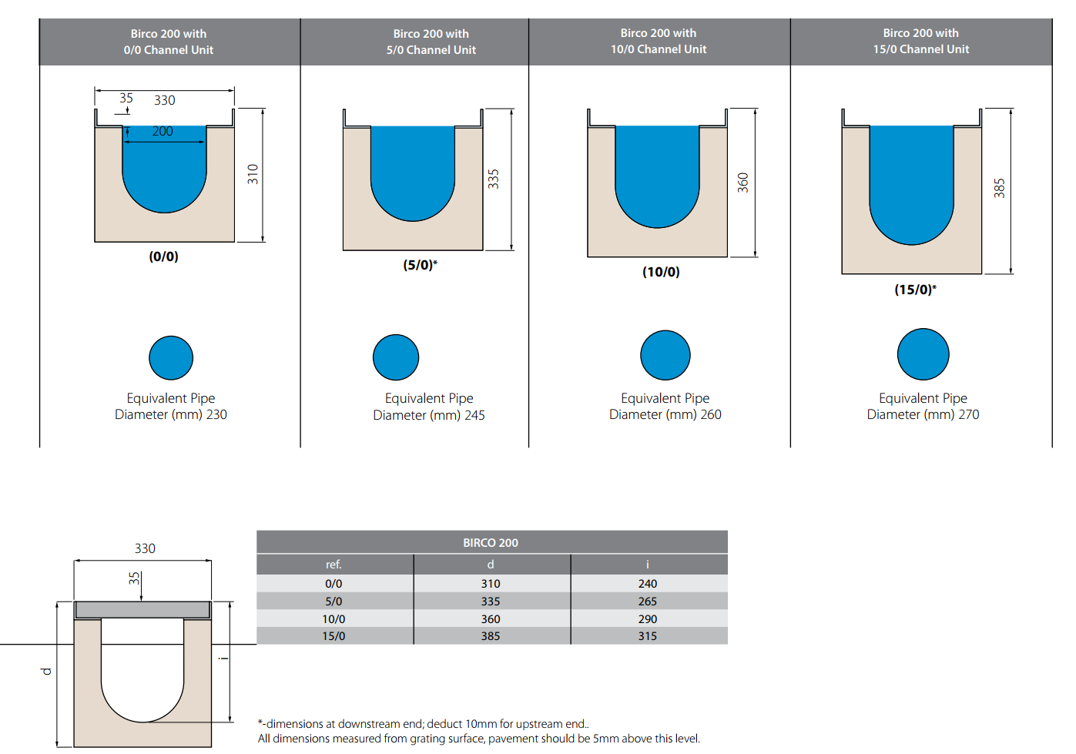
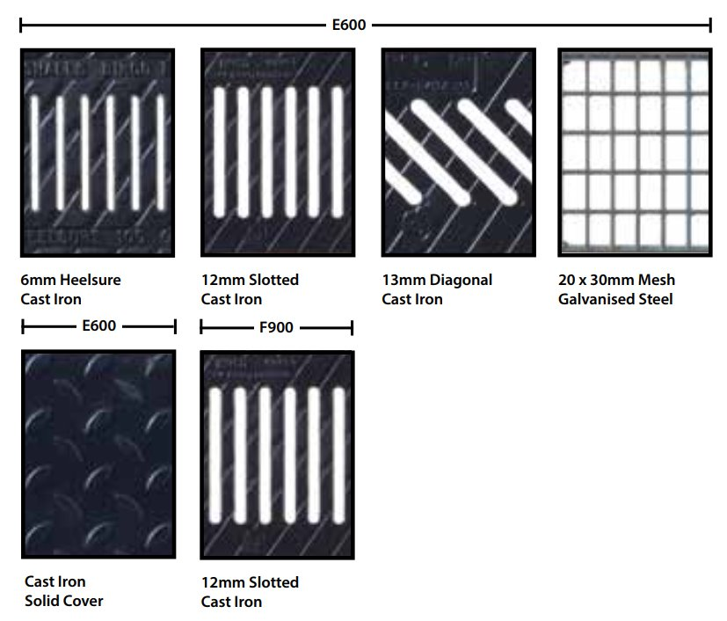

Slide 21
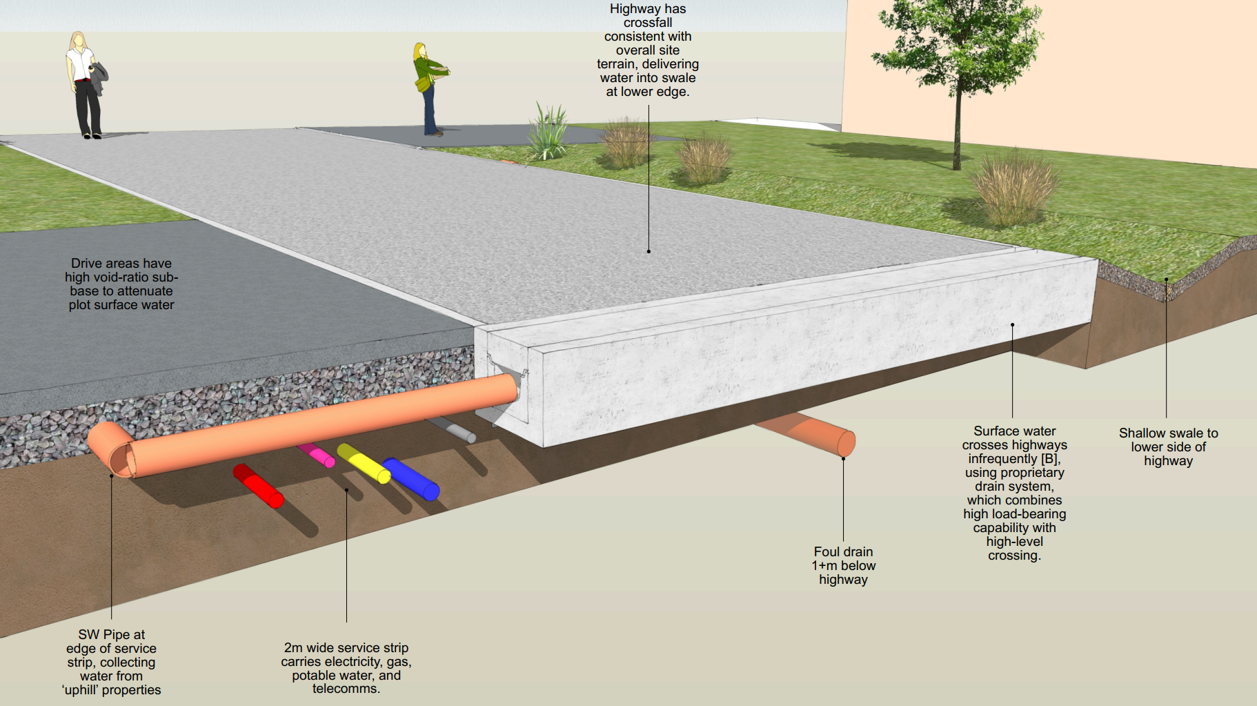

Slide 22
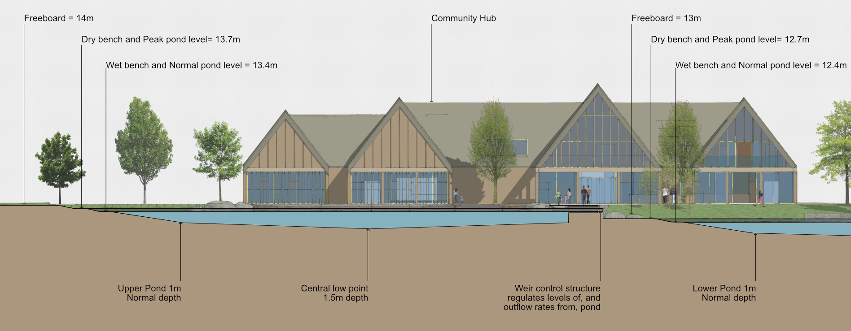

Slide 23
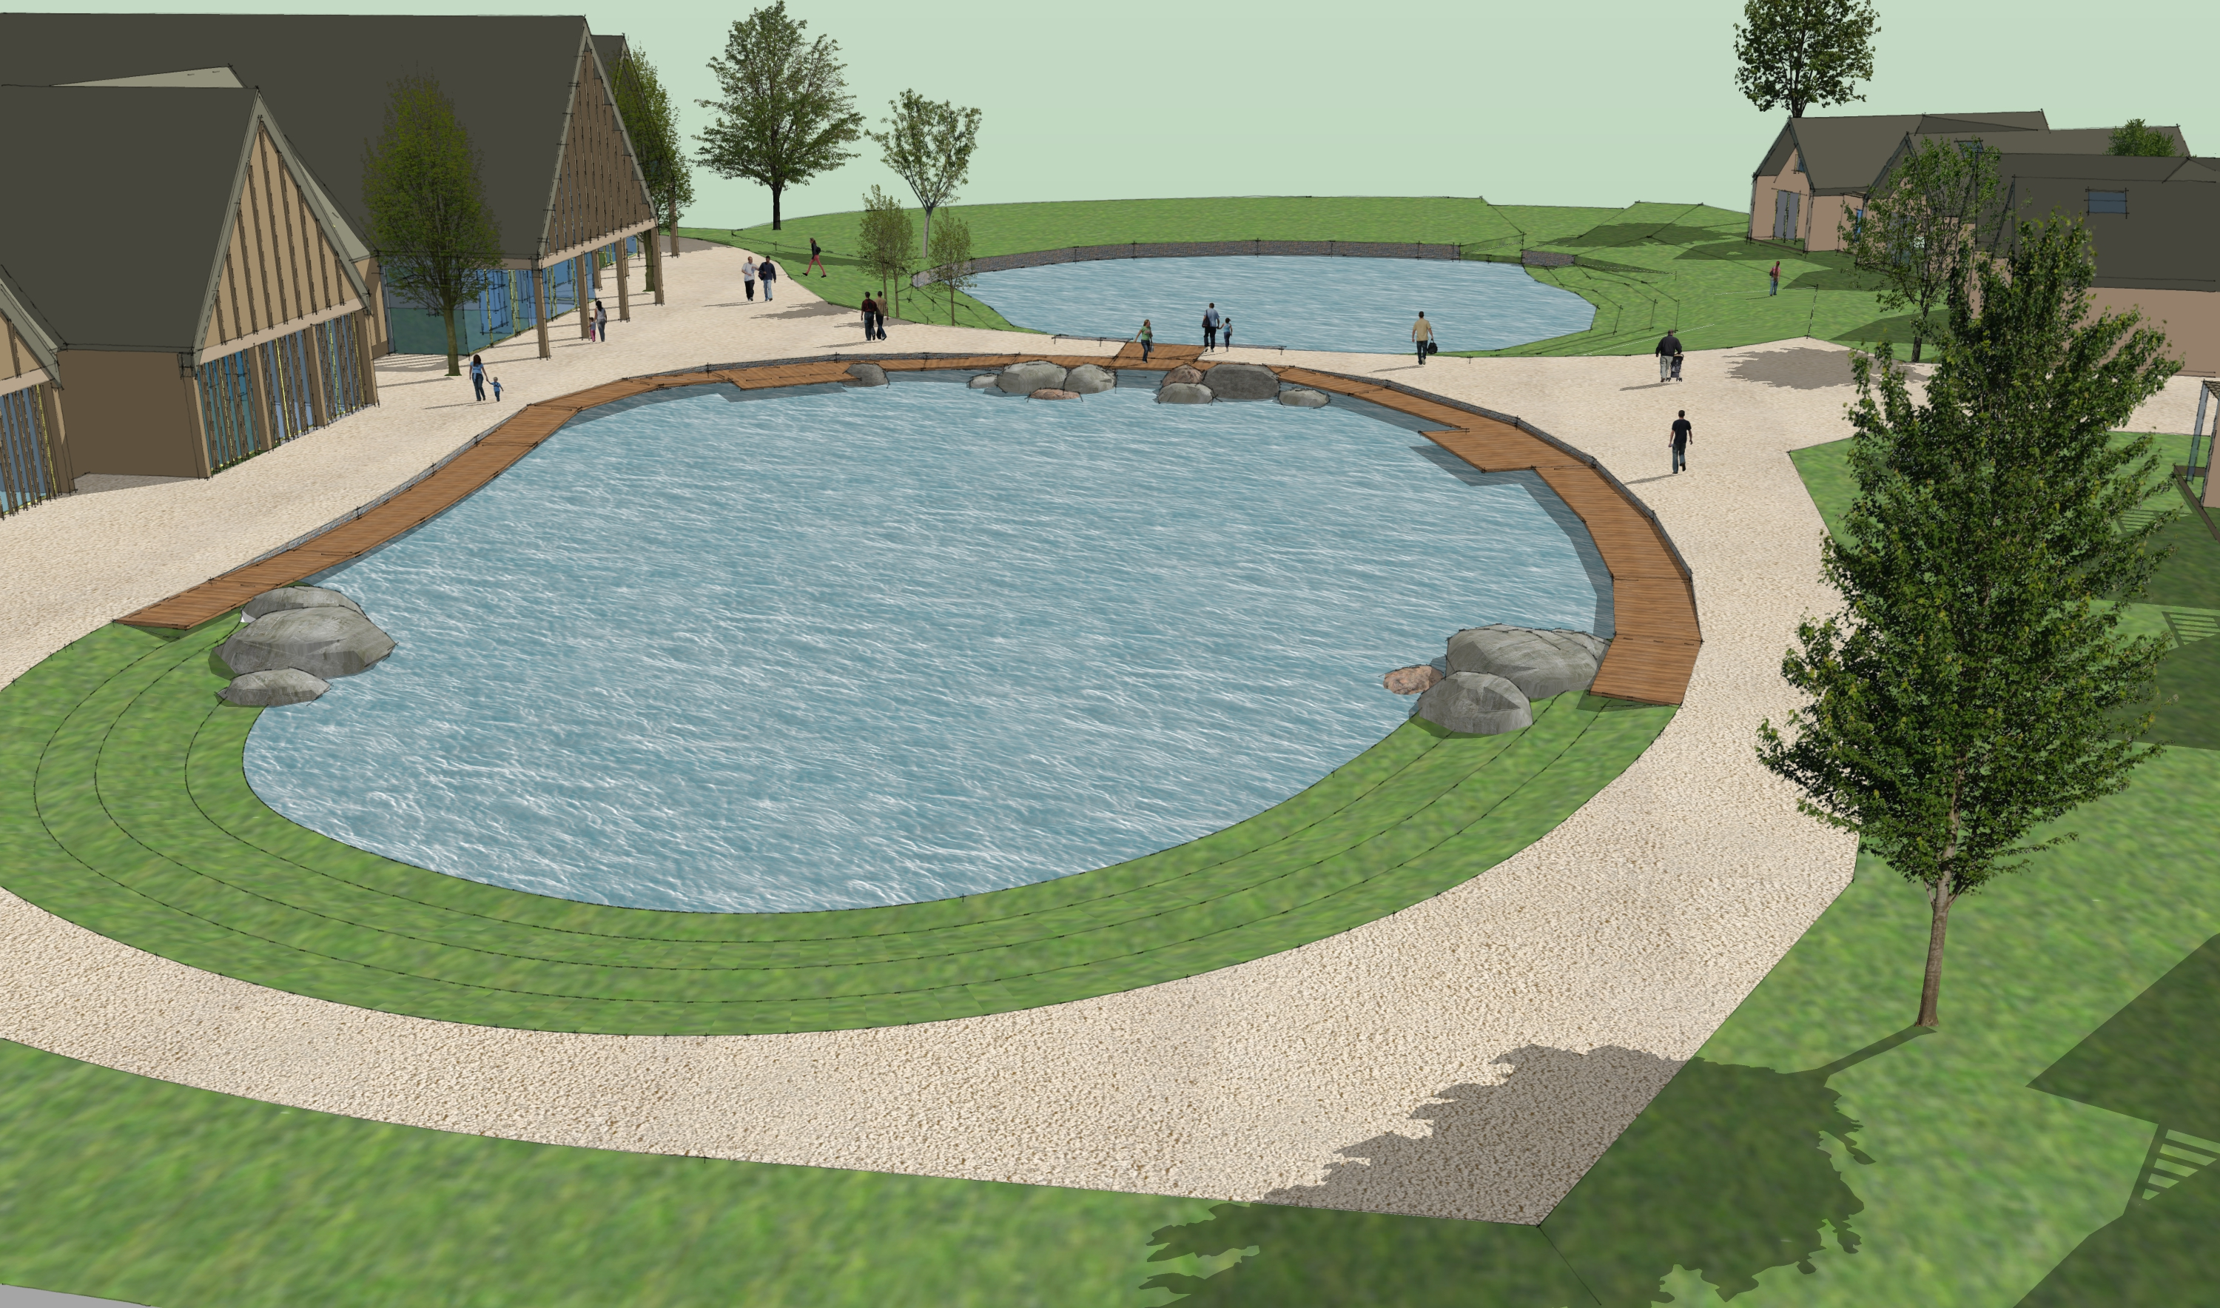
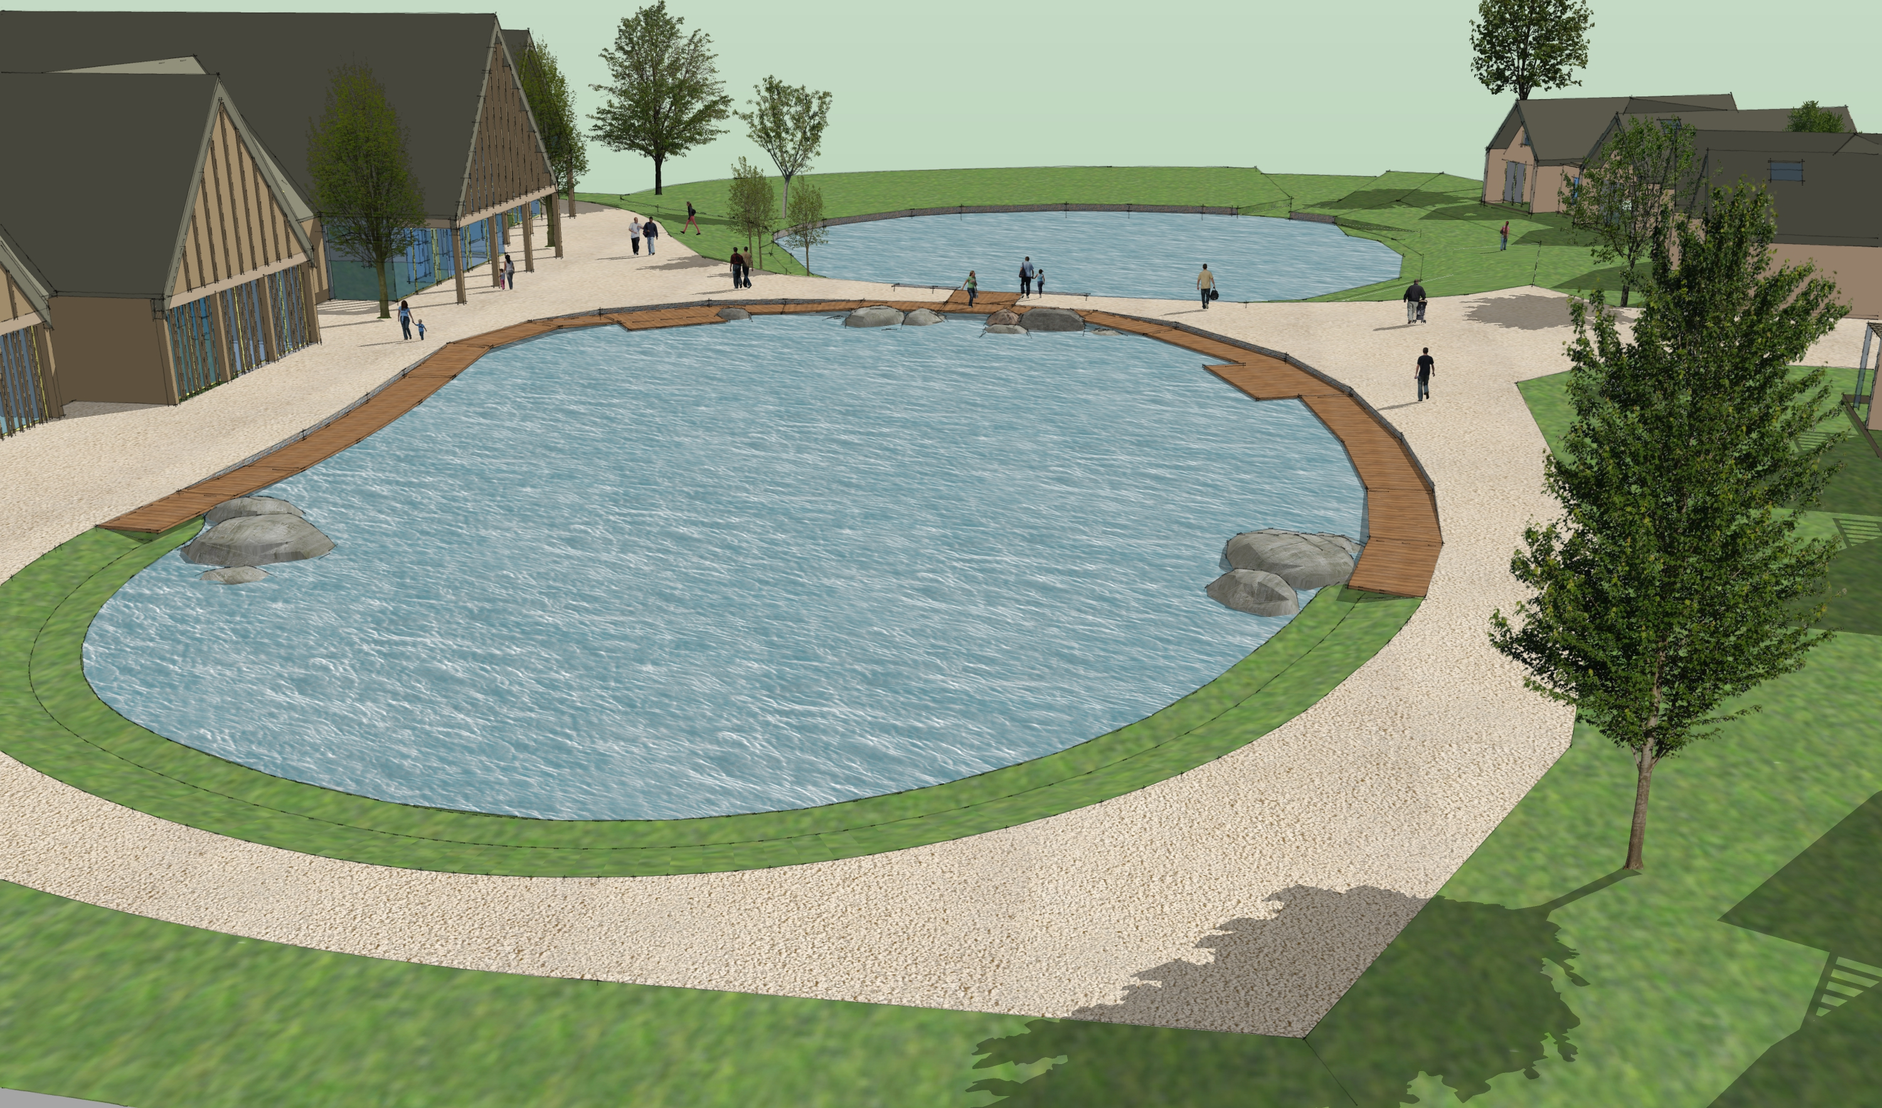

Slide 24
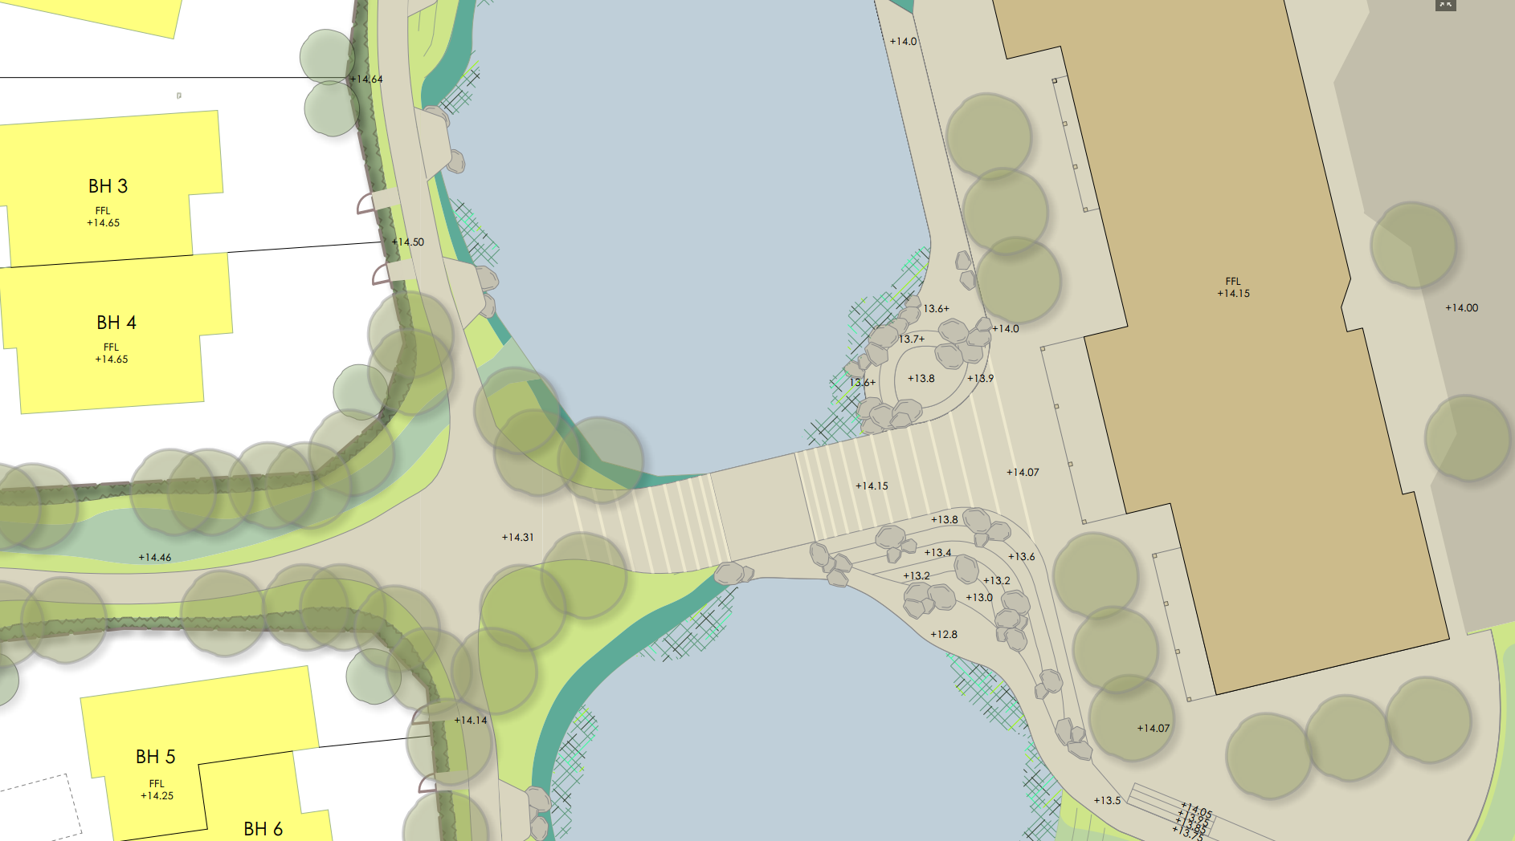

Slide 25
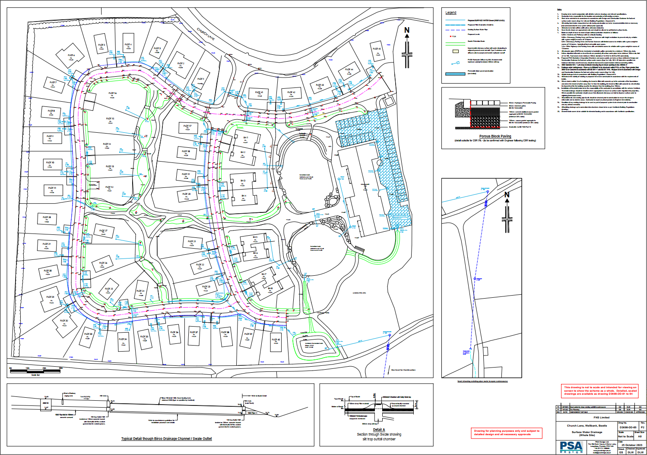

Slide 26
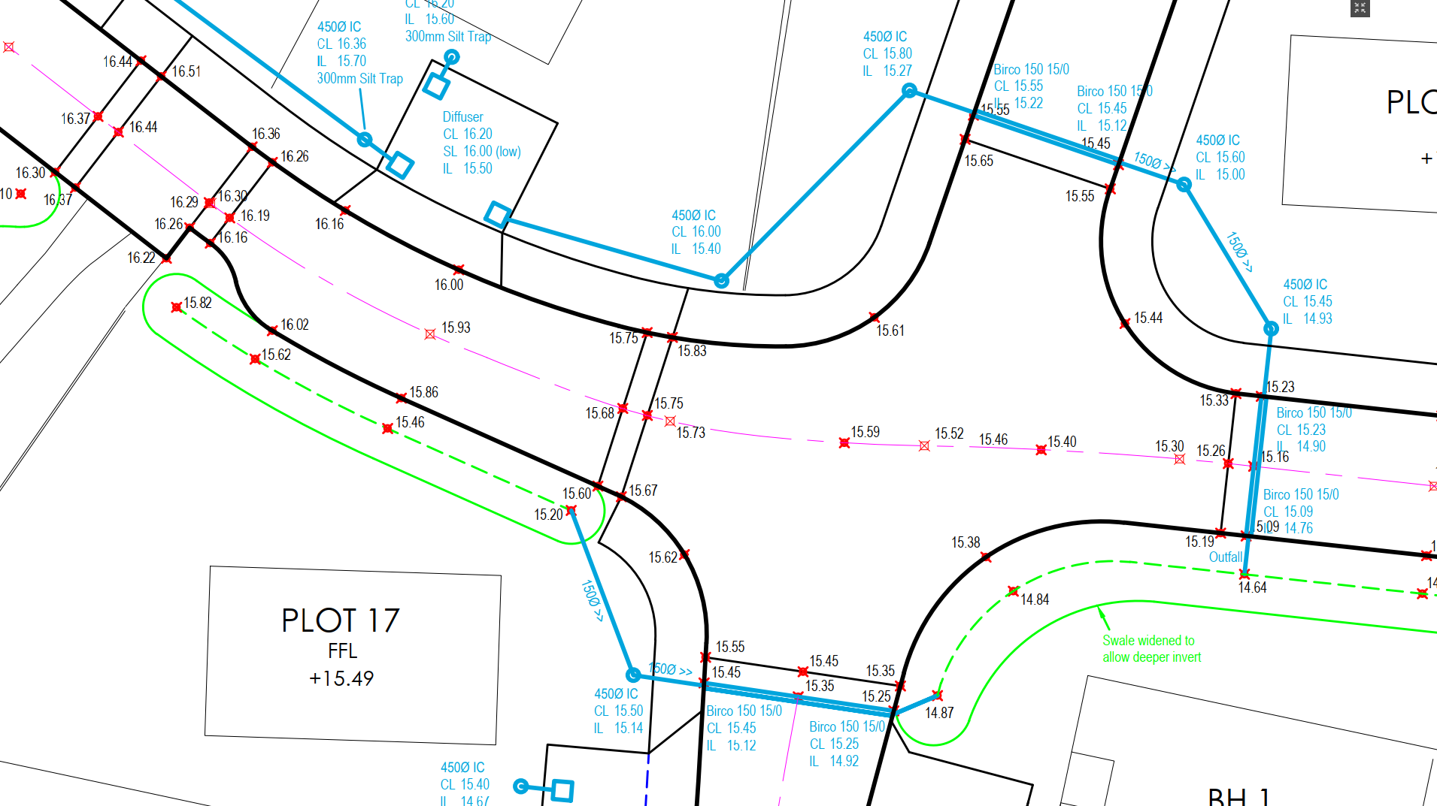

Slide 27
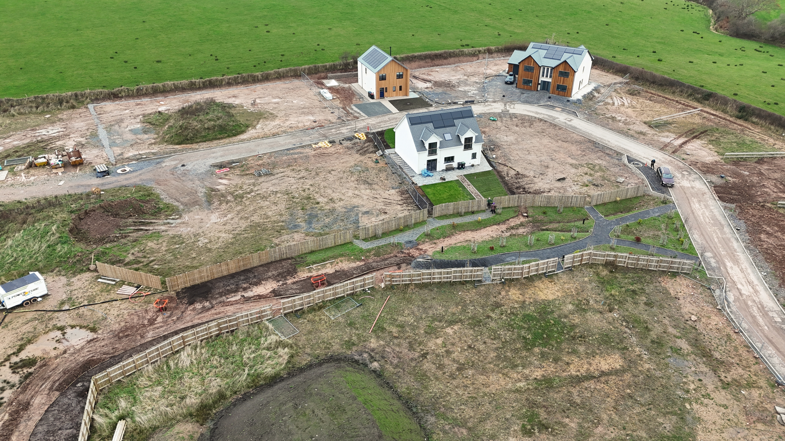


Slide 28
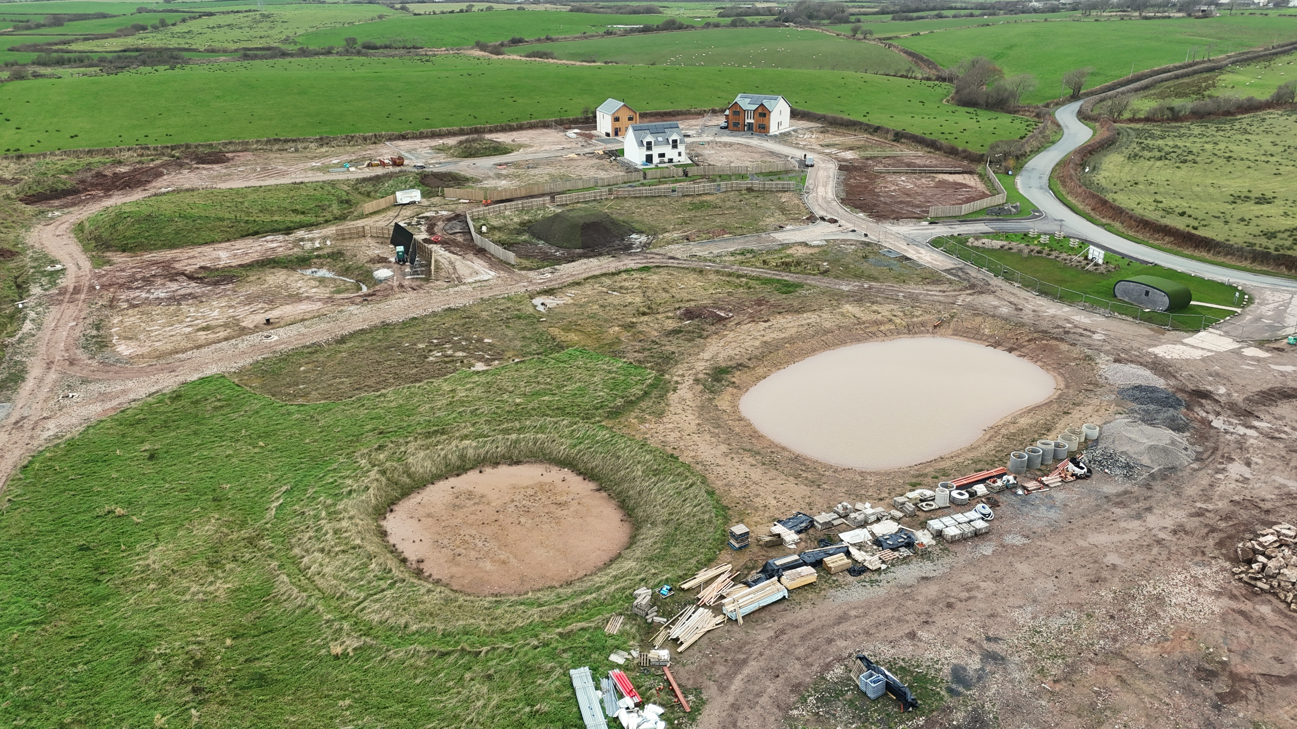

Slide 29
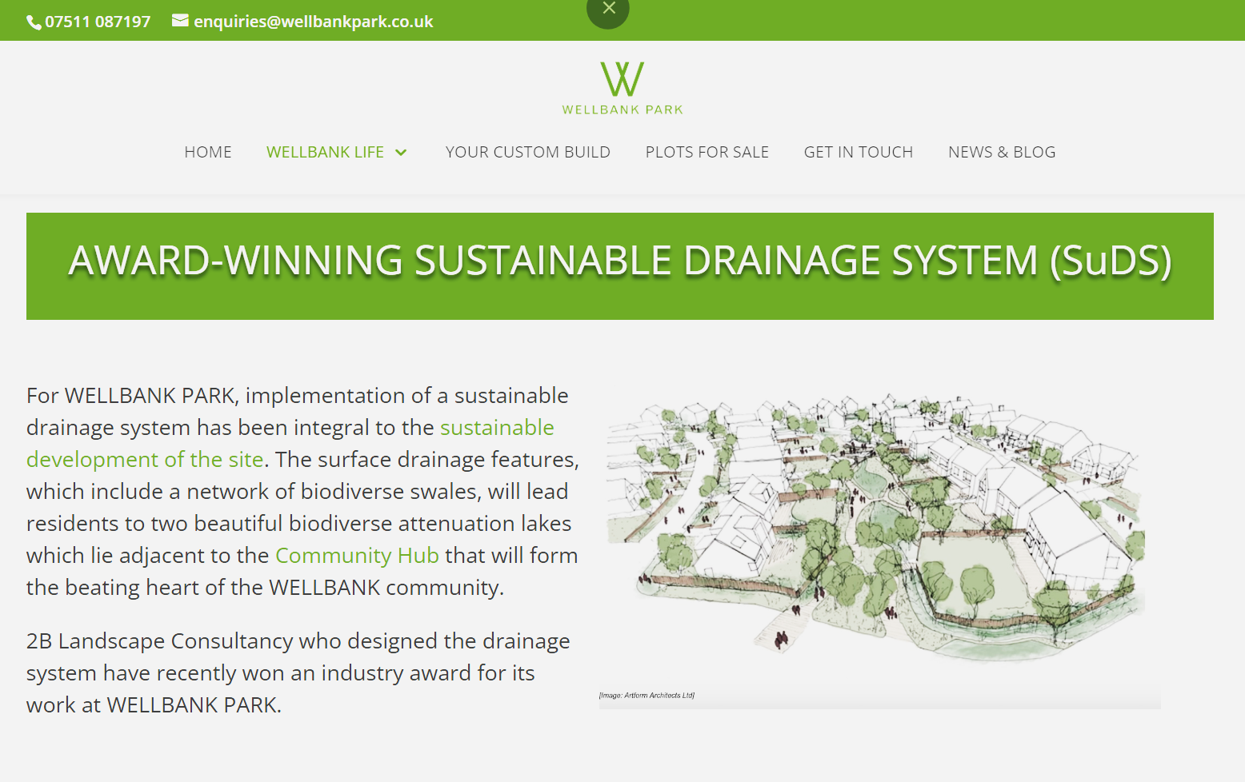

Slide 30
Thanks for listening!
Bill Blackledge
2B Landscape Consultancy Ltd
bill@2bconsultancy.co.uk
www.2bconsultancy.co.uk
https://www.linkedin.com/company/2b-landscape-consultancy-ltd
https://www.instagram.com/2b_landscape/
Susdrain SuDS Theatre, Floodex
27/11/2024

