Slide 1


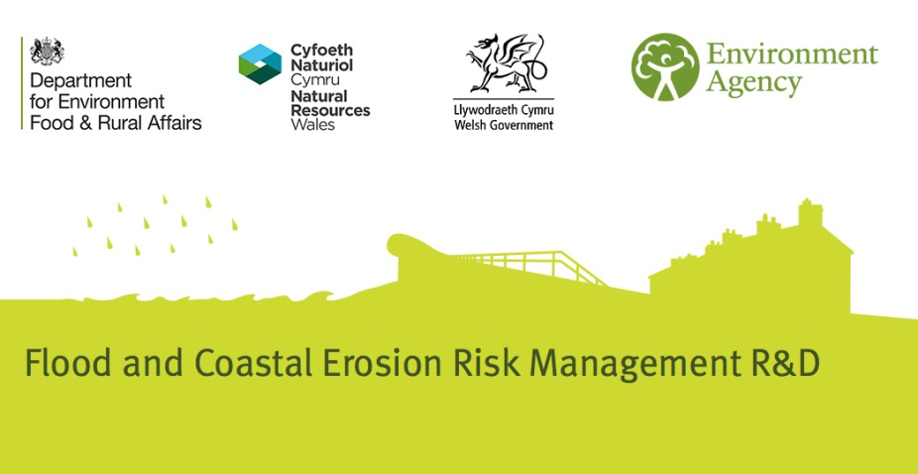

Safe routes for urban flooding
Encouraging the uptake of designing for exceedance
Notes:
Welcome!
This presentation introduces the work which CIRIA has completed to encourage the uptake of Designing for Exceedance (DfE)
This project team included Chris Digman from MWH, Paul Hargreaves and Elliot Gill from CH2MHill and Richard Ashley from EcoFutures / Pennine Water Group.
The project was mainly funded by the Environment Agency and a contribution from Wessex Water. The work was guided by a Project Steering Group as well.
Use of presentation and images
Presentation
Please make use of the presentation and feel free to adapt as required. Please also acknowledge its source as CIRIA general SuDS presentation.
Images
Please only use images that are attributed to CIRIA and please acknowledge there source as CIRIA general SuDS presentation.

Slide 2
Overview
Our drainage approach and what this means
Recognising exceedance rainfall events
How we can make our areas more resilient
Examples of managing exceedance
What makes a success
Sharing our learning
Final thoughts…
Notes:
Overview of the presentation.

Slide 3
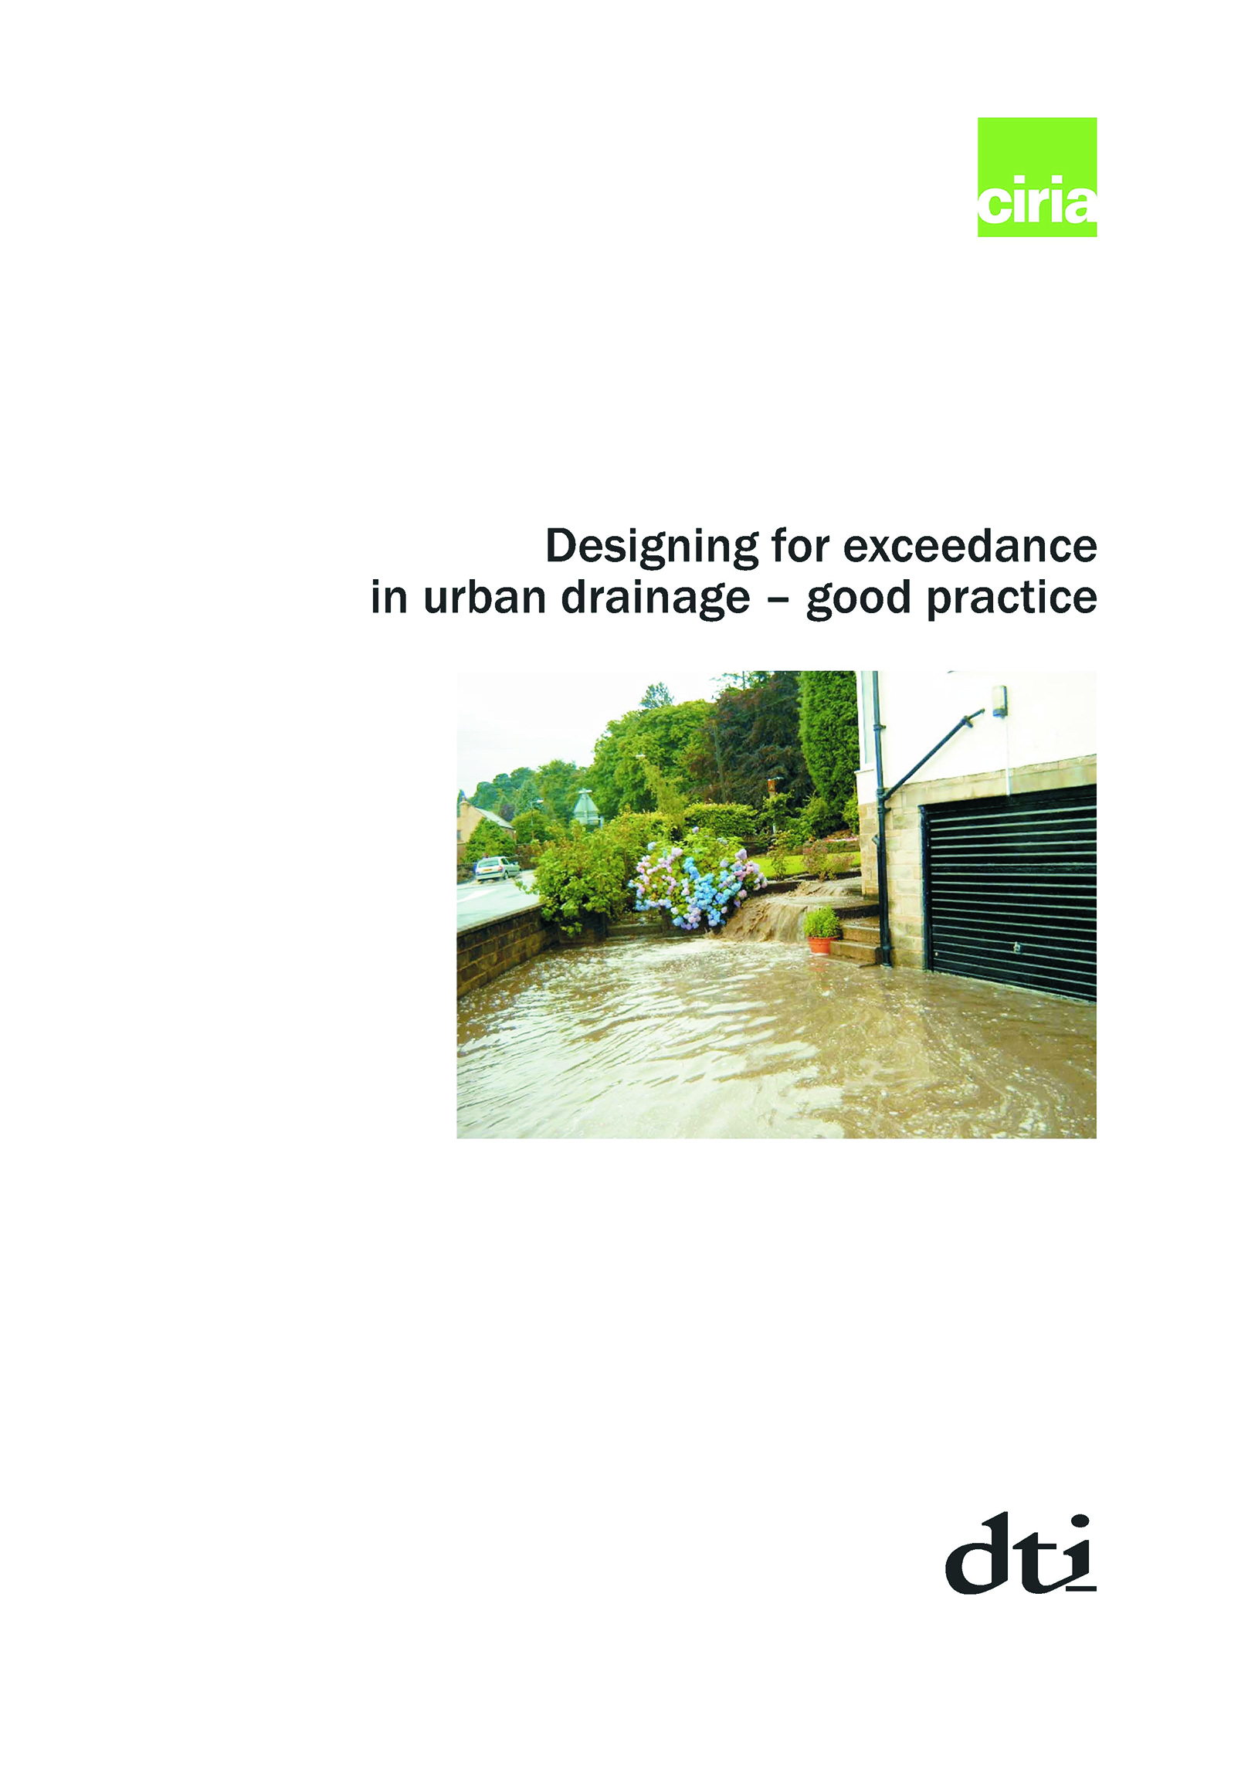
Encouraging the uptake of designing for exceedance
Provide information to support practitioners and decision makers
Learn lessons and success
factors
Identify and summarise
case studies
Recommendations
Notes:
The project’s key aim is to encourage the uptake and use of the principles and guidance in CIRIA report C635 (from 2006) Designing for exceedance in urban drainage systems – good practice. The key objectives of the project are summarised in the slide.
We know this is important because the engagement work on this project highlighted that about 1/3 of people had applied C635, another 1/3 had heard of it, but not used it and the remaining 1/3 had not even heard of it.

Slide 4
What standard do we design drainage to?
Notes:
Good place for us to start is to understand how we typically design drainage to different design standards, using rainfall return periods or as shown here, probability of flooding (using the rainfall as a surrogate for it) in any given year, as we have various design standards for new development and the typical area you might be draining (or protecting) in existing areas.
This graph shows the chance of flooding happening in any given year in different locations of impact, and used as the surrogate design standard.
New development typically governed by National Planning Policy Framework, and follows Sewers for Adoption, or the forthcoming National SuDS Standards. Typically looking at 1% chance of flooding in any given year for properties (1 in 100 year return period) .
In retrofit areas, we typically design new sewers to a 1 in 30 year return period or 3.3% probability when we come to stop property flooding.
Its worth noting though that roads are likely to flood due to their drainage design. Roads yes! have a 1 in 5 year = 20% chance of happening. (they do include a climate change uplift – but note older highway drainage may be even to a lesser design standard, e.g. 1 in 2 (50% chance of happening).
So the key message here is, depending on where you are, you can expect drainage exceedance to occur.

Slide 5
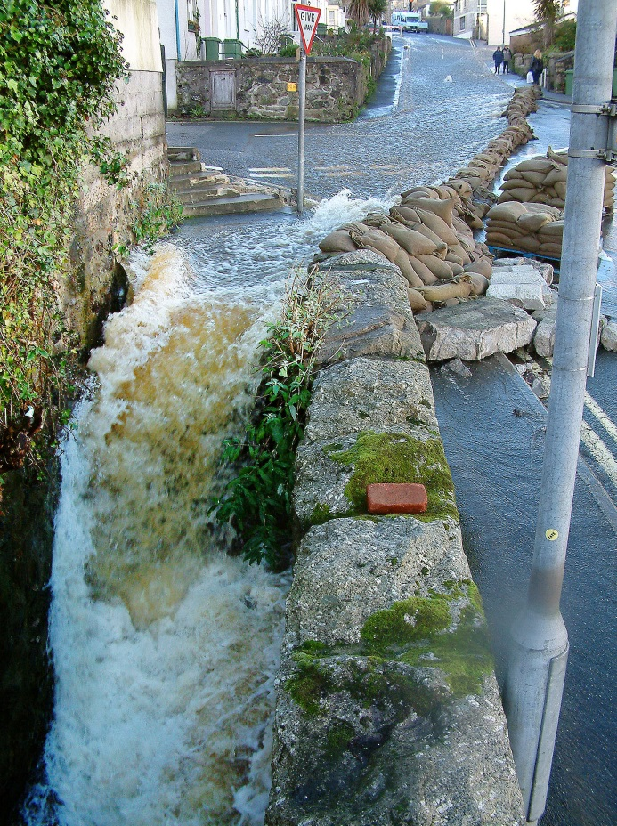
What is exceedance?
“flow that is conveyed or stored on the surface because the capacity of a drainage system carrying storm water (including as a result of a blockage to an inlet) has been exceeded”
Notes:
We define exceedance in this slide and the examples is from St Ives with water flowing down the highway
Important question to ask is have we in the past considered the exceedance event, to manage its impacts?
On this project, we worked with different stakeholders and confirmed we have not always given due regard to the exceedance events.
So a key finding from the project is that its important for people to understand and recognise what exceedance is.

Slide 6
Recognising ‘exceedance’ events
Design approach and reason to manage rainfall
Rainfall event
Everyday rainfall
Increase in the impact / consequence l (e.g. £, health)
1
Drainage - public health
Increase in rainfall
Notes:
So to recognise exceedance events, its important to think how they ‘fit’ into our overall approach to manage rainfall, but how should we explain this?
Fratini (et al) in 2012 used a rainfall to impacts relationship on a graph to help explain about the different types of rainfall, to help understand the different approaches to then manage the rainfall.
We looked to build on this relationship and develop it further as shown in the next few slides.
In this relationship, as the rainfall increases, the band of damage impacts can get wider. We identified there are four domains to consider.
Start with everyday rainfall, in Domain 1, we design drainage to manage public heath impacts.

Slide 7
Recognising ‘exceedance’ events
Design approach and reason to manage rainfall
Rainfall event
Everyday rainfall
Drainage design rainfall
Increase in the impact / consequence l (e.g. £, health)
Conventional drainage & SuDS
2
1
Drainage - public health
Increase in rainfall
Notes:
Domain 2 is we normally use ‘design rainfall’ to manage flooding, so for new sewers with a 1 in 30 year return period (3.3% chance of flooding occurring) and often using 1 in 100 year return period for SuDS on new development.
But what happens when we get rainfall above that?

Slide 8
Recognising ‘exceedance’ events
Design approach and reason to manage rainfall
Rainfall event
Everyday rainfall
Drainage design rainfall
Exceedance rainfall
3
Design for exceedance
Increase in the impact / consequence l (e.g. £, health)
Conventional drainage & SuDS
2
1
Drainage - public health
Increase in rainfall
Notes:
Previously, its often been referred to as extreme, but we believe there a Domain 3: for exceedance events (before you get to extreme)
Its an important requirement on new development to manage exceedance, but we see some developments managing the 100 year event in below ground drainage and pay little consideration to what happens after that.
If we want to become more joined up in managing flood risk for communities we need to consider beyond the drainage design standards and look at exceedance. If we do manage these events, we have a chance to really reduce the impacts that can happen from this type of rainfall.

Slide 9
Recognising ‘exceedance’ events
Design approach and reason to manage rainfall
Rainfall event
Everyday rainfall
Drainage design rainfall
Exceedance rainfall
Extreme rainfall
Emergency response & spatial
4
3
Design for exceedance
Increase in the impact / consequence l (e.g. £, health)
Conventional drainage & SuDS
2
1
Drainage - public health
Increase in rainfall
Notes:
After we consider and design for exceedance, then we have the 4th domain. Here extreme rainfall needs to be managed, typically through emergency response and spatial planning.
Of course, if we start to design for this continuum of rainfall events, we will end up with a very joined up approach to managing rainfall. But to do that, we need to consider exceedance more.

Slide 10
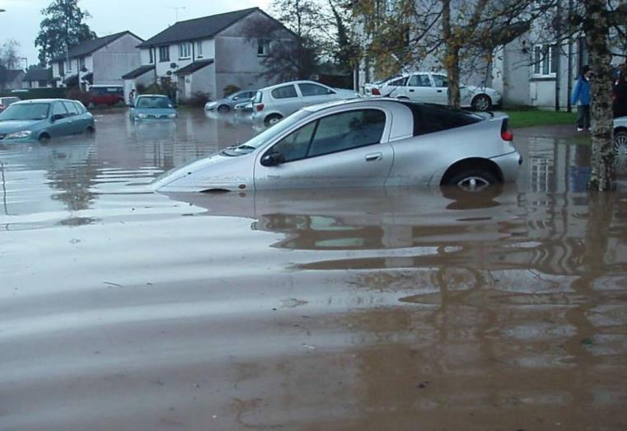
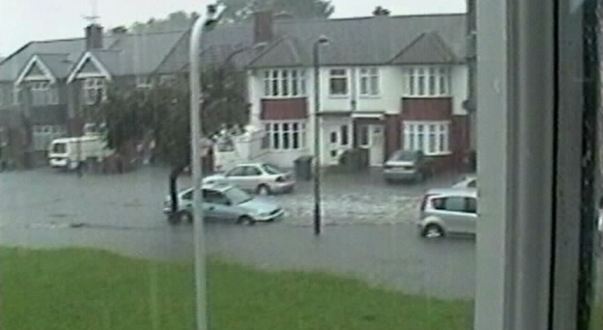
What happens when the drainage capacity is exceeded?
So what should we do?
Notes:
We will all be familiar of what happens when the drainage capacity is exceeded:
Examples here are from
Top left – St Blazey – overland flow from a watercourse running overland and contributing to major flooding in a small housing estate.
Top right – Brent in 2007, suffered major disruption due to the capacity from a range of sources (combined, foul, pluvial, watercourse)
Bottom left – Dronfield frequent overland flow from drainage exceedance collated in this area

Slide 11
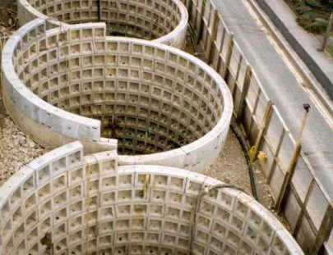
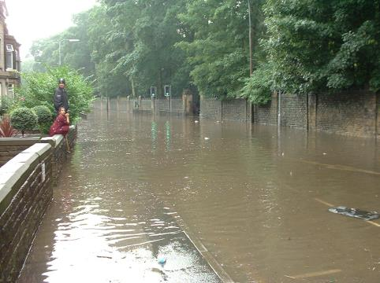
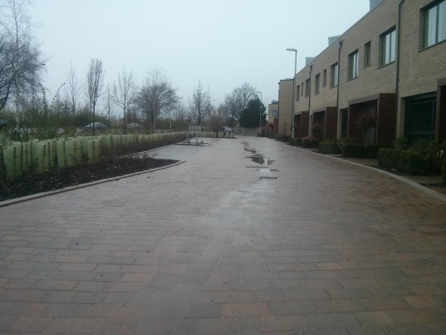
We have choices:
Build bigger? – unsustainable and unaffordable
Let it happen? – accept and manage the consequence of the impact
Make our spaces more resilient - design for exceedance
Notes:
So we have some choices, the three are simply outlined in the slide and apply equally to new development and existing areas.

Slide 12
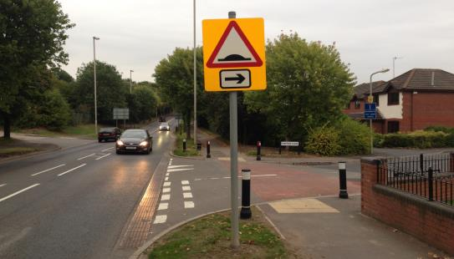
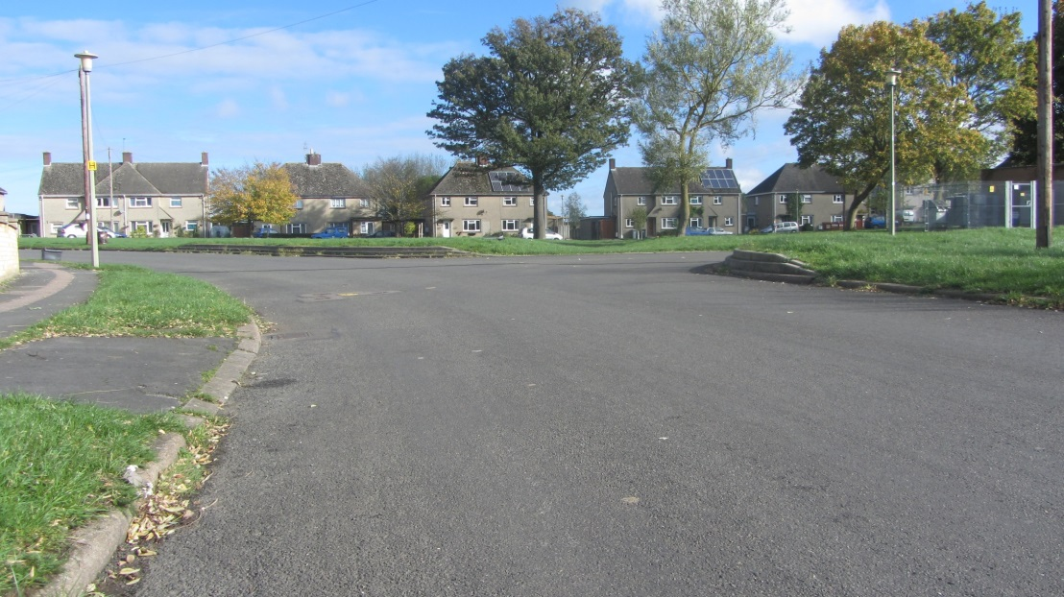
The benefits of designing for exceedance
Cost effective
Speed of delivery
Occasional use
Multi-functional assets
Awareness of water
Notes:
So if we decide to design for exceedance, what are the key benefits:
Cost effective – often lower cost, as it makes the most of existing infrastructure, making it multi-functional and limits the need to build below ground.
Speed of delivery – can be introduced quickly, and as part of a phased approach to reducing the chance of flooding
Occasional use – by definition, we don’t expect exceedance to occur very frequently, therefore it is more cost effective to use ‘what we have’
Multi-functional assets – makes use of the current open space to ‘create’ exceedance pathways and storage areas
Awareness of water – raises the awareness of water and why its important to manage it – rather it managing us!

Slide 13
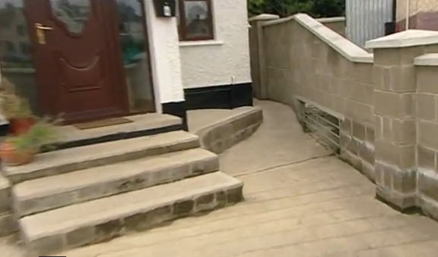
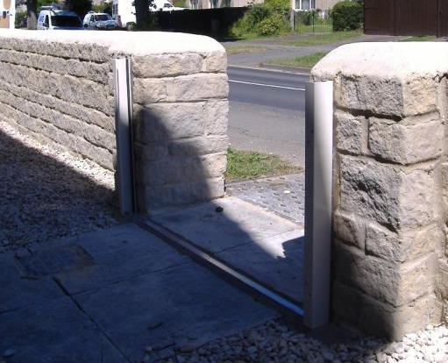
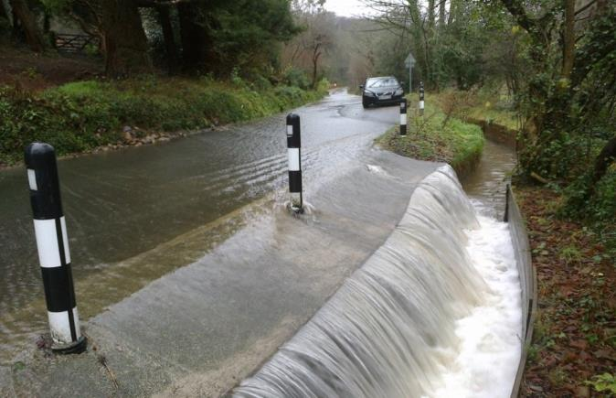
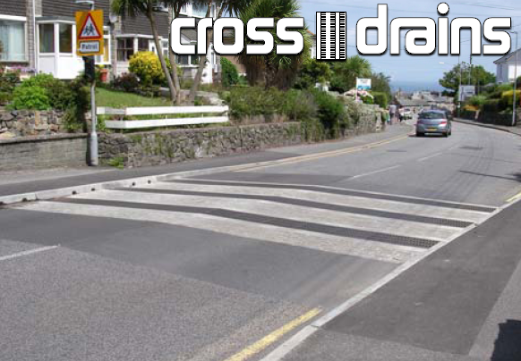
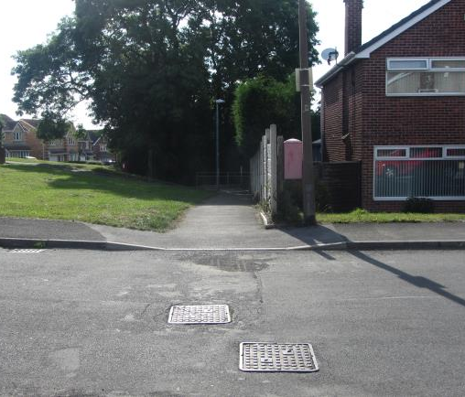
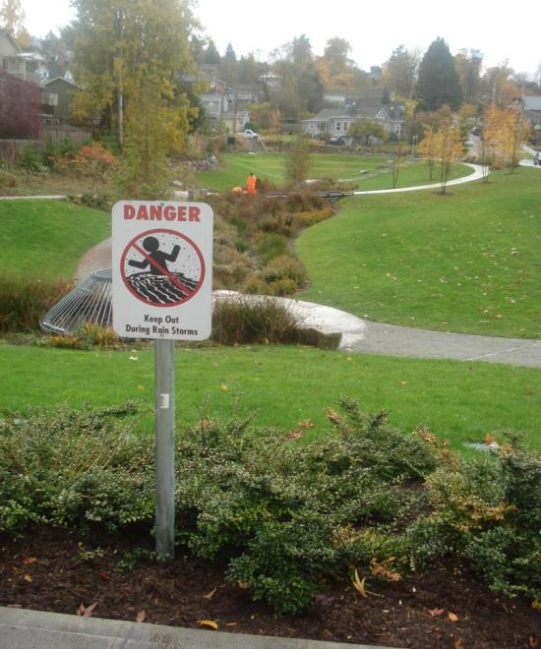
So how might we manage exceedance?
Notes:
There are many different techniques or measures we can use to manage exceedance. Here are just a few going from top left to top right and then bottom left to bottom right.
Create pathways for water around property (Dublin)
Permanent flood walls, and property level protection (keeping with the aesthetic area) (Witney)
Designing the highway to accommodate water (St Blazey)
Cross drains to intercept overland flow (St Ives)
Fine detail – a change of a drop kerb stops overland flow enter properties on the right, but go down the footpath towards a stream (Aston)
Detention basin doubling up as local community park – note the signs (Seattle in the USA)

Slide 14
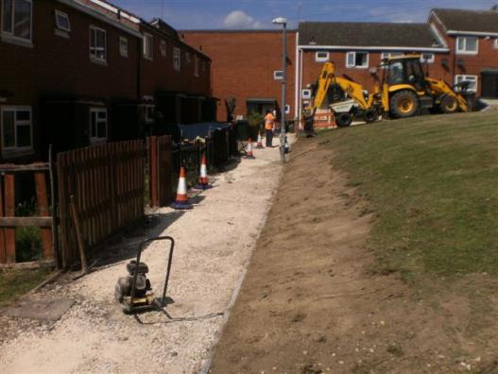
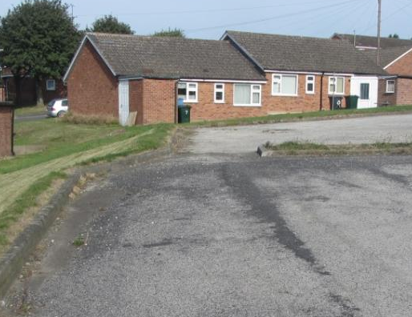
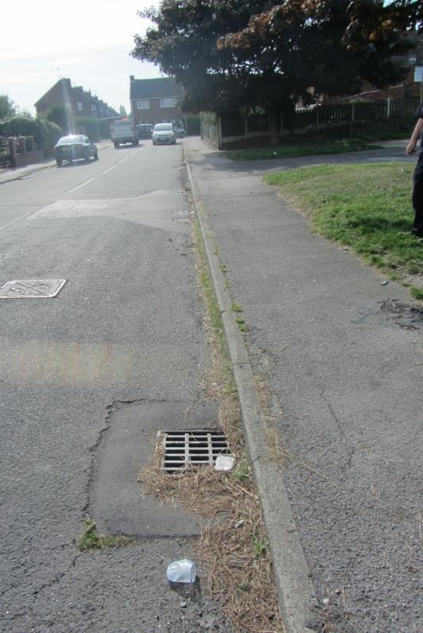
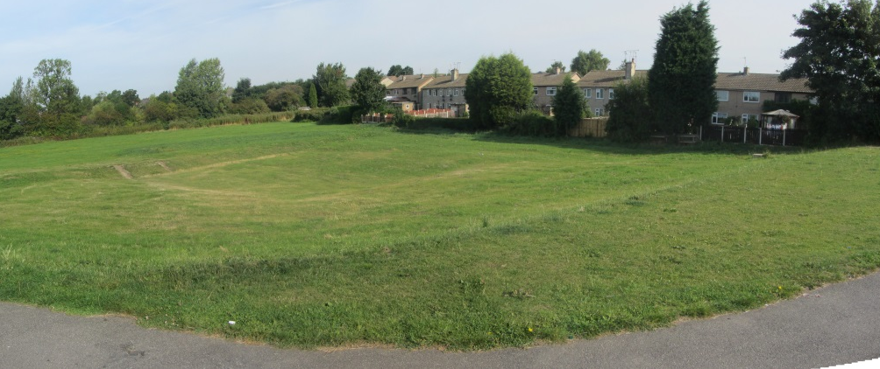
Examples of managing exceedance - Aston
❶
❷
❹
❸
Notes:
This part of Aston near Rotherham where over 20 homes flooded (just in this location) with rainfall greater than the capacity of the drainage. (greater than a 1 in 50 year return period)
Rotherham Metropolitan Borough Council investigated. They surveyed the area, and created an exceedance pathway to manage it if it happened again (using early action surface water grant funding). Starting in the top left and going clockwise:
Water overtops the parking area and kerb to the right and floods the houses on the left. Re-profiling the footpath to fall away from the houses diverts water downstream towards Photo 2
Overland flow came from the right. In the middle of the picture the kerb was removed and a grass bund formed on the left to divert the flow
Overland flow from Photo 2 travels down the highway and is intercepted by extra gullies. This transfers water into the surface water drainage system which when full discharges the base in Photo 4
This grassed area is normally dry. It was lowered to store water when it rains heavily. Once it stops raining, it slowly drains away. Water gets here through a pipe that picks up the water that runs over the surface from Photo 1 and 2.

Slide 15
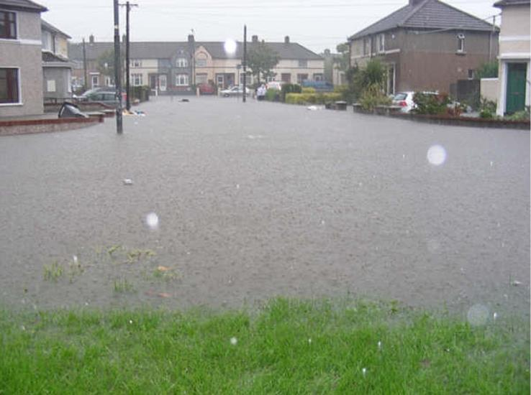
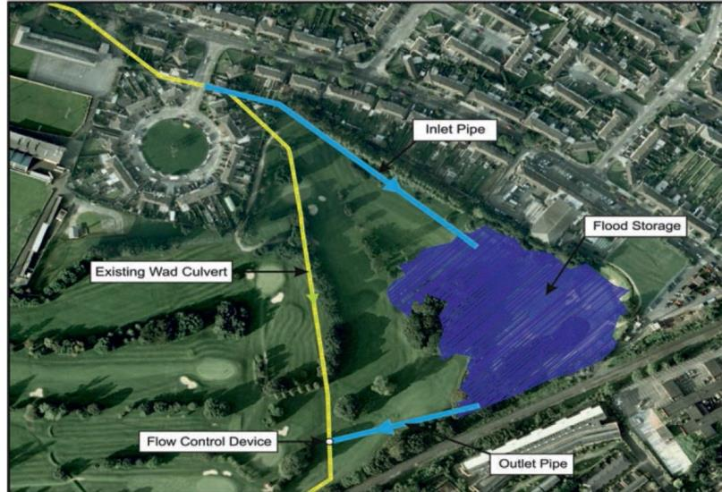
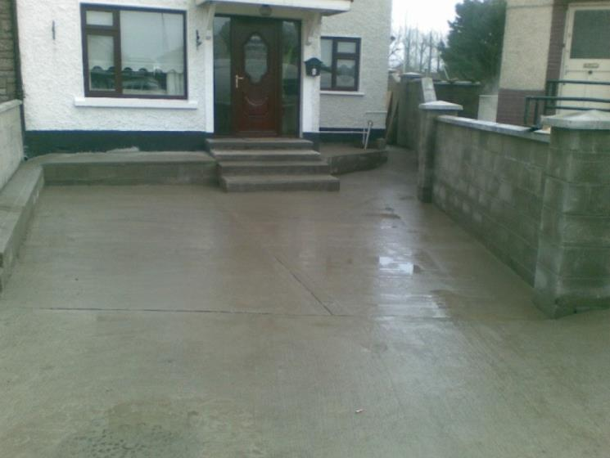
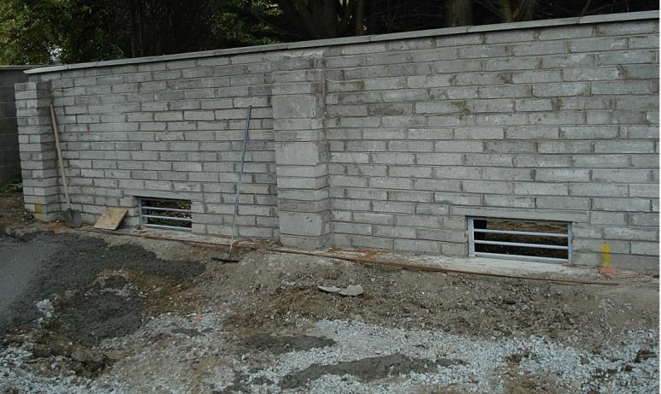
Examples of managing exceedance - Dublin
Notes:
Here in Dublin, the Wad Culvert did not have the capacity. The result was the frequent flooding to the image in the top left.
As part of a phased solution to the problem and help provide relief to the property owners in the short term until the next phase of the work was completed, in the top right, the houses were made more resilient and water channelled towards the rear of some properties and slots cut in the walls to enable water to escape out and into the golf course.

Slide 16
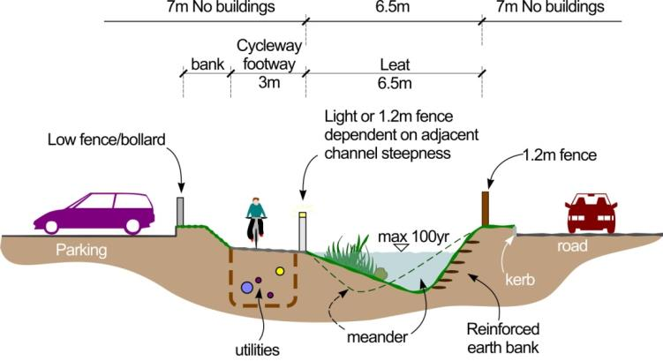
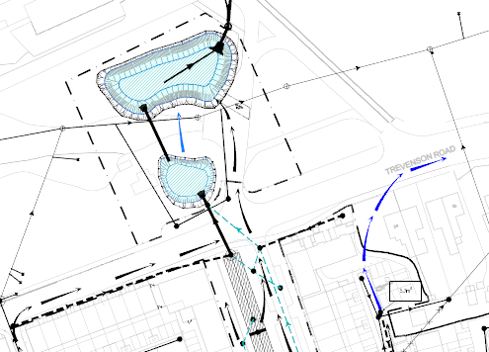
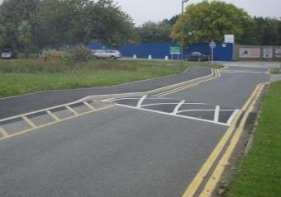
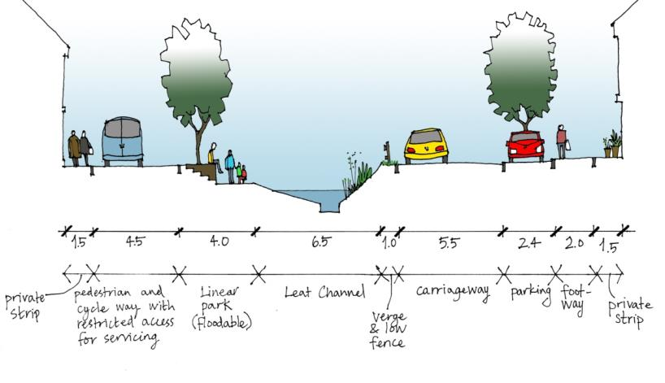
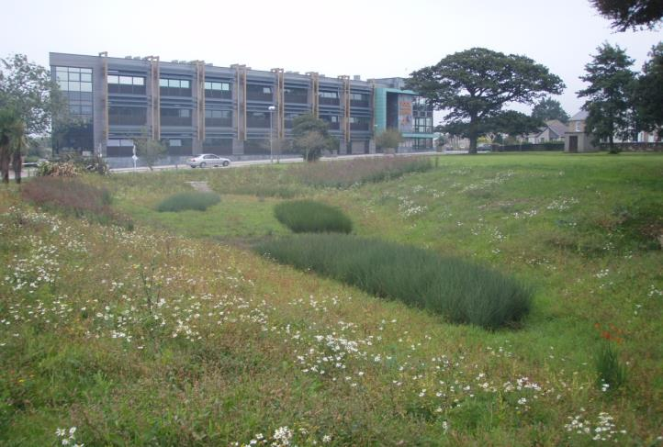
Examples of managing exceedance – Camborne Poole Redruth
Courtesy of Pell Frischmann
Courtesy of Alan Baxter Associates
Notes:
At Camborne Poole and Redruth, there was a need to take surface water out of a combined system, to make the regeneration happen. SuDS and Exceedance were considered from the outset.
Top left: The concept, strategic surface water and exceedance pathways (Halcrow)
Bottom left: Stage 2. Design codes guide appearance of swales & ponds– (Alan Baxter)
Top right: Stage 3. Detailed design of ponds linked by swales and exceedance pathways to convey excess flow (Pell Frischmann)
Bottom right: Stage 4. Completed attenuation pond near Pool Innovation Centre

Slide 17
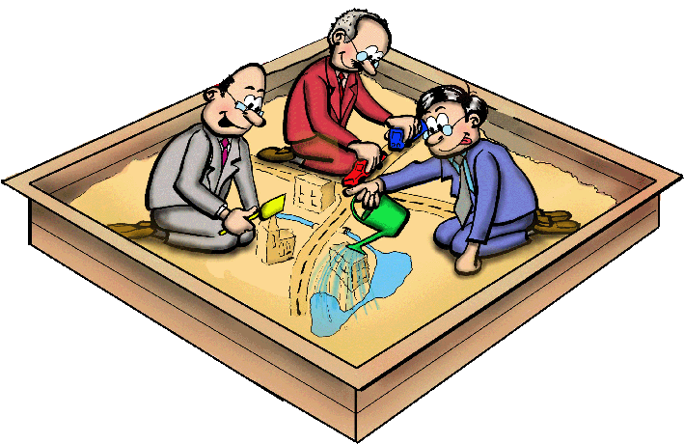
What makes a success – working together
Disciplines
Organisations
Communities
Notes:
What makes a success?
Disciplines – exceedance requires a multi-disciplinary working to make it happen. This can include highway and drainage engineers, landscape architects, urban designers, spatial planners etc etc. When the disciplines work together they can highlight, assess, design out and mitigate the risks and concerns that each of them may bring.
Organisations – often it wont be one organisation who needs to play their part, but you may need one to take a lead, bringing disciplines and communities then together.
Communities – this can be a critical element to understand the problem and help develop the solution, particularly where they form part of the solution or the solution really impacts on them.
Great examples of engaging the community and organisations include those undertaken in Witney, Oxfordshire, and the community working together in St Blazey. Videos are on susdrain explaining the approaches undertaken here.

Slide 18
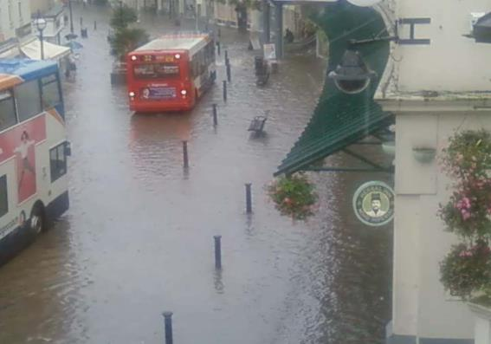
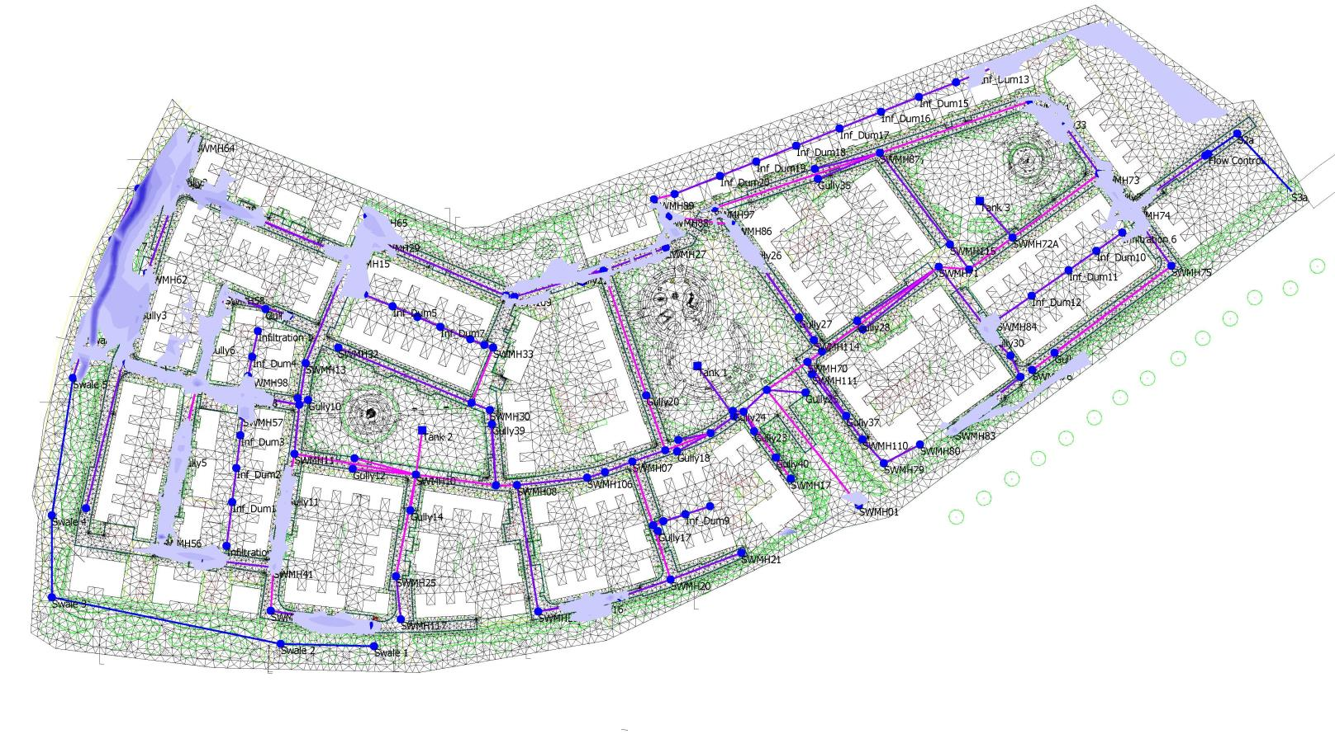
What makes a success – attention to detail
Understand where water goes
Use appropriate survey and modelling techniques
Design the measures and locations to be resilient and safe
Notes:
What makes a success:
Understand where water goes – sounds simple and obvious, but really important both when defining what the problem is and then of course the solution. This can be done through (2) below
Use appropriate survey and modelling techniques. We don’t have to model, but we do need to collect good data. If we do model (and it may depend on the size and complexity of what we are trying to resolve) then its important to use the appropriate techniques. Modelling can then give greater confidence to how a design will perform and critically point to how it can be improved and enhance the benefits compared with costs (or lower the cost).
Design the measures and locations to be resilient and safe – whatever we do, we have to consider (and not shy away from the risks) so the designs are safe and will last. Where this needs the communities to be involved, its important to communicate their role and how to safely work together.

Slide 19
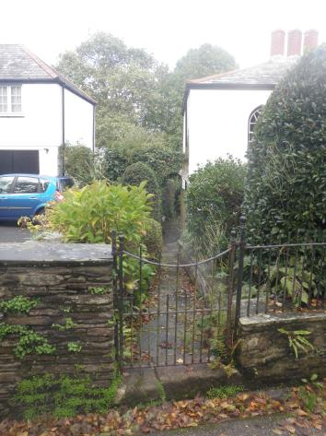
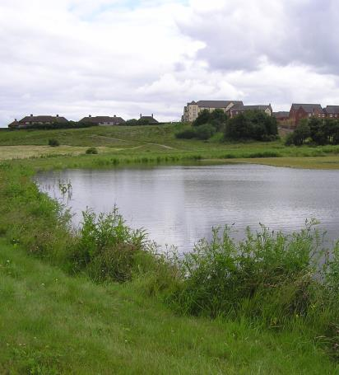
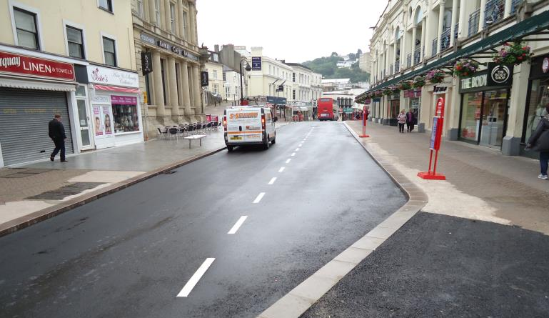
What makes a success – creating spaces in places
Create space
Share space
Multi-functional
Assess and manage risks
Notes:
What makes a success:
Create the space – recognise that water may pass through somewhere – allow it, create the space for it to happen and not be blocked. NO SPACE IS USELESS – top left image shows a gate that allows water to pass through it as the pathway becomes an exceedance pathway.
Make use of shared space – at the Manor, Sheffield, exceedance area and play area shown (top right)
Multi-funcitonal – bottom left shows a shopping area Torquay, still a pedestrian area, highway re built, with kerbs to channel exceedance flow. Using the highway is a key opportunity (if done correctly) to manage exceedance.
Assess a wide range of risks – not just flooding, and mitigate them. Consider using a risk framework such as ISO31000

Slide 20
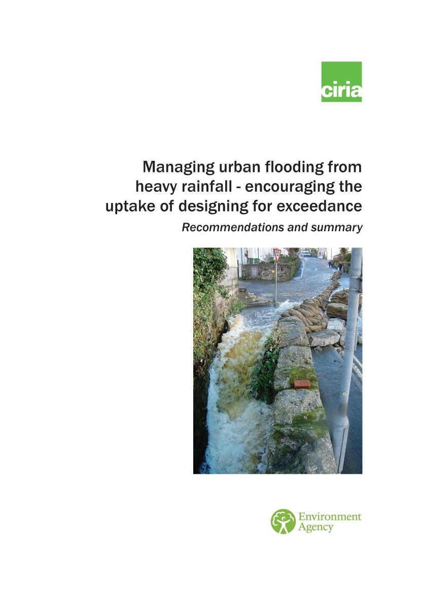
Next steps to encourage this approach
Information and resources
  Summary report
  Case studies
  Lessons and success factors report
  Literature review
Susdrain
Notes:
The project has created four key outputs and various articles and conference presentations/papers to also raise awareness.
All of these reports noted here can be found on Susdrain.

Slide 21
Recommendations based on learning
Making it happen – local authorities
  Make the most of opportunities
  Developers demonstrate
Encouraging the uptake
  Professional bodies
  Lead local flood authorities
Strategy, policy and legislation
  Consider using the learning
  Institutions and stakeholders
Notes:
These are the main recommendations that came up from the workshops we held, project steering group and our discussions. As Designing for Exceedance (DfE) requires a change in approach / behavior and often a partnership approach many of the recommendations are around what practitioners and representative bodies government could do to adopt this as a more common approach.
Firstly: Local Authorities, Highway Authorities and Lead Local Flood Authorities to use exceedance approaches
Planners need to request developers (in all cases) demonstrate how exceedance is managed – project has brought to light good and bad examples.
Secondly: Professional bodies should consider how they can encourage their members to DfE within day to day practice and assess and mitigate the risks.
Lead Local Flood Authorities should encourage the use of this approach through their strategic partnerships and incorporate DfE into local strategies, as we are seeing in some places.
Thirdly: Government should consider using the learning from this work when they are reviewing and updating policy and legislation, in particular for new development.
Institutions and stakeholders should review and update their guidance related to DfE to support and guide practitioners in day to day work.

Slide 22
Final thoughts
Do not miss opportunities
Know where exceedance occurs and where it moves over the surface
Use a range of measures to make our spaces and places more resilient
Create multi-functional infrastructure and shared space
Work together and manage risk
Notes:
Final thoughts on what we should do……..

Slide 23
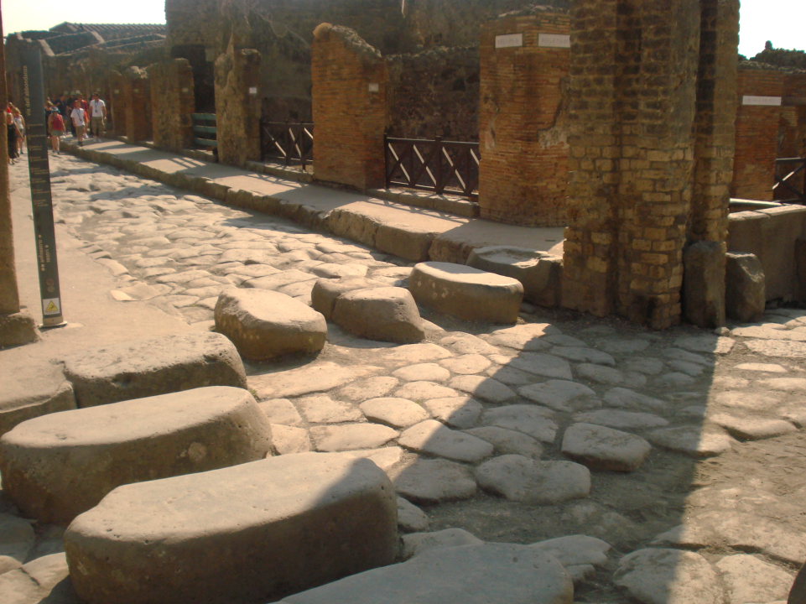
www.susdrain.org
For more information contact:
paul.shaffer@ciria.org
suzanne.simmons@ciria.org
christopher.j.digman@mwhglobal.com
Any questions?
Notes:
Perhaps we can still learn something from the romans in how they managed rainfalll….
In Pompei, roads were designed like this to drain water. Note the stepping stones that allowed the cart wheels to drive straight through.
A great example of shared space and multifunctional use

