Slide 1
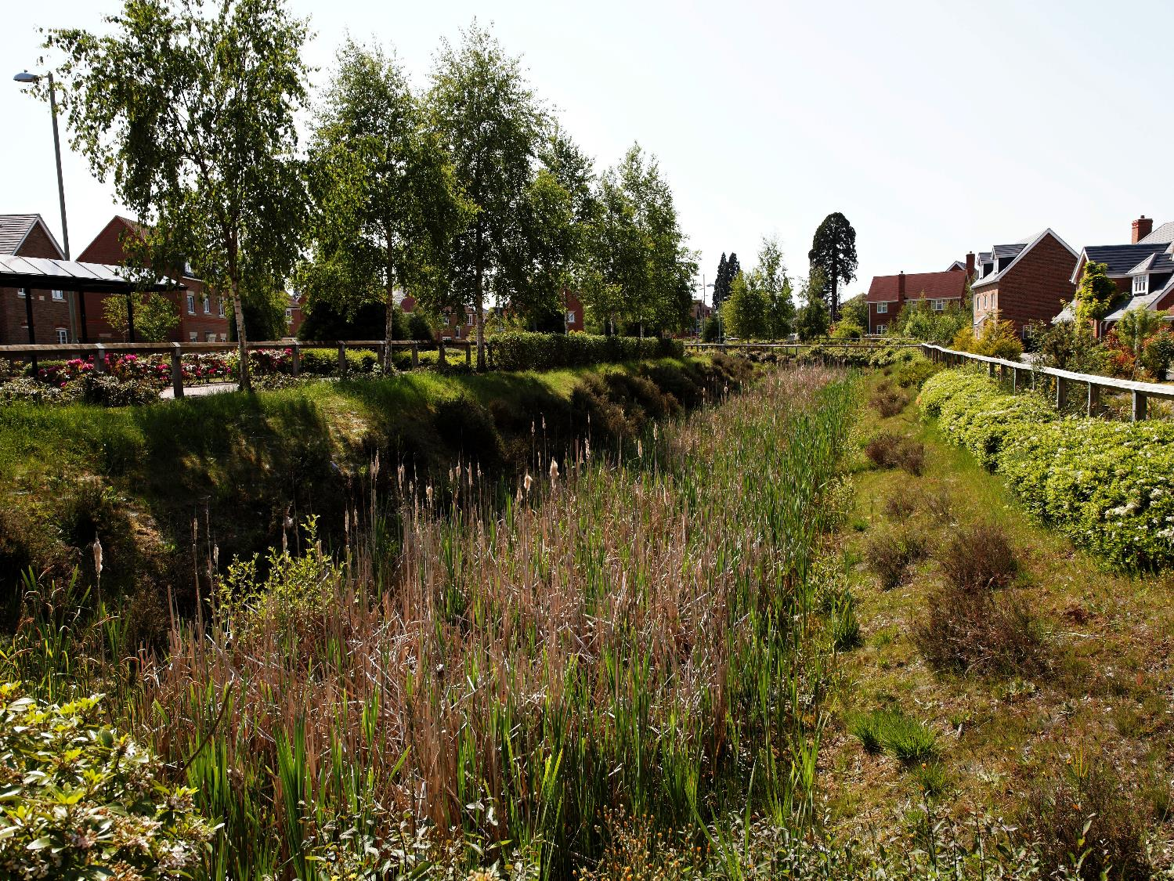


Evaluating the benefits of SuDS
Using CIRIA’s BeST
July 2015
Elvetham Heath, Hampshire
Notes:
This presentation provides an overview of why we should evaluate the wider benefits that SuDS may bring as a drainage approach and the development and application of a tool developed by CIRIA: W045 BeST – Benefit of SuDS Tool.

Slide 2
Assessing benefits – why should we?
Elvetham Heath, Hampshire

Slide 3
Should we value benefits?
Difficult to
  Identify & link benefits to quantifiable outcomes
  Value quantified benefits (reliance on transfers)
  Aggregate (benefits, populations, time)
Uncertainty
Takes time and resources
Moral concerns
If we don’t, they are zero
Notes:
It’s difficult to evaluate benefits
To identify and link benefits, e.g. will SuDS tangibly improve water quality? If so, by how much (e.g. change in good ecological status class) and over what length?
To value benefits - Pretty much all values in literature on benefits of SuDS use ‘benefit transfer’ method. This raises questions about accuracy and reliability
To aggregate benefits – we need to avoid double counting across categories, identify beneficiaries, identify when benefits start/end and discount those occurring in the future
This leads to lots of uncertainty as there can be big differences or ranges in values in the literature. There are also some major gaps, e.g. contribution of SuDS to jobs and investment
It takes time and resources to do valuation properly, hence the need for this work to provide assistance.
There are moral concerns about whether human-based valuation is valid (doesn’t cover intrinsic value).

Slide 4
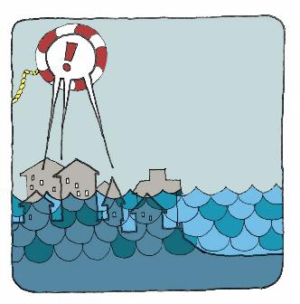
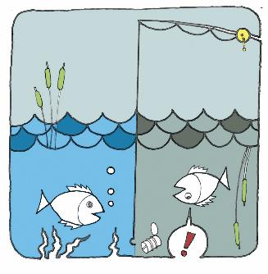
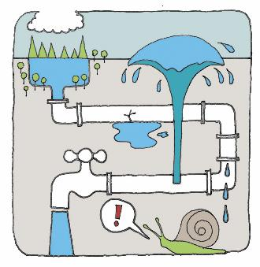

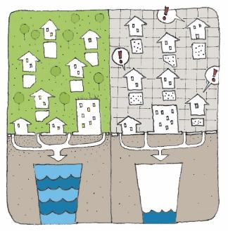
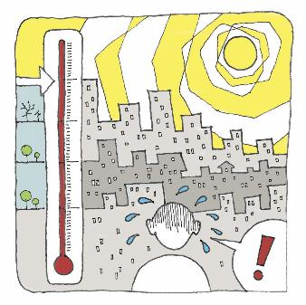
We have challenges now and in the future
Flooding – people and property
Water quality of urban watercourses
Connecting with water (on the surface)
Legislation and planning
Support growth – population & economy
Liveability – quality of life
Notes:
There are many important reasons why we need to manage surface water and create multiple benefits.
Here are 6 examples of the challenges / benefits that may be created and how SuDS can contribute to meeting these challenges now or in the future

Slide 5
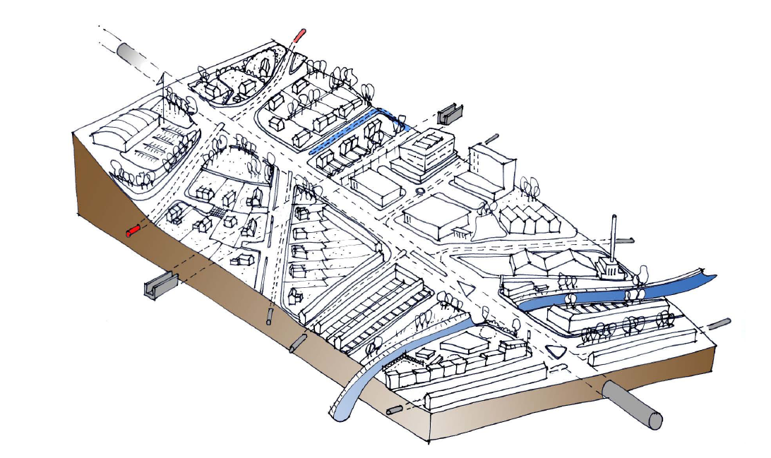
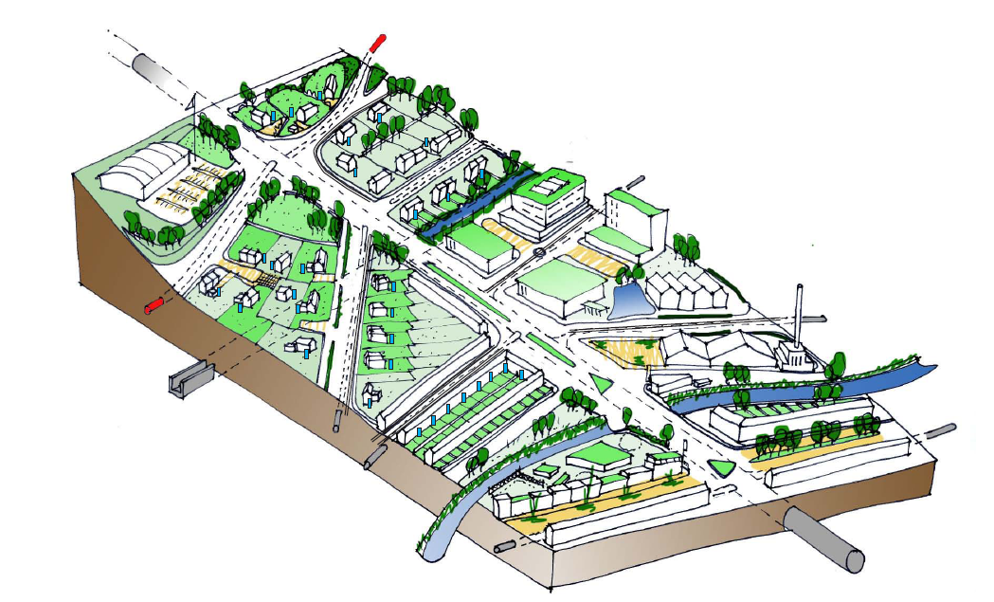
What is possible? How do we account for the benefits and should we?
Increase property value
Limit flows entering system
Enhance biodiversity
Improve thermal comfort
Provide education
Help manage air quality
Provide amenity and recreation
Enhance quality of urban space
Improve health and wellbeing
Maximise network capacity
Use as a resource
Improve water quality
Notes:
Local Authority’s have the responsibility to balance up a number of competing demands. Taking an integrated SuDS approach both from a retrofit and a new development perspective can help support these competing demands.
So if we take our existing urban areas or where we are developing – what is possible?
We can go beyond just visual enhancements and improvements (which we can spend money on without even thinking about the surface water), but contribute to achieving all these other benefits, depending upon the choices we make in our drainage design integrated with its surroundings.
This wont happen overnight, but we do need to start somewhere.

Slide 6
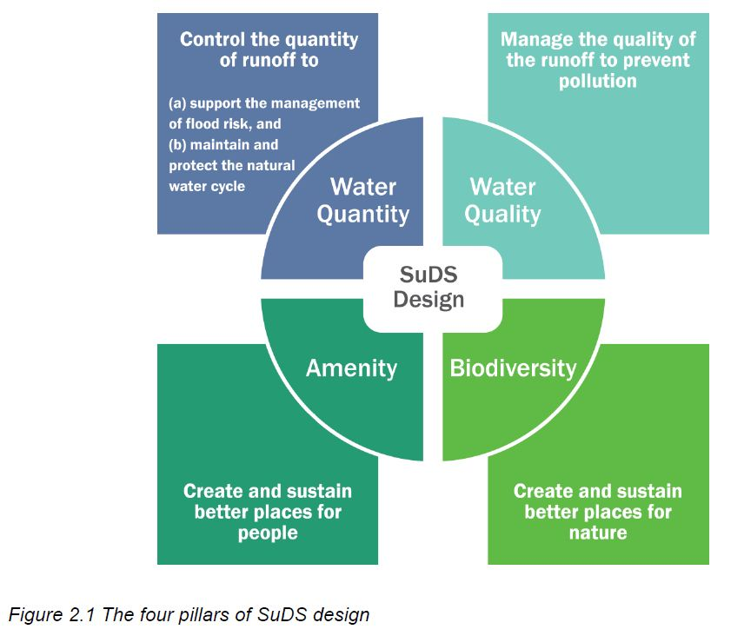
How do we change?
Sustainable Drainage Systems manages impacts from development on the quantity and quality of runoff, provides amenity and biodiversity as well as other potential benefits.
Notes:
So how might we achieve this change? One key aspect is to use SuDS (which include a range of hard and soft measures, green, grey and blue infrastructure) for both new development and retrofit that can help us to meet this challenge.
SuDS have long been recognised to give us more than just water quantity control (benefit) but improve water quality, enhance amenity and biodiversity.
The new (updated) SuDS Manual can help with the design of these systems.

Slide 7
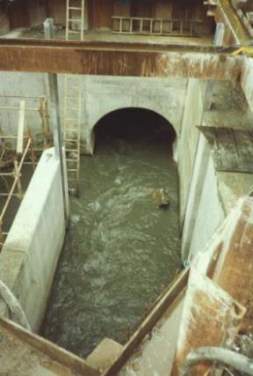
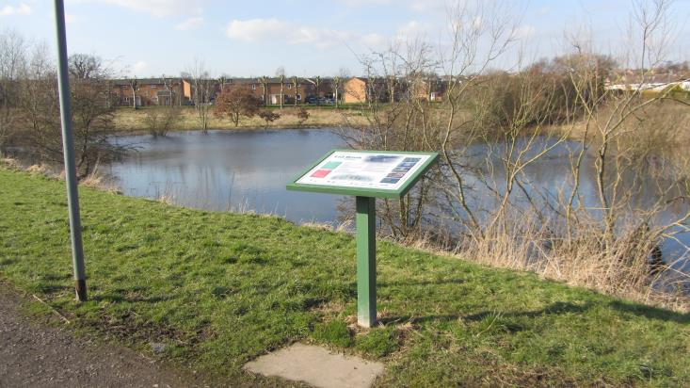
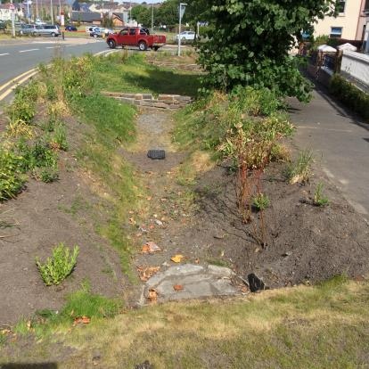
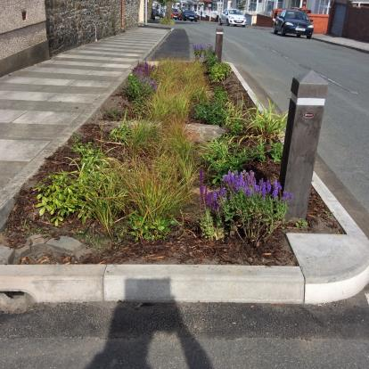
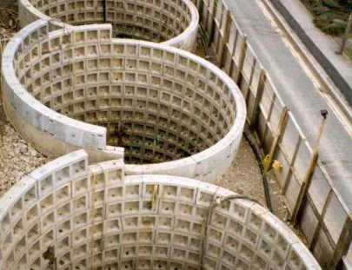
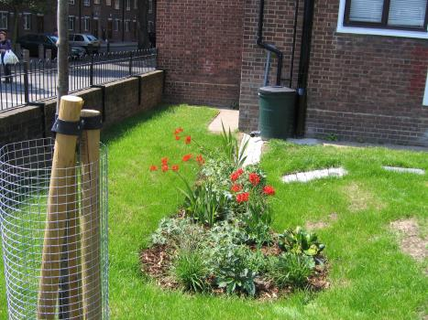
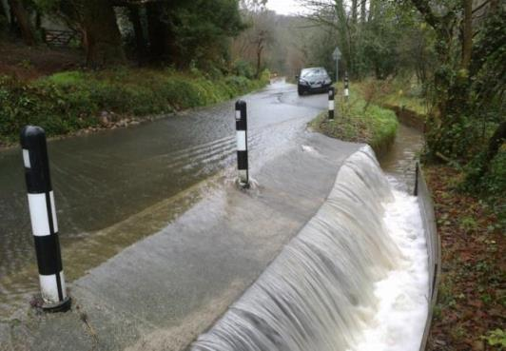
Stormwater management approaches to cope with different size storms in different ways can create a range of benefits
Notes:
Its important to highlight here, this is not about the green brigade charging to fit green infrastructure or vegetative SuDS on a whim. This is about getting the balance to address the various quantity and quality challenges we face to come up with an overall sustainable drainage system.
Ultimately, its about getting the right combination, moving away from grey infrastructure only – to a more balanced equation.

Slide 8

Evaluating the benefits unlocks the potential for…
Fairer comparisons
Better decision making
Meeting funding requirements
Enabling conversations
Delivering SuDS
Notes:
So how can evaluating benefits help? It:
Enables comparisons between different options by valuing the wider benefits
Supports making decisions by providing more information
Can help to meet other potential funders requirements
This in turn critically will help enable conversations between partners and stakeholders
Ultimately we believe it will help to deliver SuDS.

Slide 9

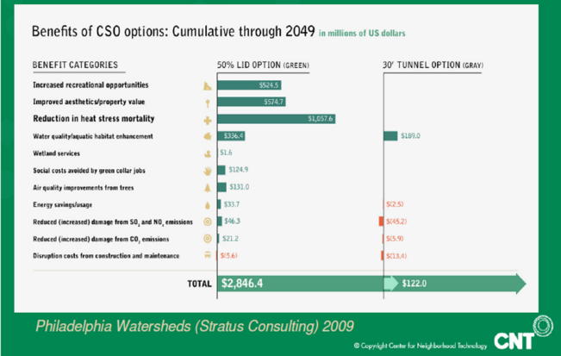

Some tools exist but…..
Notes:
There are some existing tools, but cannot be easily or appropriately applied to drainage schemes in the UK.
The top image shows the GINorthWest Toolkit that is focused on green infrastructure performance, and does not consider the fuller drainage impact that SuDS may have, as it is the collective performance on drainage that is critical when considering surface water management.
The middle image is the CNT tool which is primarily focused around small developments. The right image is a summary of the Philadelphia benefits example where two options were considered. It shows the significant benefits of greening even if you take out heat stress mortality.

Slide 10
Overall aim of BeST
“The overall aim of this proposal is to collate and evaluate potential methodologies for assessing the benefits of SuDS, develop approaches accepted by relevant stakeholders and using available data develop a tool to estimate the multiple benefits of SuDS”.
Notes:
So the overall aim of Best is…….

Slide 11








Thanks to our funders
Notes:
As always, thanks to:
The project steering group,
Industry testers,
and those who have provided Case Studies.
Without their help, this project would not of been completed.

Slide 12
Introducing: W045 BeST
Elvetham Heath, Hampshire
Notes:
The next few slides introduces the approach taken to develop BeST, reasoning and some key components of the tool.

Slide 13
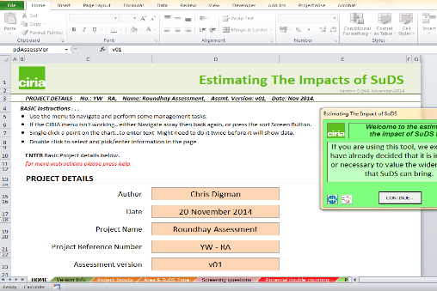
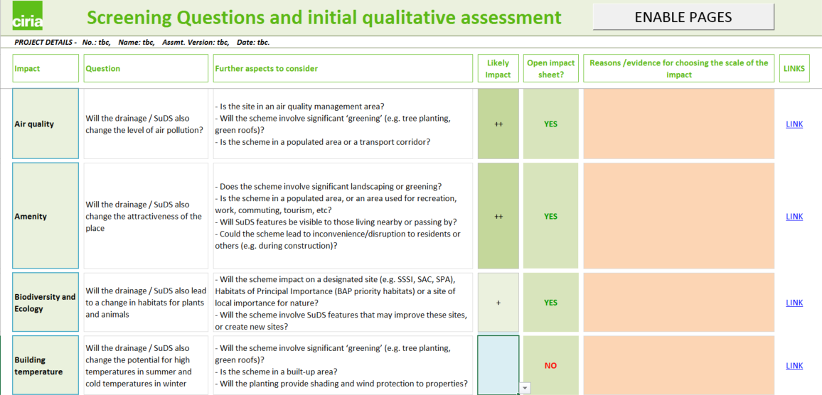
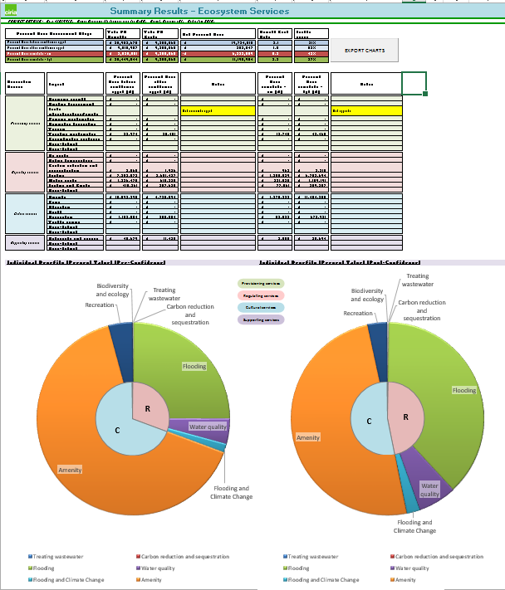



BeST: Benefits of SuDS Tool
Collation of evidence (values)
Structured assessment approach
Considers confidence
Support practitioners to qualify and quantify (monetise) benefits
Compare drainage options
Provision of detailed audit trail
Notes:
Project completed by MWH, (Dr Bruce Horton and Prof Chris Digman), Prof Richard Ashley of EcoFutures (and various universities) and Elliot Gill of CH2 along with support from a wide number of colleagues covering various disciplines.
Overview of the project is to support practitioners to evaluate the multiple benefits of SuDS (or any drainage option) and wherever possible, determine the estimated monetary benefit. Developed by practitioners across a number of disciplines (such as drainage, landscape architecture, ecology, economics).
Collation of evidence (values) – we considered over 400 values from 100s of papers, led by an environmental economist to look at quantities and monetised values and how they had been assessed, where and when. Followed an impact pathway approach.
Structured assessment approach - we developed a structured assessment approach that logically walks the user through an assessment, which can be quite a challenge when not knowing where to start. Its important to note that we built this in excel 2010 and 2013 due to the available functionality.
Considers confidence – we are not always sure about these things, therefore confidence values are applied so we don’t get into the trap of over-estimating what the benefits are
Support practitioners to qualify and quantify (monetise) benefits – the tools provides structure for the user to think about the impacts that will take place (it is not a black box), and ask the user to qualify and then quantify benefits.
Compare drainage options – where more than option is being considered, the tool can be used more than once, and the results copied into the comparison tool to enable simple comparisons and graphs to be automatically generated.
Provision of detailed audit trail – the tool holds all the information and encourages the user to record down the evidence, where it has come from etc

Slide 14
Wide range of benefits
Triple bottom line
Benefit category | Monetised?
Air quality | ✓
Amenity | ✓
Biodiversity and ecology | ✓
Building temperature | ✓
Carbon reduction & sequestration | ✓
Crime | ✗
Economic growth | ✗
Education | ✗
Enabling development | ✓
Flexible infrastructure | tbc
Flooding | ✓
Groundwater recharge | ✓
Health | ✓
Pumping wastewater | ✓
Rainwater harvesting | ✓
Recreation | ✓
Tourism | ✗
Traffic calming | ✗
Treating wastewater | ✓
Water quality | ✓
Environmental
Ecosystem Services
Supporting
Provisioning
Cultural
Notes:
These are the benefits on the right currently included in the tool and which ones we have placed monetary values against with confidence (indicated by a tick).
Others can be qualified – or if the user has some local information from surveys (or there has been information published not yet incorporated into the tool), it can still be monetised. Beyond this also, there are 5 user defined benefits to account for categories not included here.
The benefits and then summarised in a series of graphs and linked to two accounting contexts: Triple Bottom Line (TBL) or Ecosystem Services (ESS) which each impact mapped onto each TBL or ESS category.

Slide 15
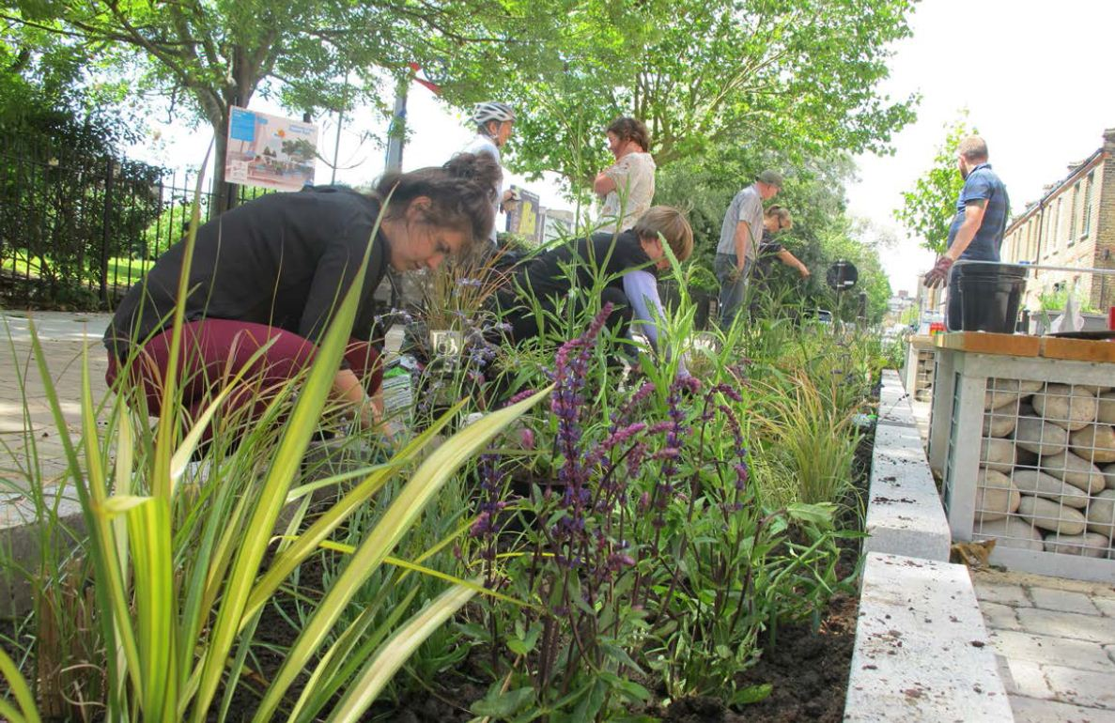
BeST has a suite of outputs
Tools
W045a
Evaluation
Support
Wo45c
Technical guidance
W045b
Comparison
W045d
User manual
Notes:
BeST has a suite of components:
W045a BeST: Evaluation Tool supporting practitioners evaluate benefits for a drainage proposal
W045b BeST Options Comparison Tool: Tool to compare more than one drainage proposal
W045c BeST Technical Guidance: Provides technical information behind the tool
W045d BeST User manual: Provides an overview of how to use the tools

Slide 16
Using BeST – applying it
HOME
Project inputs
Screening questions
SuDS Used
Work sheets to fill in
Values library
Benefits / impacts
Double counting check
Potential stakeholders
For information
Yearly Values library
Summary of outputs
Summary Results ESS
Comparison tool
Fill in & for information
Notes:
These next slides just take you through some of the detail behind the tool, linked with the process map (the key steps) for completing an evaluation.
The first key stage after recording down project details is to complete the screening. The aim of this is to help the user think what benefits to evaluate, and their potential impact, with space to record your reasons. Some will be obvious, others need a little more thought. The screening tab opens up the individual benefit tabs when you click on ‘enable pages’ after you have selected whether to assess them or not. Therefore it is a crucial part of the evaluation tool.

Slide 17
Using BeST– applying it
HOME
Project inputs
Screening questions
SuDS Used
Work sheets to fill in
Values library
Benefits / impacts
Double counting check
Potential stakeholders
For information
Yearly Values library
Summary of outputs
Summary Results ESS
Comparison tool
Fill in & for information
Notes:
After the screening tab, you may be asked to complete the SuDS you are using in your scheme if individual values are needed in the benefit categories you have selected to evaluate.
Linked to your selected benefits is an “potential stakeholders” sheet. This indicates (broadly) which stakeholders may have an interest in your scheme considering the types of benefits that may materialise.

Slide 18
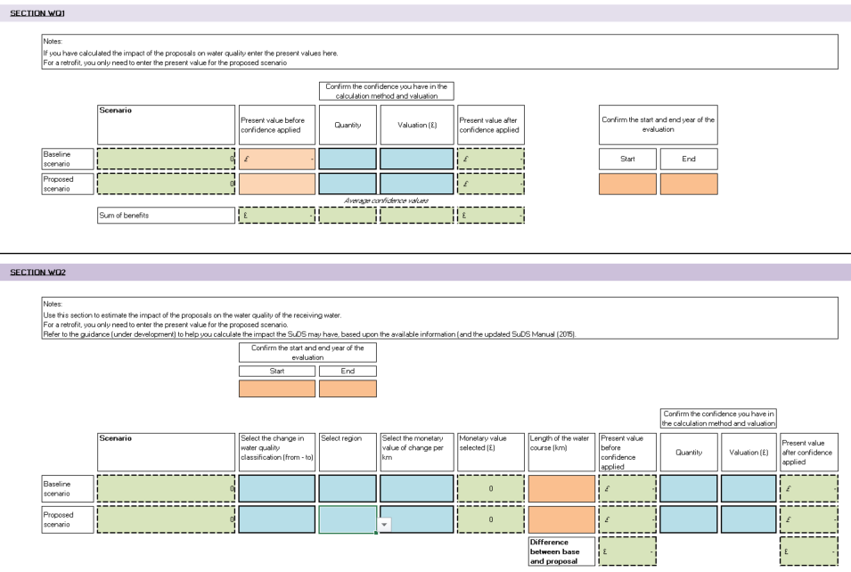
Using BeST– applying it
HOME
Project inputs
Screening questions
SuDS Used
Work sheets to fill in
Values library
Benefits / impacts
Double counting check
Potential stakeholders
For information
Yearly Values library
Summary of outputs
Summary Results ESS
Comparison tool
Fill in & for information
Notes:
Each benefit sheet that you select to open has a similar look and feel to it.
Firstly, if you have undertaken an independent assessment, you can bring in the values and calculation. If you have not, the tool provides 1 or more approaches to enable you to evaluate the potential benefits. Colour coding/formatting is used to indicate the boxes to fill in:
Green (dotted): information automatically comes in from other cells entered (such as the present value calculations before and after applying confidence)
Orange: user enters values (some are limited by the ranges such as the years you can enter for the start and finish of the evaluation period)
Blue (bold outline): these contain information for the user to select, such as values we identified from literature that may be appropriate to use or the confidence values to apply (25%, 50%, 75%, 100%).

Slide 19
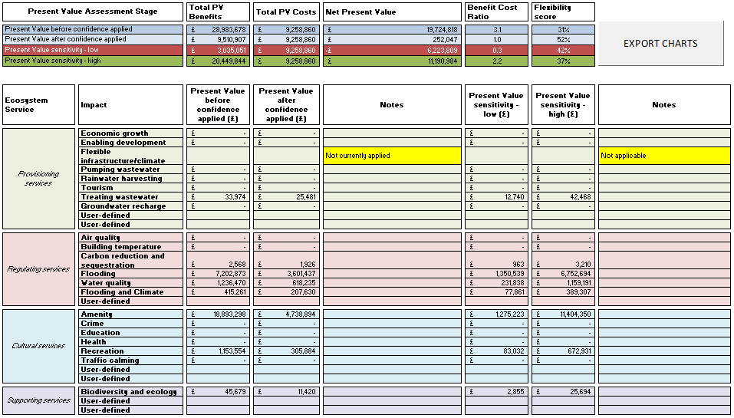
Using BeST – applying it
HOME
Project inputs
Screening questions
SuDS Used
Work sheets to fill in
Values library
Benefits / impacts
Double counting check
Potential stakeholders
For information
Yearly Values library
Summary of outputs
Summary Results ESS
Comparison tool
Fill in & for information
Notes:
The benefit values all come through into summary tables for both an ecosystem services or triple bottom line approach. Graphs are also automatically generated and can be exported directly into a word document to facilitate their use in reports and presentations.

Slide 20
Examples using W045 BeST
Elvetham Heath, Hampshire

Slide 21
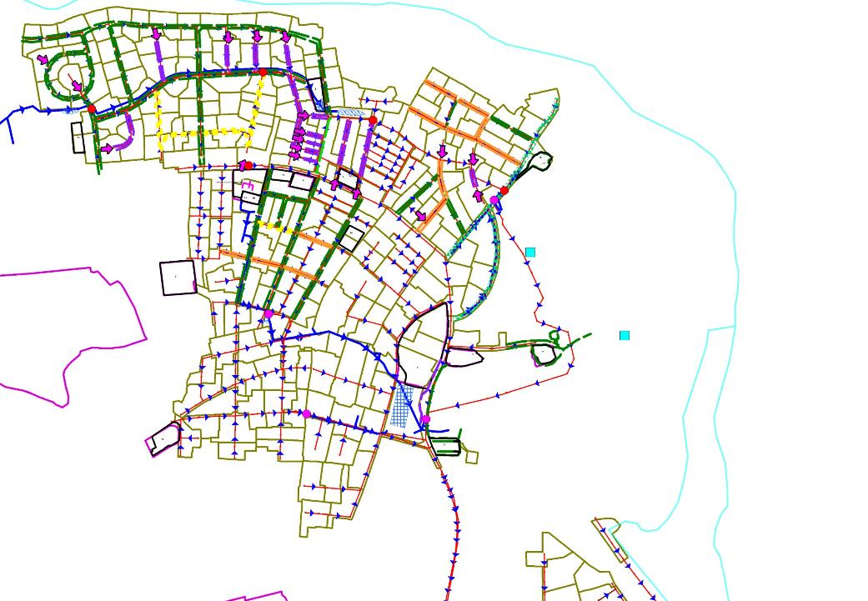
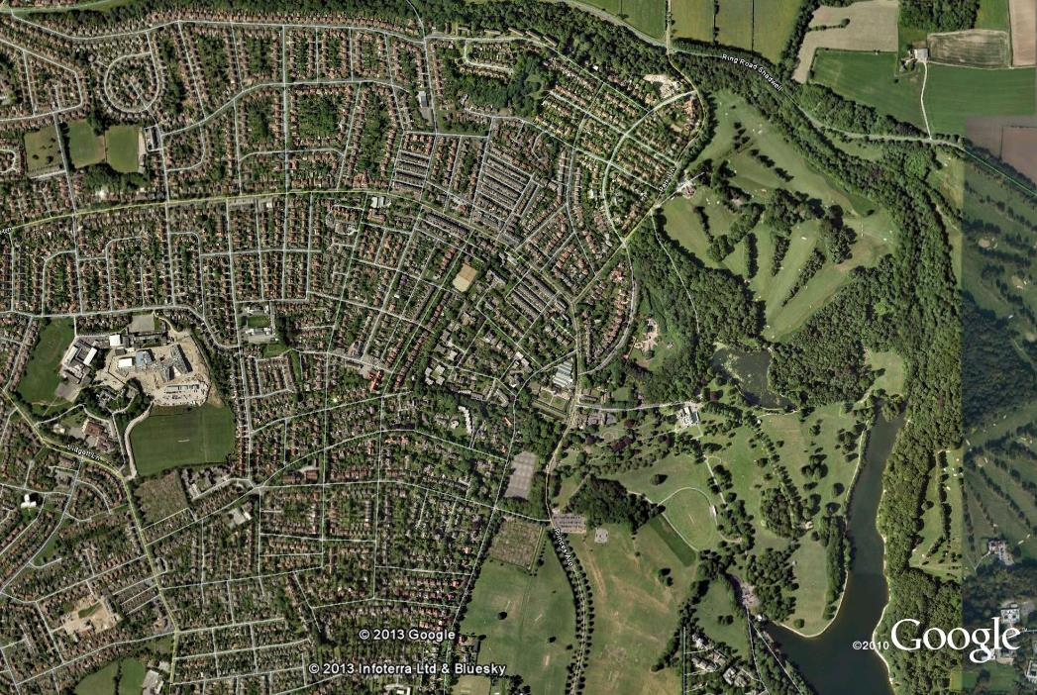
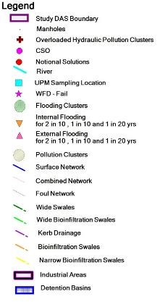
Applying BeST – Retrofit Case Study
Notes:
Yorkshire Water investigated the potential of different options to reduce combined sewer overflow (CSO) spills in Roundhay Park in Leeds, as part of its plans for the 2014 Periodic Review. The two CSO locations are shown in red on the plan, and the catchment boundary is in red with flows running from west to east.
The aim was to compare the costs, immediate and wider benefits of a SuDS and conventional drainage approach. An initial assessment of the benefits of the options using an ecosystem services approach.

Slide 22
Applying BeST – Retrofit Case Study
Notes:
The study considered four options:
Option 1: A conventional solution to store water in concrete tanks at CSOs to limit the volume spilling to thewatercourse and return it to the combined sewer after the storm.
Option 2: A conventional (+) option that limited the volume spilling from the CSOs but also reduced predicted flooding in the catchment (giving similar hydraulic performance in the combined sewer network to options 3 and 4). This option included a combination of storage tanks and pipe upsizing to manage the flow in the combined sewer.
Option 3: A SuDS approach in public areas to disconnect surface water from the combined system and pass it through the conveyance and storage SuDS. This used a combination of swales, detention basins, geocellular storage and connecting pipes.
Option 4: A SuDS approach as in option 3 with measures added in residential private locations. These included water butts and residential rain gardens on properties of sufficient size.

Slide 23
Applying BeST – Retrofit Case Study
Notes:
A comparison of the costs and benefits shows how the different options are associated with a large range in net present value. This uses W045d – the comparison tool.
Option 1 reduced the CSO spills, was lowest cost but offered limited other benefits. Option 2 provided similar levels of drainage performance in the sewer network as option 3 and 4, but created fewer benefits having underground infrastructure only, and was also less resilient to climate change. Options 3 and 4 included distributed SuDS features across the catchment, creating a second drainage network to manage surface water, in turn creating wider benefits to the community and environment. These options had similar costs and benefits. Overall, only the ‘SuDS public’ option 3 generated a positive NPV (benefits greater than costs)

Slide 24
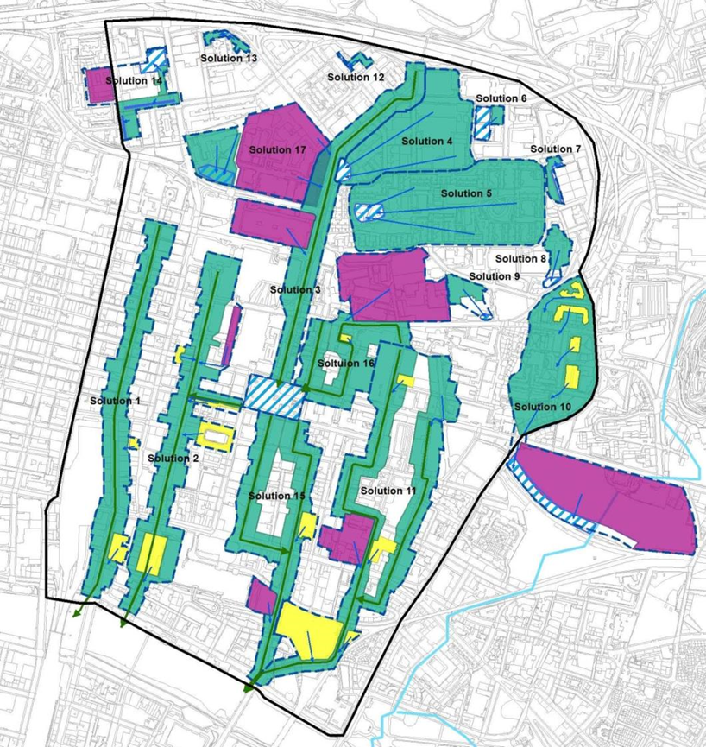

Applying BeST – Glasgow SWMP
Notes:
The Glasgow City Centre Surface Water Management Plan (SWMP) contains four key phases.
Phase 1 – Site Appraisal
Phase 2 – Catchment Assessment
Phase 3 – Feasibility Study and Schematic Design
Phase 4 – Economic Impact Assessment
This case study is based on a restricted Economic Impact Assessment (EIA) carried out by MWH for Glasgow City Council in 2013. The EIA includes an assessment of the (capital and operational) costs, flood risk benefits and other, wider benefits from surface water management options, including SuDS. Glasgow City Centre was the location for the SWMP that contains a mix of residential, educational, commercial and retail uses.
Green routes using SuDS to convey most rainfall events, strategic storage and exceedance pathways was selected to manage surface water and take it to the river, removing it from the combined sewer.

Slide 25
Applying BeST – Glasgow SWMP
Notes:
The proposed option assessed using BeST was to ‘implement SuDS with other surface water management measures’. It included a number of retrofit measures that could form part of the city’s redevelopment plan, including green roofs, swales, permeable paving, a pond/wetland and exceedance management measures. The proposed option was compared to a baseline ‘do nothing’ case.
Based on the screening questions, the following benefit categories were assessed using the tool:
Amenity
Carbon sequestration
Enabling development
Flood risk
Health
Recreation
Water quality
Most of the benefit categories were assessed using information within the tool and guidance. The exceptions to this were ‘flood risk’, which was assessed using damage cost estimates from the Multi-Coloured Manual, and ‘enabling development’, which was based on information from the original EIA. The present value costs of the option had already been estimated at £28.3 million.
Results
The breakdown of benefits (before and after confidence applied) is shown in Figure 1. The majority of benefits are associated with flood risk reduction. Other potentially important benefits are recreation, water quality and amenity.
A summary of the results exported from BeST is shown in the table. The estimated benefits of the option are always greater than the costs. The central estimate after confidence is applied gives a benefit cost ratio if 2.3. This is 1.3 under low sensitivity and 3.7 under high sensitivity.

Slide 26
Applying the results
£ does not equal a £ - its an indication
Help identify the wider benefits
Demonstrate the potential level of benefits
Understand who might benefit
Support conversations, look at wider funding opportunities
Understand benefits to investigate further
Notes:
So in summary when looking to use the results:
£ does not equal a £ - its an indication – the message here is that the assessment will give you an indication to the size of the benefits. The exact benefits will always be different, but the tool provides the framework and support to enable an estimate of what those benefits may be (otherwise they would be zero).
Help identify the wider benefits – the tool aims to help you think about what the wider benefits, which may have been missed previously
Demonstrate the potential level of benefits – links to point 1, it provides the foundation of what the size of those benefits might be which in turn enables you to consider point 4
Understand who might benefit – by understanding the type and scale, its easier to identify to your local context who will be the beneficiaries – these may be the same or different to local stakeholders interested in the benefits that may arise
Support conversations, look at wider funding opportunities – critically, we see that this information supports conversations with stakeholders who will be interested in the benefits. this may lead to wider funding opportunities or support.
Understand benefits to investigate further – as it indicates the size of each benefit and their proportion of the overall benefit it points to where you may wish to invest further to increase the confidence in the benefit values by improving the input data or undertaking a local evaluation for the monetary benefit.
Summary of making use of the results – how it will help
£ does not equal £ - this is all about the fact we cannot be 100% sure these are the benefits, in the same way as we are never certain what the costs of a scheme will be.

Slide 27
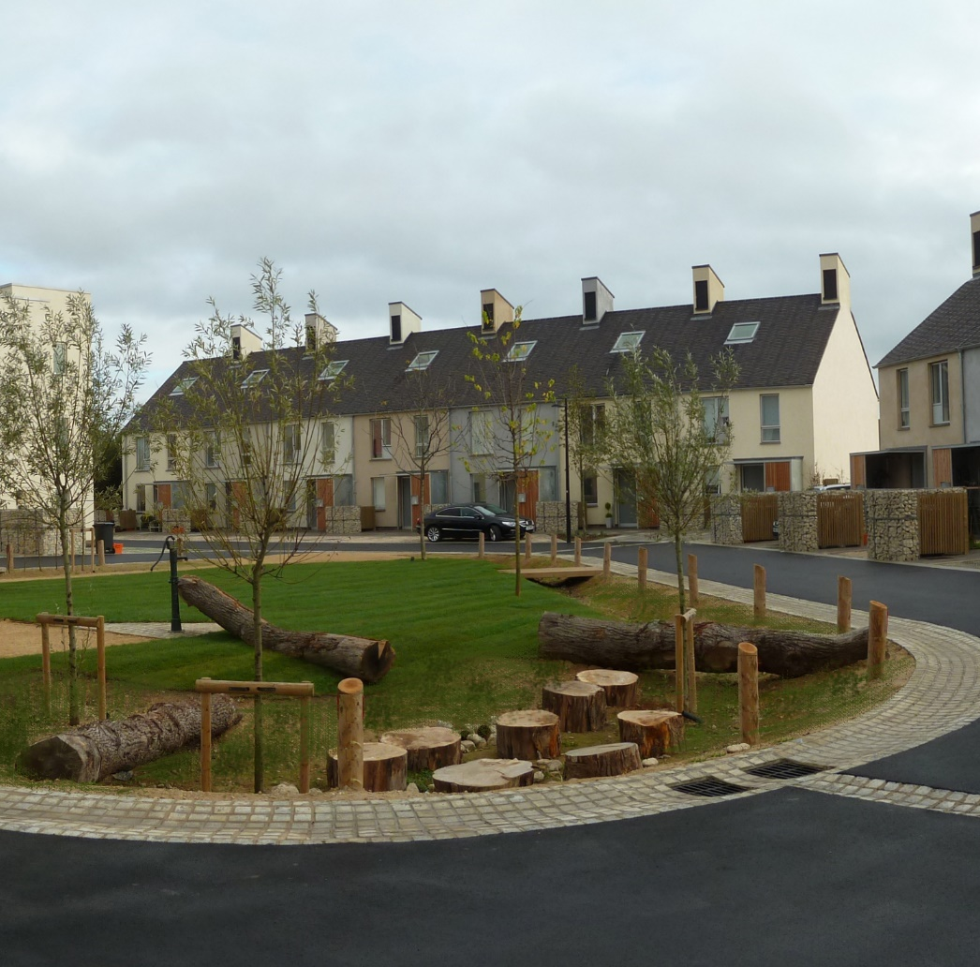
Thank you
Want to know more?
http://www.susdrain.org/resources/best.html
best@susdrain.org
Studio Engleback, Curtins Consulting & Kevin McCloud
Notes:
If you want to know more, please visit susdrain or email us

